Slide 1
Text Analysis and Text Classification with NLTK and scikit-learn
Rachel Rakov

Slide 2
Greetings! What are we doing here?
Introduction to text analysis with the Natural Language toolkit (NLTK)
Introduction to machine learning
Introduction to text classification with scikit-learn

Slide 3
What do you need for this workshop?
Python (I will be using Python 2.7, but you are welcome to use Python 3)
Download jupyter notebook file for this session
The Natural Language Toolkit (NLTK)
Scikit-learn (comes with Anaconda – can also be installed independently)
Pandas (comes with Anaconda – can also be installed independently)

Slide 4
Text Analysis with NLTK
What does this mean, exactly?
Let’s break it down!
There is a tremendous amount of textual data
Books, news articles, medical documentation, tweets, and everything in between
More and more, this textual information is available online
In downloadable / scrapable / otherwise accessible formats
And more content is being created all the time (thank you, Internet!)
Researchers are able to use tools to learn about textual data on a large scale
Notes:
a field wherein computer scientists and linguists work together to apply statistical or rule-based models and machine learning techniques to the task of natural language processing.

Slide 5
What tasks involve text analysis?
Sentiment Analysis
Information Extraction
Automatic Summarization
Authorship Identification
Search
Trend tracking
To name simply a few!!!!

Slide 6
The Natural Language Toolkit
A package for Python that provides users with tools for text analysis
Premade tools and corpora
So you don’t have to make them yourself!!
Introduction to these tools, and see how they’re used
Let’s get started!!
import nltk
import matplotlib
from nltk.book import *

Slide 7
Text Analysis: start with looking at what you’ve got
Word Concordance
Shows the context of a particular word in your corpus
Default width = 40 characters on either side
Common contexts
Takes two words as an argument, returns contexts in which they appear similarly across the text (within one text)
Word locations across text
Create a dispersion plot to see where particular words occur in your text
Takes a list of words as an argument

Slide 8
Basic analysis: Counting things
Easy to do, and extremely helpful!
Total number of words in your corpus, specific words in your corpus
Percentage of word occurrence in your text
Frequency Distributions
Allows us to find the frequency of each vocabulary token in our text
Built in method

Slide 9
Frequency Distributions methods
A happy chart from "Natural Language Processing with Python" (Bird, Klein & Loper)
# Example #Description
fdist = FreqDist(samples) create a frequency distribution containing the given samples
fdist[sample] += 1 increment the count for this sample
fdist['monstrous'] count of the number of times a given sample occurred
fdist.freq('monstrous') frequency of a given sample
fdist.N() total number of samples
fdist.most_common(n) the n most common samples and their frequencies
for sample in fdist: iterate over the samples
fdist.max() sample with the greatest count
fdist.tabulate() tabulate the frequency distribution
fdist.plot() graphical plot of the frequency distribution
fdist.plot(cumulative=True) cumulative plot of the frequency distribution
fdist1 |= fdist2 update fdist1 with counts from fdist2
fdist1 < fdist2 test if samples in fdist1 occur less frequently than in

Slide 10
Why do I keep getting punctuation as a word?
NLTK makes use of tokenization, a method of separating every word from it’s punctuation, making each their own separate tokens.
Punctuation often causes problems
Word_tokenize returns tokenized text

Slide 11
Comparing texts with frequency distributions
NLTK includes some of the Brown University Standard Corpus of Present-Day American English (Brown Corpus for short)
Contains one sample from each of the 15 categories
What if we wanted to compare usage of modal verbs in one text category to the modal verbs in another text category?
A modal verb is a word like can, could, will, must, might, or should. Modal verbs are often used to distinguish between different registers of speech.

Slide 12
Analysis is fun! Let’s tag parts of speech
One way you might want to analyze your text is by looking at what parts of speech are contained within the text
NLTK has built-in the UPenn part of speech tagset, which allows for relatively accurate part of speech tagging.
Since some of the tags used aren’t easily intuitive, use this piece of code to clarify them!
nltk.help.upenn_tagset("<tag>")

Slide 13
Representing your text as features

Slide 14
Text Analysis: Getting the most out of your data
We’ve taken a look at some of the way we can analyze some of the basics of texts…but what can we do with this information?
What if we wanted to compare sentences in the News and Romance categories to see how different they are?

Slide 15
Comparing News and Romance sentences
For every sentence in the two different categories of the Brown corpus (news and romance), count how many of the words are nouns
A noun, in its most basic definition, is usually defined as a person, place, or thing. For example, a movie, a book, and a burger are all nouns. Counting nouns can help determine how many different topics are being discussed.¹
^{1. Michelle Morales, 2017}

Slide 16
Comparing News and Romance sentences
This is a feature representation of the two categories.
It gives us a way to differentiate the categories by giving us an approximation of how many different topics are discussed within sentences in each category.
The feature representation we are using is: How many nouns are in each sentence in the corpus?

Slide 17
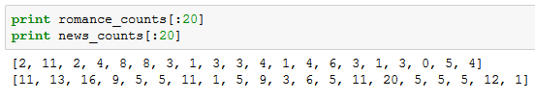
What do we find from this?
The news corpus seems to have more nouns per sentence than the romance corpus (in a way that looks pretty obvious)
One drawback: we are only looking at the first 20 sentences
Out of 4,623 sentences in the news corpus, and 4,431 in the romance corpus
Notes:
4623 4431

Slide 18
Is this a good feature representation?
Looks promising..
But since there are so many sentences, we can’t really say this for sure just by looking at the numbers
How can we test this theory on a larger scale?
We can build a machine learning model that predicts whether a sentence belongs in the news category or the romance category, based on how many nouns it has

Slide 19
Getting to meaningful feature representations
We need to translate our language problem into something that a computer can understand.
One way we can do this is by representing language as a set of features.

Slide 20
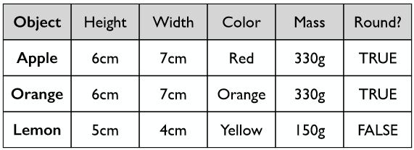
Example: Fruit
How would you describe apples to a computer? How would they differ from oranges?
One way:

Slide 21
What did we do?
We counted the number of nouns in each sentence, creating a feature vector (of a single feature per sentence)
A feature vector is a set of features that represent your text in such a way that they are machine-understandable
We will use this feature vector as input for machine learning.
Notes:
4623 4431

Slide 22
Feature representation for machine learning
Our approach: Use number of nouns in a sentence to predict whether the sentence belongs in the news or romance category
If the system performs well, we’ll know this is a good feature representation
If the system performs poorly, we’ll know this is not a good feature representation

Slide 23
Machine Learning: An Introduction

Slide 24
What is Machine Learning?
Automatically identifying patterns in data
Automatically making decisions based on these patterns
Hypothesis:
Data
Learning Algorithm
Behavior
≥
Data
Programmer or Expert
Behavior

Slide 25
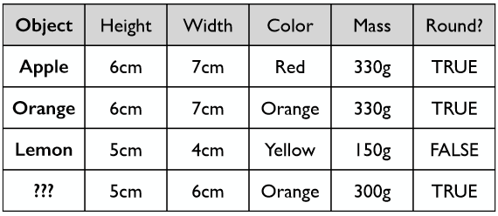
Example: Fruit classification
What if we have a new, unknown fruit? How would you classify it?

Slide 26
Machine Learning tasks
The fruit example is an example of a classification task
We predict a categorical value
Another kind of machine learning task is a regression task
This task predicts a continuous value
Classification and regression are both examples of supervised machine learning
Another type of machine learning task is a clustering task
This is an unsupervised machine learning task
Used to identify groups of similar entities
Groups unlabeled data points by proximity

Slide 27
Graphical Example of Classification

Slide 28
Graphical Example of Classification
?

Slide 29
Graphical Example of Classification
?

Slide 30
Graphical Example of Classification

Slide 31
Graphical Example of Classification

Slide 32
Graphical Example of Classification

Slide 33
Decision Boundaries

Slide 34
Graphical Example of Regression
?

Slide 35
Graphical Example of Regression

Slide 36
Graphical Example of Regression
Notes:
Different styles of regression learn different functions.

Slide 37
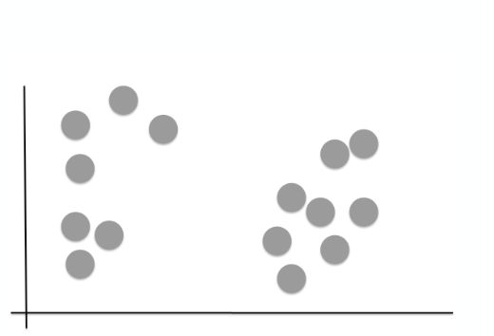
Clustering: Example

Slide 38
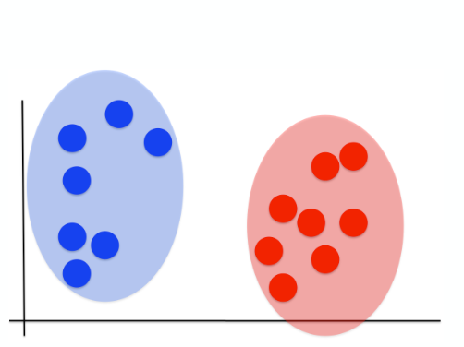
Clustering: Example

Slide 39
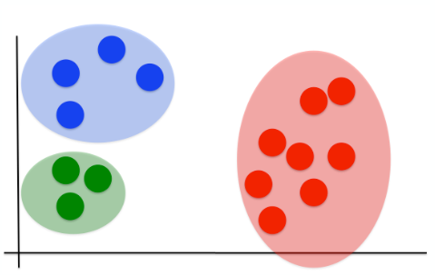
Clustering: Example

Slide 40
So back to our Fruit example!
What if we have a new, unknown fruit? What kind of machine learning task would we need to predict the type of the unknown fruit?

Slide 41
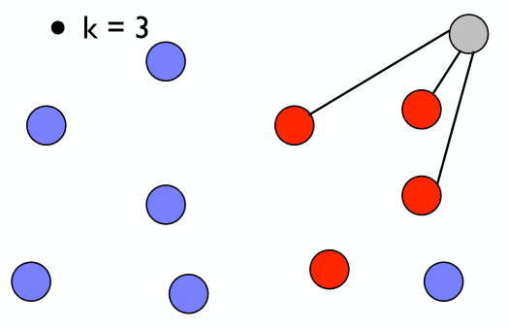
k nearest neighbors – Classification example
One way we could identify it is by seeing what it’s “nearest” to, and give it the same label
Ex. 3 “nearest” things
Graphical example!

Slide 42
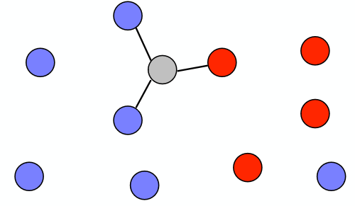
Classification example
But it might not always be easy…

Slide 43
So back to our nouns!
What kind of machine learning task would suit our task and our data?
Remember: We would like use our features (number of nouns per sentence) to predict whether a sentence belongs in the news category or the romance category.
Classification
Used to predict categorical values

Slide 44
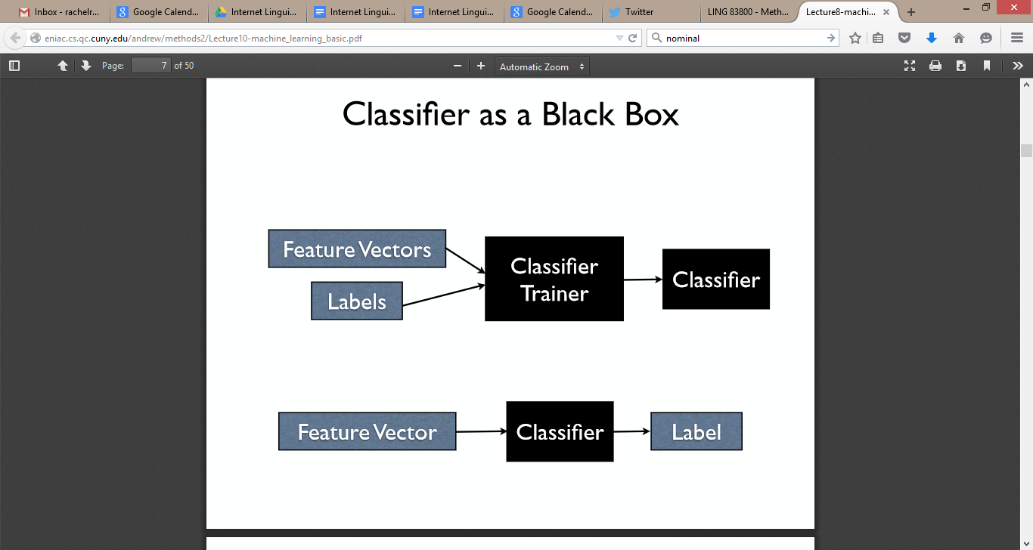
How does machine learning work?
Step 1: Training
Step 2: Testing

Slide 45
Machine Learning: In Practice
Using scikit-learn

Slide 46
scikit-learn (sklearn)
Open source software for machine learning in Python
User friendly
Well documented
Quickly becoming standard in industry for machine learning
Used by Spotify, OKCupid, Evernote (just to name a few)
We will be using scikit-learn for the machine learning section of this workshop

Slide 47
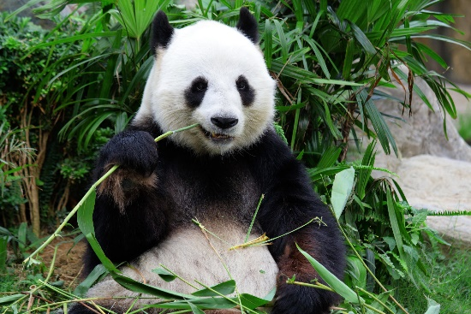
Data management & wrangling: pandas
Often it can be useful to put your data together into a format that makes it easy to visualize and manage
Pandas is a library for Python that allows for data wrangling and analysis
Makes use of a data structure called a DataFrame, which looks similar to an Excel spreadsheet
scikit-learn often prefers for data to be in a DataFrame format

Slide 48
Training a machine learning algorithm
Goal: Build a machine learning model that can predict whether a sentence belongs in the news category or the romance category of the Brown corpus
We cannot use the same data that we trained the model on to evaluate how well the model does
The model will remember the data, and therefore always make correct predictions
This will not tell us how well our model will perform on new data
We will therefore partition the data into two parts

Slide 49
Partitioning data
We partition our data into two sets: training data (train set) and testing data (test set)
We use the training data to build our machine learning model
We use the testing data to evaluate how well our model performs on previously unseen data
A good starting place is often to use 75% of your data for training, and 25% of your data for testing

Slide 50
Creating a training and testing set
For both the training and testing sets of data, we need to create:
A feature vector that represents our data
A label for each sentence (does it come from news or romance?)
Why do we need labels for the testing set?
So we can evaluate our model and see how well it predicts by comparing it’s predictions to the ground truth labels

Slide 51
Create labels
Decide how much data we want to hold our for testing
500 sentences from news, 500 sentences from romance
Create a list of labels for as many sentences as we have in the corpus, minus 500 from each category
These are our training labels
Create another list of 500 news labels and 500 romance labels
These are our testing labels

Slide 52
Create data
Remember our features?
Number of nouns in each sentence in the news and romance categories
Remove the first 500 features from news and romance and concatenate them into a list (preserving order so the labels align)
This is our testing set
Concatenate the remaining features from news and romance into a single list (again preserving order)
This is our training set

Slide 53
Final steps in data prep
Once we have created our data, we need to make sure it’s the correct format for scikit-learn
Split the full DataFrame into training and testing sets
In sklearn, it is convention to use X as a variable name for data, and y as a variable name for labels
This will leave us with a training set called X_train, y_train (training data and training labels)
We will also have a testing set called X_test, y_test (testing data and testing labels)

Slide 54
One additional step…
Because we are only using one feature (most machine learning tasks use many features), sklearn asks us to reshape our data using the following syntax
X_train = X_train.reshape(-1,1)
X_test = X_test.reshape(-1,1)
sklearn is excellent at throwing useful warnings and errors, letting you know what needs to be changed in order for it to run!

Slide 55
We’re ready for machine learning!
…What machine learning algorithm do we use?

Slide 56
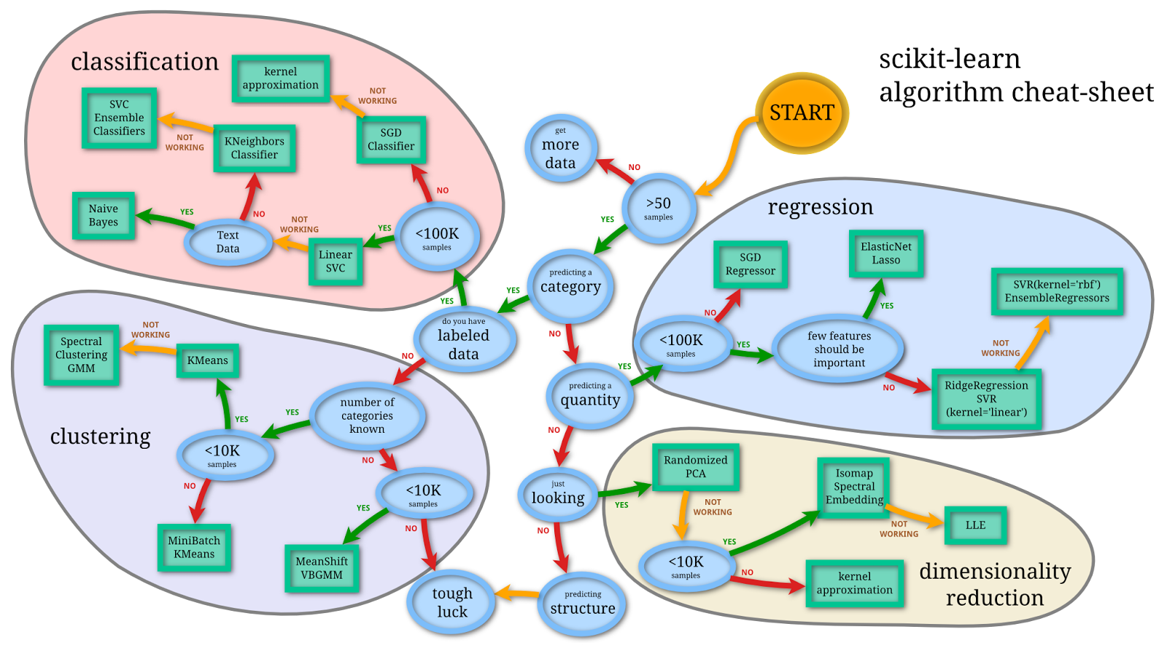
Image by Andreas Müller

Slide 57
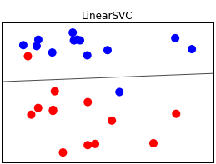
Linear SVC
A linear model for classification
Stands for Linear support vector classifier
A type of support vector machine (SVM) algorithm
A linear classifier separates classes using a line, a plane, or a hyperplane
Image by Andreas Müller (2016)
Notes:
Delete slide?

Slide 58
The beauty of sklearn: simplicity
To do machine learning with sklearn, you really only need to know a few commands.
1. Import your desired classifier
from sklearn.svm import LinearSVC
2. create an instance of your machine learning algorithm
classifier = LinearSVC()
3. Fit, predict, and score!
classifier.fit (X_train, y_train)
classifier.predict (X_test, y_test)
classifier.score(X_test)

Slide 59
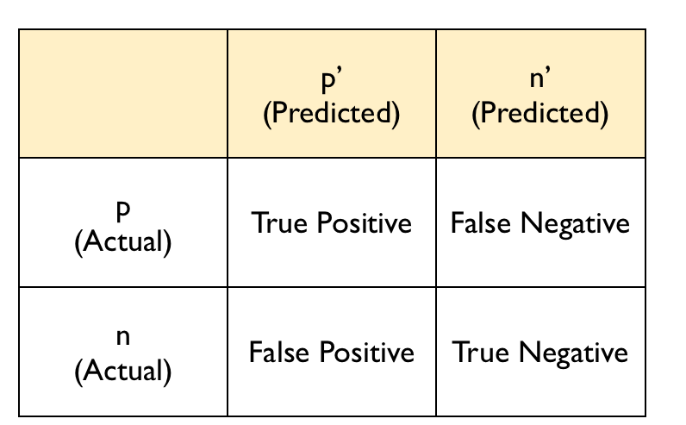
Evaluating your classifier
Our classifier is currently about 67% accurate
This is pretty good, considering we are only using one feature!
Can also be visualized in a confusion matrix
Image by Marcel Caraciolo (2010)

Slide 60
Our confusion matrix
 | Predicted news label | Predicted romance label
Actually a news label | 342 | 158
Actually a romance label | 168 | 332
Our model predicts more news labels than romance labels
This is understandable, as our training data has more instances of news noun counts than romance noun counts
Notes:
342, 158], [168, 332

Slide 61
So what comes next?
Evaluate your features – were they effective for this task?
Can we distinguish between news and romance sentences just by counting how many nouns are in each sentence?
Yes! …to some degree!
Are there other features that we could add to our model that would better represent our sentences, and improve classification?
Almost certainly!
Evaluate your classifier - is it optimal for this task?
Tuning of parameters
Using a different classification algorithm
What happens if we use the k nearest neighbor algorithm?

Slide 62
k nearest neighbors – Classification example
One way we could identify it is by seeing what it’s “nearest” to, and give it the same label
Ex. 3 “nearest” things
Graphical example!

Slide 63
Changing classifiers in sklearn
1. Import your desired classifier
from sklearn.neighbors import KNeighborsClassifier
2. create an instance of your machine learning algorithm
classifier = KNeighborsClassifier()
3. Fit, predict, and score! (Oh look! It’s the same!)
classifier.fit (X_train, y_train)
classifier.predict (X_test, y_test)
classifier.score(X_test)

Slide 64
So how did kNN do?
Ouch! 54% accurate!
We are over-predicting news labels
 | Predicted news label | Predicted romance label
Actually a news label | 449 | 51
Actually a romance label | 404 | 96

Slide 65
Different algorithms are good at different things
This demonstrates that k-nearest neighbors isn’t really the best algorithm for this task
Not really a surprise….

Slide 66
So what comes next?
Evaluate your features – were they effective for this task?
What are some other features we could add to our model that would better represent our sentences, and improve classification?
Earlier, we looked at a frequency distribution of modal words (“can” “might” “should” “could”) in our news and romance categories
Do you think adding how many modal words a sentence contains would improve our model?

Slide 67
Adding new features
Create the new feature vector that you would like to add
Make sure that you are preserving the test/train split
Add columns to your DataFrame
df.insert(<location>,<“name”>,<features>)
Note: DataFrames are mutable
Update X_train, y_train, X_test, and y_test to reflect the new features
X_train = train_data[train_data.columns[:2]]
y_train = train_data["labels"]

Slide 68
Retrain and re-evaluate!
How do we do?
No real improvement – still at 67%
Demonstrates that this is not a particular effective feature for this task
It is important to keep in mind the problem that you are trying to solve, and to find good ways to model and represent that problem.
What works well for one text problem may not work well for another

Slide 69
A word to the wise
When building a machine learning model, you want to be careful not to put in too many features that are very specific to the training corpus itself
Building a model that achieves high accuracy on the training set but doesn’t generalize well to new data is called overfitting
However, you also don’t want to build too simple a model by not accounting for variation in your training set
Using too simple a model is called underfitting
Notes:
Overfitting to training data is a common problem in machine learning

Slide 70
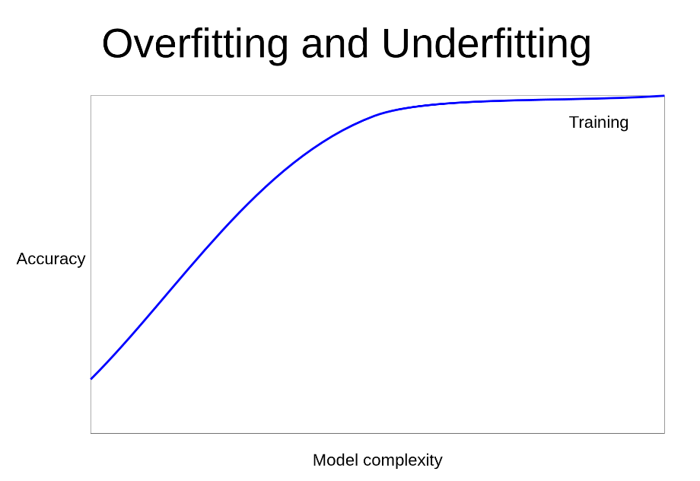
Image by Andreas Mueller, 2016

Slide 71
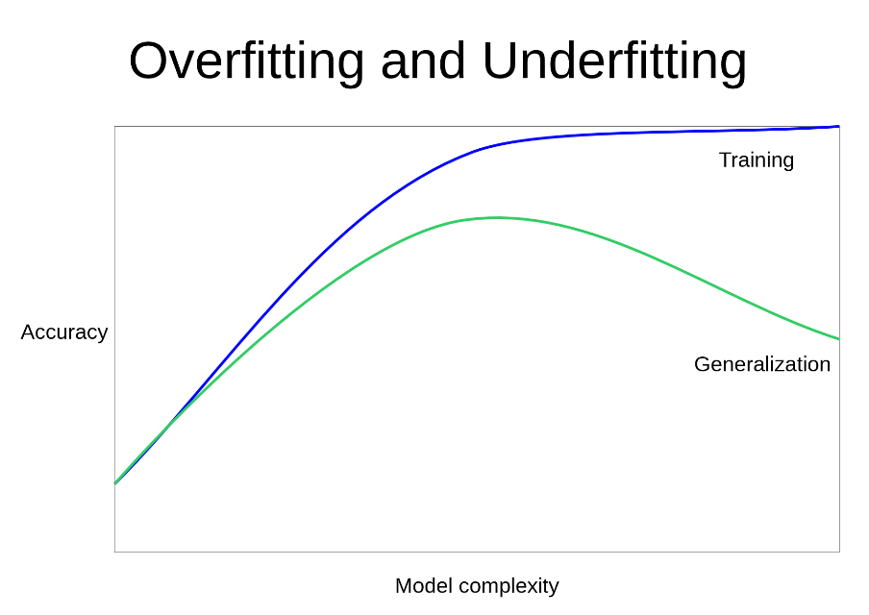
Image by Andreas Mueller, 2016

Slide 72
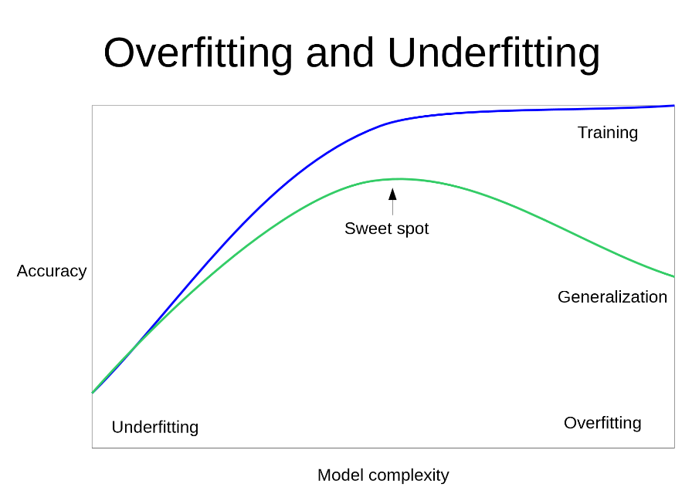
Image by Andreas Mueller, 2016

Slide 73
Wow, we’ve done a lot of things! Let’s recap
Text analysis and the basics of NLP
First passes of tools in NLTK (concordance, word tokenization, pos tagging)
Frequency distributions as a means of counting stuff
Representing textual information as a set of machine-understandable features
Introduction of machine learning tasks
Used scikit-learn and pandas to build a classifier for a specific text analysis question
Building training and testing sets of data
Training and evaluating a machine learning model
Changing machine learning models
Adding more features

Slide 74
“This is awesome! How can I learn more?”
Come to Digital Fellows workshops!
Join or start Digital Project Working Groups!
Also there are books!
“Natural Language Processing with Python”, Bird, Klein, & Loper (2009)
“Introduction to Machine Learning with Python”, Müller & Guido (2016)

Slide 75
Acknowledgements
Some slides adapted from Matt Huenerfauth’s ‘Language Technologies’ class (spring of 2012)
Some slides adapted from Andrew Rosenberg’s ‘Machine Learning’ class (spring 2011)
More slides adapted from Andrew Rosenberg’s “Methods in Computational Linguistics II” class (2015)
Even more slides adapted from Andrew Rosenberg’s “Natural Language Processing, Machine Learning, and the Web” course (Spring 2015)
Additional images from “Introduction to Machine Learning with Python” (Müller & Guido, 2016)
Additional help: Sam Raker, Andreas Müller

Slide 76
Thank you!
Problems? Questions? Corrections? Additions?

