Slide 1
Tracking Workflows with Git and Collaboration with GitHub
http://github.com/jentang/GitDRI

Slide 2
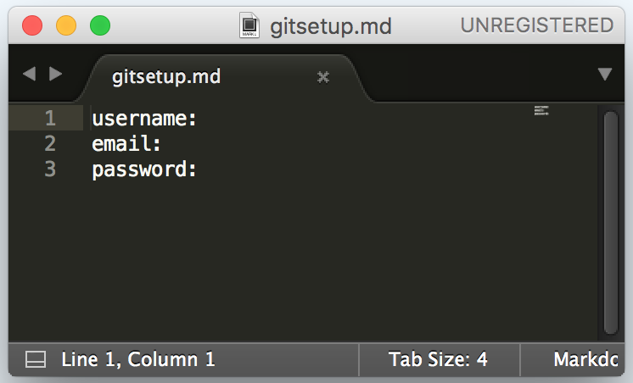
Tracking Workflows with Git and Collaboration with GitHub
Workshop Goal: Create a Git repository on your computer, add files, and push this repository to your GitHub.
Follow this workshop at http://github.com/jentang/GitDRI
If you have yet to do so:
Register for a GitHub: http://github.com/
Record your username, email, and password in the projects folder you created on your Desktop yesterday
Example →

Slide 3
Agenda
Reviewing the Command Line
What is Git, GitHub and Markdown?
Configuring Git
Initialize Git
Connect to GitHub
Break
Git Add, Git Commit, Git Push
Git for Collaboration
MAC
WINDOWS
STICKY FLAGS

Slide 4
Open your Terminal/Command prompt
Do you remember how?
Mac: press the space bar and the command key at the same time and type in "terminal.”
Windows: launch the command prompt from the run window.

Slide 5
Review of Command Line
Move into your Desktop
Make a folder called ”GitPractice”
cd Desktop
mkdir GitPractice

Slide 6
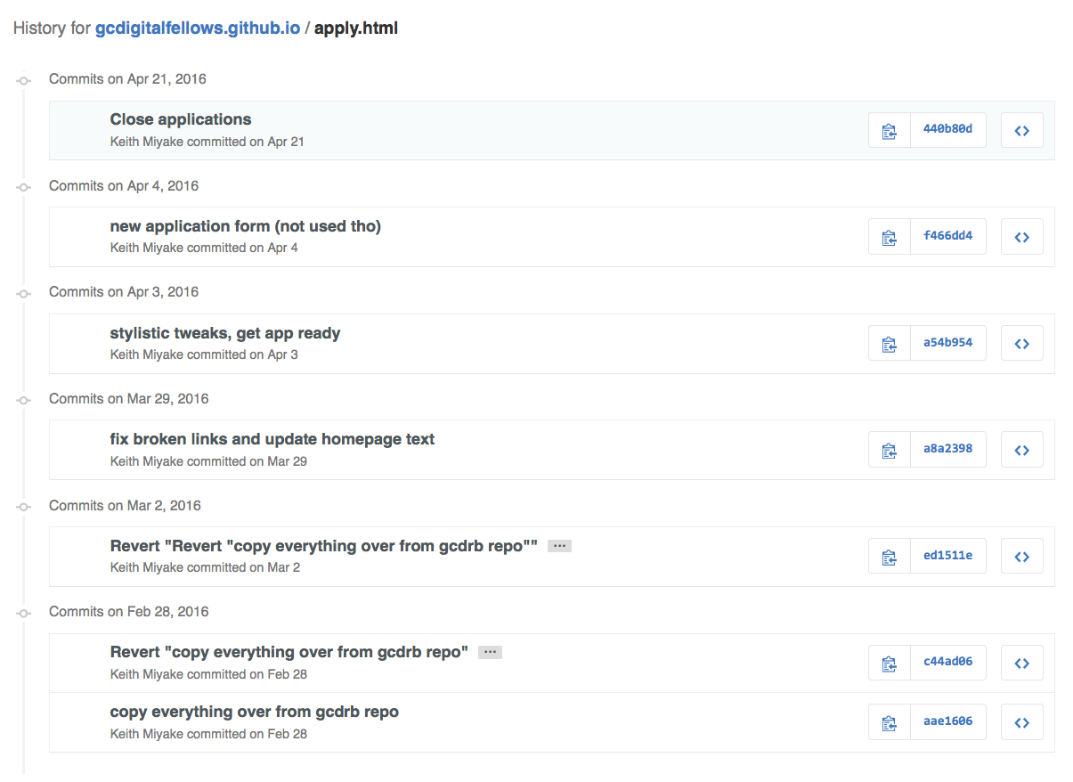
What is Git?
Git is a version control
tool

Slide 7
What is Git?
Git lives on your computer (is local), and is accessed through the command line.
Git tracks changes when the user tells it to git add
This cues your file up for revisions
Git logs this version of the file when the user tells it to git commit
This adds modified files to your repository
All files live in the .git repository
Git = version control

Slide 8
What is GitHub?
GitHub is a hosting service for git repositories
Github connects git repositories remotely (not on your computer)
Your GitHub account must be configured to your computer
Once your local git repository and Github are connected, you can:
make copies of repositories
edit them
propose changes
Github connects git repositories

Slide 9
What is GitHub?
GitHub is a hosting service for git repositories
Github connects git repositories remotely (not on your computer)
Your GitHub account must be configured to your computer
Once your local git repository and Github are connected, you can:
make copies of other users' repositories
edit them
propose changes to the user
Github connects git repositories, facilitating collaboration.
GitHub = collaboration

Slide 10
What is Markdown?
Markdown is a way to format text in a quick and lightweight manner
Think of it as a kind of language read by many platforms to interpret the style of text
Documents written in markdown are more sustainable and transferrable, so decrease the risk of losing important formatting
There is a quick link to the markdown cheatsheet at the bottom of the README file

Slide 11
Check that you have installed Git
Open your terminal/command prompt
Make sure you are in your Desktop
Type git
Press enter
If you get a list of things, you’re good to go
If you don’t, put up a sticky and ask your neighbors to help you install Git

Slide 12
Configuring Git on your computer
git config --global user.name "John Doe"
git config --global user.email johndoe@example.com
You may have saved this info is in your gitsetup file in your projects folder
To check your set-up, use git config --list
STICKY
user.name=Superstar Git User user.email=gitsuperstar@gmail.com.

Slide 13
Initialize Git
Navigate inside the folder 'GitPractice'
Type git init and hit enter
Initialized empty Git repository in /Users/Jen/Desktop/GitPractice/.git/
This initializes the Git repository so it knows to pay attention to this folder.

Slide 14
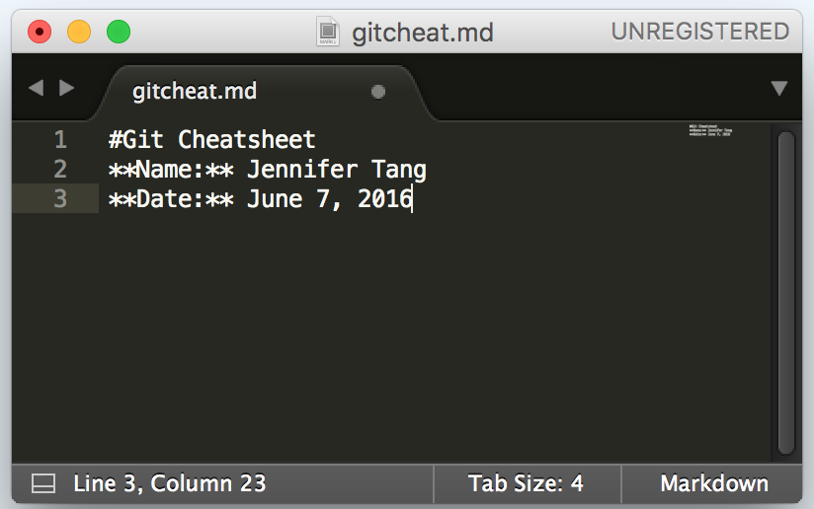
Create gitcheat.md
Make sure you're inside your GitPractice folder
Do you remember how to create a file?
touch gitcheat.md
Open this new file and add some text
Try experimenting with markdown to make headers or add emphasis
I used # to indicate a heading and ** on either sides of text I want to appear in bold

Slide 15
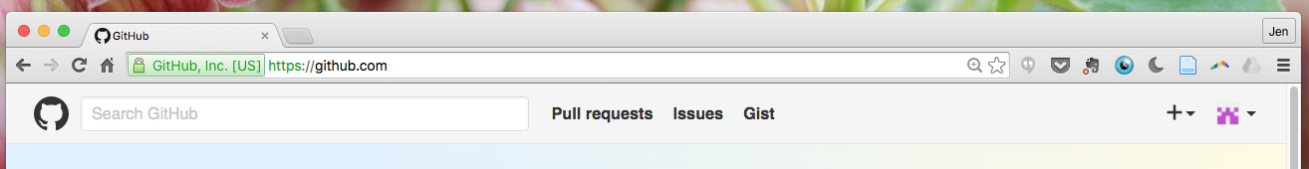
Connect to Your Remote Repo
Go to GitHub in your browser
Click the plus sign in the upper right hand corner to create a new remote repo

Slide 16
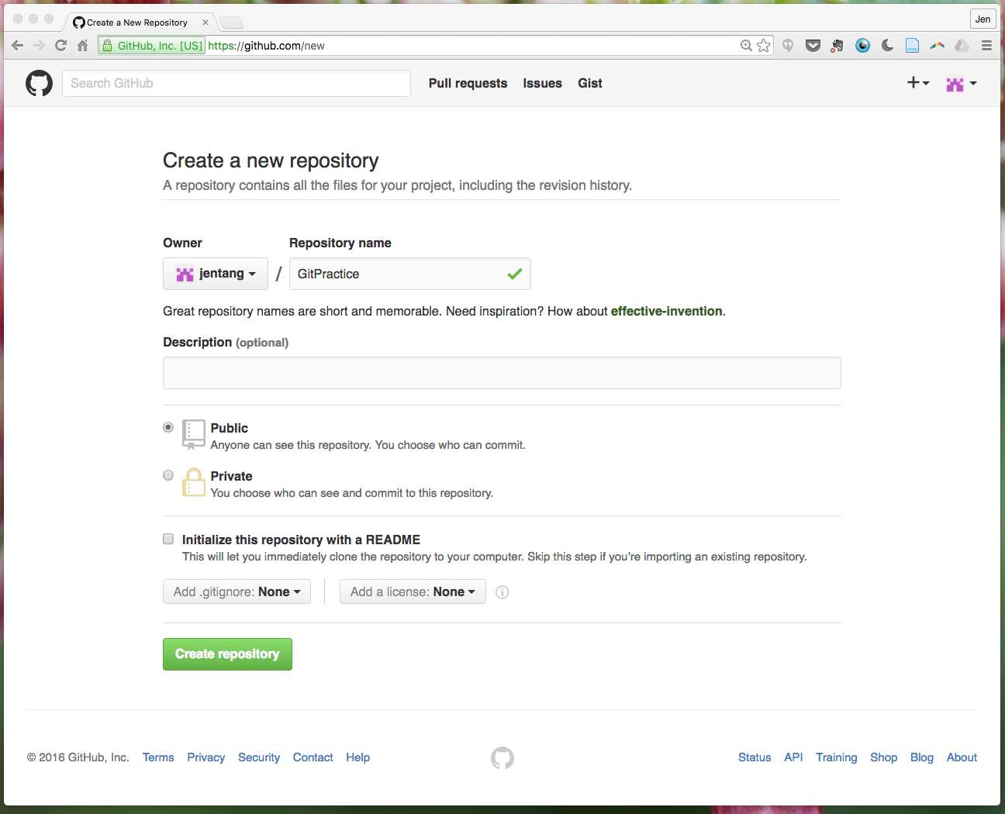
Give it the same name as your local repo
Select Public
Do not select ”initialize with a README" since you'll be importing an existing directory
Click Create repository

Slide 17
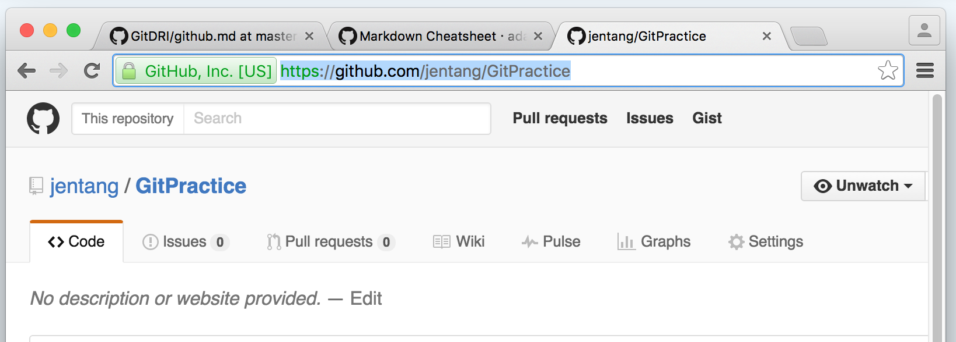
Connect to Your Remote Repo
Navigate to your new remote repo in the browser, and copy its HTTPS: URL.

Slide 18
Connect to Your Remote Repo
Type:
git remote add origin [URL of your remote repo]
This will link the local and remote repo
To confirm, type: git remote -v
Origin https://github.com/jentang/GitPractice (fetch) Origin https://github.com/jentang/GitPractice (push)
STICKY

Slide 19
Git Add, Commit, and Push
Remember, Git = version control
First, you add a file so that Git knows which file you are interested in
Then, you commit the changes you made
This all happens on your local computer
When you want these changes to to appear on the remote repo you are connected to (on GitHub), you then push it from the local to the remote

Slide 20
Git add
Back in our command line, type: git add gitcheat.md
This stages the file to be tracked, and prepares it to be committed
The command line will look like nothing in particular happened

Slide 21
Git commit
Committing tells Git this is the version you want to log
Type: git commit -m “[add a message here about the commits you're making]"
Be brief but descriptive so other collaborators can understand different versions
You have just committed everything you have saved on gitcheat.md to Git on your local computer

Slide 22
Let’s go through another add & commit cycle
In gitcheat.md, let’s make some notes about our new commands:
git init
git remote add origin [url or remote repo]
git remote -v
git add [filename]
git commit -m “[message]"
After the first commit, you can combine add and commit
git commit -am “[message]”

Slide 23
The local version is what we want to share
Always check what’s going on: git status
Now, how do you get these changes onto a shared GitHub so that others can see your good work?
On branch master
nothing to commit, working directory clean

Slide 24
Git push
pushes our local repo to its remote repo on GitHub
In the command line, type: git push -u origin master
You'll be prompted to enter your GitHub username and password
Hint: it’s in your gitsetup file in your projects folder
For some, you will only be prompted on your first push, for others, it will be for each push

Slide 25
Git push
git push -u origin master
Go back to your browser and refresh your GitPractice repo on GitHub to see your changes
See changes → jazz hands
Don’t see changes → put up a sticky and find some jazz hands
After your first push, you can just use git push

Slide 26
Git clone
Making a copy of a GitHub repo to work on locally
A clone is a local copy of a repository
In your command line, get back to your Desktop
Clone the repo for this workshop so you can have a copy for yourself!
git clone https://github.com/jentang/GitDRI
Take a look in your Desktop to see if you have a new GitDRI folder
If you want to clone any other user’s repo, you can use
git clone [URL of your GitHub repo]

Slide 27
Git pull
Sometimes changes are made on the remote GitHub repo that have not yet been logged locally
You will need to pull the repo
i.e. log the newest version in GitHub as compared to your local repo
git pull [URL of your GitHub repo]
Then merge the changes by using
git commit -u origin master

Slide 28
Review
Git = version control
GitHub = collaboration
Git config so Git knows who is working
Git init lets Git knows the repo you are going to work on
Git add tells Git to track this file
Git commit tells Git to log this version with a note about it
Git push puts this local version up on your remote GitHub
Git clone makes a local copy of a repo on GitHub
Git pull logs any remote changes on your local repo

