Slide 1



RECURSION
BY
Aaamna Fathima
Abdullah Alblooshi
Mohamad Fadi Dakwar

Slide 2






CONTENTS
RECURSION
RECURSIVE FUNCTION
PROS & CONS
PROBLEM SOLVING

Slide 3
Introduction To Recursion
A recursive function is a function that calls itself directly or indirectly. when a function’s condition is satisfied. It’s a fascinating yet challenging mechanism to understand.
A recursive function terminates if base case is found. A base case is essentially the condition that will be met, and where recursion will cease.
A recursive function can end up in an infinite loop if base case is not met in the calls.

Slide 4
How Recursion Works
In recursion, a function calls itself, using a return function, until it reaches a base case or essentially the stop command which stops the recursion. Think of it as a for loop reaching it’s requirement, or a while loop turning into false.
Recursion is far better well used and is a more natural way to solve problems rather than loops, and it’s far easier to think about. The only issue is that it consumes memory due to stacks which we will discuss later.
To simply write a recursive function:
Define a clear base case.
Ensure the recursive call moves towards the base case (for example, power(n-1))
Manage parameters generally
Let's explore this process using an example and emphasize the significance of base cases in ensuring termination.

Slide 5
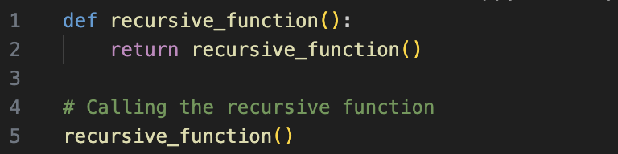
Why is the base case important?
It provides a termination condition
without it, the recursion would continue indefinitely
infinite loop
stack overflow

Slide 6
Stack Frames
When a recursion function calls itself again, a stack frame is created.
Each stackframe is a snapshot of the local variables and parameters in scope, it also contains a return address.
The oldest stack is at the bottom, while the newest is always at the top.
Recursion depth refers to the number of times a recursive function is called before reaching a base case.
There is a limit to it, the python default is 1000.

Slide 7
PROS | CONS
USING RECURSION , THE LENGTH OF PROGRAM IS REDUCED | RECURSION REQUIRES EXTRA STORAGE SPACE . FOR EVERY FUNCTION CALL , SEPARATE MEMORY IS ALLOCATED TO AUTOMATIC VARIABLES
RECURSION IS VERY FLEXIBLE IN DATA STRUCTURES LIKE LISTS , STACKS ETC. | NOT EFFICIENT IN EXECUTION SPEED AND TIME

Slide 8
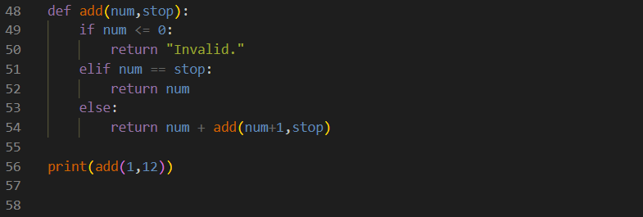

PROBLEM SOLVING

Slide 9
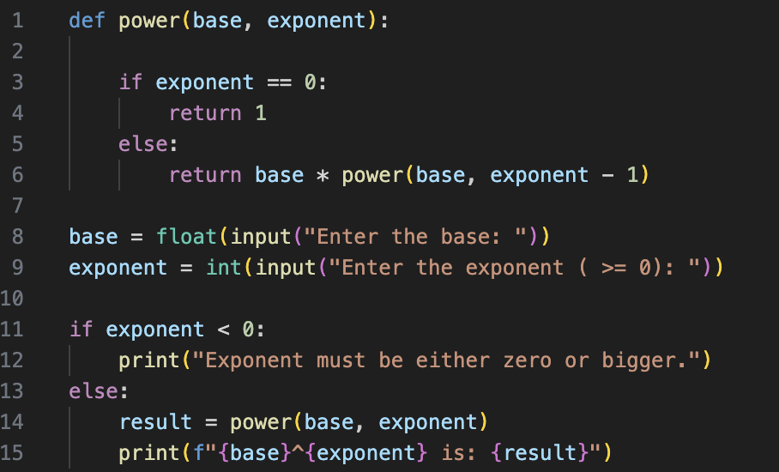
Exponentiation function
The power function uses two parameters. (Base, exponent)
It calculates the base and the power.
How is it a recursive function?
The base case is ( exponent == 0 )
The recursion is (exponent - 1)
Notes:
It calculates base * power(base, exponent - 1). In other words, it multiplies the base by the result of raising the base to the power of (exponent - 1). This is the recursive step.
The recursion keeps breaking down the problem by subtracting 1 from the exponent in each step until the base case is reached. This mirrors the mathematical definition of exponentiation, where you repeatedly multiply the base by itself according to the value of the exponent.
This recursive approach is a way of expressing exponentiation as a series of repeated multiplications, breaking down the problem into simpler subproblems. Each recursive call handles a smaller exponent until it reaches the base case, providing the final result.

Slide 10
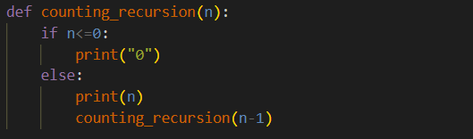
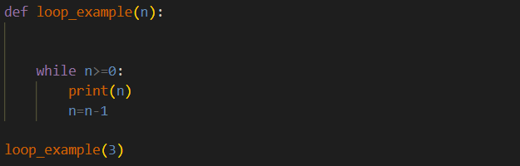
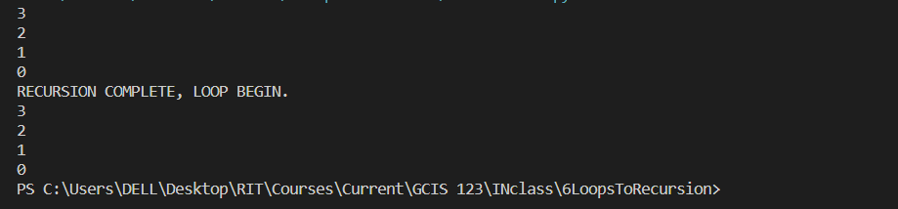
Recursion vs Iteration CODE!

Slide 11
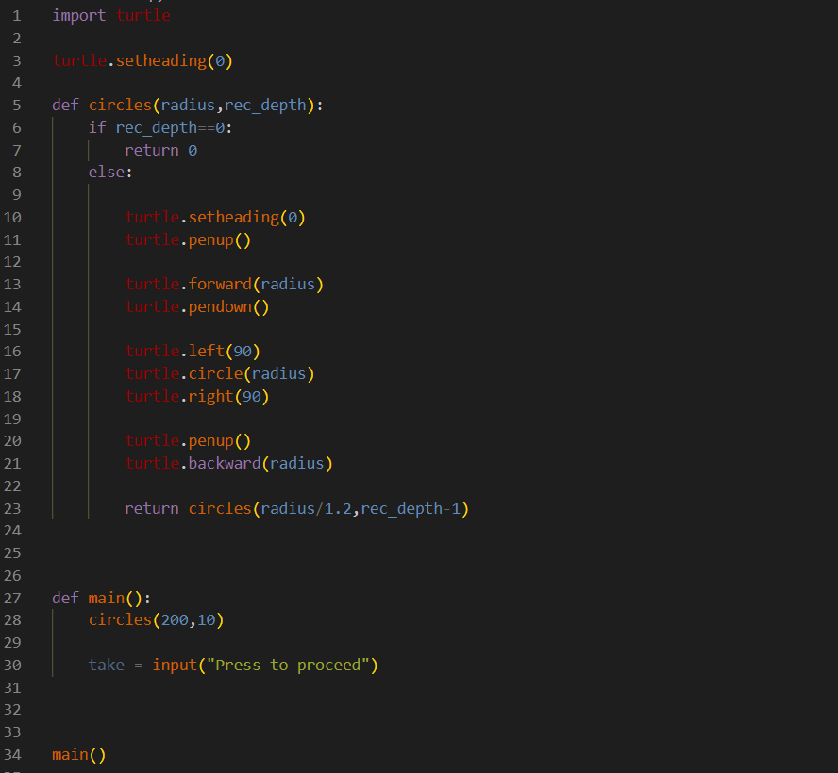
Turtle Strikes, Yet again!
This is a very basic turtle recursive code, and is very simple. It has no moving parts, it just draws a centered circle on centered circle.

Slide 12
Thank you for your kind attention.

