Slide 1
A Prototype of Indoor Positioning System Using Wi-Fi Signal
Plan B Option: Technical project
Bader Aldawsari
Option: Software Engineering
Advisor: Dr. Yunkai Liu

Slide 2
Objectives
Design and develop a generic prototype for indoor positioning system, which includes
Collecting Wi-Fi fingerprints
Designing a database for saving indoor map information
Integrating Wi-Fi fingerprints with indoor map layout
Providing a generic application for positioning and navigation
Case study in Zurn building’s 3rd floor

Slide 3
Development Tools
Eclipse + ADT plugin for android development
Android SDK (API 18)

Slide 4
Zurn Indoor Map Application
Features:
Detect current location using Wi-Fi (nearest, exact)
Get latest indoor map fingerprint from a webserver
Indoor map layout is generated based on an XML file that contains indoor map specification

Slide 5
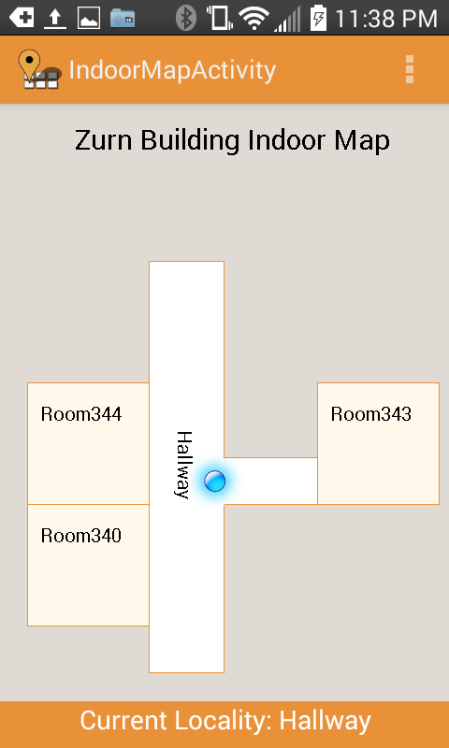
Zurn Indoor Map Application

Slide 6
Architecture Design

Slide 7
Deriving Wi-Fi Fingerprint
Wi-Fi Fingerprint Data Collection:
In each location, Wi-Fi signals data was recorded for 10 minutes
Collected Wi-Fi data was analyzed to get average and standard deviation pf each AP in every location
Generating Fingerprint for a Locality:
Three APs have been used (two APs devices were setup)
The range of each AP signal is found using average and standard deviation
[Average – 1.96 * StdDev, Average – 1.96 * StdDev]
Notes:
This range enhances the fingerprint matching method, as signal strength is within roughly 1.96 standard deviations of the mean

Slide 8
Fingerprint Matching
Finding Matching Locality
Locality is found by matching all AP signals to the defined fingerprint’s range of each locality
Finding Nearest Locality
This method will find the nearest locality using the Euclidian distance algorithm
Notes:
Two different methods to find locality:

Slide 9

Finding Nearest Locality
Euclidean distance algorithm was used to determine the nearest location
s_{j}^{(i)} is the calculated signal strength average of access point j at locality i
t_{j} is the read signal strength of access point j at a test location

Slide 10
One Room Setup
Room 343 was selected and it was divided into six localities (blocks)
Wi-Fi fingerprint recording was done in the center of each block
 | AP Name | Range (Min) | Range (Max)
B1 | WL330 | -50 | -46
 | MK8 | -55 | -52
 | GUWireless | -67 | -65
B2 | WL330 | -61 | -58
 | MK8 | -65 | -61
 | GUWireless | -69 | -65
B3 | WL330 | -54 | -46
 | MK8 | -66 | -61
 | GUWireless | -67 | -64
B4 | WL330 | -55 | -52
 | MK8 | -65 | -61
 | GUWireless | -72 | -70
B5 | WL330 | -60 | -57
 | MK8 | -63 | -59
 | GUWireless | -69 | -64
B6 | WL330 | -66 | -61
 | MK8 | -72 | -65
 | GUWireless | -71 | -69

Slide 11
Accuracy Testing
187 Wi-Fi scans were recorded while walking around the room
Each recorded scan was labeled with the actual location
The result of the location estimation algorithm was compared with the actual locality to determine the accuracy
The result of accuracy of the estimation algorithm was 71 correct out of 187 = 38%
Conclusion:
Signal strength value is mostly similar in all localities due to the short distance between them
Recorded Wi-Fi data of moving device was collected in a different day (weather, AP device placement)

Slide 12
Multi Room Setup
Room 343, Room 340 and Room 344 were selected
Wi-Fi fingerprint recording was done in the center of each room
Room Name | AP_Name | Min | Max
RM340 | VD2YH | -68 | -64
 | MK8 | -35 | -29
 | CISACL | -65 | -59
RM343 | VD2YH | -59 | -49
 | MK8 | -76 | -68
 | CISACL | -79 | -75
RM344 | VD2YH | -78 | -74
 | MK8 | -78 | -64
 | CISACL | -60 | -58

Slide 13
Accuracy Testing
148 Wi-Fi scans were recorded in while walking in all three rooms
The accuracy of the estimation algorithm was 143 correct out of 148 = 96.62%
The errors are because Room 344 and Room 340 are close and it could be fixed by revising the fingerprint

Slide 14
Performance Testing
Testing was performed on three different android devices to find how much time it takes to find the current locality
The total time is about 500ms for LG LS620 and Galaxy S3 (average 100 runs)
The total time is about 1264ms for Galaxy Tab 8.9 (average 100 runs)
Fingerprint matching algorithm takes 15ms on average

Slide 15
Demo

