Slide 1
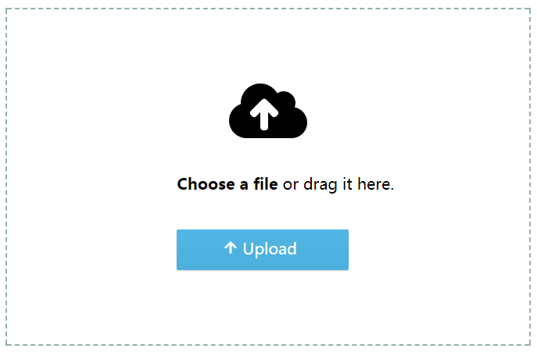
Initial state
Accept
1. browse to files
2. Drag files and folders

Slide 2
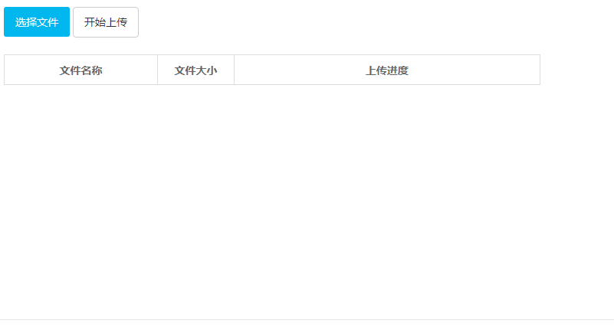
Object Selected

