Slide 1

Sea-Bird CTD Data Processing Toolkit
Aligning conductivity and oxygen in CTD cast data from SFER cruises
github.com/GCOOS/SBE-Data-Processing-Toolkit
Notes:
A GCOOS toolkit of folder templates, scripts, and Plotly Dash apps for post-processing Sea-Bird CTD casts with SBE Data Processing.

Slide 2




What the Toolkit Does
Scripts and apps around Sea-Bird SBE Data Processing
Prepares a cruise folder and checks cast file names
Finds casts where downcast detection kept too little data
Tests and compares conductivity and oxygen alignment values
Browses converted CNV files as interactive plots
MIT-licensed, open source on GitHub
Windows
Sea-Bird software is Windows-only
SBE Data Processing
SBEBatch.exe must be on the PATH
Python 3.11+
dash, pandas, plotly
Bash terminal
perl, sed, awk (Git Bash, WSL, Cygwin)
Notes:
Requirements from the README. A web browser is also needed for the interactive apps.

Slide 3
Recommended Conversion Workflow
Two options: take the defaults, or find the best alignment values
Prepare the cruise folder: init script, copy casts to CNV, rename files, check naming
Option 1
Default values
Convert all data in CNV, downcast and upcast
Done
Option 2
Find the best values
1
2
3
4
5
Convert downcast only (in CNV)
Check that downcast kept enough data
Re-convert short casts in UPDOWN
Run TC and O experiments; review plots
Final conversion with chosen values
Notes:
Option 2 follows the README's Option 2 steps 1 to 6. The experiments and plotting steps are shown on the alignment slides.

Slide 4
Prepare the Cruise Folder
Same first steps for both options
Run init_cruise_folder.sh in a bash terminal from the toolkit directory
Copy the original CTD cast files into CNV
Check the field notes or data sheet; rename files if needed
Cast number is optional, needed only to separate casts at one station
File name pattern
<cruise_name>_Stn.<station_name>
[_running_cast_number]
Folders used in the workflow
CNV/ downcast conversion
UPDOWN/ down + upcast
ALIGN_TC/OUT/ conductivity alignment tests
ALIGN_O/OUT/ oxygen alignment tests

Slide 5
Check the Downcast Detection
Find casts where Sea-Bird kept too little data
Pump status available
No pump status
python pump_status_report.py <path>
python compare_cnv_lengths.py <cruise_name>
Writes pump_status_report.txt in the analyzed folder
Pump-on files listed shortest to longest
Same report in app_pump_status.py
First run the Convert step in UPDOWN (down + upcast)
Compares row counts of CNV and UPDOWN files
Smallest relative CNV length listed first
Then re-convert affected stations in UPDOWN and copy them to CNV

Slide 6
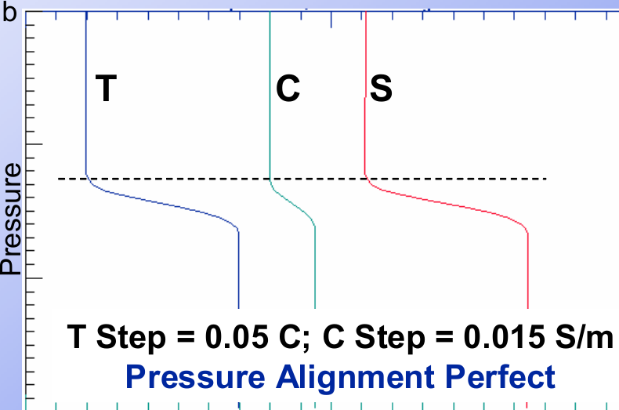
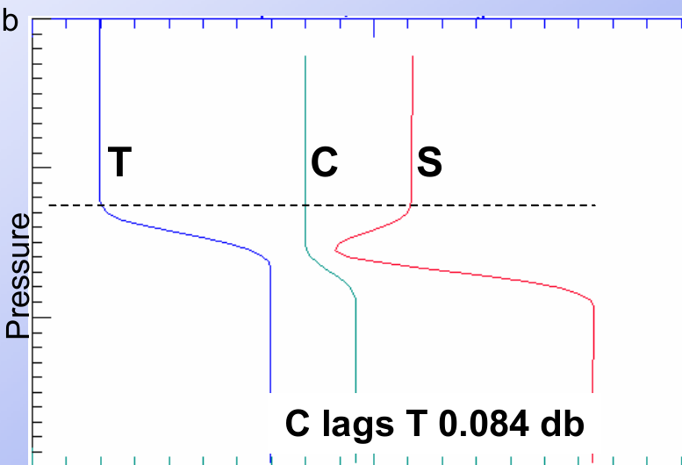
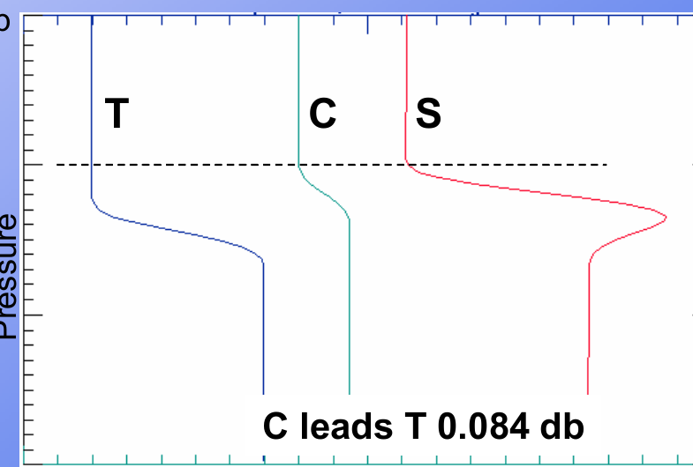
Why Align Conductivity
Mismatched T and C samples create salinity spikes
Misaligned T and C show up as salinity spikes and density inversions
Not a sensor fault: any T and C pair gives bad salinity if one scan mixes water parcels
Fix: shift conductivity relative to pressure, in seconds
Aligned: clean salinity step
C lags T: negative spike
C leads T: positive spike
Figure: Sea-Bird Scientific, SBE Data Processing training, Module 9
Notes:
Source: SBE Data Processing training PDF, page 335 (Module 9). Blue is temperature, green conductivity, red salinity. The spike direction reverses if T and C decrease with depth. In the training example, 0.084 db equals 2 scans at the 9plus data rate and a 1 m/s lowering rate.

Slide 7
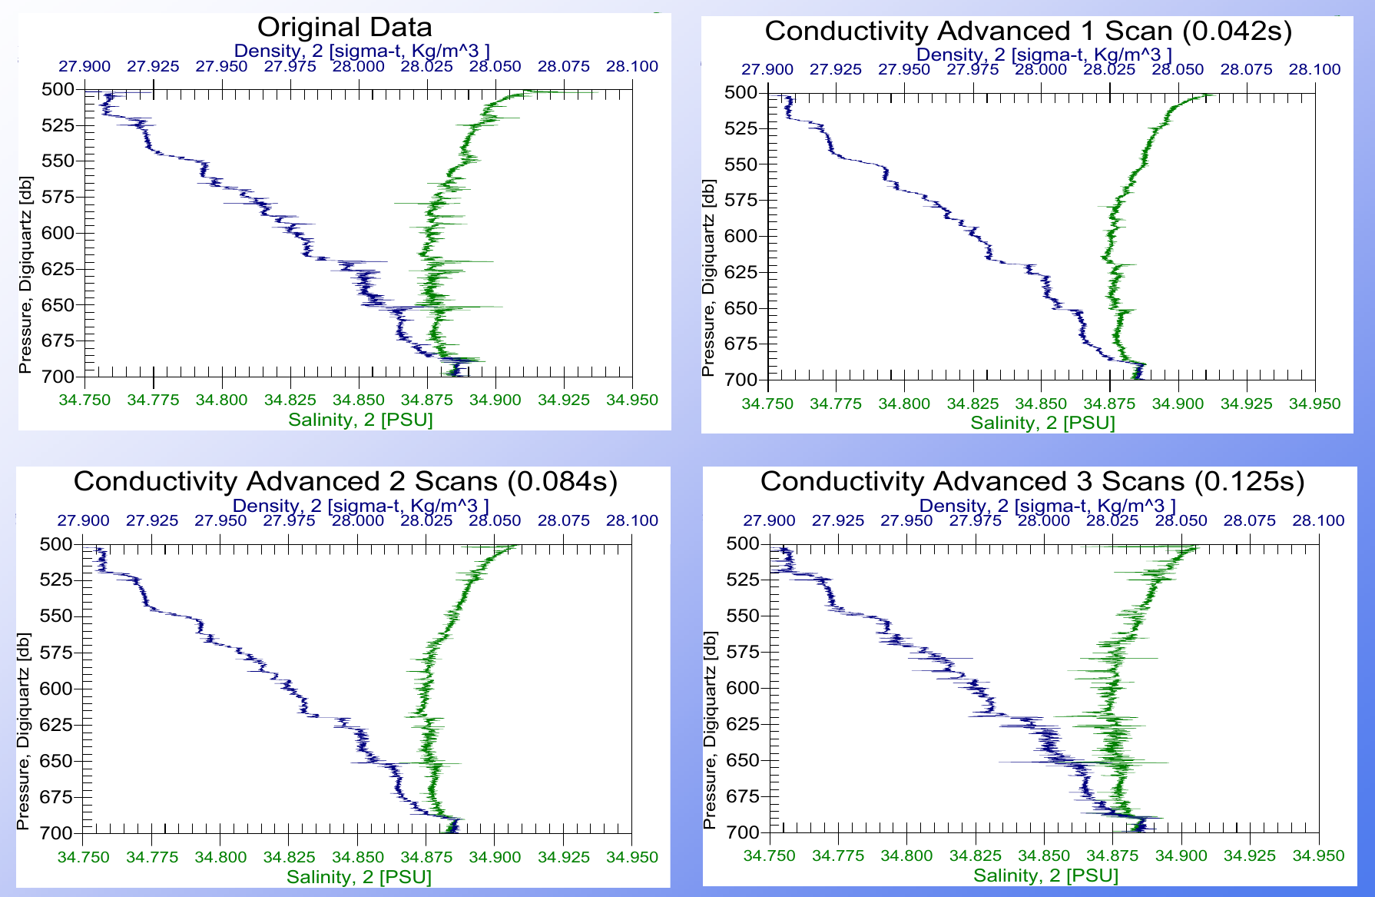
Choosing the Conductivity Shift
Look at a sharp gradient and test values
SBE 11plus applies 1.75 scans (0.073 s) automatically to primary channel; that is the Sea-Bird default
Plumbing or pump speed changes move the best value: slower pump, larger shift
Pick a sharp salinity gradient and adjust until spikes shrink
Plot descent rate too: ship heave causes spikes that alignment cannot fix
Faroe data: original vs conductivity advanced 1, 2, 3 scans
Figure: Sea-Bird Scientific, SBE Data Processing training, Module 9
Notes:
Source: training PDF page 341. One scan (0.042 s) greatly improved the spiking; two scans began producing spikes in the other direction; three scans reversed and lengthened them. Non-integer scan shifts are allowed.

Slide 8
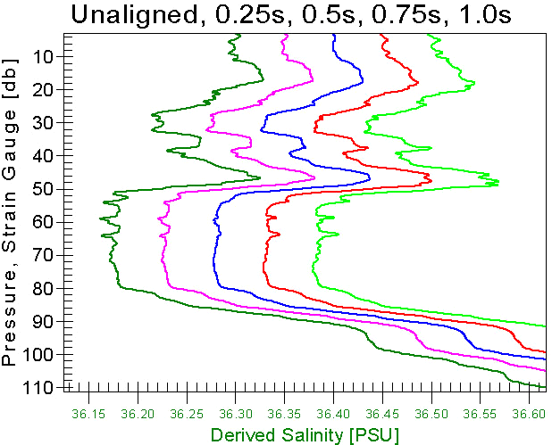
Conductivity Alignment Experiment
experiment_TC_delays.sh tests several values at once
bash experiment_TC_delays.sh <cruise> [start end n]
Default: 4 values from 0.03 to 0.09 s; SBE911Plus default is 0.073 s
Needs the downcast conversion already done in CNV
One folder per value in ALIGN_TC/OUT/
Stops if SBEBatch.exe is missing or output folders already exist
SBE 19plus example: unaligned, then 0.25 to 1.0 s
Figure: Sea-Bird Scientific, SBE Data Processing training, Module 9
Notes:
Source: training PDF page 342 (extra-credit SBE 19plus data set). The optimal value there lies between 0.25 and 0.5 s. Results are compared with plot_alignment.py.

Slide 9
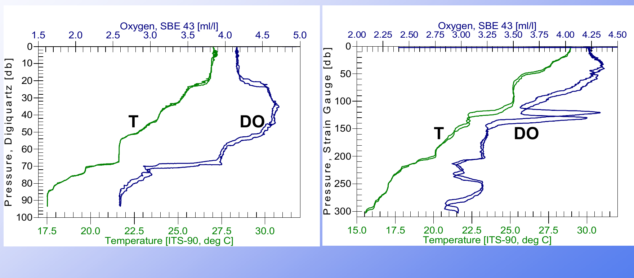
Why Align Oxygen
Plumbing and sensor response delay the signal
Sensor time constant is about 2 to 6 s, depending on temperature
Plumbing adds about 2 s; delays total about 4 s
Delays, T mismatch, and slow response cause hysteresis in profiles
The newer SBE 43 reduces these problems
Temperature and oxygen vs pressure, two casts
~4 s typical total oxygen delay
Figure: Sea-Bird Scientific, SBE Data Processing training, Module 9
Notes:
Source: training PDF pages 343 and 344.

Slide 10
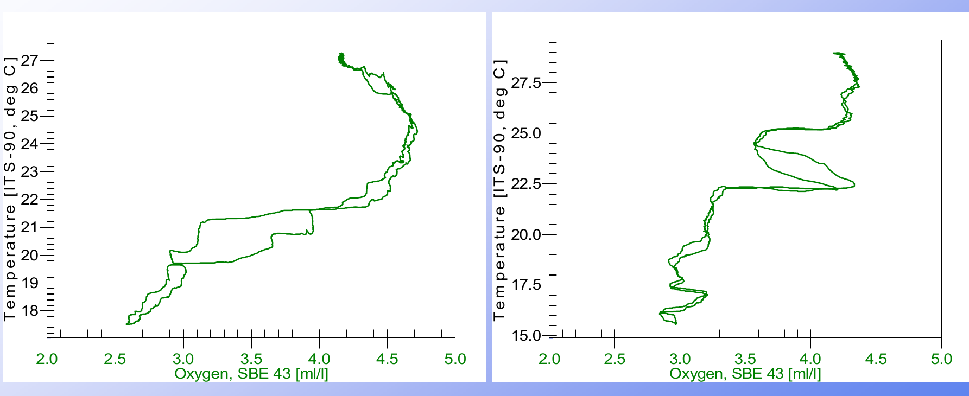
Hysteresis or a Real Feature?
Check before you shift the oxygen data
Hysteresis is easy to see in pressure vs oxygen profiles
But real ocean features can look the same: a drifting ship near the Gulf Stream sampled a feature at different depths on down and upcast
Plot oxygen vs temperature to tell the two apart
Hydrographic phenomena should not be removed by data manipulation
Oxygen vs temperature plots for two casts
Figure: Sea-Bird Scientific, SBE Data Processing training, Module 9
Notes:
Source: training PDF pages 344 and 345. Viewing hysteresis in DO-T space helps separate it from hydrographic features.

Slide 11
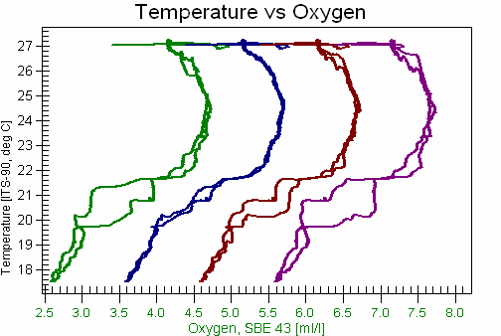
Oxygen Alignment Experiment
experiment_O_delays.sh tests several values at once
bash experiment_O_delays.sh <cruise> [start end n]
Default: 5 values from 2 to 6 s; SBE911Plus default is 3.5 s
Reads UPDOWN/01-cnv, so run Convert there for all casts first
One folder per value in ALIGN_O/OUT/
Same requirements as the conductivity script
Oxygen advanced 0, 2, 4, 6 s relative to pressure
Figure: Sea-Bird Scientific, SBE Data Processing training, Module 9
Notes:
Source: training PDF page 347. The training activity advances oxygen voltage 2, 4, and 6 seconds and plots T vs oxygen.

Slide 12
Review Results: plot_alignment.py
Compare every tested value side by side
Finds .cnv files in OUT/*/06-drv for each tested value
One interactive pressure profile per alignment folder
Same file, scan-discard, and variable choices apply to every plot
Opens in your browser at http://127.0.0.1:8050
python plot_alignment.py "<alignment-root>"
1 Pick one CNV file name
2 Choose # of initial scans to discard
3 Select up to 5 variables
Custom X/Y axes tab for any pair

Slide 13



Other Tools
Optional helpers for browsing and checking results
plot_cnv_files.py
plot_single_folder.py
port 8053
port 8052
Browse CNV files shortest first; compare two folders side by side
Load CNV files from any one folder, at any depth
cnv_file_summary.py
app_pump_status.py
command line
port 8051
List variables, row counts, and max pressure per file
Pump status report app with CSV export of short pump-on files

Slide 14
Default Alignment Values by Instrument
Advance in seconds, relative to pressure
Instrument
Temperature (s)
Conductivity (s)
Oxygen (s)
SBE 9plus
-
0.073
3 to 5 (3.5)
SBE 19plus / 19plus V2
0.5
0.1
-
SBE 25 / 25plus
-
0.1
3 to 7
✓
✓
SBE 49 (TC, 3000 rpm pump)
0.0625
-
-
✓ checked against the Seasoft manual in the source spreadsheet. “-” = no value listed.
Toolkit script defaults suit the SBE 9plus; pass start, end, and count to test other instruments
Notes:
Source: DOC/SBE_parameters.xlsx in the toolkit repo (Align block). Values are advances in seconds relative to pressure. Instruments with no value listed in the file show a dash. Only the SBE 25/25plus conductivity and oxygen values are highlighted in the file as checked against the Seasoft Data Processing manual; the file also carries a note 'My guess for Hogarth (SBE 25plus)' on a filter cell, so confirm other values against the manual for your own instrument. The file also lists filter time constants and cell thermal mass (alpha, beta) per instrument, and an 'align' row showing conductivity 0.0. The original text for the SBE 9plus oxygen entry reads '3 bis 5 (3.5)', meaning 3 to 5 s with 3.5 s as the typical value. Repository: https://github.com/GCOOS/SBE-Data-Processing-Toolkit

