Slide 1

Team Z ReadMe PPT
Written by 202135752 Kim Taeryang

Slide 2
First, Please click our Github link
Our project’s Github link : https://github.com/GCU-Algorithm-Group-Z/MealPlanner.git

Slide 3
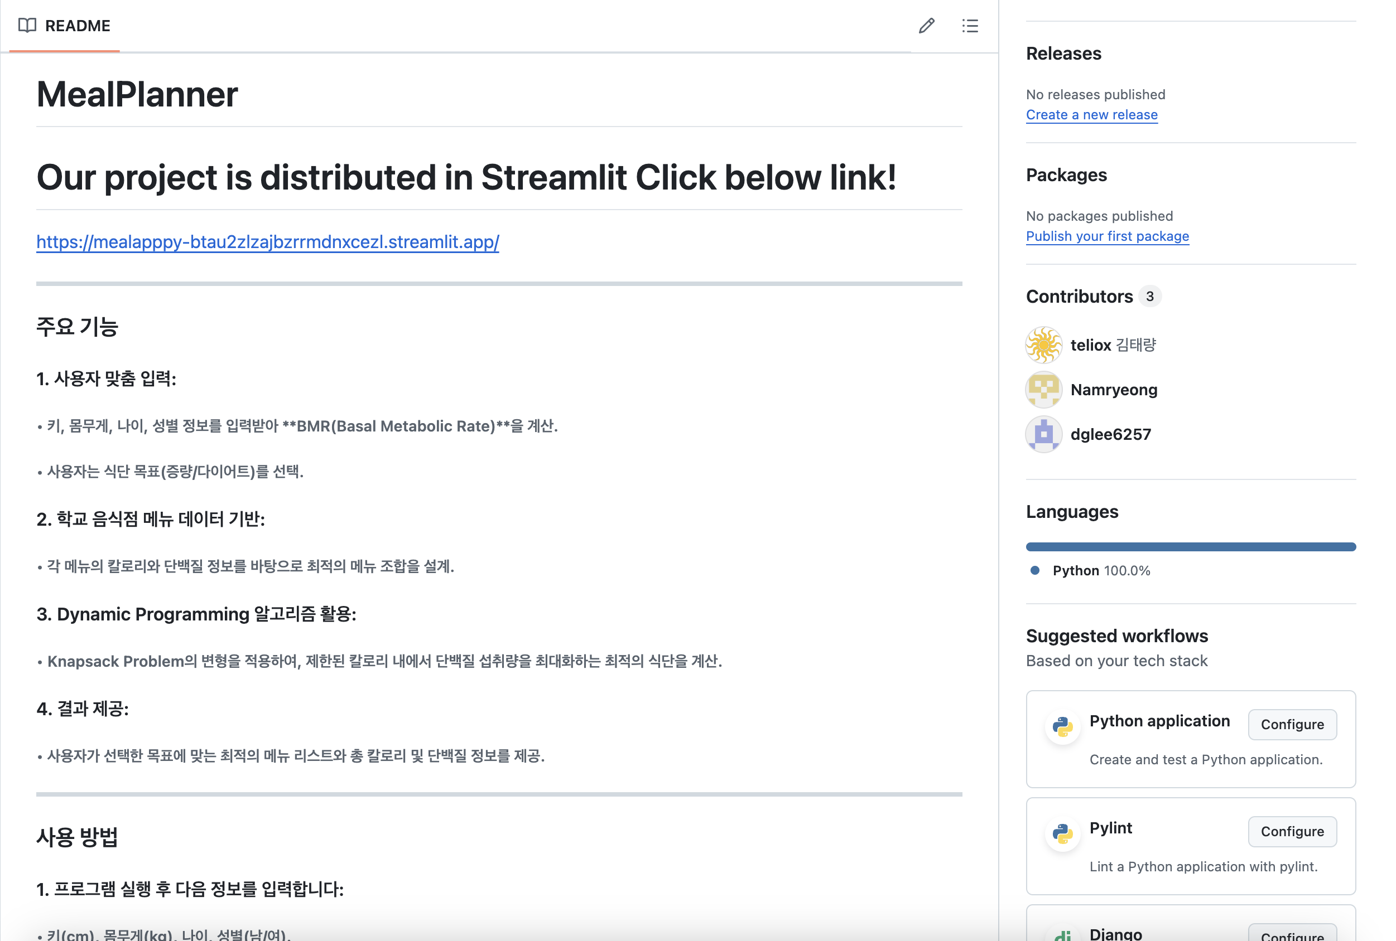
Click here!
There are additional description for our project,
And have Link for distribution

Slide 4
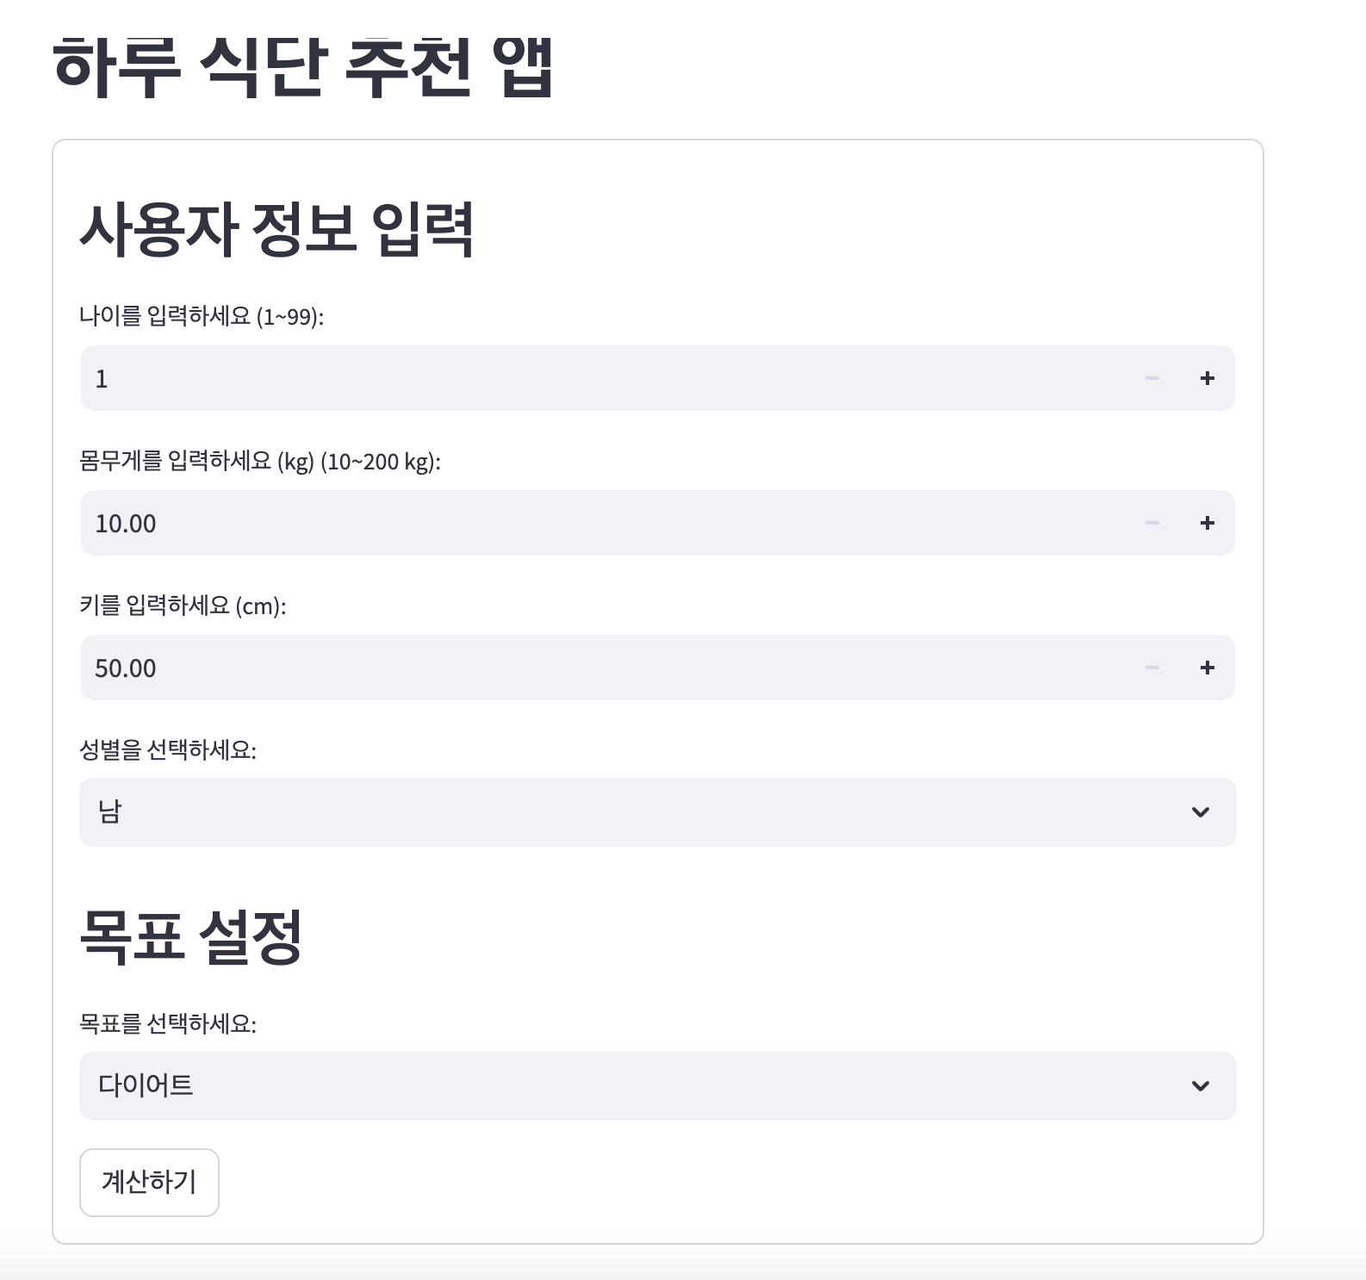
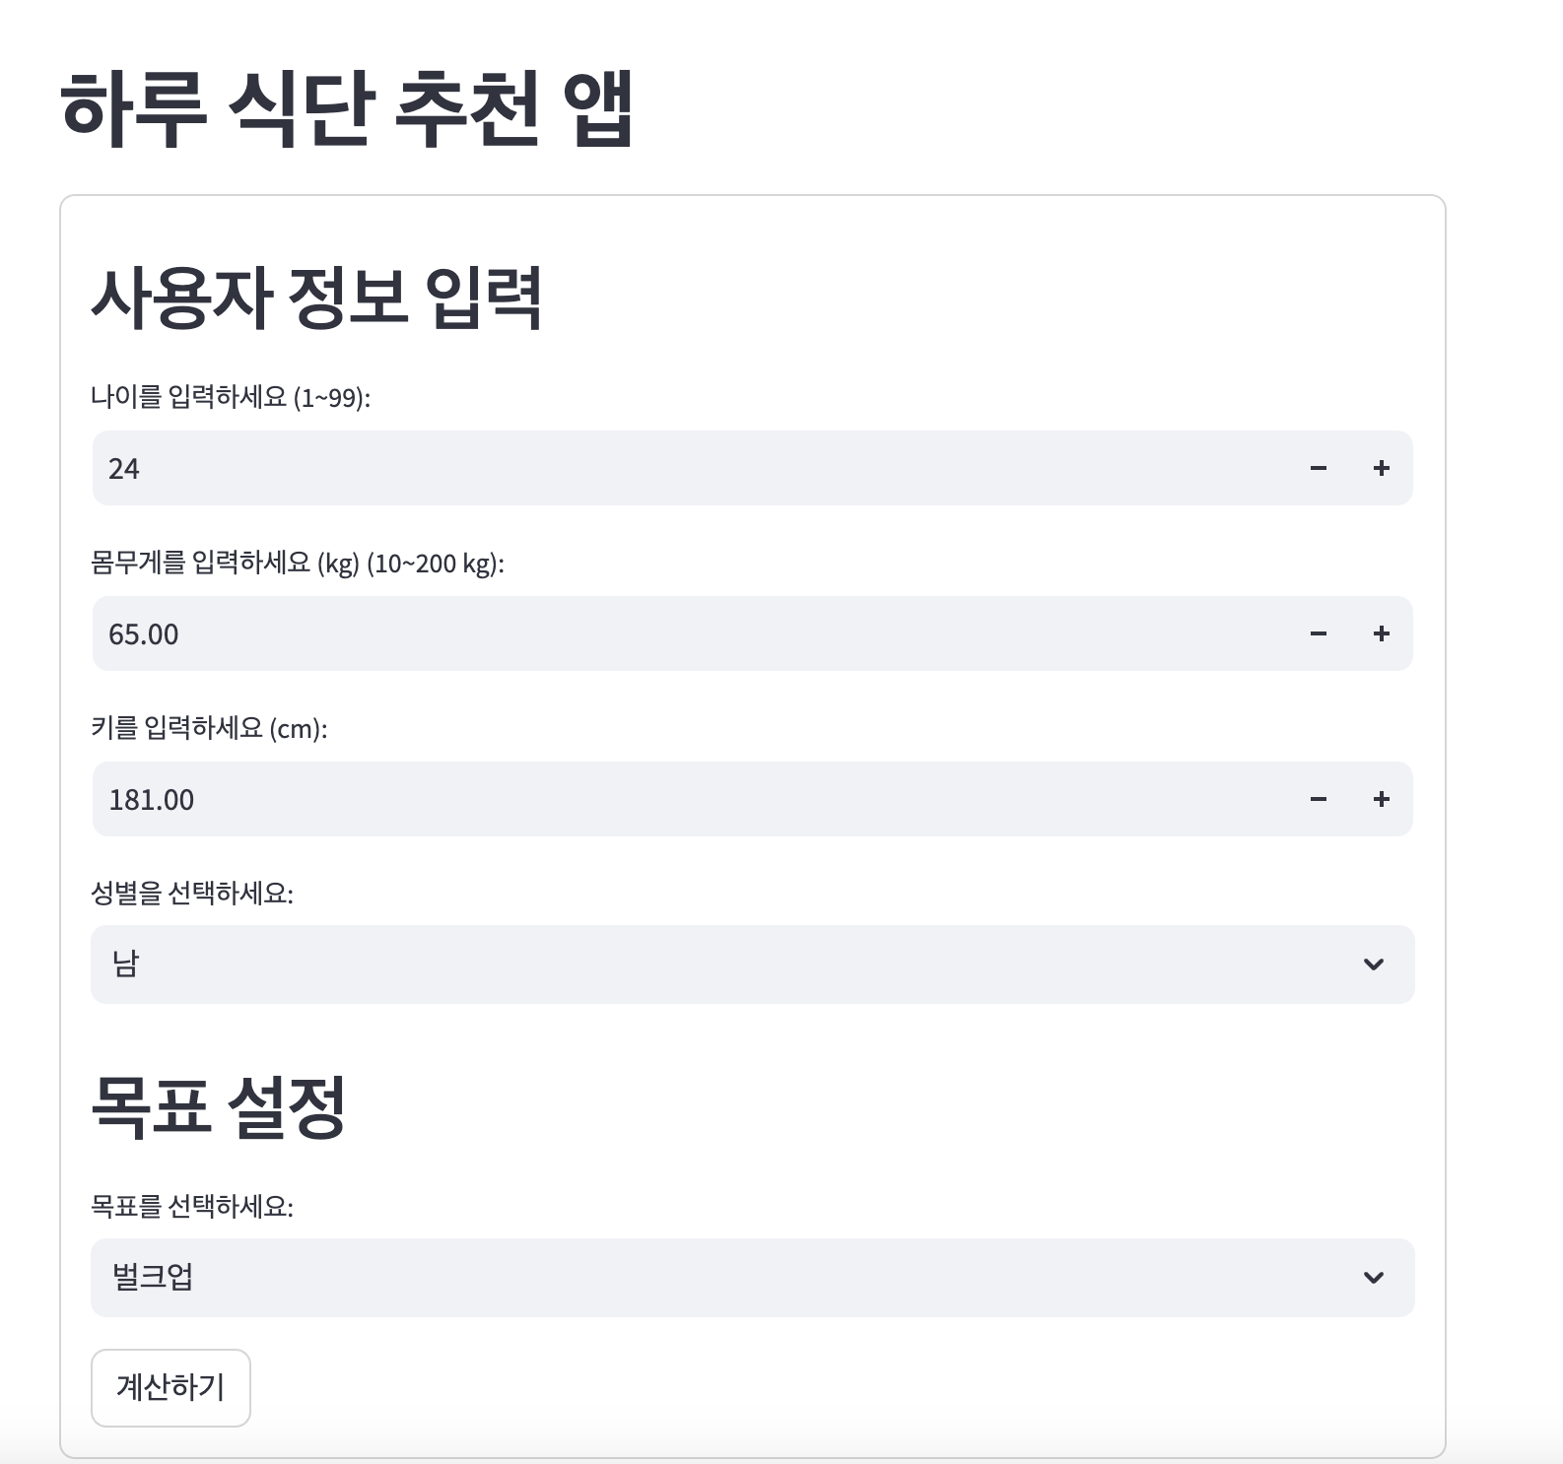
Second, Enter your Data and click 계산하기
Click

Slide 5
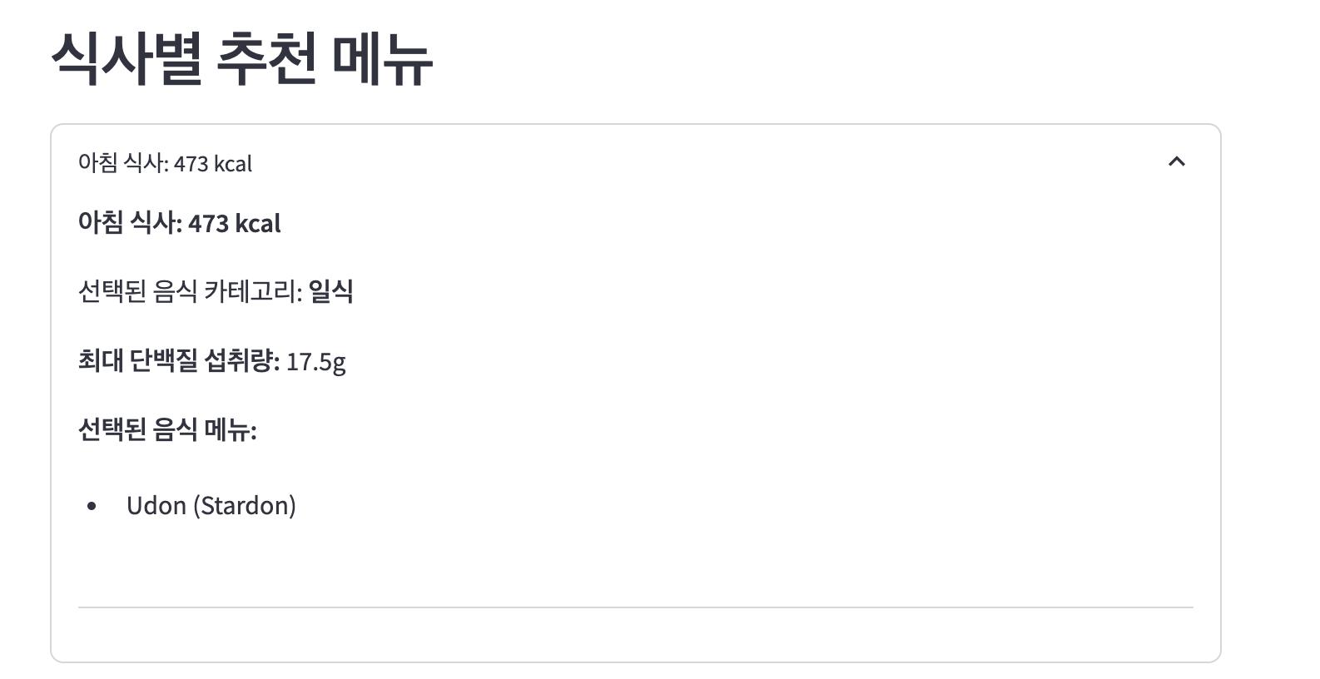
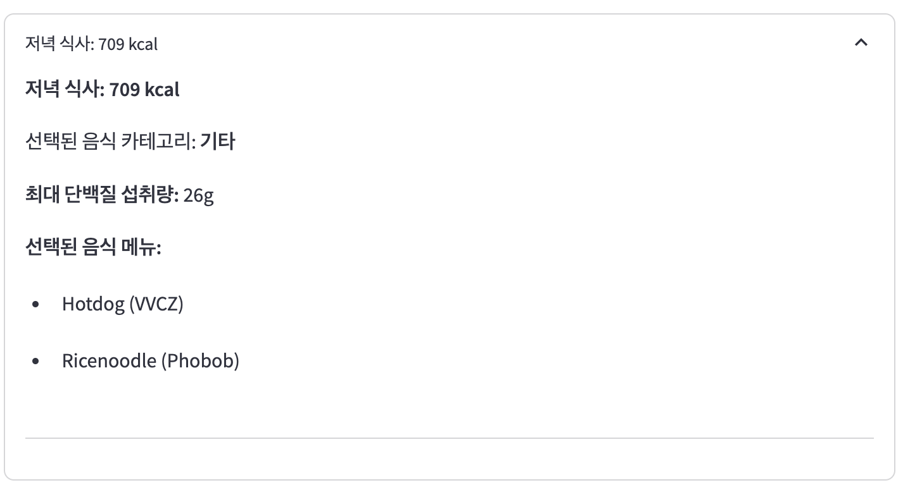
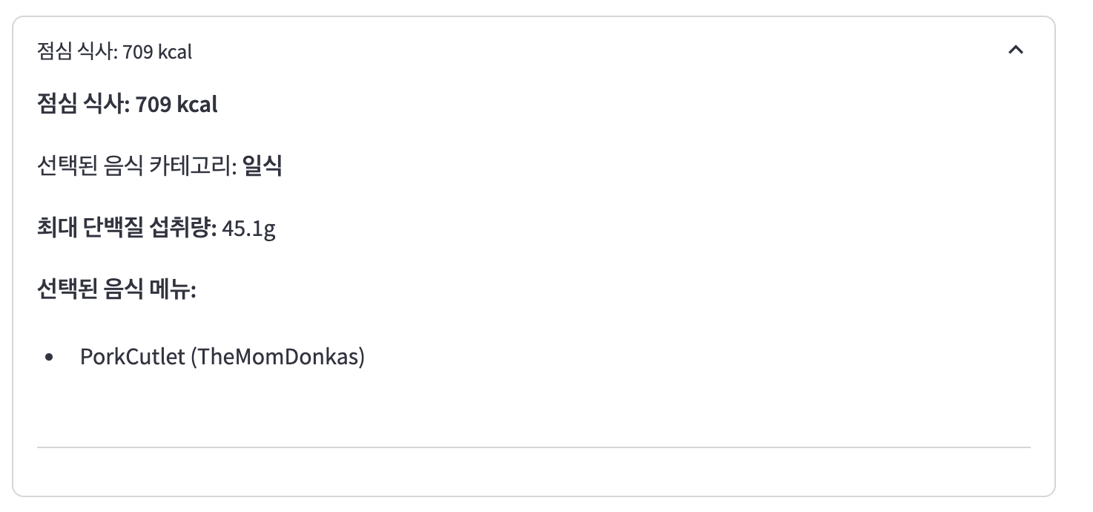
There are result about your meal plan!
Easy to use!

Slide 6
Or you can run ’mealApp.py’ on terminal through streamlit run mealApp.py (actually, can run in your IDE with no UI)

Slide 7
Execute our planner whenever you want it’s fast, easy, effective Thank you

