Slide 1
TECHNOLOGICAL UNIVERSITY (MEIKTILA) DEPARTMENT OF INFORMATION TECHNOLOGY
Driver Drowsiness Detection and Alert System
Using Ensemble of Regression Trees Algorithm
2nd Seminar
Supervised by
Daw Than Than Soe
Presented by
Mg Chit Ye Aung
VI-IT-13

Slide 2
Outlines of presentation
Abstract
Introduction
Objectives
Ensemble of Regression Trees
Training and Testing with Datasets
Flow Chart of Purposed System
Part of implemented
Conclusion

Slide 3
Abstract
Driver drowsiness is a primary cause of several hightway calamities leads to severe physical injuries, loss of money, and loss of human life.
The implementation of driver drowsiness detection in real-time will aid in avoiding major accidents.
The system is designed for driver’s fatigue or drowsiness is detected and alerts the person.

Slide 4
Introduction
Driving has become an important part of our day-to-day life, expecially in urban areas sleepiness-related accidents are occurring infrequrnt.
If the accident caused by abnormality of the driver, it can be prevented by placing abnormality detecting system within the vehicle.
It is suitable for the real-time application, because of no need for sensing electrodes.
The driver drowsiness is determined by the frequency of eye blinking and head tilting.

Slide 5
Objectives
To prevent and reduce the accidents caused by the driver getting drwosy
To detect drowsiness
To alert if the driver is going to drowsiness
To know how to apply ERT algorithm

Slide 6
Ensemble of Regression Trees
An ensemble of regression trees is a predictive method composed of a weighted combination of multiple regression trees. In general, combining multiple regression trees increases predictive performance.
An ensemble of regression trees can be used to estimate the face's landmark positions directly from a sparse subset of pixel intensities, achieving super-realtime performance with high quality predictions.
It is based on gradient boosting for learning an ensemble of regression trees that optimizes the sum of square error loss and naturally handles missing or partially labelled data.

Slide 7
Training and Testing with Datasets
Training Datasets
Test Data
Preprocessing
Generated Model
ERT Algorithm
Eye’s Landmark
Generated Model

Slide 8
Flow Chart of Purposed System
Start
Read Video from Camera
Covert to numpy array
Calculate EAR
Generated Model
Eye’s Landmark Location
Drowse?
No
Close?
No
Yes
Alert
Yes
End

Slide 9
Part of implemented
Installing the necessary packages in python
pip install numpy
pip install dlib
pip install imutils
pip install opencv-python
Downloading Datasets
http://dlib.net/files/data/ibug_300W_large_face_landmark_dataset.tar.gz

Slide 10
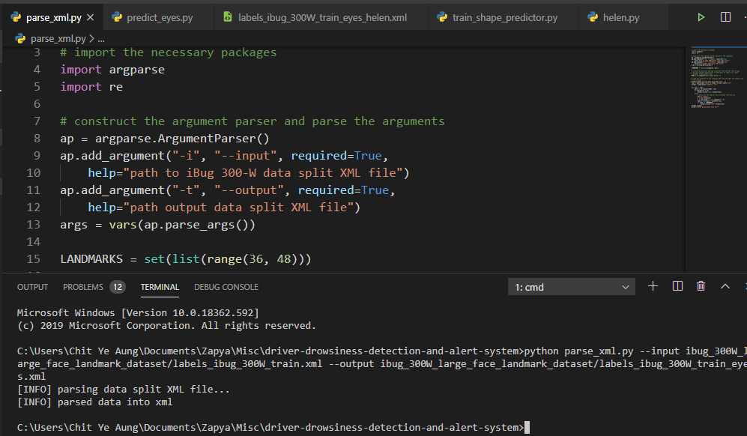
Cont’d
Parsing eye’s data into xml

Slide 11
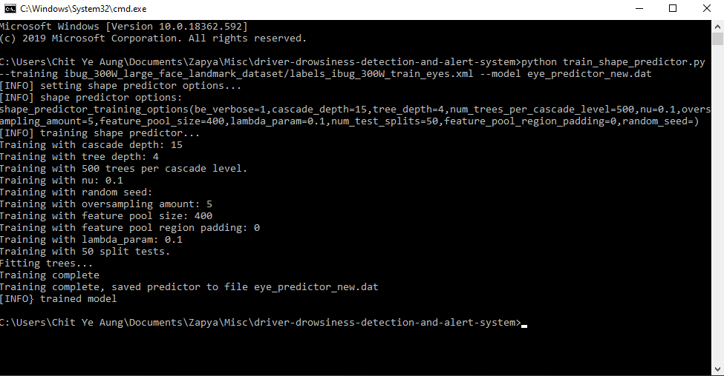
Cont’d
Training Datasets

Slide 12
Conclusion
Driver drowsiness detection is designed mainly to keep the driver awake while driving to avoid the accident to sleepiness.

Slide 13
Thank you for your attention

