Slide 1
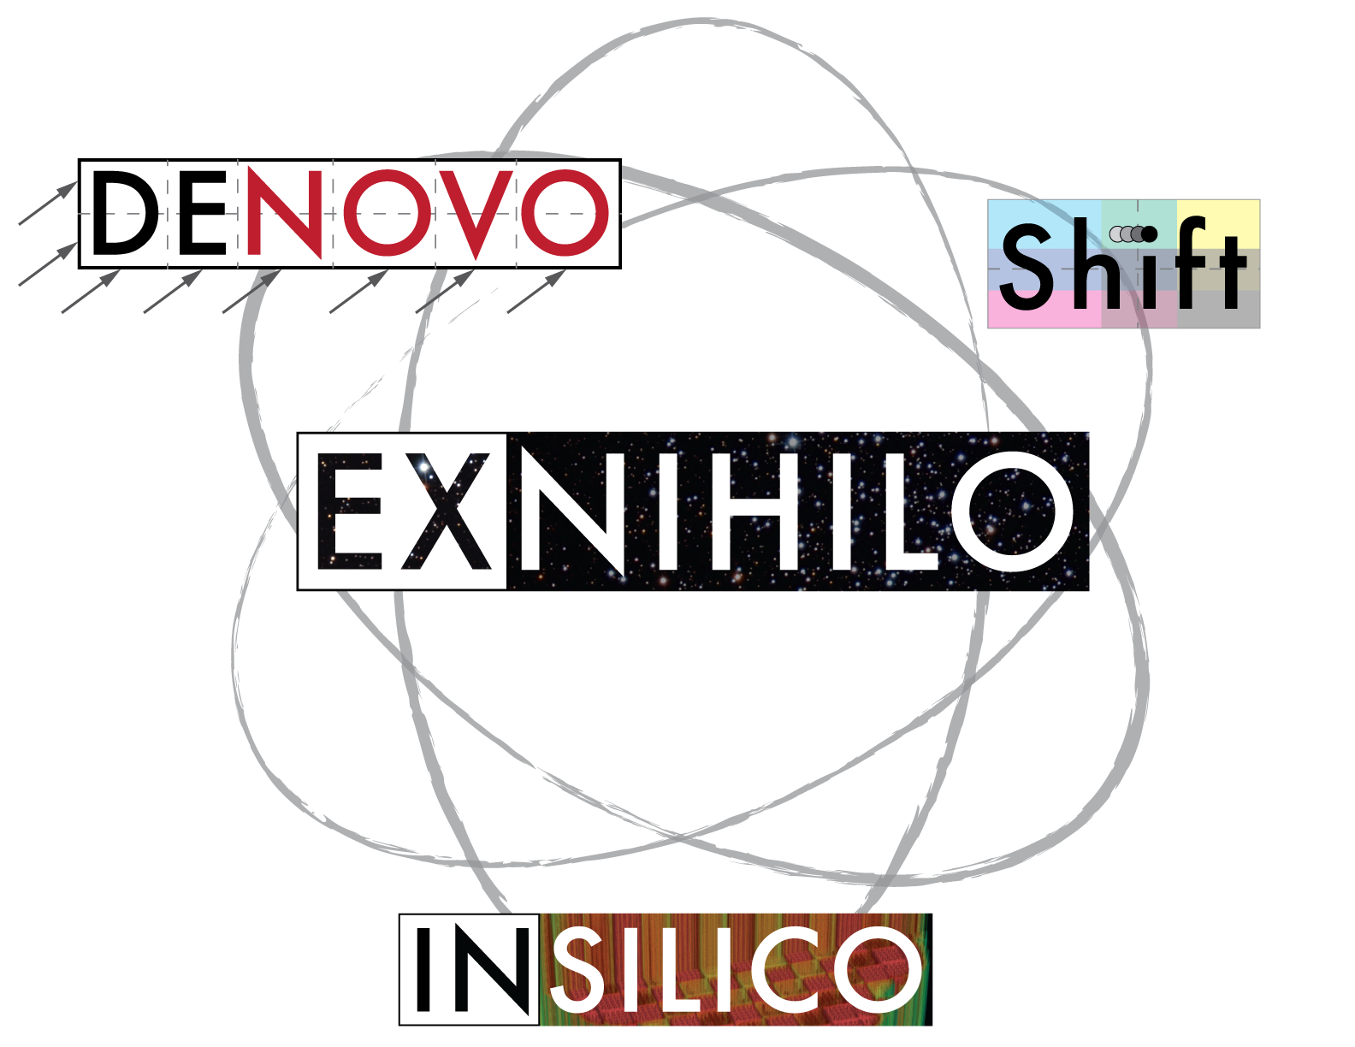

Profugus Mini-Application
Extracts core computational kernels from the Exnihilo transport code suite
Denovo: deterministic transport solvers
Discrete ordinates (S_{N})
Simplified Spherical Harmonics (SP_{N})
Method of Characteristics (MOC)
Shift: Monte Carlo (stochastic) transport
Insilico: Reactor neutronics
Couples cross section processing, reactor problem configurations, output with Denovo deterministic and Shift Monte Carlo transport solvers
Exnihilo is export-controlled.
Makes collaborations with the general computer and computational science community difficult.
It is an integral part of the CASL-hub reactor simulation software VERA that has been released through RSICC.
Provide open-source kernels that effectively capture the algorithmic features of the full applications

Slide 2
Current Status
Profugus currently provides an implementation of Denovo’s SP_{N} solver and Shift’s Monte Carlo kernel:
Fixed-source and eigenvalue modes
Supports same suite of Trilinos solvers as Exnihilo’s Denovo SP_{N} package
XML-driven input allows easy generation of simplified reactor problems
Effectively captures solver complexity
Generic material cross section libraries are provided that capture the salient physics of reactor simulations
Monte Carlo domain replication parallelism

Slide 3
Profugus Requirements
Capture salient physics embedded in Exnihilo production code.
Non-export controlled (currently under DOE review)
Planned release on external ORNL-hosted GitHub site as soon as review is complete.
Minimal Third-Party-Dependencies
Trilinos/LAPACK/BLAS required
HDF5 optional
C⁺⁺-11 supported
Uses Trilinos’ TriBITS build system
Extensions to cmake

Slide 4
SP_{N} Equations
SP_{N} is a “naïve” extension of 1-D P_{N} equations to higher dimensions (though an asymptotic derivation is possible)
1-D P₃ Equations
Multi-D SP₃ Equations

Slide 5
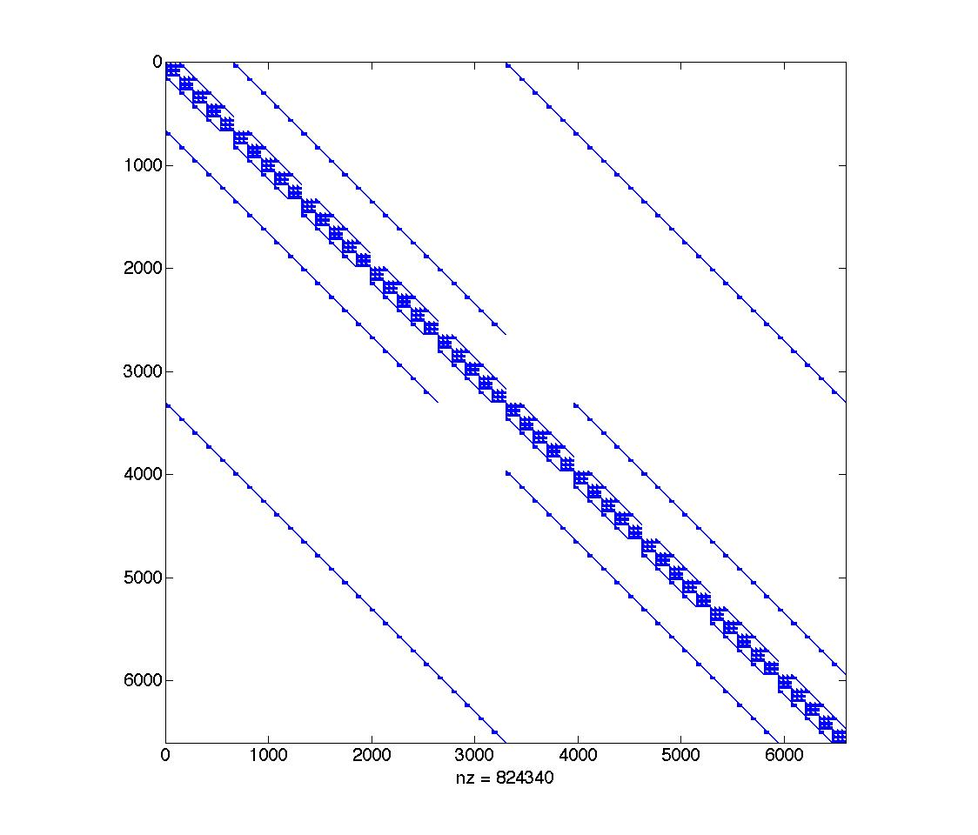
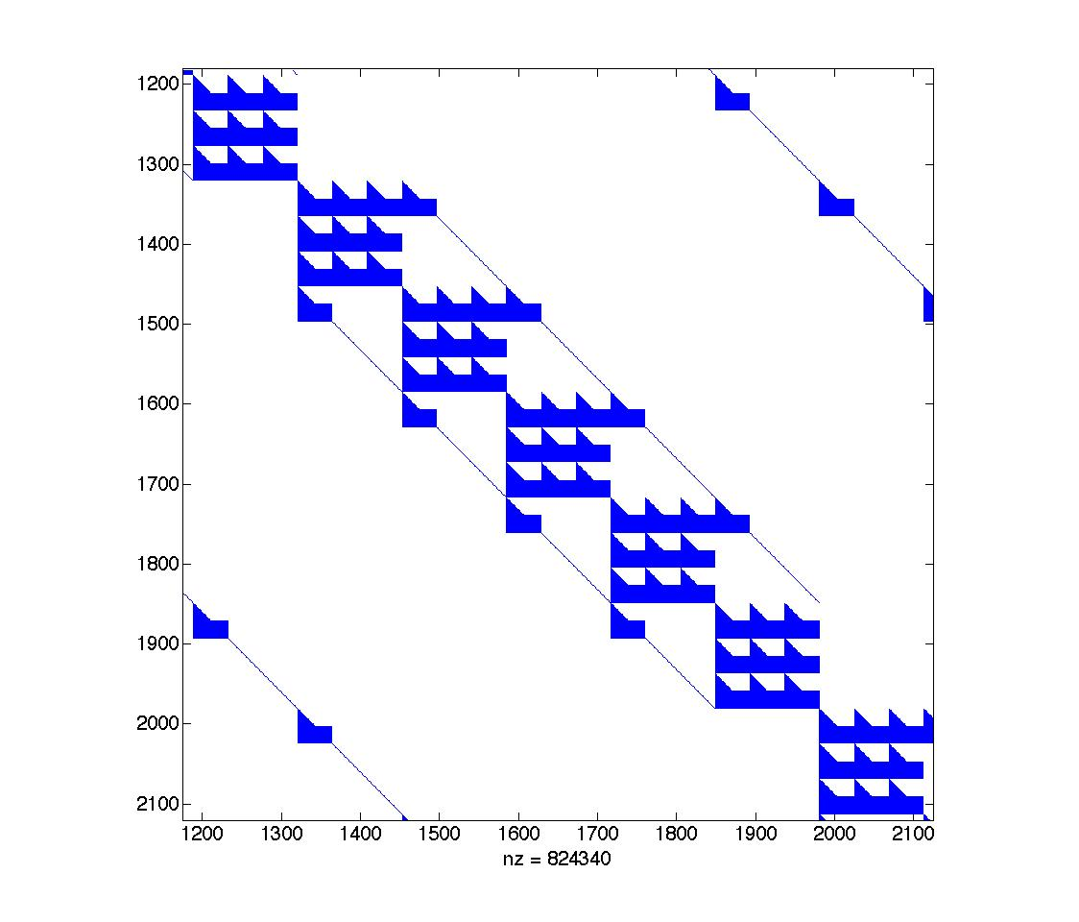
Denovo SP_{N} Implementation
Unlike S_{N} transport, which is necessarily matrix-free, it is possible to explicitly construct the SP_{N} matrices
Placing energy as innermost variable enables cache-efficient operations on dense blocks
Opens door for algebraic preconditioning strategies

Slide 6
Profugus SP_{N} Implementation
Finite volume discretization (2nd order accurate)
Arnoldi and generalized Davidson eigensolvers
Davidson solver recently contributed to the Anasazi package of Trilinos
Numerous linear solvers through Trilinos (AztecOO)
Preconditioning options include incomplete factorizations (AztecOO and Ifpack) and algebraic multigrid (ML)
Spatial parallelism using KBA partitioning
Allows significant reuse of components designed for S_{N} discretizations

Slide 7
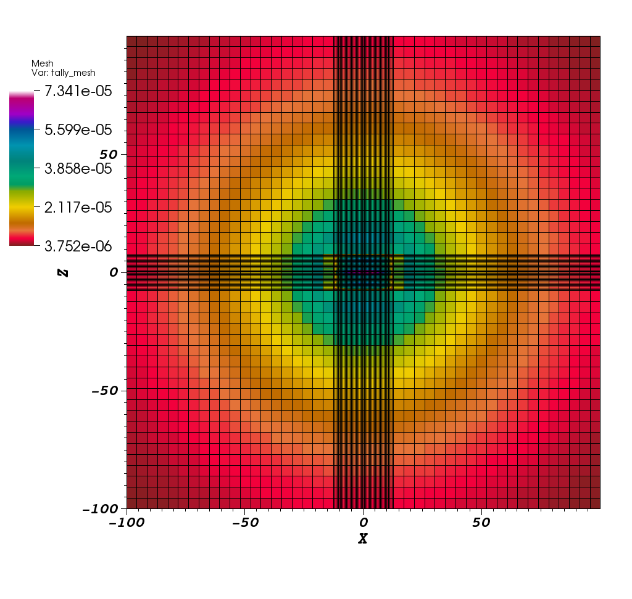
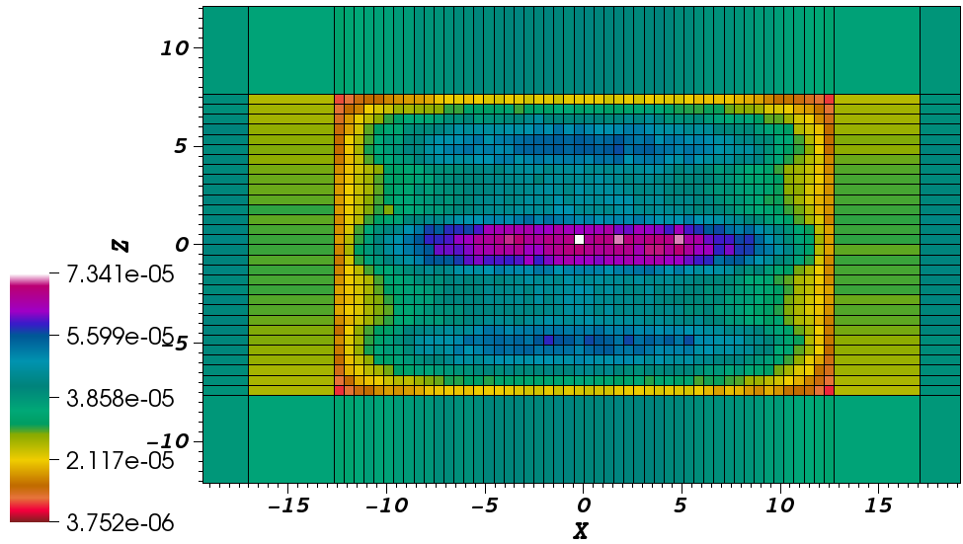
Shift Monte Carlo Implementation
Flexible, high-performance Monte Carlo framework
Shift is physics agnostic
Simplified multigroup physics (P₀ only)
SCALE CE physics
MCNP CE physics (incomplete
Shift is geometry agnostic
MCNP geometry
Atlas/KENO geometry (in progress)
Exnihilo RTK geometry
DagMC-CUBIT CAD geometry (in progress)
Shift is designed to work from laptops to supercomputers
Uses Multi-set/Overlapping Domain (MSOD) parallel algorithm
Panda benchmark showing non-uniform mesh tally

Slide 8
Profugus Monte Carlo Kernel
Multigroup physics
Simplified tally system
Keff and path-length flux
Single geometry support (RTK)
Supports same geometries as Profugus SP_{N} kernel
Incomplete MSOD parallelism
Full domain-replication only (no decomposed spatial domains)

Slide 9
ASCR Profugus Projects
XPRESS
MCREX
Use HPX (http://stellar.cct.lsu.edu) to accelerate SPN and Monte Carlo algorithms
Particular focus on applying HPX to hybrid (SP_{N}-accelerated Monte Carlo) algorithms
Use Monte Carlo Linear Solvers to solve SPN equations
MCLS library is a Trilinos-solver package (unreleased) that can be switched at runtime
Investigate concurrency using HPX with MCLS

