Slide 1
Monte Carlo Synthetic Acceleration as Approximate Polynomial Preconditioning
Steven Hamilton
Tom Evans
Stuart Slattery
Oak Ridge National Laboratory

Slide 2
Motivation
As we move towards exascale computing, the rate of errors is expected to increase dramatically
Algorithms need to not only have increased concurrency/scalability but have the ability to recover from faults

Slide 3
Towards Exascale Concurrency and Resiliency
Two basic strategies:
Start with current “state of the art” methods and make incremental modifications to improve scalability and fault tolerance
Start with methods with natural scalability and resiliency features and work at improving performance
One possibility: Monte Carlo

Slide 4
Synthetic Acceleration
Nomenclature from particle transport community
No formal definition, typically refers to acceleration (preconditioning) of fixed point iteration with low order approximation of problem
Initial Richardson iteration is crucial (smoothing)
Examples: DSA, TSA, S2SA

Slide 5
Monte Carlo Synthetic Acceleration (MCSA)
Standard synthetic acceleration algorithm, but use Monte Carlo process as preconditioner
Unlike particle transport Monte Carlo algorithms, random walks are purely algebraic rather than physics-based
Based on Halton’s sequential Monte Carlo algorithm for linear systems

Slide 6
Adjoint Monte Carlo
Want to solve linear system Ax=b
Use Neumann series expansion of solution:
Converges if ρ(H)<1
Decompose adjoint of H into element-wise product of transition probability matrix (P) and weight matrix (W):
Typically rows of P chosen to be probability distribution functions with magnitudes based on elements in row of H^{T}

Slide 7
Preconditioning
H formed from Richardson iteration on preconditioned system:
We require explicit representation for preconditioned matrix
Sparsity of preconditioner does not imply sparsity of H
Developing preconditioners resulting in sparse H is an area for future work

Slide 8
Example
Suppose history current resides in state 3
20% chance of transition to state 1, 80% chance to state 2
Weight of history multiplied by 0.5
Solution updated by: x_{i} = x_{i} + w

Slide 9
Starting and stopping random walk
To determine the initial state and weight of particle, sample right hand side vector:
In MCSA, b is the residual corresponding to the current iterate: more particles started in locations where residual is large
Terminate history when particle weight decreases by prescribed amount:

Slide 10
Previous Success with MCSA
Evans, Mosher, Slattery, Hamilton, “A Monte Carlo Synthetic-Acceleration Method for Solving the Thermal Radiation Diffusion Equation,” JCP 258 (2014)
Radiation diffusion Marshak wave problem
Transient 100ns in duration
Solver | Total Iterations | Relative Time Per Iteration | Relative Total Time
CG (ML) | 12150 | 74.7 | 2.7
GMRES (ILU) | 40294 | 103.0 | 9.2
MCSA (Jacobi) | 98863 | 1.0 | 1.0

Slide 11
Weight vs. History Length Cutoff
JPWH_991 matrix from Matrix Market
MCSA w/diagonal preconditioning (ρ(I-D⁻¹A)≈0.98)
Statistically noisy approximation to full Neumann series far worse than good approximation to a few terms
Iteration Count to Convergence
 | Weight Cutoff |  | History Length Cutoff
# Histories | 1e-4 | 0.5 | 10 | 20 | 40
100 | - | - | 269 | 356 | -
400 | 232 | 234 | 56 | 186 | 220
1600 | 206 | 200 | 57 | 31 | 179
6400 | 185 | 169 | 57 | 32 | 16
25600 | 159 | 128 | 57 | 31 | 17

Slide 12
Weight vs. History Length Cutoff
JPWH_991 matrix from Matrix Market
MCSA w/diagonal preconditioning (ρ(I-D⁻¹A)≈0.98)

Slide 13
Weight vs. History Length Cutoff
JPWH_991 matrix from Matrix Market
MCSA w/diagonal preconditioning (ρ(I-D⁻¹A)≈0.98)
Statistically noisy approximation to full Neumann series far worse than good approximation to a few terms

Slide 14
Truncated Neumann Series
Terminating Neumann series after relatively small number of terms leads to better statistical behavior
Monte Carlo process approximates application of Neumann series polynomial to a vector
Why stop with Neumann series?
Monte Carlo tally: x_{i} = x_{i} + c_{m}w
Contribution to solution depends on current “stage” in history

Slide 15
Polynomial Preconditioning
Choose polynomial p_{n}(x) such that p_{n}(A)≈A⁻¹
Typically desirable to make I-p_{n}(A)A “small”
One approach: let q_{n+1}(A)=I-p_{n}(A)A, choose q_{n+1} such that
q_{n+1} is the Chebyshev polynomial T_{n+1}(αI+βA)
α,β related to extremal eigenvalues of A

Slide 16
Neumann vs. Chebyshev Polynomials
Iteration Counts to Convergence
 | Neumann Polynomial Order |  |  |  | Chebyshev Polynomial Order
# Histories | 5 | 10 | 20 | 40 | 1 | 2 | 3 | 4
250 | 96 | 48 | 216 | 251 | 143 | - | - | -
1000 | 99 | 57 | 29 | 194 | 126 | - | - | -
4000 | 98 | 57 | 32 | 48 | 124 | 64 | - | -
16000 | 97 | 57 | 31 | 17 | 123 | 63 | 38 | -
64000 | 97 | 57 | 31 | 17 | 122 | 63 | 39 | -
256000 | 97 | 57 | 31 | 17 | 122 | 63 | 39 | 27
For given polynomial order, Chebyshev polynomials result in much lower iteration count
Far more histories required for stability
Chebyshev coefficients increase exponentially

Slide 17
Neumann vs. Chebyshev Polynomials
Relative Timing to Convergence
 | Neumann Polynomial Order |  |  |  | Chebyshev Polynomial Order
# Histories | 5 | 10 | 20 | 40 | 1 | 2 | 3 | 4
250 | 2.4 | 1.0 | 2.6 | 3.0 | 1.4 | - | - | -
1000 | 2.6 | 2.4 | 2.6 | 3.4 | 2.5 | - | - | -
4000 | 4.5 | 4.5 | 3.6 | 4.4 | 6.8 | 5.1 | - | -
16000 | 8.4 | 8.4 | 8.1 | 6.8 | 23.9 | 19.4 | 15.1 | -
64000 | 15.8 | 16.1 | 17.0 | 11.4 | 93.9 | 74.0 | 64.1 | -
256000 | 31.1 | 32.3 | 33.6 | 33.8 | 365.6 | 292.1 | 256.3 | 228.9
For comparison, GMRES(10) with same preconditioner took 70 iterations and relative timing of 1.5

Slide 18
SP_{N} Equations
SP_{N} approximation to Boltzmann neutron transport equation
Series of coupled diffusion equations (moment and energy)
More accurate than standard diffusion approximation for nuclear reactor problems, easier to solve than transport

Slide 19
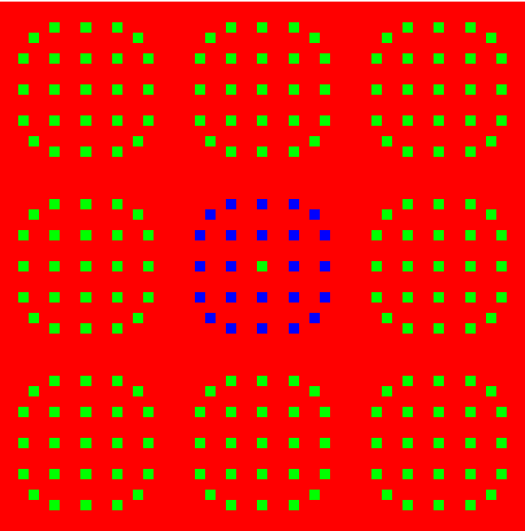
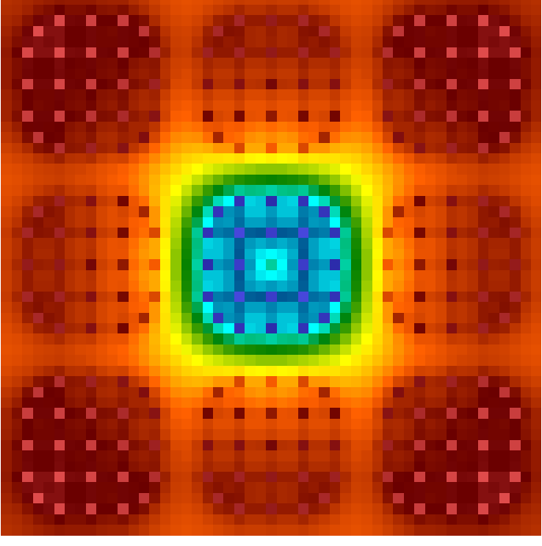
Reactor Assembly Problem
2601 mesh cells
3x3 array of assemblies in 2D
Each assembly is 17x17 array of fuel pins
1 mesh cell per pin
Homogenized cross sections
23 energy groups
SP₃ (2 moment equations)
120k total unknowns, 6.8M nonzeros
Δt=10⁻⁶
Block diagonal preconditioning
Block size is number of energy groups
ρ(H)=0.99

Slide 20
Reactor Assembly Results
Iteration Counts to Convergence
 | Neumann Polynomial Order |  |  | Chebyshev Polynomial Order
# Histories | 5 | 10 | 20 | 1 | 2 | 3
25k | 347 | 376 | - | - | - | -
50k | 286 | 106 | 464 | - | - | -
100k | 178 | 104 | 364 | 300 | - | -
200k | 175 | 103 | 62 | 260 | - | -
400k | 174 | 102 | 59 | 250 | - | -
800k | 174 | 102 | 58 | 250 | - | 453
1.6M | 174 | 102 | 57 | 251 | - | 77
Similar behavior as simpler problem
More histories required for stability (larger dimension and higher spectral radius)

Slide 21
Reactor Assembly Results
Relative Timing to Convergence
 | Neumann Polynomial Order |  |  | Chebyshev Polynomial Order
# Histories | 5 | 10 | 20 | 1 | 2 | 3
25k | 1.3 | 1.2 | - | - | - | -
50k | 1.6 | 1.0 | 2.2 | - | - | -
100k | 3.1 | 2.2 | 2.7 | 2.0 | - | -
200k | 6.2 | 4.8 | 1.9 | 3.7 | - | -
400k | 13.9 | 10.5 | 4.6 | 6.4 | - | -
800k | 27.1 | 22.9 | 10.1 | 12.3 | - | 12.1
1.6M | 49.2 | 45.7 | 22.4 | 23.1 | - | 13.7
GMRES approximately factor of 5 faster than best case (124 iterations)

Slide 22
Parallel Performance

Slide 23
Conclusions
Truncating Neumann series leads to improved statistical behavior in adjoint Monte Carlo process
Better iterative convergence with fewer histories in MCSA algorithm
Replacing Neumann series with Chebyshev polynomials can further reduce iteration counts
Statistical properties far worse than Neumann series
Not currently competitive, may change with parallelism

Slide 24
Difficulties, Opportunities, Future Work
Spectral radius must be less than 1
Preconditioning while maintaining sparsity
Alternate polynomials to approximate A⁻¹
Better convergence than Neumann, better statistical behavior than Chebyshev
GMRES polynomial?
Hybrid parallelism
Good scaling in both MPI and OpenMP individually
Possibly overlapping additive Schwarz, minimal communication
Strong potential for GPU, Xeon Phi

Slide 25
Acknowledgements
Funding for this work was provided by a DOE Advanced Scientific Computing Research (ASCR) grant
This work was authored by UT-Battelle, LLC, under Contract No. DE-AC05-00OR22725 with the US Department of Energy.

