Slide 1
S-GEMS Warm-up
Modeling Uncertainty in the Earth Sciences

Slide 2
Getting familiar with S-GEMS
S-GEMS warm-up

Slide 3
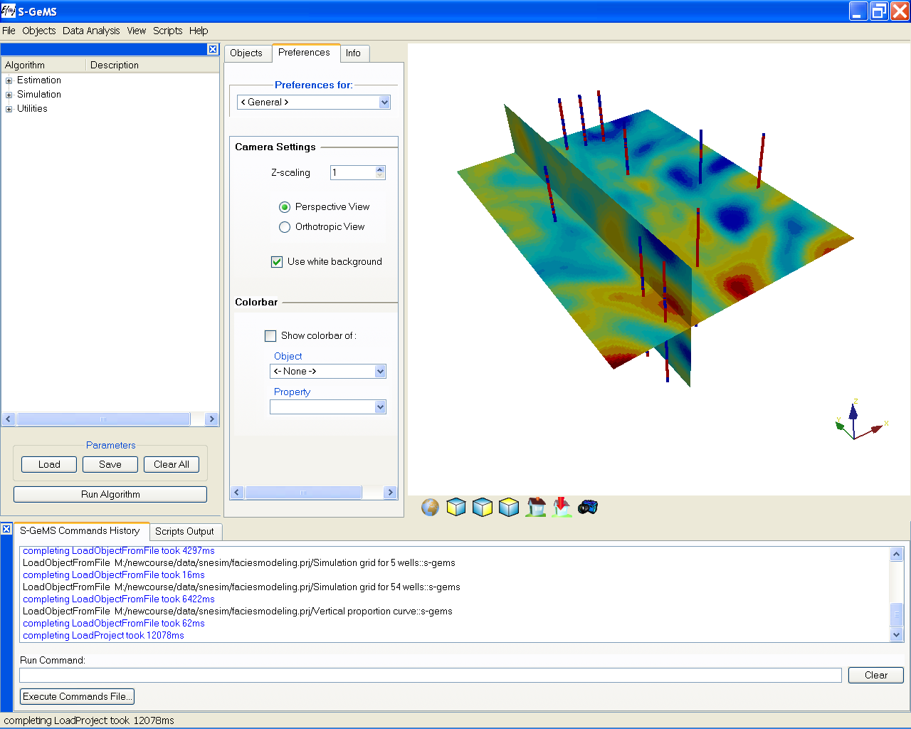
S-GEMS: Stanford Geostatistical Earth Modeling Software
http://sgems.sourceforge.net
Algorithm
panel
View
panel
Object
panel
Command
panel

Slide 4
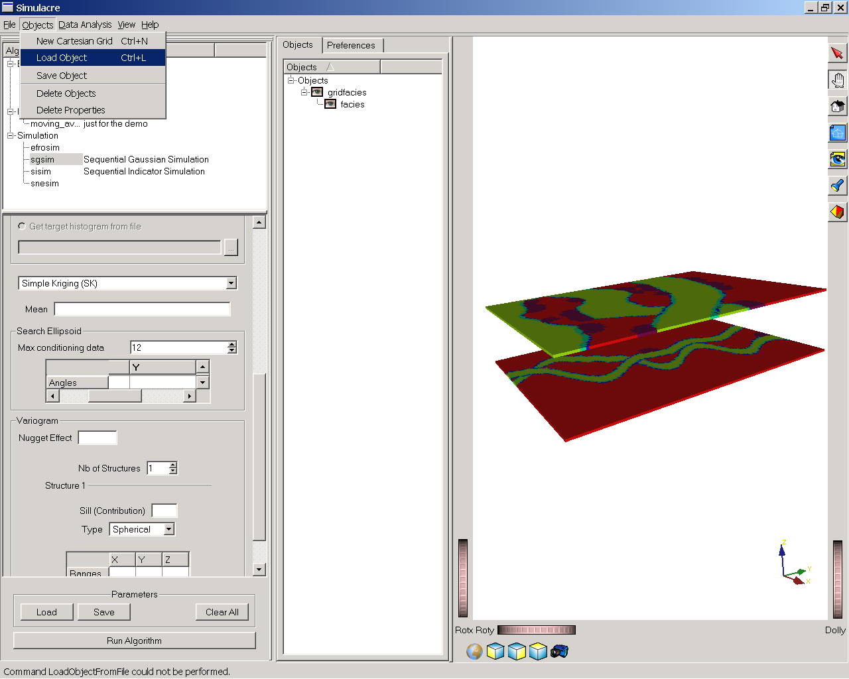
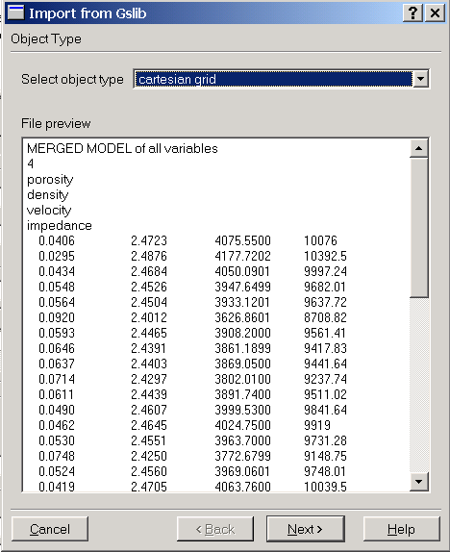
Data format
Data can be imported using “Load object”, two type of data
are used:
regularly gridded (Cartesian), or,
not gridded (point sets)

Slide 5
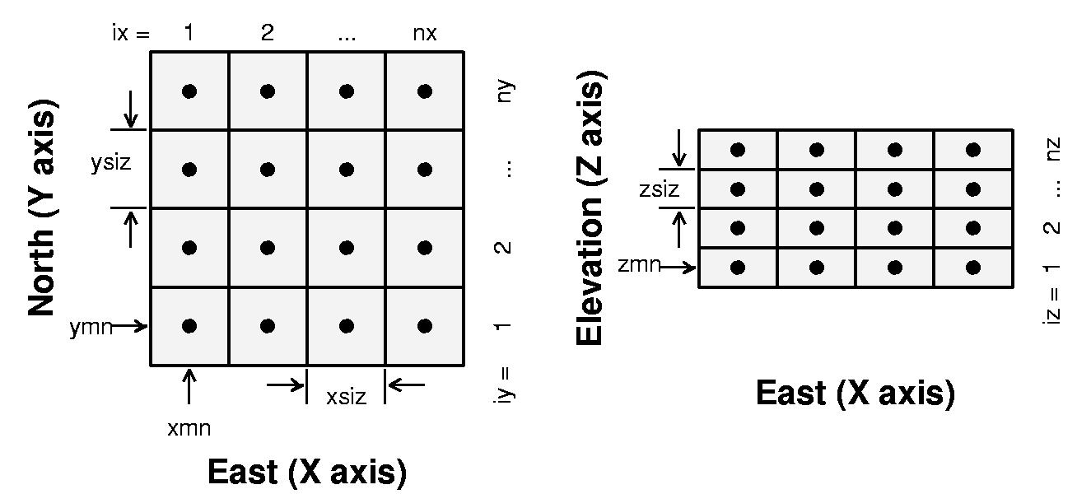
Convention for gridded data
Regular grids are uniquely defined by 9 parameters
nx, ny, nz: the grid dimension
xsiz, ysiz, zsiz: the cell size in each direction
xmn, ymn, zmn: the coordinates of the origin of the grid
Regular grids are stored/imported as arrays indexed as follows
index=(iz-1)*nx*ny+(iy-1)*nx+ix
(X cycles fastest, then Y, then Z)

Slide 6
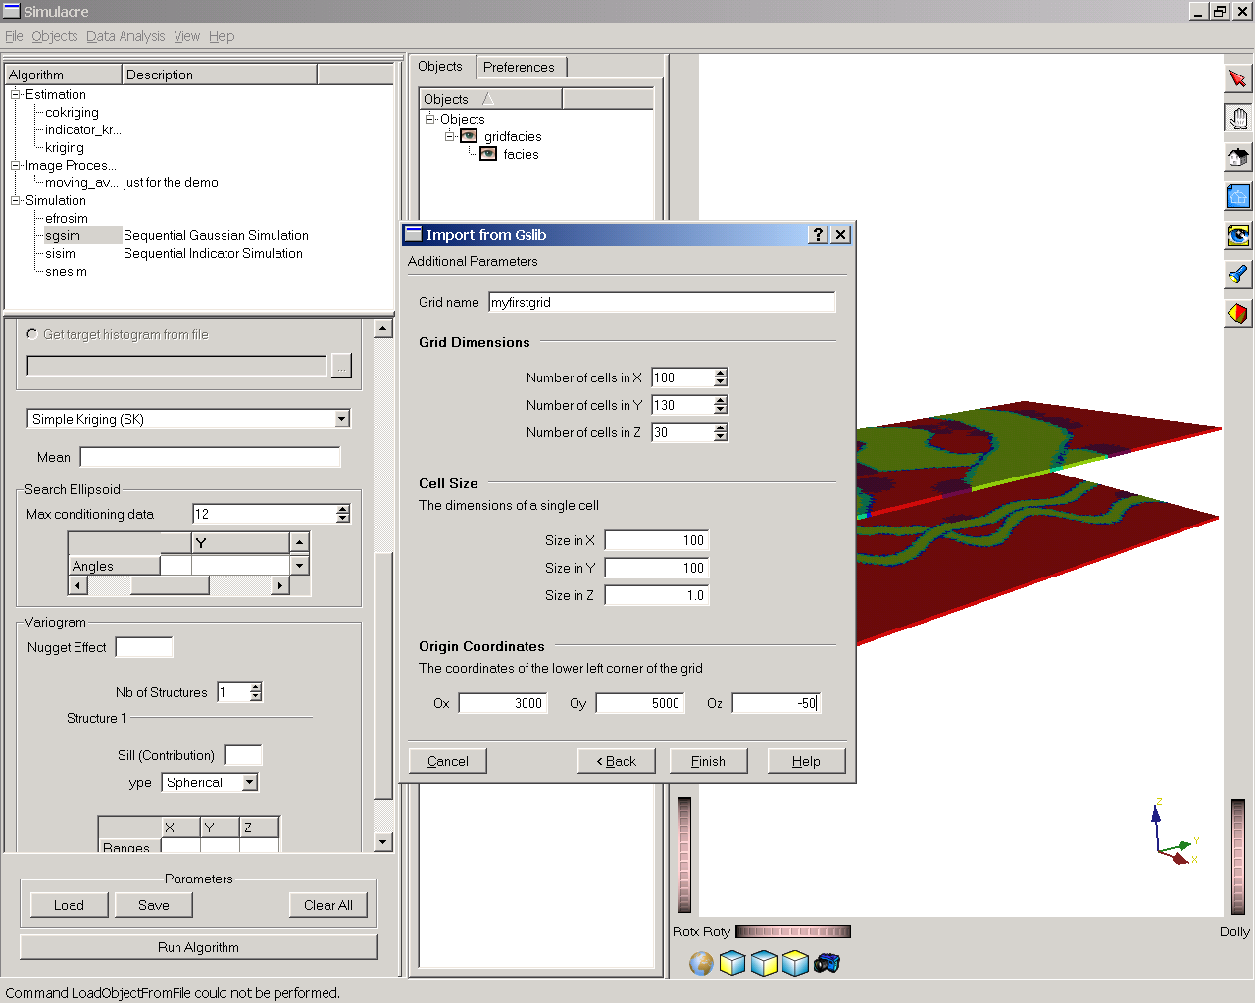
Data format
Enter a grid name
nx
ny
nz
xsiz
ysiz
zsiz
xmn
ymn
zmn

Slide 7
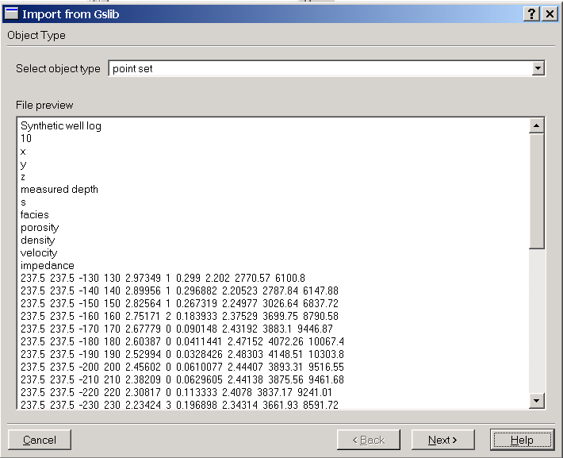
Pointset

Slide 8
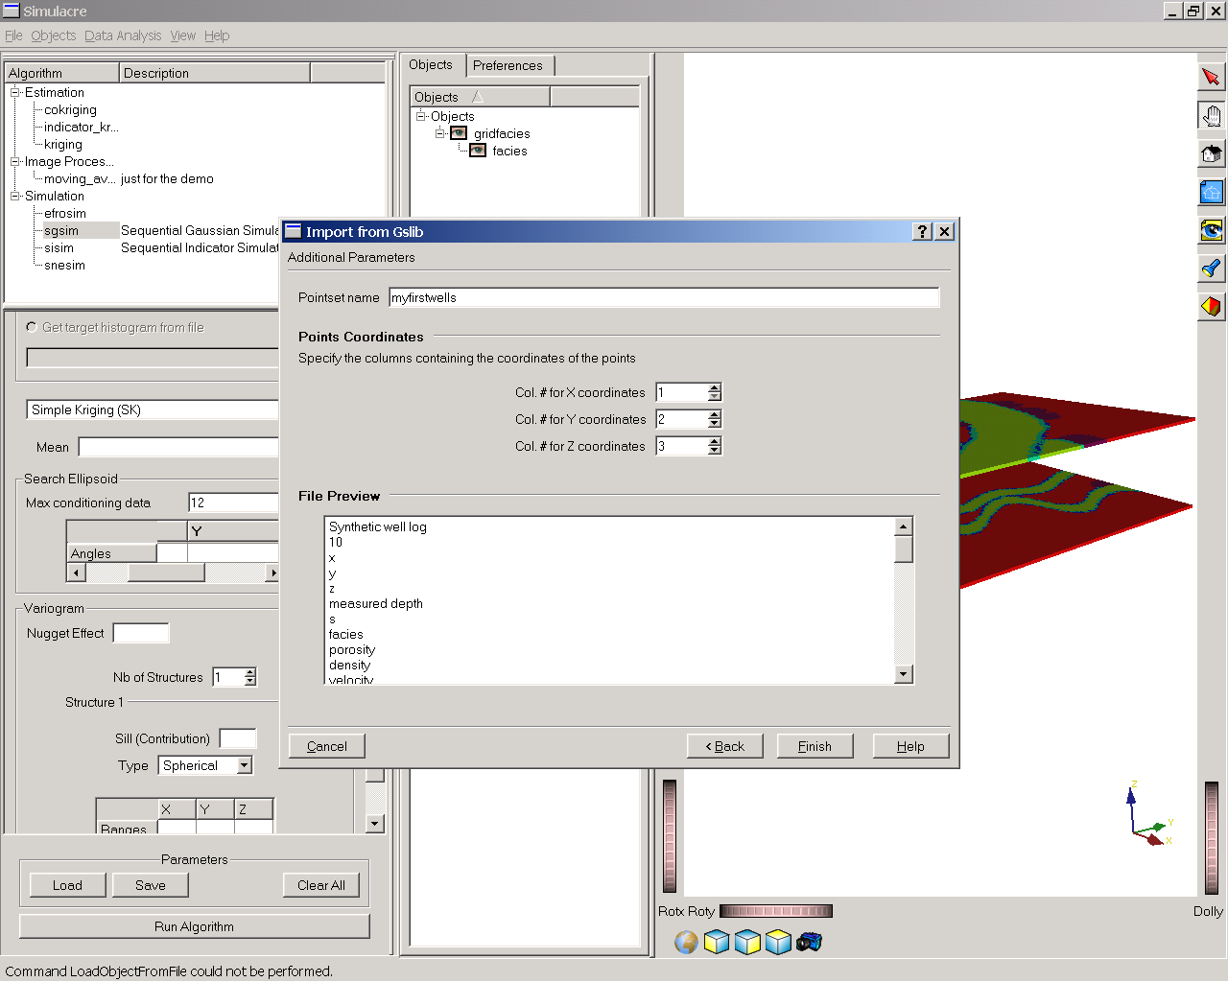
Point set
Enter a point set name

Slide 9
Exercise on S-GEMS visualization
Open the project S-GEMSviz.prj
Note how there are two types of objects, a Cartesian grid with properties and a point-set (wells)
Experiment with the visualization tools by looking under preferences in the object-panel
Load two datasets to test the data-loading capabilities
“data1.dat”, a 150 x 200 x 80 gridded dataset
“data2.dat”, a point-set

Slide 10
Exercise on EDA
Open the project S-GEMSEDA.prj
Plot the histogram of the two variables
Comment on the histogram plot
Comment on the statistics listed below the histogram
Plot the QQ-plot of those variables
Comment in the QQ-plot
Make a scatter-plot between those variables
What is the correlation coefficient ?
Is this a linear association?

