Slide 1
Task 7 Aap

Slide 2
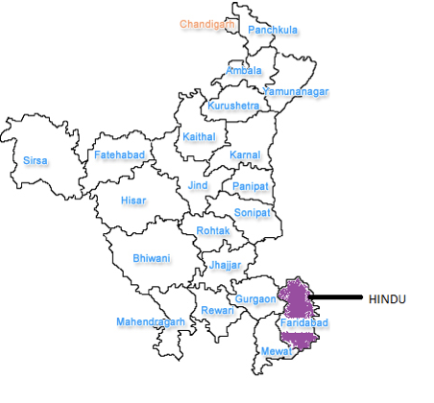
DOMINATING COMMUNITY

Slide 3
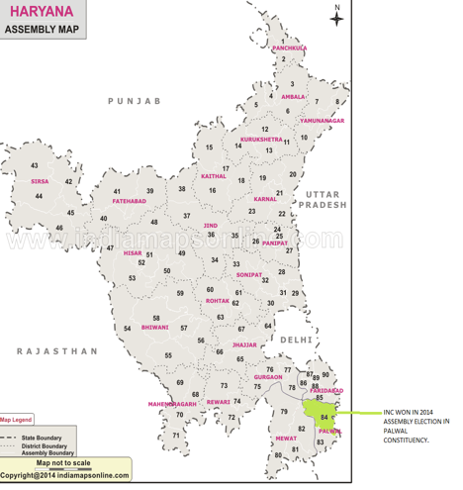
WINNER OTHER THAN BJP IN 2014 WINNE TWO TIMES IN PALWAL 21WWWWW

Slide 4
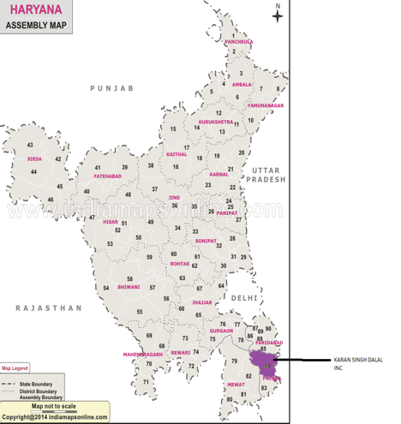
Winner two times in palwal constituency (2014 and 2005)

Slide 5
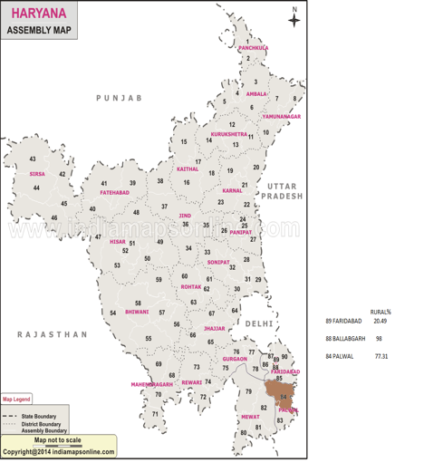
RURAL POPULATION %

Slide 6
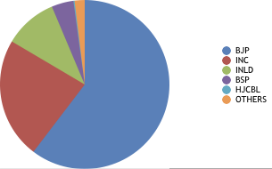
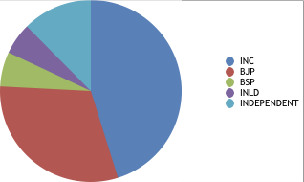
PIE CHARTS ON % OF VOTES SECURED
FARIDABAD
2014
2009

Slide 7
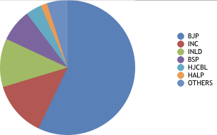
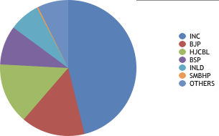
BALLABGARH
2014
2009

Slide 8
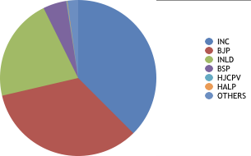
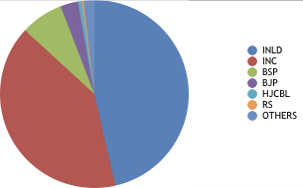
PALWAL
2014
2009

