Slide 1
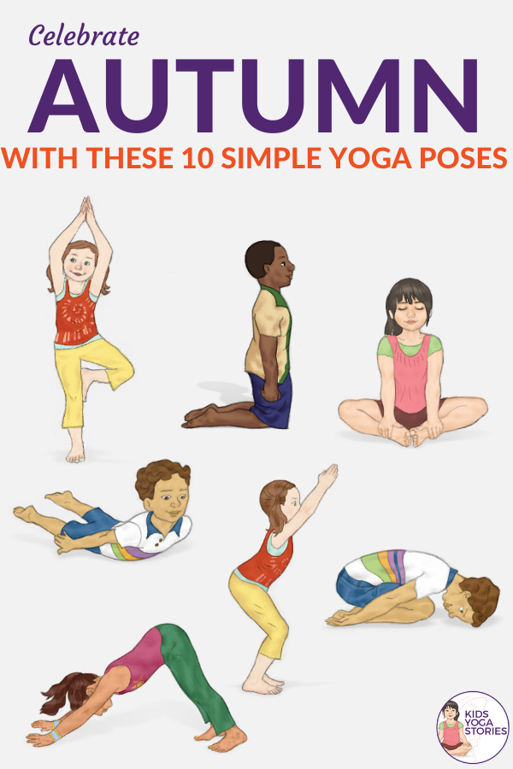

Welcome to STEM!
While you wait, please do the following…
Pin the screen I am sharing to make it big.
Make sure you are muted.
Use the bathroom if you need to!
Stand up and stretch your arms and your legs. Try these stretches!
Close your eyes and take 5 slow deep breaths - in through your nose and out through your mouth.
Think of 2 things that have made you smile this week.

Slide 2
AI and Cognitive Computing
Today we will…
Learn about how humans have developed computers with Advanced Intelligence.
This is important because…
Seeing how humans have developed robots to think will help us when we need to create our own algorithm for our robots.
We will be successful when…
We have trained the Ocean AI in code.org
Itinerary:
-

Slide 3


Slide 4

AI = Artificial Intelligence
Review Vocabulary
AI - Making a machine intelligent with smarter algorithms
(Complicated Math)
Today:Classification
Future:Think like human
Algorithm - a set of instructions a machine can understand.
Example: Google Maps

Slide 5

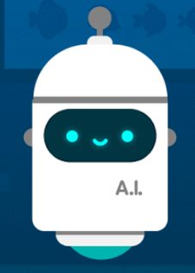
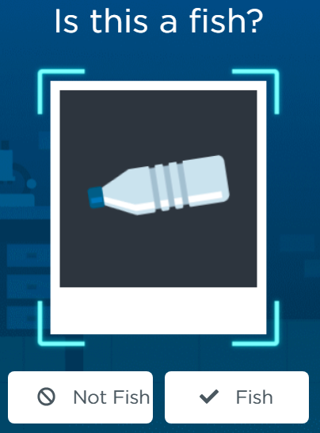
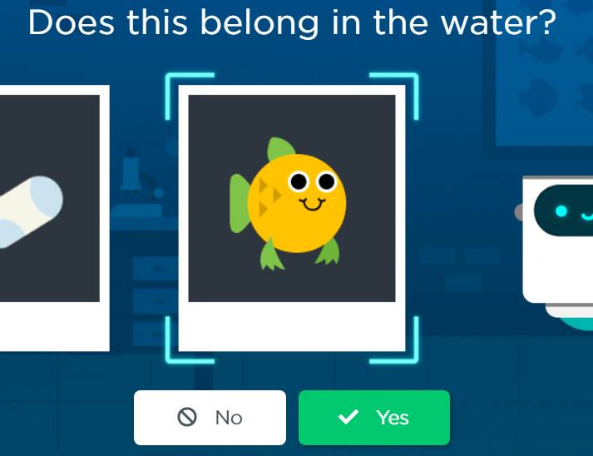
AI for Oceans
In this lesson, you will train an Advanced Intelligence Robot to recognize what it should and should not clean out of the ocean.

Slide 6
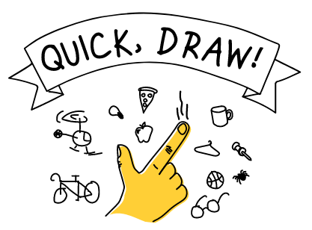
Quick Draw with Google’s AI
Quick, Draw!
This AI system has been built to try and recognize drawings.
Follow the directions and try to draw the object. Can you get the system to recognize your drawing? It takes practice!

Slide 7
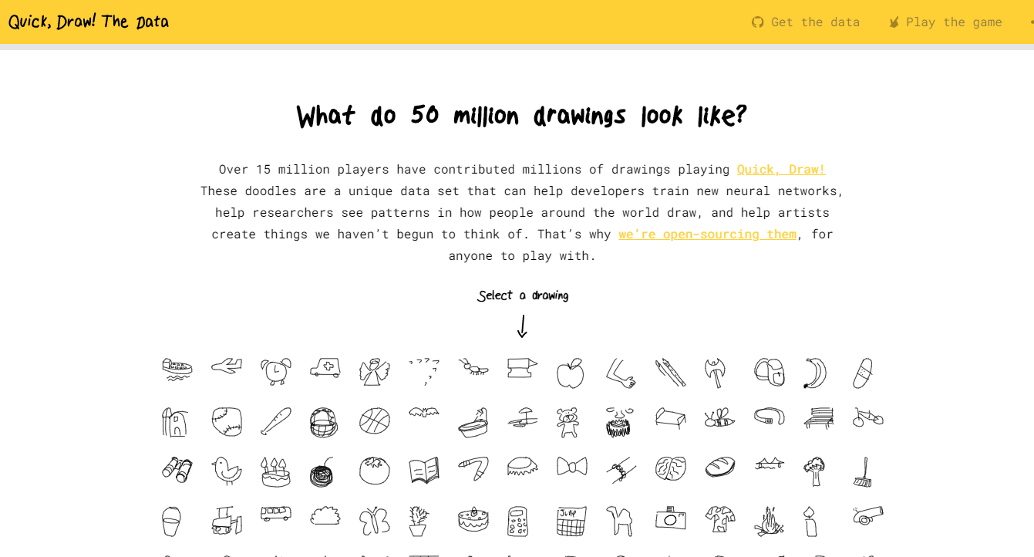
Quick Draw with Google’s AI
Quick, Draw!
This AI system has been built to try and recognize drawings.
Follow the directions and try to draw the object. Can you get the system to recognize your drawing? It takes practice!

Slide 8
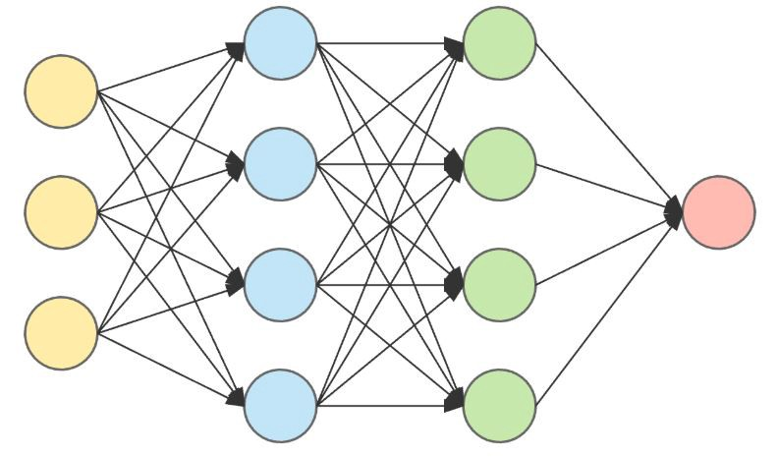
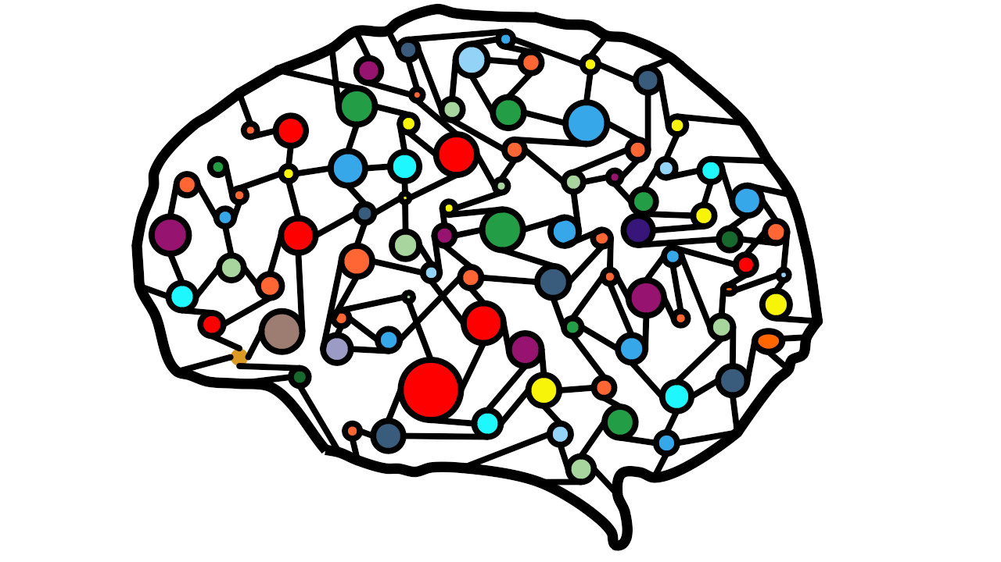
How Quick Draw Works-Neural Network
Neural Network
-A brain for computers
-Brains have a lot of
neurons
-Each drawing represents a neuron
-Neuron for computers=node
-Nodes help recognize patterns of data
-Drawings are what in computers = …

Slide 9
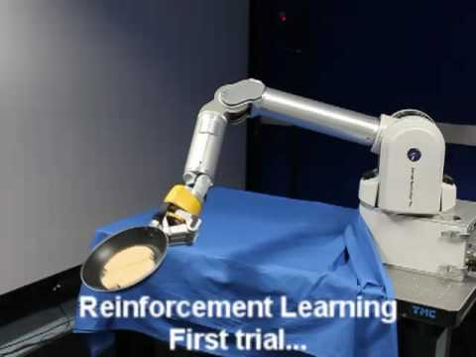
How Neural Networks Help Us
Neural Network
-Classifying stuff:
-Images
-Movements
-Sounds
-Create video games that can learn
-Help robots learn tasks autonomously
-Pancake Flipping robot

Slide 10
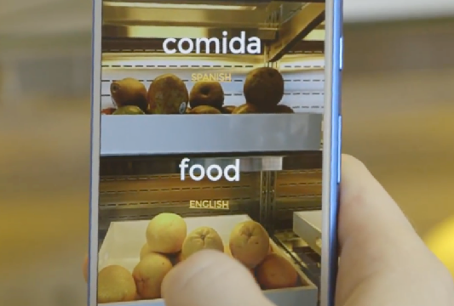
Explore AI-Images
Thing Translator
This AI system has been trained to recognized images and learn languages. Follow the direction to “Allow” the site to use your camera. Hold up objects to see if the system can recognize your object.

