Slide 1
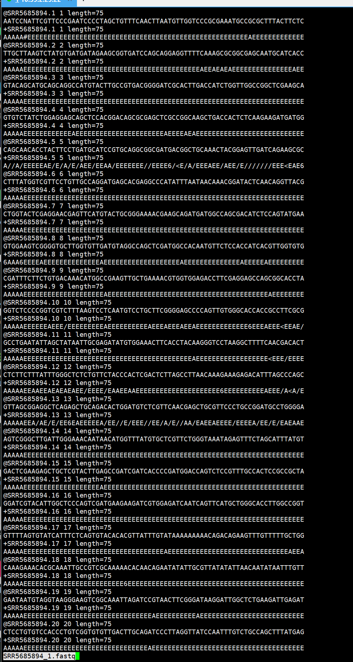
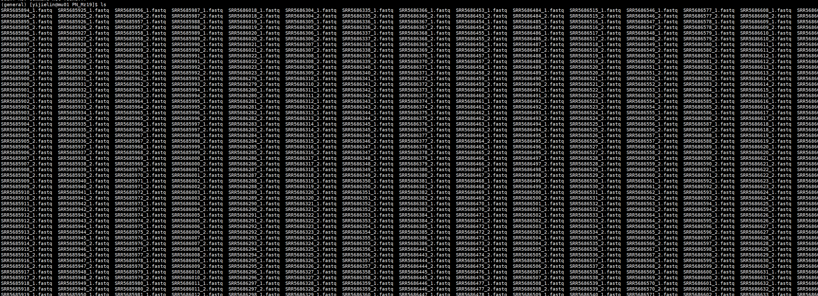

Slide 2
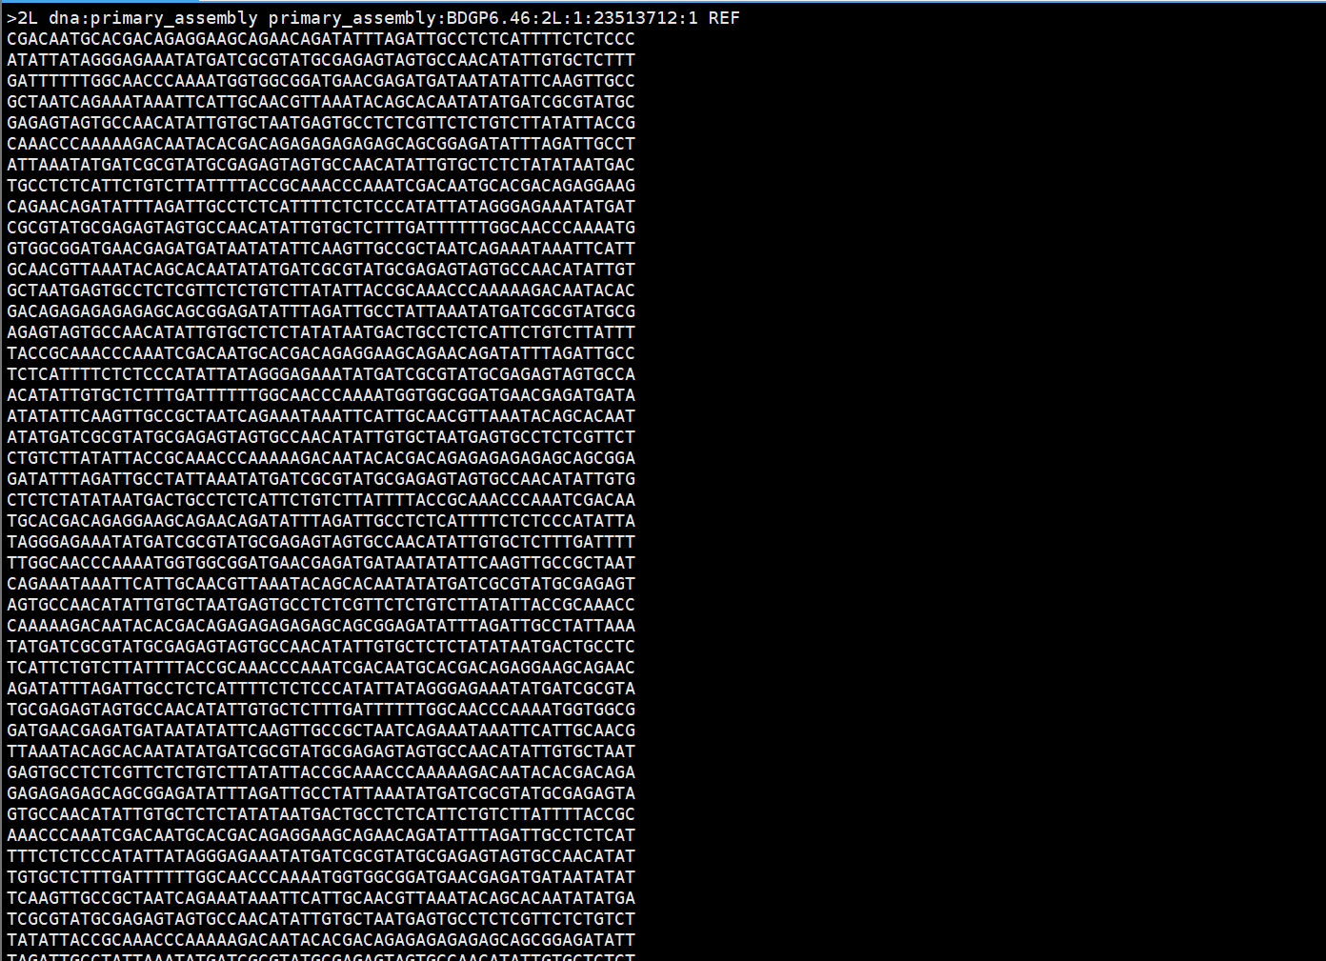

Slide 3
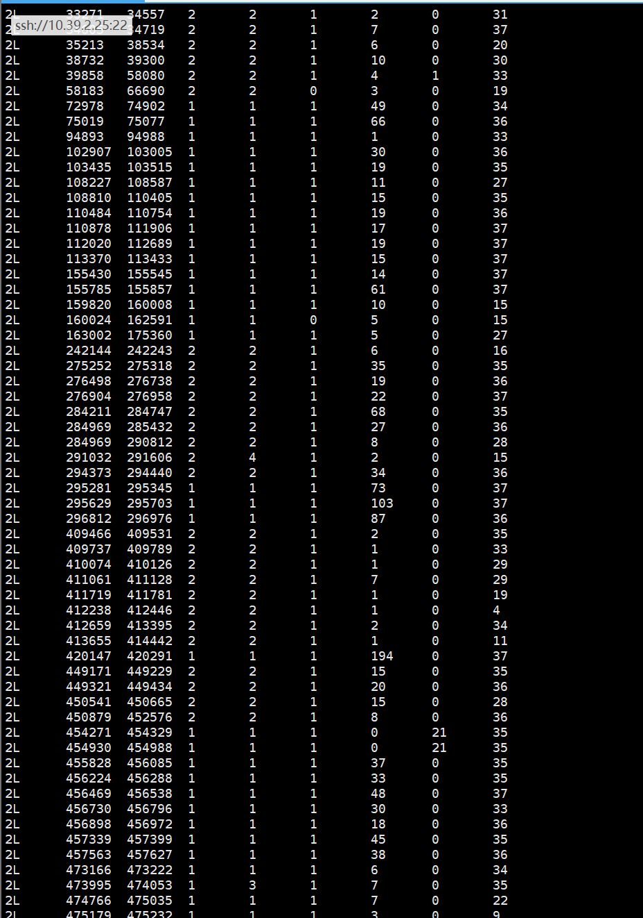

Slide 4
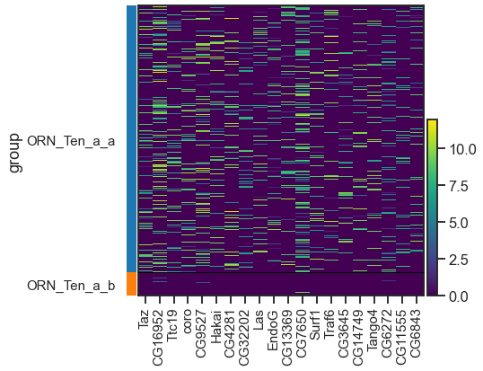
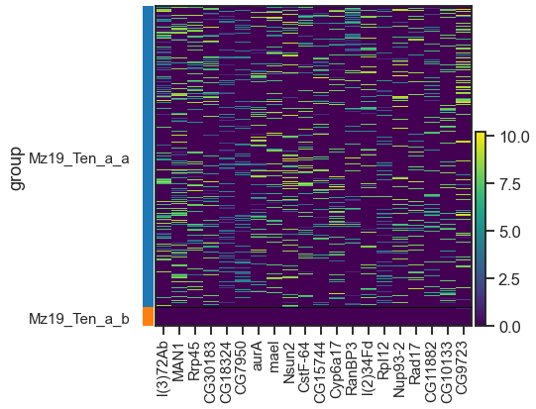
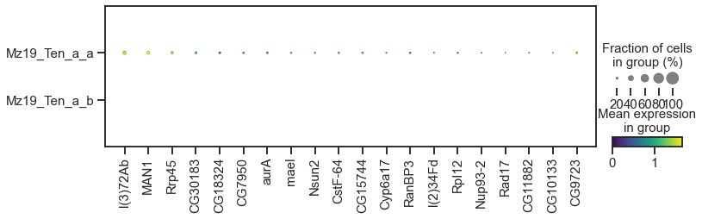
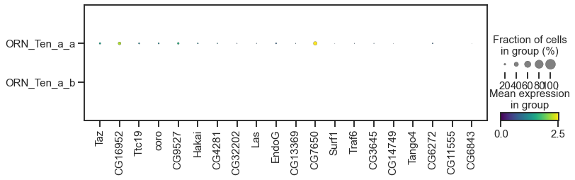
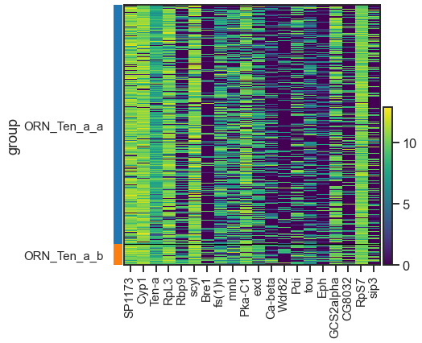
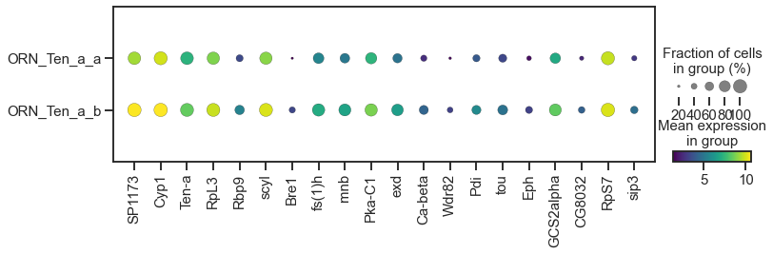
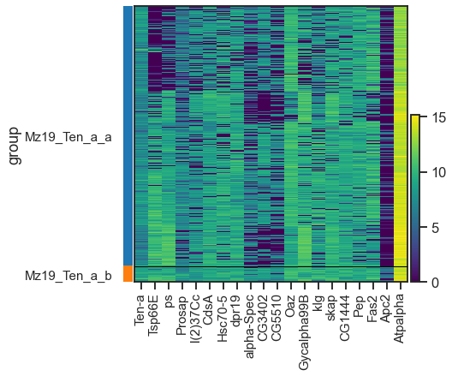
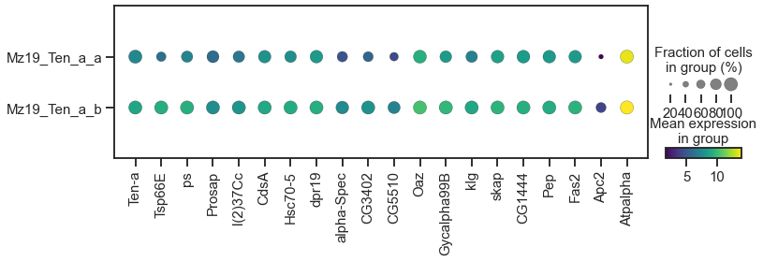
Mz19_Ten_a_a Mz19_Ten_a_b
0 l(3)72Ab Ten-a
1 MAN1 Tsp66E
2 Rrp45 ps
3 CG30183 Prosap
4 CG18324 l(2)37Cc
5 CG7950 CdsA
6 aurA Hsc70-5
7 mael dpr19
8 Nsun2 alpha-Spec
9 CstF-64 CG3402
10 CG15744 CG5510
11 Cyp6a17 Oaz
12 RanBP3 Gycalpha99B
13 l(2)34Fd klg
14 RpI12 skap
15 Nup93-2 CG1444
16 Rad17 Pep
17 CG11882 Fas2
18 CG10133 Apc2
19 CG9723 Atpalpha

