Slide 1

UBER & LYFT Trip Planner
Team Duckers
George Chen
HsunFu Liu
Di Bao
Miao Wang
??????

Slide 2
Description
To create an application to compare car trips between UBER and LYFT
Allow users to create, modify, view and delete drop-off locations
Use GoogleMap APIs to determine the coordinate of the input locations
Use the APIs supported by UBER and LYFT to obtain trip information
Input data is stored into a MySQL database
Users can use the application to plan trips consisted of multiple drop-off points

Slide 3
Architecture

Slide 4
Programming tools used
Python/Flask
HTML
Postman
UBER API, LYFT API, GoogleMap API(Geocoding)
WAMP
Development Environment
Sublime, Notepad++, Atom, MS Visual Studio Code, GitHub

Slide 5
RESTful Services
Add Locations: Users can create new locations by input the location information
Update Locations: Users can view the location by input the location ID
Modify Locations: Users can modify the name of the location
Delete Location: Users can delete a location by input the location ID
Plan the trip route: Users can plan a trip with multiple drop-off points
DEMO TIME!!

Slide 6
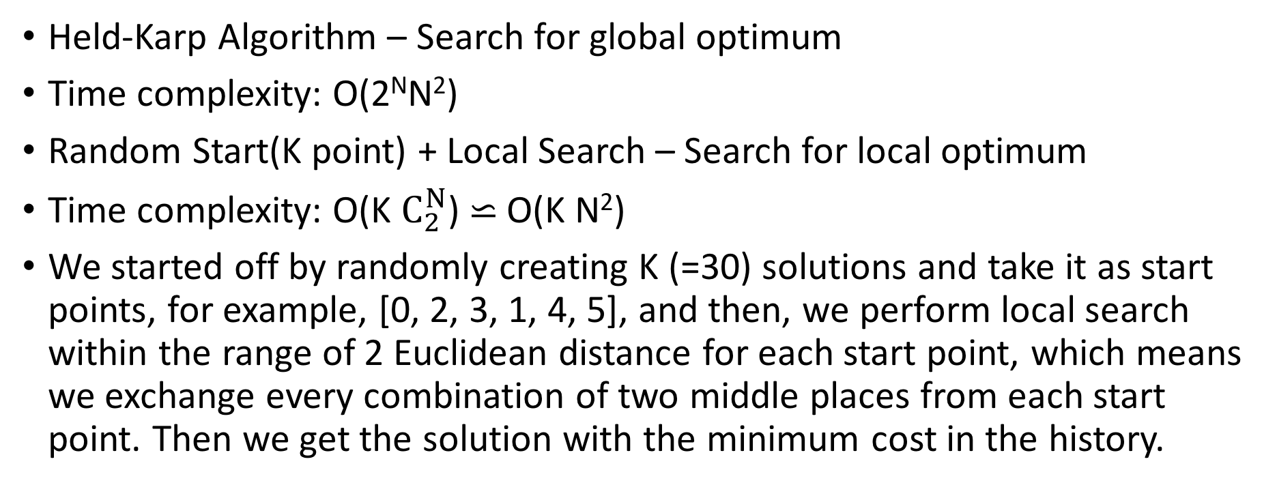
Algorithm
Held-Karp Algorithm – Search for global optimum
Time complexity: O(2^{N}N²)
Random Start(K point) + Local Search – Search for local optimum
Time complexity: O(K $C_{2}^{N}$)$⋍$ O(K N²)
We started off by randomly creating K (=30) solutions and take it as start points, for example, [0, 2, 3, 1, 4, 5], and then, we perform local search within the range of 2 Euclidean distance for each start point, which means we exchange every combination of two middle places from each start point. Then we get the solution with the minimum cost in the history.

