Slide 1

JavaScript
The Language

Slide 2

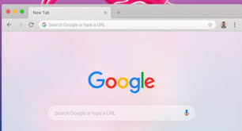
Chrome and Google

Slide 3
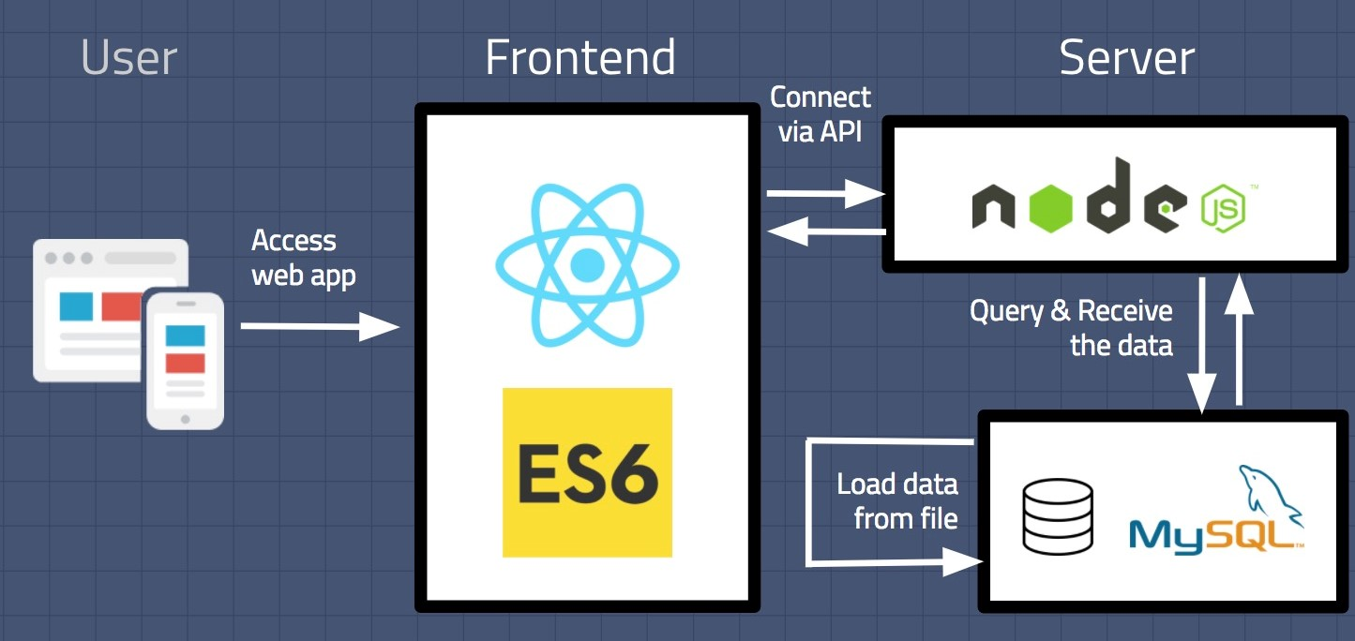


Slide 4
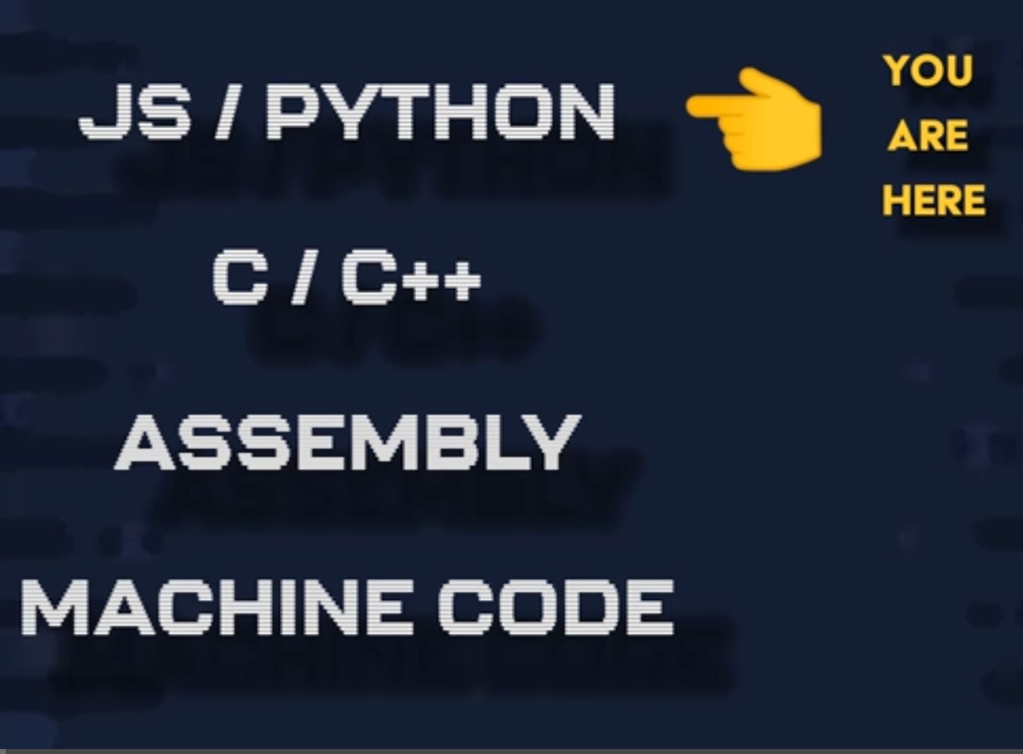

Slide 5
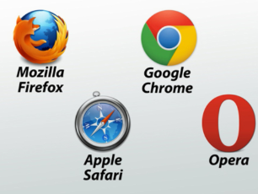

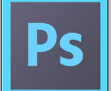
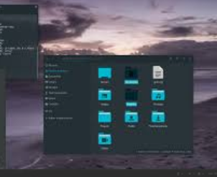


JavaScript Runs in
Browsers
Server
Desktop environment
IoT Devices
Adobe Acrobat, Adobe Photoshop
SVG

Slide 6

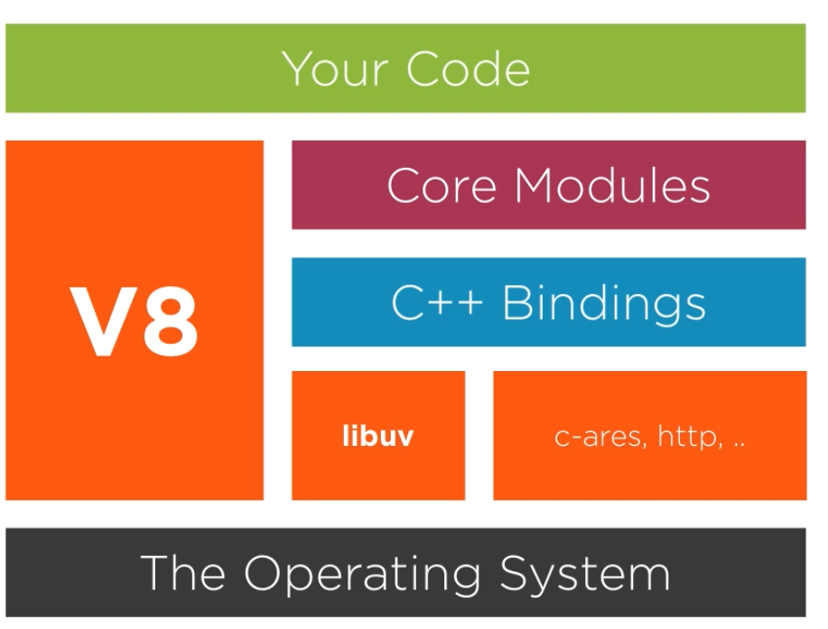
NodeJS

Slide 7
Story of JavaScript
Created by Brendan Eich of Netscape in just 10 days
Schema
Self
Java
LiveScript

Slide 8
Continued…
Live Script
JavaScript
EcmaScript

Slide 9
PRIMITIVE TYPES
Undefined
String
Number
Boolean
Null
Symbols(ES6)

Slide 10
NON PRIMITIVE TYPES
Arrays
Object literal
Function
Others…..

