Slide 1

Sit in your Groups from Discussion You’ll get used to Group Work and Collaboration FAST!!!

Slide 2

Astro 230: the Science and Fiction of Planetary Systems
Unit 1: Gravity, Density, Spin
Prof. Marvin Q. Jones, Jr.
Slides adopted from Dr. Alan Peel

Slide 3
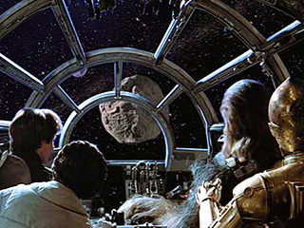
Example!
Watch these youtube clips from The Empire Strikes Back:
https://www.youtube.com/watch?v=60dFh008LKo
https://www.youtube.com/watch?v=9AKMLJ6UTo0
[Star Wars V: ch20 (38:32), ch27 (57:38)]
Enjoy and…
…criticize the science (all the science! Astronomy, chemistry, physics & biology)
Talk to your neighbors?

Slide 4
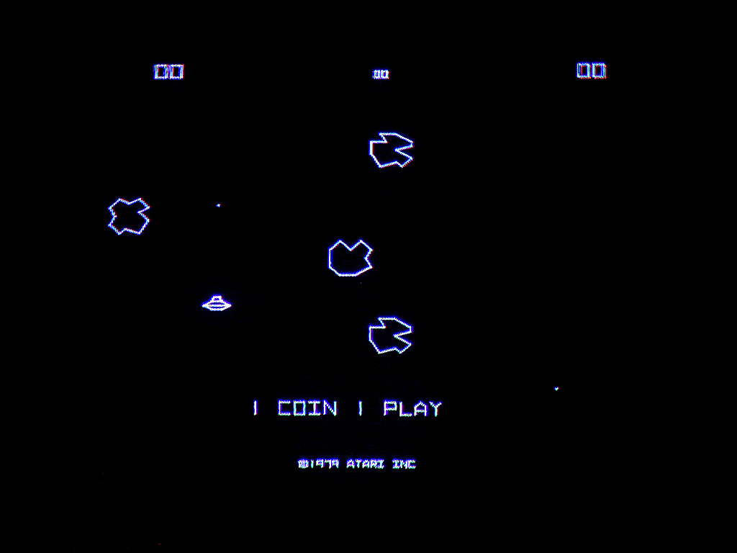
Example!
[Star Wars V: 20, 27]
What’s wrong (if anything) with the:
…gravity?
…atmosphere?
…biology?
…astronomy?
Are we just spoiling a fun story?
Think, pair, share (“TPS”)
Talk to your neighbors!
Notes:
Sideways? WAY too much.
Why is there an atmosphere?
Space-hardened creature? With 1 atm pressure inside?
Asteroids are NOT that close together for very long.

Slide 5
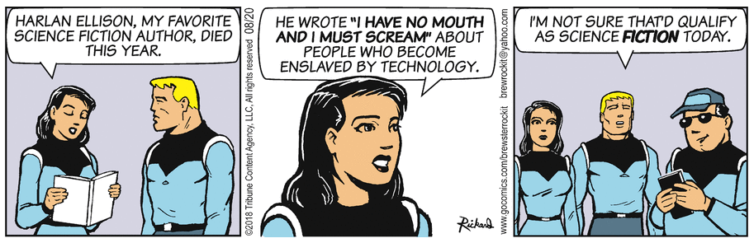
What is Science Fiction?

Slide 6

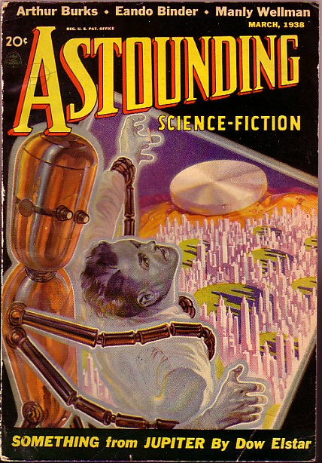

What is Science Fiction?
Science fiction (roughly two subcategories: social science fiction and hard science fiction)
vs.
Space westerns, space opera, space wars, etc. which are westerns, opera, war simply set in space.

Slide 7


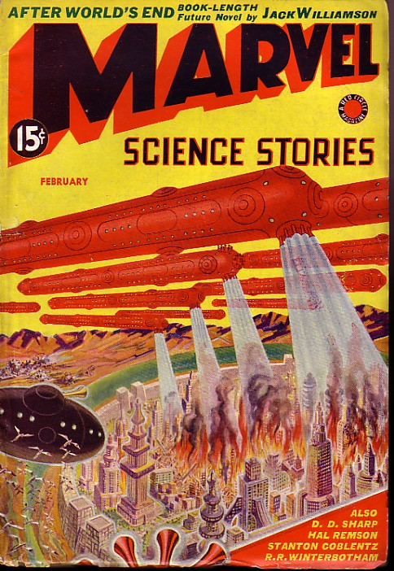

What is Science Fiction?
Did George Lucas and friends do a lot of research on planetary physics for the Star Wars series?
No, he/they did a lot of research on what makes a “good story”
John Campbell Hero with A Thousand Faces
Name your favorite science fiction story (any format)

Slide 8


What is Science Fiction?
All fiction requires willing suspension of disbelief
Easier with a good plausibility factor!
“Good” science fiction should not ask you to suspend disbelief more than you would for any “mainstream” novel…
…otherwise, it’s fantasy
Too snobby? [opinion?]

Slide 9

Syllabus Basics
Prof. Marvin Jones, Jr.
elms.umd.edu for the syllabus (updates are happening, please be patient.)
Office hours explained online on ELMS
Tu & Th. 12:30 – 2:30 PM
Check for TA office hours on ELMS!
This is one of the Big Question (formerly, iSeries) courses. It’s interdisciplinary!

Slide 10
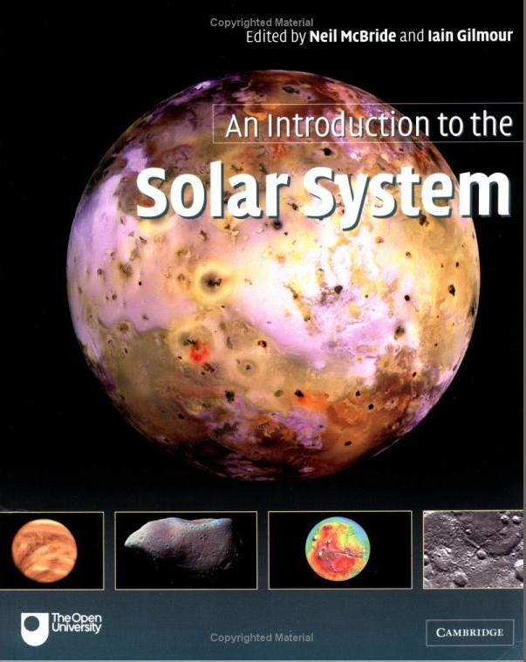
Textbook
An Introduction to the Solar System eds. David Rothery, Neil McBride and Iain Gilmour THIRD EDITION
Useful for looking up things, delving deeper into our own solar system, checking data, etc.
Other reading suggested on course website “Lecture Schedule”
[Sometimes entire chapters, like Read Chapter 1 now!]
Also used for Astro 330, Geol 212

Slide 11
Course Expectations
Five units:
Gravity/Density/Formation (math heavy)
Light/Energy/Flux/Temperature (math heavy)
Simple Chemistry Liquids and Gases (surfaces, atmospheres; very little math!)
Age, Deep Time, Life! (not so math-heavy)
Terraforming (estimate heavy more than math)
Four tests (no Unit V test and no Final Exam)
Final Project – A Paper, Presentation, and Possible Poster!

Slide 12

Course Expectations
Grading:
Class Participation 10%
Discussion Section 40%
Tests 30%
Final Group Project 20%
Total 100%
There isn’t much room for extra credit!

Slide 13

Course Expectations
Class Participation
Often will work with your neighbors…
…You don’t have to get the answer right, but you do have to answer in order to take the lecture participation quiz
Please try not to make a random guess!
Don’t flirt with an XF in the class…
Because the university changed its policy on clickers, I am not requiring you to buy a clicker. We will use other means of participation.

Slide 14
Course Expectations
Discussion Section
Started Monday (did you miss it? Don’t miss today!)
40+ discussions: Will drop your two worst discussion grades (except 5.4 which is worth double)
These are your “homework”: making sure you understood them and have the right answers is your responsibility – there will be no detailed solution sets (but you can always ask for confirmation/help/etc.!)
Download the questions just before/beginning of the discussion class on the day
Upload your answers as PDFs usually by midnight or in some cases the next night. Deadlines will be noted in Elms.

Slide 15
Course Expectations
Tests
Dates listed on Lecture Schedule
Read the syllabus regarding missing tests for valid reasons…
No test for Unit V and no Final Exam
Drop your lowest test
Final Project is your real Final Exam
Group paper
Group presentation
More details as semester progresses…
(but see wiki page on ELMS)

Slide 16
Course Expectations
Lecture participation: mandatory (with the usual exceptions) - please see me in advance for religious holidays, etc.
Discussion section also mandatory (MWF 12, 1, 2)
DSS Accommodation: Please see me ASAP
Preparation: HIGHLY recommended
at least skim the reading prior to the lecture…
...then read in depth after the lecture
Study Habits: DON'T WAIT until right before tests ask for help; collaborate with your classmates, but put homework answers in your OWN words.
Ask questions on the ELMS discussion board!

Slide 17
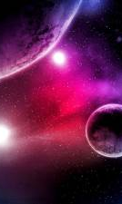
Learning Outcomes
By the end of this class you should be able to:
Judge a planet by its cover (mass, radius, composition, distance from star/temperature, age)
Understand the variety of possibilities for planets
Grok the profusion of planets out there
Be able to write about a convincing, scientifically sound, and hopefully interesting planet – where the geology and atmosphere might play a role in a fictional plot!
[And of course, you’ll know a lot more about our own Solar System]

Slide 18
Learning Outcomes
This class is designed to engage you in many different ways.
It’s actually difficult to fail if you do the work and do your best.
Pace yourself and work within your groups!
I want you to be able to engage with various media sources and use science to understand what is “good” and “bad” fiction.

Slide 19
Math Fundamentals
Skills Needed:
Ratios
Estimation
Algebra
Dimensional Analysis
Analytic Reasoning
Geometric Reasoning
How do you get and practice those skills?
In discussion!

Slide 20
Warm Up Math!
Calculate the force of Gravity between the Sun and the Planet Uranus.
How many seconds old were you on your first birthday?
Calculate the following quantities for Earth, assuming a radius (R) of 6371 km. Be sure to include units in your answer.
The circumference of Earth.
The surface area of Earth.
The volume of Earth.

Slide 21

Warm Up Math!
Compare the volumes of two spheres, one of which has 5 times the radius of the other.
You obtain the following result from a ratio problem comparing the radius of two spheres: $\frac{R_{a}}{R_{b}}=\frac{1}{5}$. Which sphere is bigger, sphere a or sphere b, and by how many times?

Slide 22
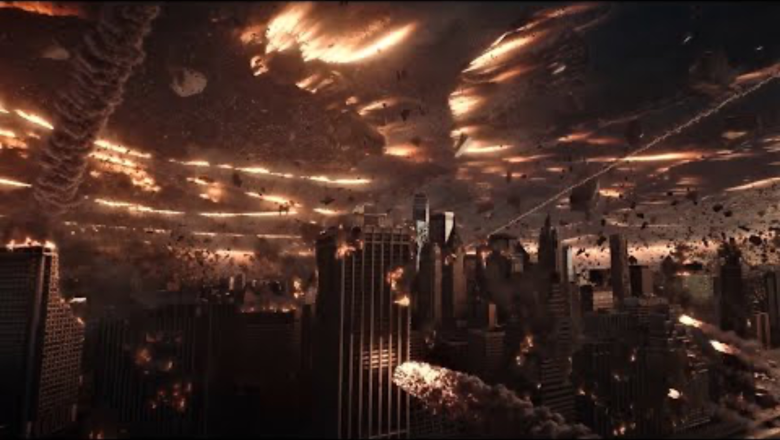
Science Fiction Gone Wild…

Slide 23
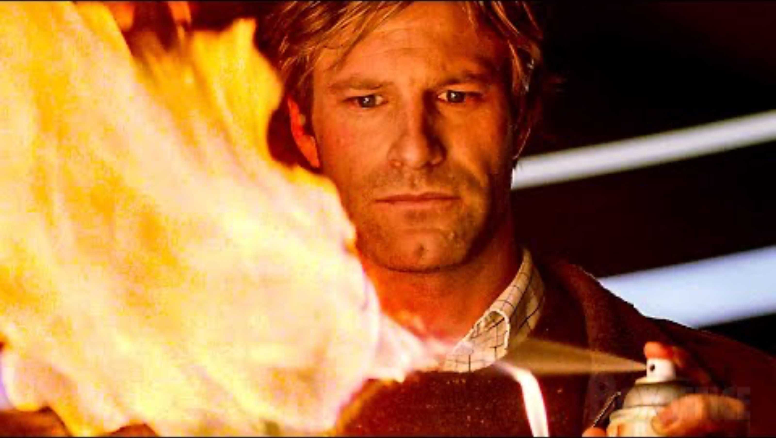
Decent Science with some Razzle Dazzle

Slide 24
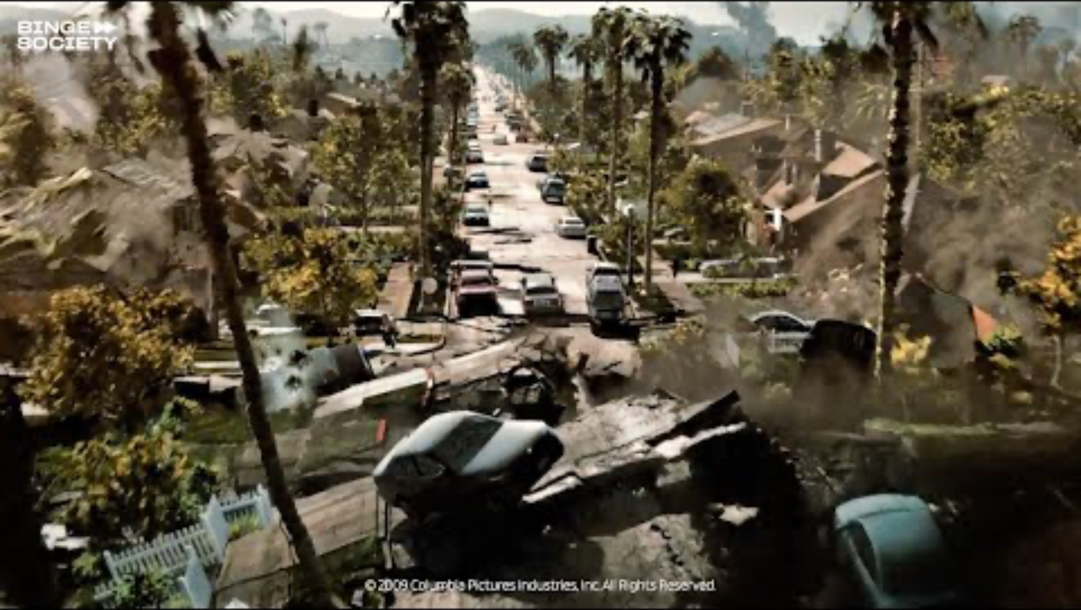
Astrophysics Gone VERY WILD

Slide 25
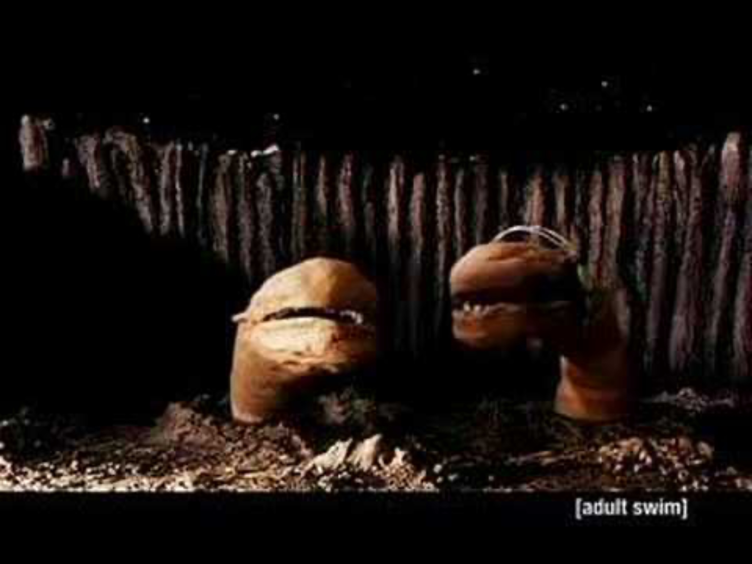

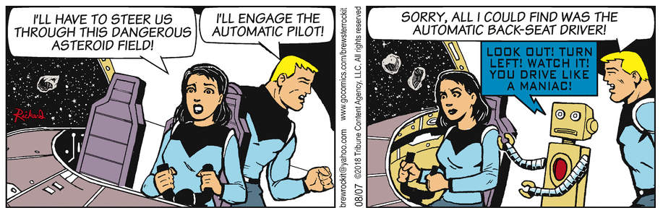
Case in point, Parodies:

Slide 26

Astro 230: the Science and Fiction of Planetary Systems
Unit 1: Gravity, Density, Spin
Prof. Marvin Jones

Slide 27

Pluto (see ch. 7)
New Horizons launched on Jan 19, 2006
In August 2006, the IAU defined “planet” in such a way that Pluto failed to meet the definition (irony?)
Swung past Jupiter a year later in Feb 2007
Got to Pluto…
…July 2015
http://pluto.jhuapl.edu/

Slide 28
Is Pluto a planet?
Yes, DAMMIT!
No, it’s a Kuiper Belt Object
No, it’s a dwarf planet
No, it’s a plutino
No, it’s a plutoid
B and C
B and E
B, C, and D
B, C, D, and E
Notes:
Plutino = 3:2 resonance w/Neptune; Plutoid = trans-Neptunian dwarf planet

Slide 29
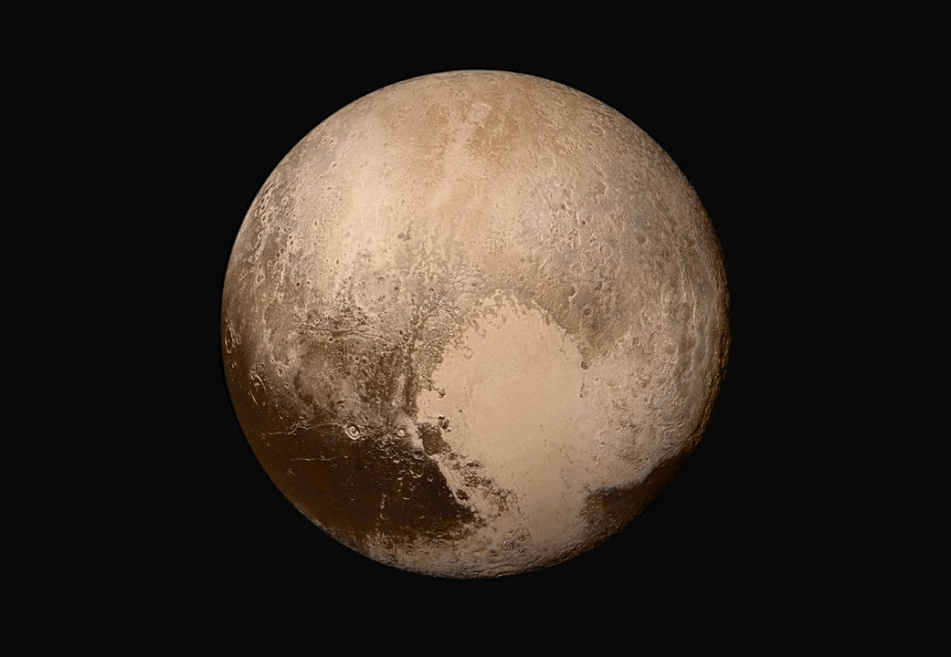
What is a Planet?

Slide 30
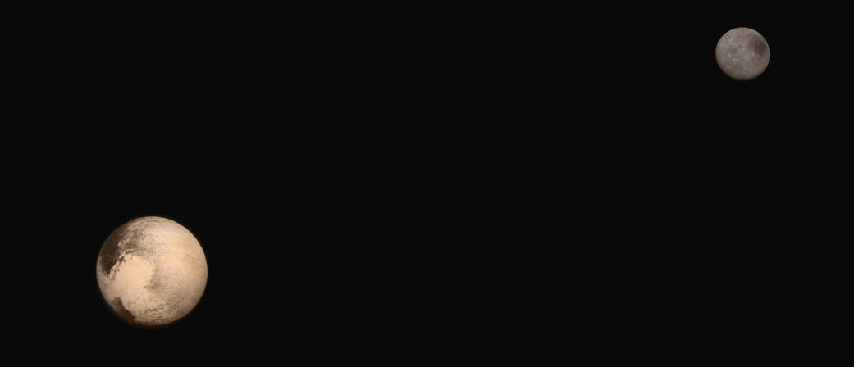
What is a Planet?
Talk amongst yourselves.
What is the definition of a planet?
Think about size, composition, maybe even behavior?

Slide 31
What is a Planet?
Formal (new) IAU definition:
Celestial body orbiting a star or stellar remnant.
Massive enough to be rounded by its own gravity…
…but not massive enough to cause thermonuclear fusion (then it would be a ….) [they forgot this one!...]
Has “cleared” its neighboring region of planetesimals.
Thus Pluto is not a planet, because it fails on #4. Instead it is called a dwarf planet. It is also called a plutoid, meaning a trans-Neptunian dwarf planet large enough to be round (compare Ceres) and it is also a plutino, meaning 3:2 resonance with Neptune…
More about resonances later!

Slide 32
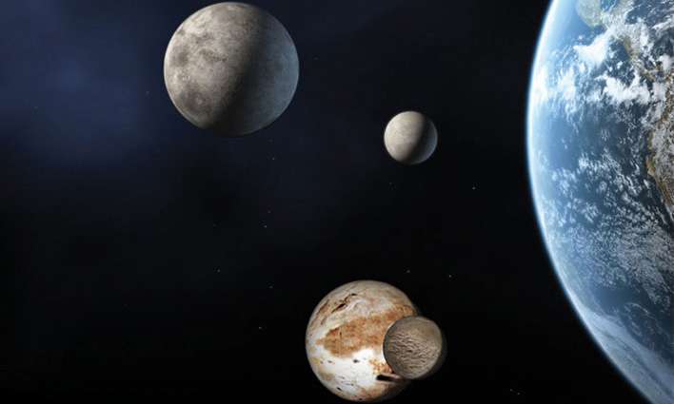
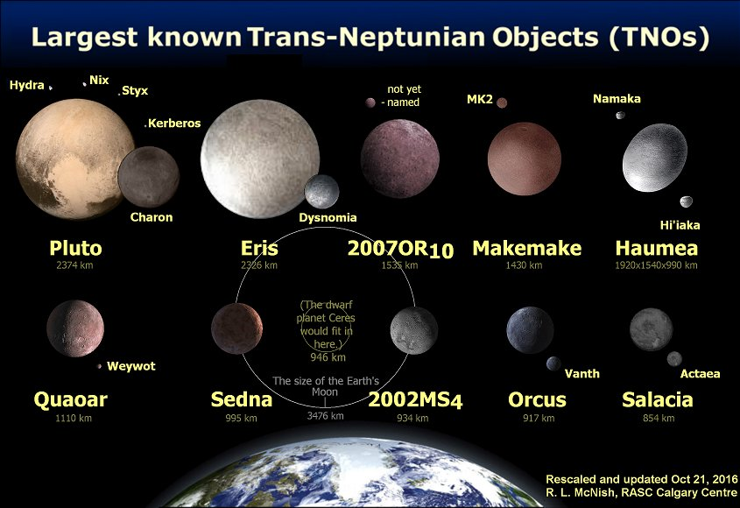
Dwarf Planets
There are 5 recognized dwarf planets in our solar system: Ceres, Pluto, Haumea (2003 EL₆₁), Makemake (2005 FY₉), and Eris. Three of these are plutoids.
Likely many more dwarf planets to be recognized, (including more asteroids?)
Size is hard to measure.
http://solarsystem.nasa.gov/planets/profile.cfm?Object=Dwarf
http://web.gps.caltech.edu/~mbrown/dwarfplanets/
Eris Ceres
Pluto/Charon
Notes:
From wikipedia: TNOs are thought to have icy cores and therefore would require a diameter of perhaps 400 km to relax into gravitational equilibrium, making them dwarf planets of the plutoid class.
32

Slide 33
Density is destiny
Planets (and dwarf planets) come in various “flavors”:
Terrestrial
Super Earths?
Giant (Jovian) (not really “gas” so much…)
Neptunian (“ice giants”?)
Icy? Consider Europa, Titan, etc., which have FAR more volatiles than we do…we’ll discuss more when we do chemistry.
Water(?)
Useful to consider for your project…

Slide 34
Can’t just have “any old” surface gravity!
For your final project you’ll create (or address existing) planets
You’ll decide what kind they are (terrestrial, giant, water/icy), i.e., composition which sets the density (and probably their rough size)
Then you’ll decide their actual size which (combined with density) will set their mass
Now you know the size and mass which completely sets the surface gravity

Slide 35
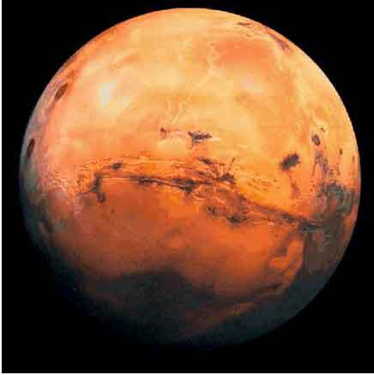
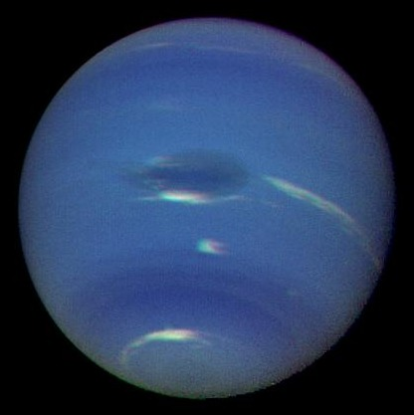
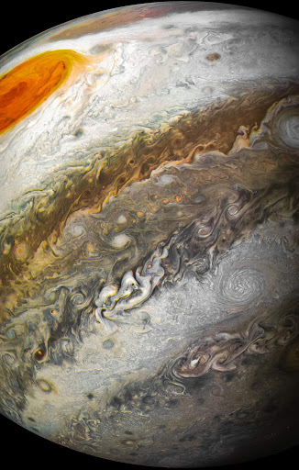
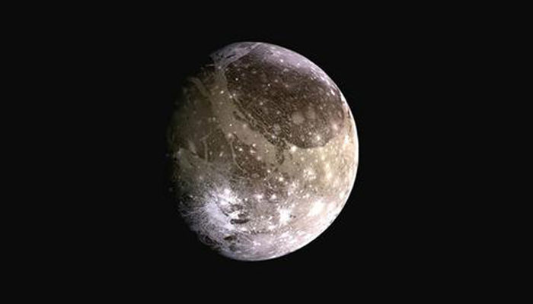
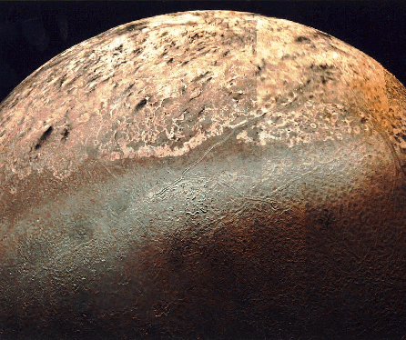

Can’t just have “any old” surface gravity!
Mathematically,
1. Density $ρ$depends on composition and weakly on size (because of compression). Decide what kind of planet it is:
Terrestrial planets $ρ≈3000 – 5000 \text{kg}/{\text{m}}^{3}$ cf. Mars – Io – Earth
Water/icy planets $ρ≈1500 –3000 \text{kg}/{\text{m}}^{3}$ cf. Ganymede – Pluto – Io
Giant planets $ρ≈600 –1500 \text{kg}/{\text{m}}^{3}$ cf. Saturn – Jupiter

Slide 36

Can’t just have “any old” surface gravity!
2. Then pick a radius $R$ which weakly depends on composition (unlikely to have Neptune sized planets of iron, or Earth sized planets of hydrogen)
3. Everything is a sphere, so the mass is given by:
$$ρ=\frac{M}{V}=\frac{M}{\frac{4π}{3}R^{3}} → M=\frac{4π}{3}ρR^{3}≈4ρR^{3}$$
4. Now you can calculate the surface gravity:
$$g=\frac{GM}{R^{2}}$$
i.e., you don’t have total freedom for any old $g$ once you know $ρ \text{and} R$. If you don’t like the g you get, you should start over and chat with us!

Slide 37
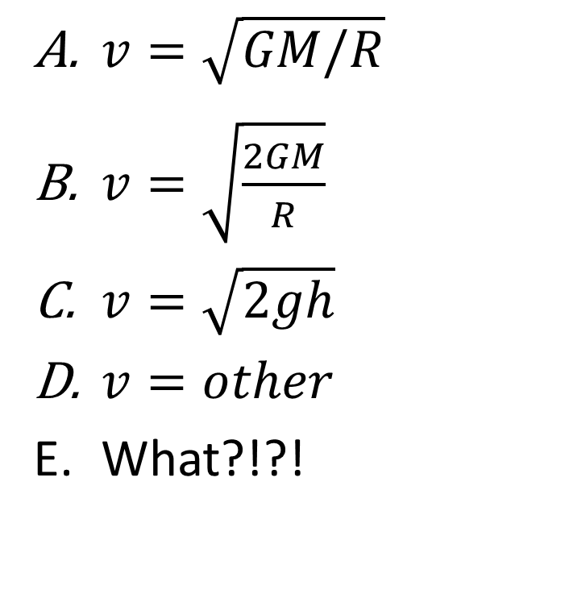
How fast do you have to go to get off a planet of mass M and radius R?
$v=\sqrt{GM/R}$
$v=\sqrt{\frac{2GM}{R}}$
$v=\sqrt{2gh}$
$v=other$
What?!?!

Slide 38
Escape!!
How do you get out of here? How fast does something have to be moving up near the ground* so that it gets out of a “gravity well”?
You’ll think about motion energy and gravity energy (and the conservation of energy!) from your discussion about John Carter
*neglect rockets that can keep firing even as they get higher…
Note that you can’t use mgh now! That was only good for g being nearly constant! Little g is a “surface gravity” convenience…

Slide 39
Escape!!
How do you get out of here?
Think about the final location? Where? Think about how a thrown object going up always slows down*… when would it “stop”?
← Energy “budget”
*Again, neglect rockets that can keep firing even as they get higher…

Slide 40
Escape!!
http://xkcd.com/681/ - Gravity Wells
So what does this mean about “holding on” to an atmosphere?

Slide 41


Astro 230: the Science and Fiction of Planetary Systems
Unit 1: Gravity, Density, Spin

Slide 42
All the planets in the solar system are the same age old
True
False
I don’t know

Slide 43
How to build a stellar system
(Astro 340): early universe only has hydrogen (~ 3/4) and helium (~1/4) and a smattering of lithium [universe still mostly H, He today]
First stars burn H (some He) → carbon, nitrogen, oxygen
BUT EVEN AFTER THAT, THEY’RE STILL MOSTLY H AND HE!!!
First supernovae make even heavier elements
[New astrophysics: neutron star collisions help produce rare elements in bulk!]
More in the Chemistry unit: for now, H, He and “metals”

Slide 44
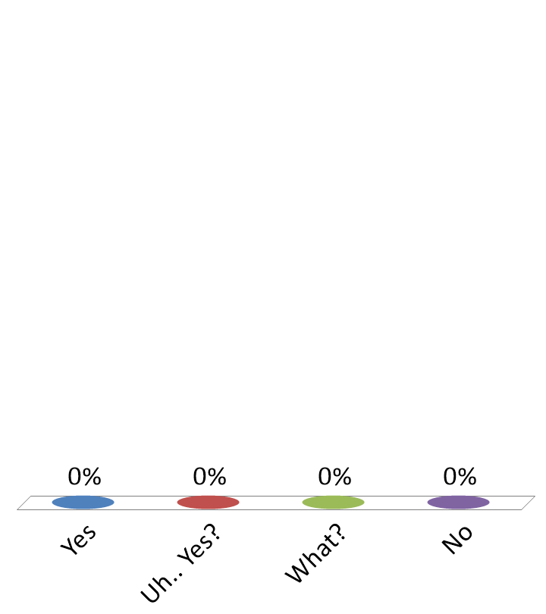
I have found my group!
Yes
Uh.. Yes?
What?
No

Slide 45
What fights gravity? What prevents things from collapsing forever?
Nothing; all is lost; give up hope
Pressure
Electromagnetism to the rescue!
Nuclear forces
Antigravity
Other

Slide 46
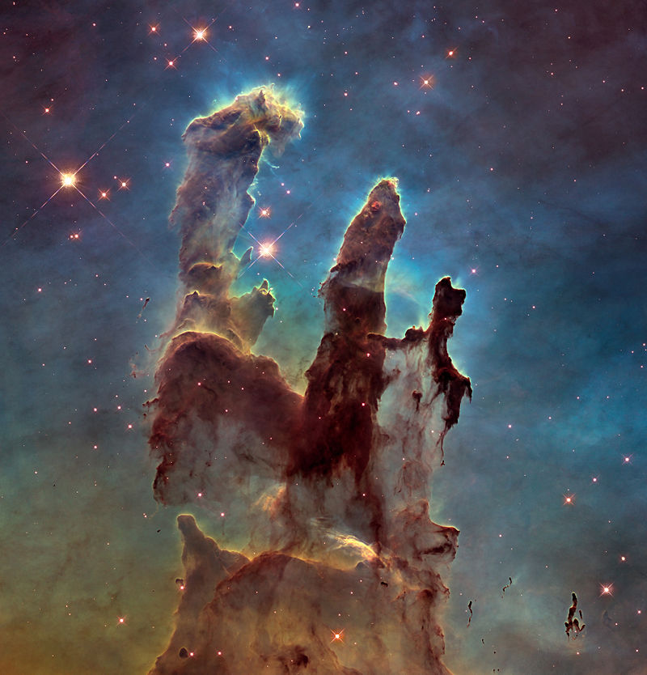
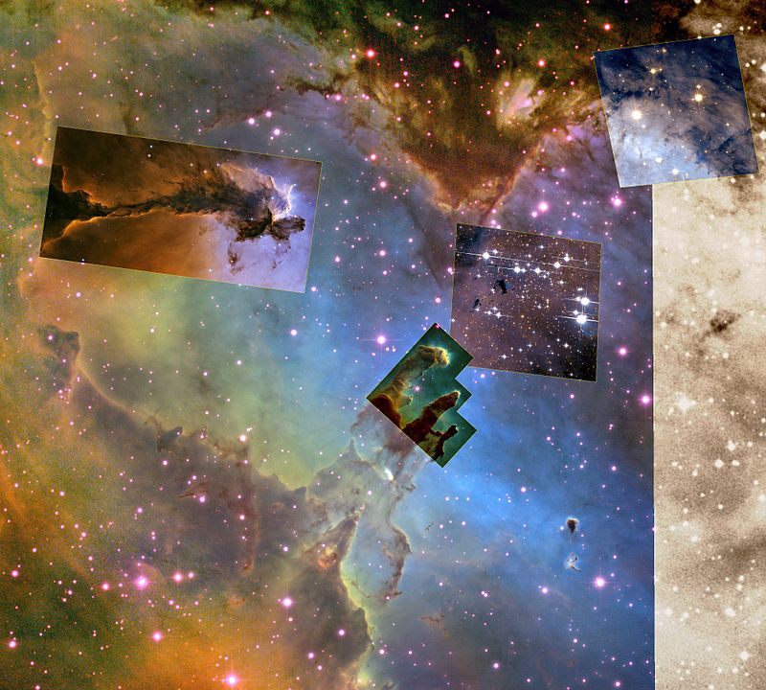
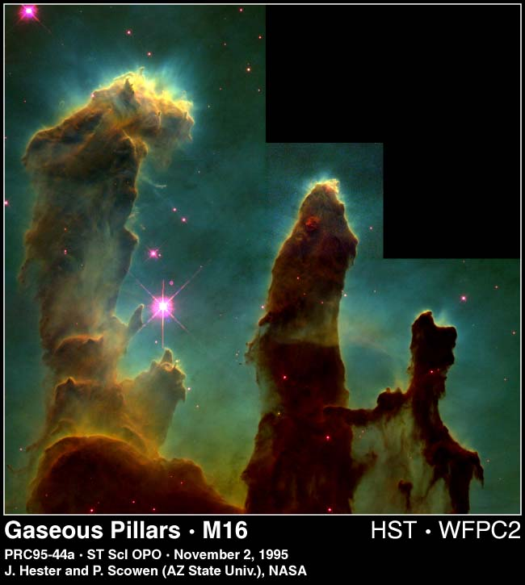
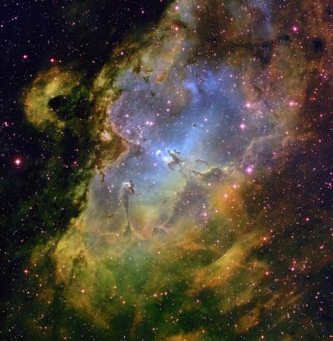
Notes:
“Pillars of Creation” – gas/dust clouds deep in the Eagle Nebula ~7000 ly from here

Slide 47
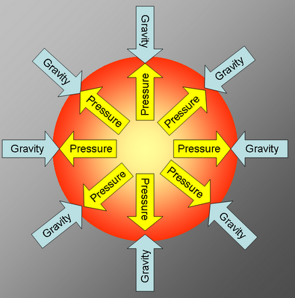
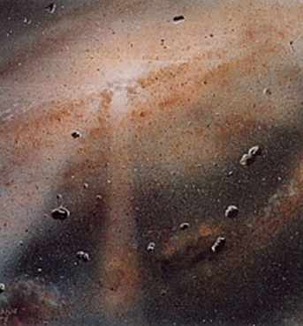
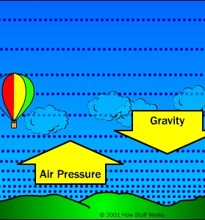
Gravity vs. pressure: the nature of collapse
Stellar system construction
Notes:
47

Slide 48
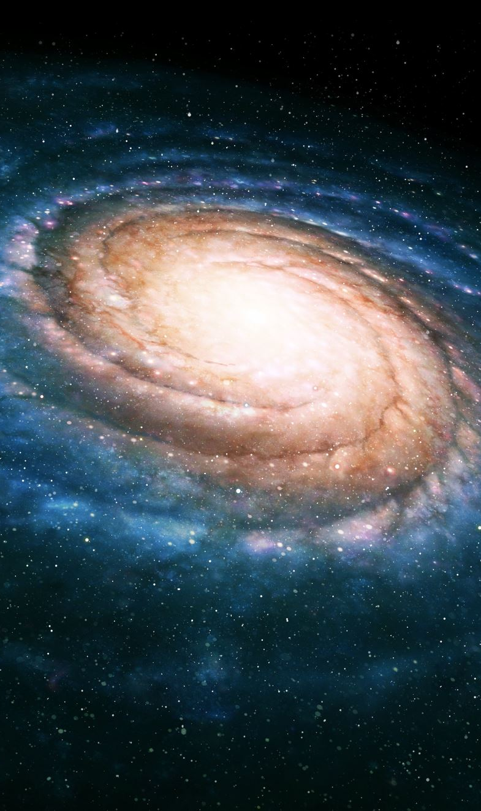
The Nebula Hypothesis
Laplace (1796): Solar System formed from a cloud of gas and dust…
maybe ~light-year across ~10,000-100,000 AU
…that collapsed (gravity again!) into a protoplanetary disk.
maybe ~100 AU across (!)
The disk’s rotation sped up as it contracted…
…due to conservation of angular momentum, (like skater bringing arms in during a spin)
This explains why the our planets roughly share the same orbital plane (any net angular momentum would favor “supporting” two dimensions against collapse, but not the third!)

Slide 49
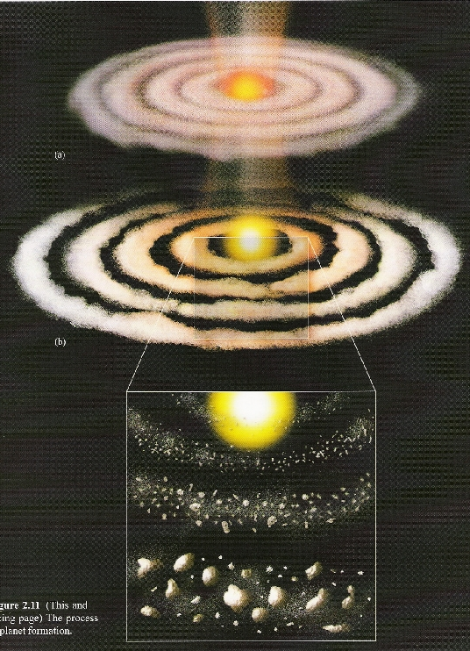
Formation of the Solar System
Start with nebula
(Large cloud)
Sun turns on…(but when?)
…as “dust” and gas start to clump (accrete)
Takes 10⁵-10⁷ yrs depending on your model

Slide 50
Formation of the Solar System
This process “cleans up” the Solar System relatively quickly…
…in geologic time (<10⁵ years?)
That’s partly why asteroid belts don’t look like this!
But after 5 billion years, planets are in general the same age as their star!

Slide 51
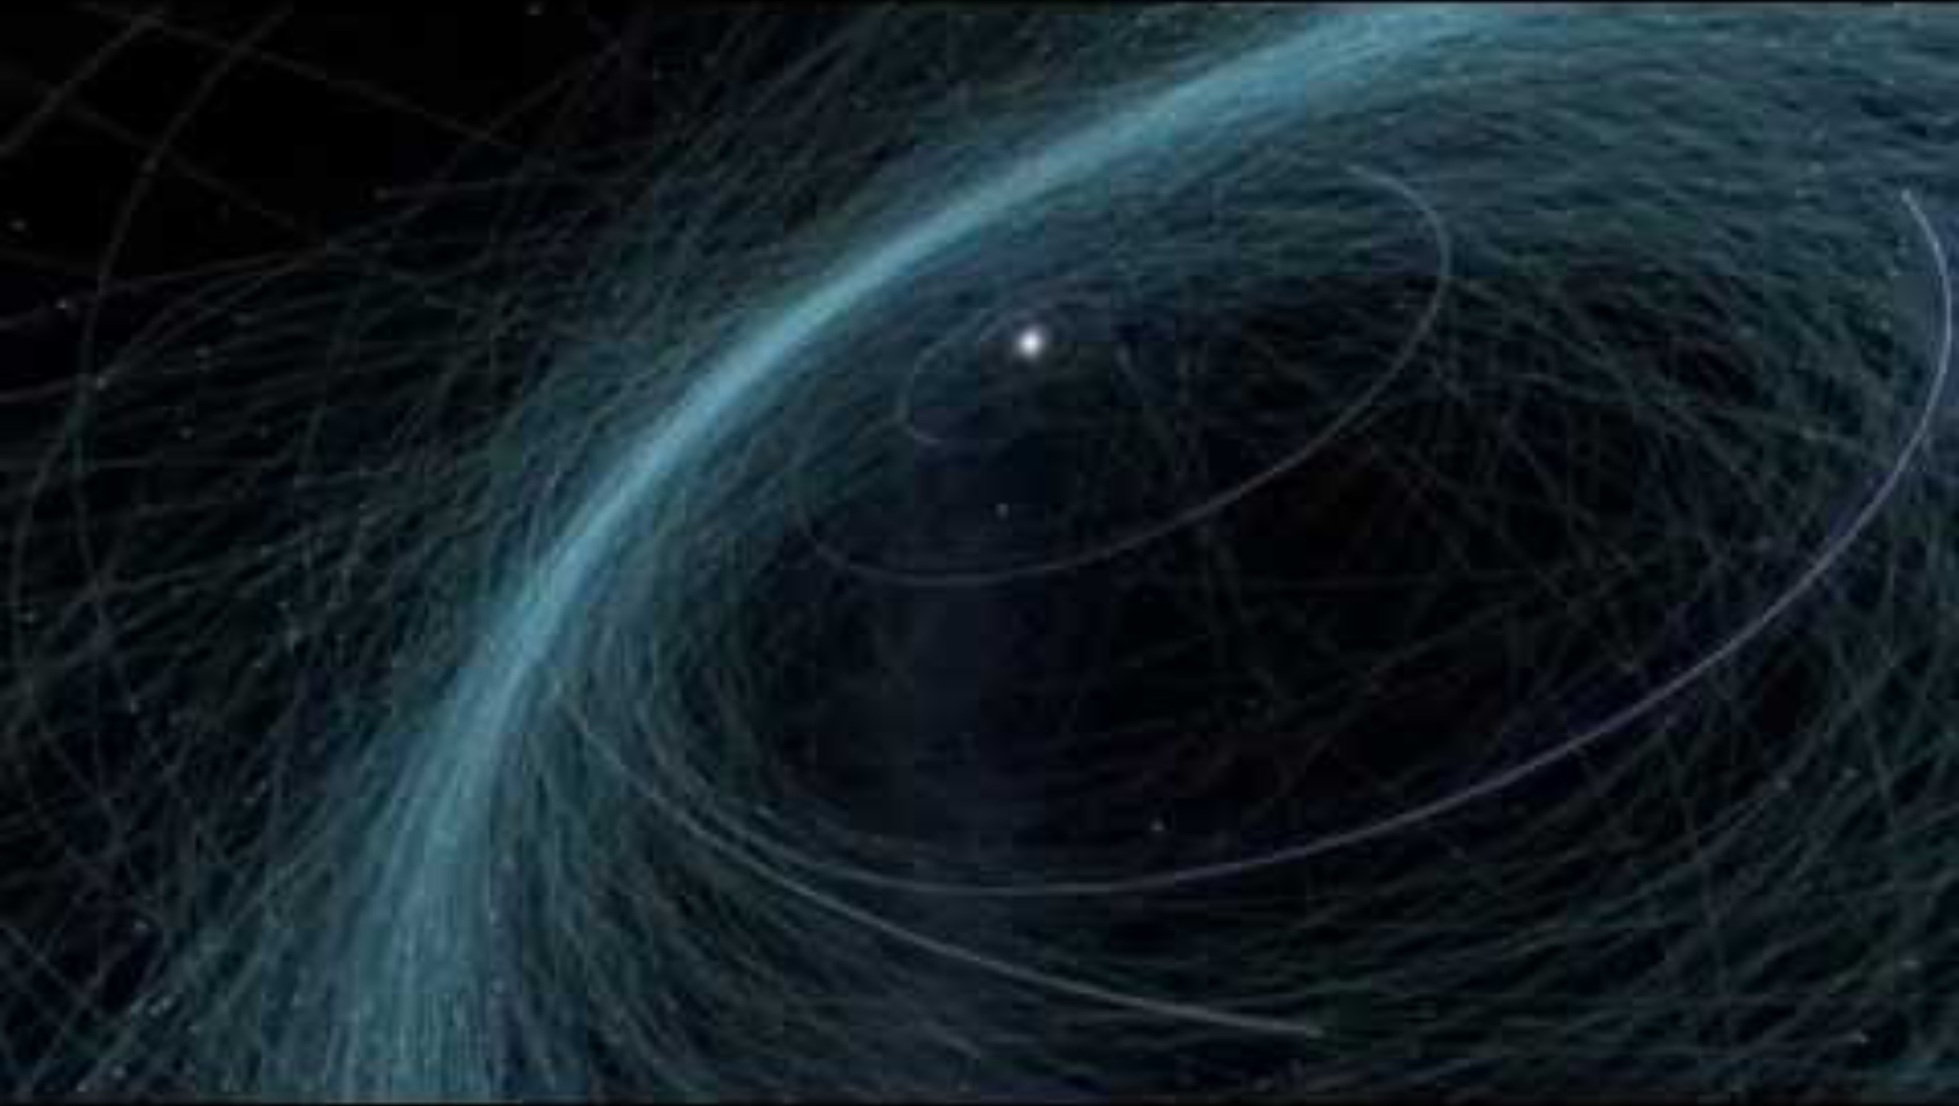
Formation of the Solar System

Slide 52
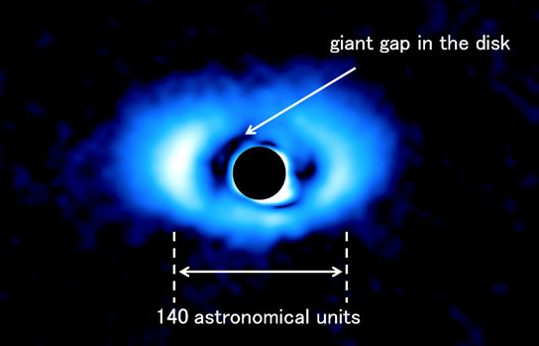
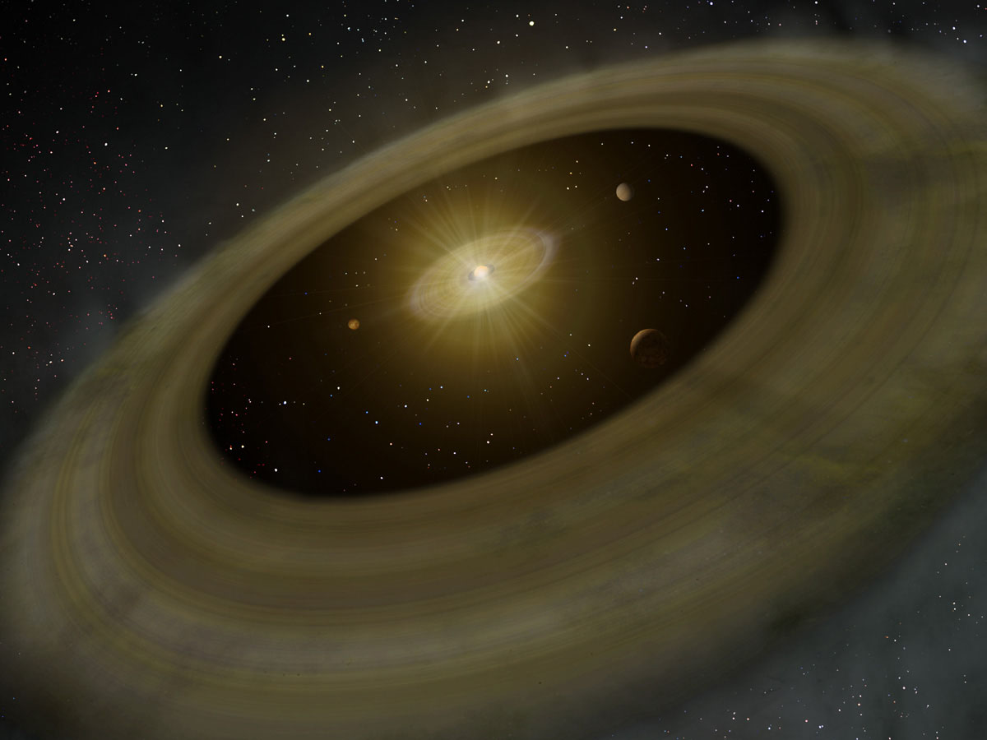
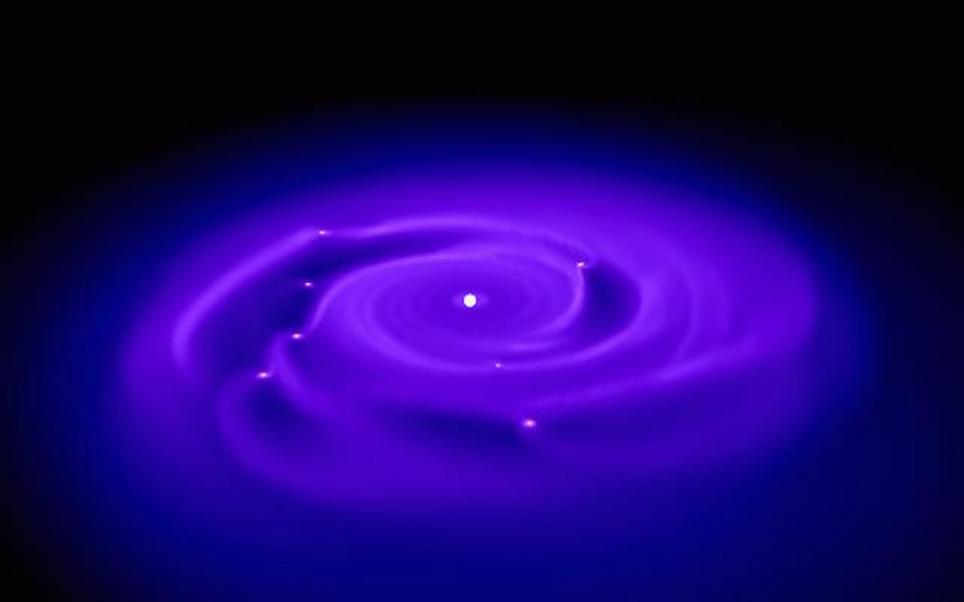
Protoplanetary Disk – multiple planets? (PDS 70) – planets’ sizes not shown to scale
Data
Simulation
Artist’s rendition

Slide 53
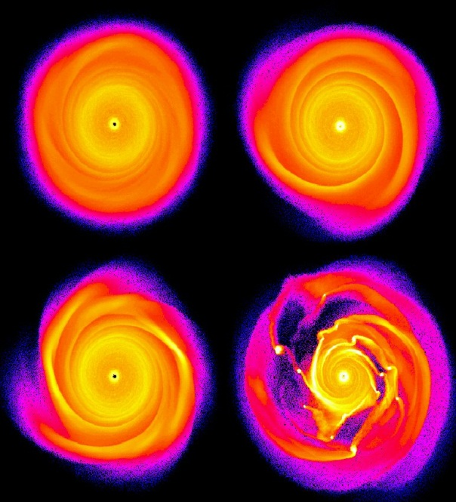
Meanwhile
So how fast does it take?
Models used to say ~10⁶ years or less
New models (higher resolution) think it’s MUCH faster (active area of research), maybe even just 100’s of years to form the cores of gas giants… (then some more time for the rest)
Recipe:
Start with protoplanetary disk and allow material to interact…
More simulations

Slide 54
Condensation Sequence (standard model…?)
Inner region of the system supposedly too hot for volatiles and (traditional) ice: rocky accretion leads to terrestrials.
Further out, volatile solids (ices) available for planet making: larger planetary embryos accrete gas directly.
But we “see” giant extrasolar planets close to their stars (“hot Jupiters”)
Contradiction? (wait for it…)

Slide 55
Puzzles
Symbol | Definition | Example
ka (for kiloannus) | 10³ years (thousand/ millennium) | 0.48 ka Copernicus developed the heliocentric model.
Ma (for megaannus) | 10⁶ years (million) | Dinosaurs died around 65 Ma years ago.
Ga (for gigaannus) | 10⁹ years (billion) | Cosmology and Geology – The formation of Earth occurred 4.54 Ga. Age of the universe is 13.8 Ga
Ta (for teraannus) | 10¹² years (trillion) | 70 times as long as the age of the universe; estimated life span of a small red dwarf.
Pa (for petaannus) | 10¹⁵ years (quadrillion) | Half-life of nuclide cadmium-113 is about 8 Pa
Ea (for exaannus) | 10¹⁸ years (quintillion) | Half-life of tungsten-180 is 1.8 Ea

Slide 56
Puzzles
The Late Heavy Bombardment (LHB) of the Moon: the appearance of large impact basins, the youngest of which are about ~3.9 Ga old (so they formed ~700 Ma after the solar system “started”).
NASA | Evolution of the Moon
Why bombarded so “late”?

Slide 57
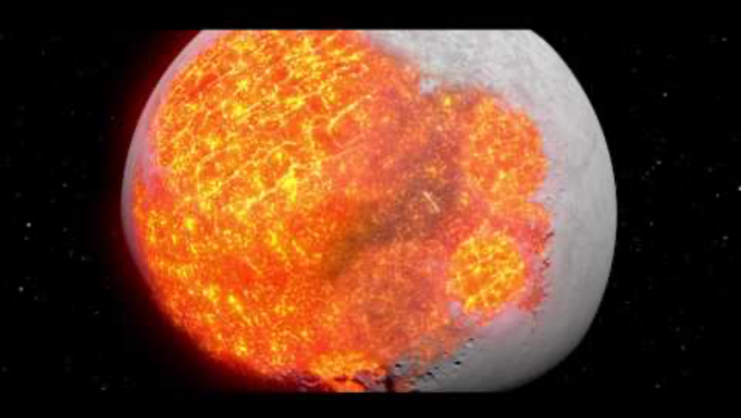

Slide 58
Need a “Nice” Model
Late Heavy Bombardment (LHB) of the Moon…was it…
…just the tail-end of terrestrial planet accretion?
…a spike in the impact rate due to something else?

Slide 59
The Nice Model Proposes…
Our 4 giant planets formed within 5 – 20 AU of the Sun (much closer in toward the Sun than Neptune currently is)
Beyond them was a massive leftover disk of material out to ~30 AU
The four giants migrate slowly, spreading out as they interact with the disk

Slide 60

The Nice Model Proposes…
Jupiter & Saturn cross a strong 2:1 mean-motion resonance at around 700 Ma.
Gravity again!
This causes Uranus & Neptune to go unstable and get scattered farther out into the disk.
Uranus & Neptune evolve into current orbits due to interactions with the disk.
Incredibly violent process!!!! (remember: it’s not violent to Jupiter (318 x mass of the Earth) or Saturn (95 x mass of the Earth)

Slide 61
Planetary Migration
Some movies to watch to help understand what the problems really are and how we might solve them…Nice model; Grand Tack Hypothesis; etc.
Science Today: Simulating Solar System Formation | California Academy of Sciences
Nice model - Solar System simulation (one data set)
Science of the Solar System - The Grand Tack (Lecture by Mike Brown)

Slide 62
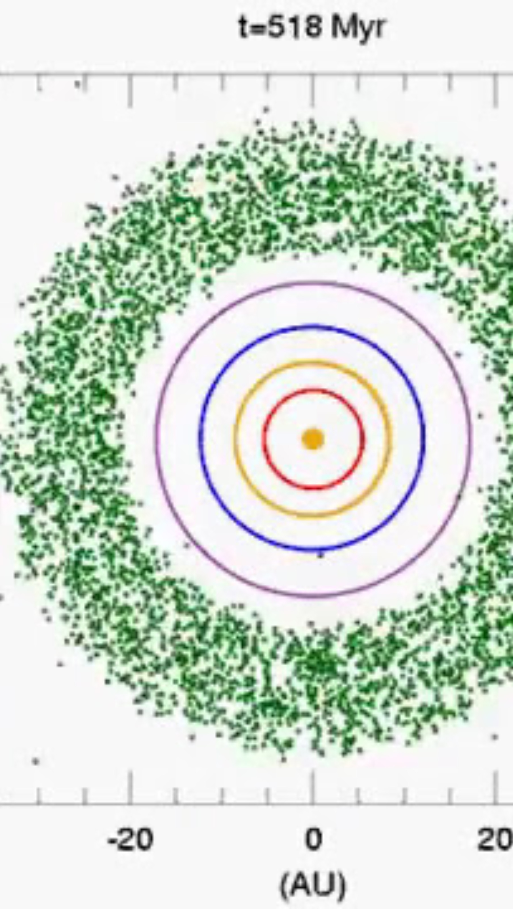
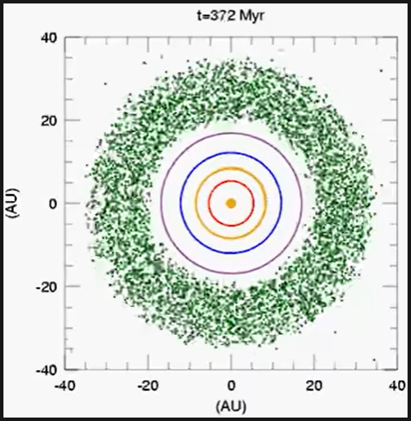
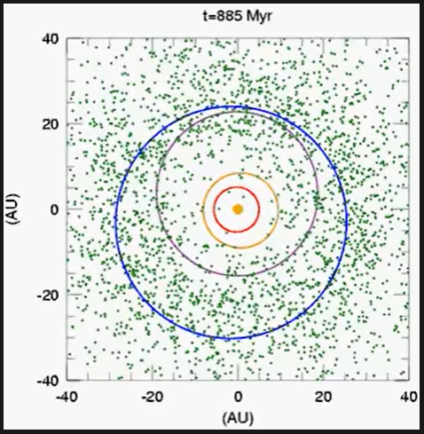
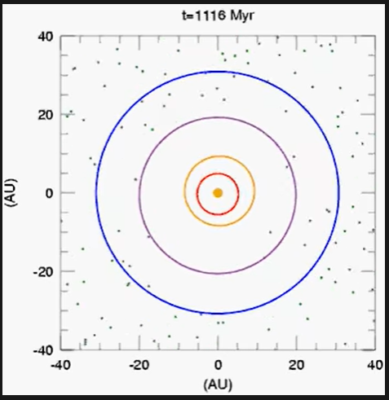

Slide 63

The Nice Model Explains…
The present-day orbits of the giants (Neptune too!)
The late heavy bombardment!
And some other things to some extent:
Capture of the Trojan asteroids
Trapping of comet-like asteroids in the main belt.
Capture of giant planet irregular moons.
Properties of Kuiper belt

Slide 64
The Nice Model Explains…
Most importantly, we can see that planet migration matters…
…may explain “hot” Jupiters…
Or we may need to scrap many details of the conventional stellar system formation model

Slide 65
The Grand Tack Hypothesis…
Explains why Mars is so small…
…and why the asteroid belt is pathetic (in total mass, not total number of rocks)
Again – remember that the big planets aren’t easy to move around. Even the Grand Tack is only because early on the disk had more material than the protoplanets/early planets
Where did all that disk material go?

Slide 66
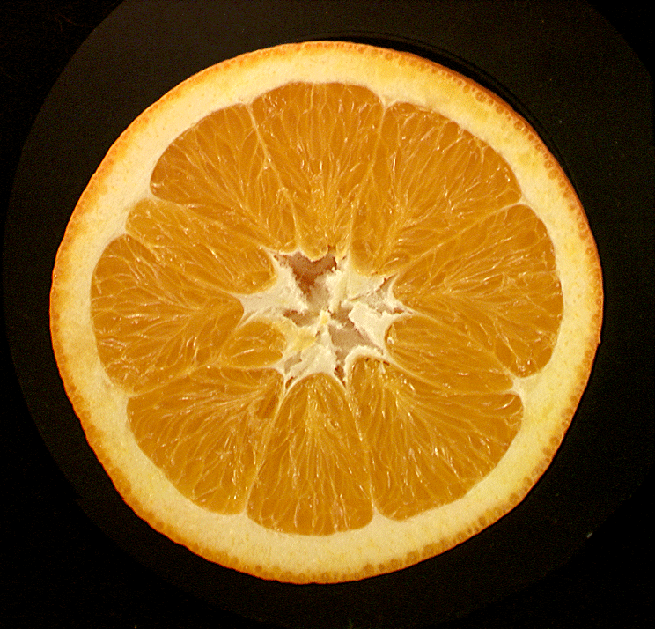
Terrestrial Planet Interiors
Crust
Mantle
Core

Slide 67
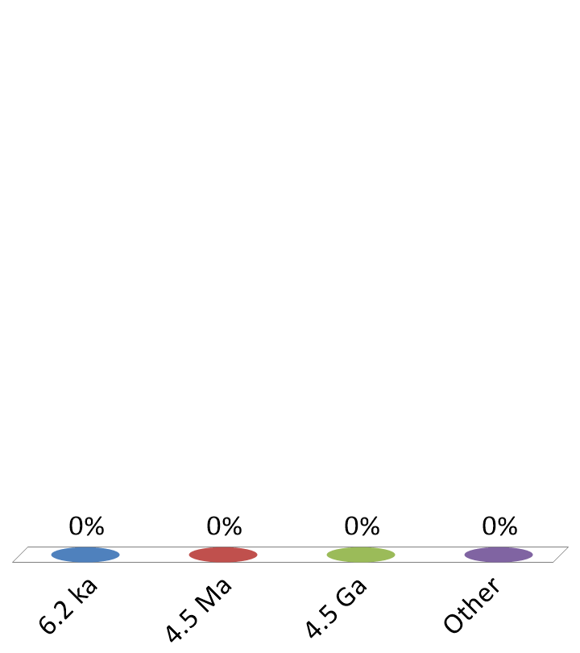
The Earth has been cooling for…
6.2 ka
4.5 Ma
4.5 Ga
Other
Notes:
George Campe (2/6)
James Ramirez
Stefan Fasano

Slide 68

How do we know what’s down there?

Slide 69
How do we know what’s down there?
Seismic waves reflecting/refracting off boundaries
Evidence from below! (Xenoliths)
Volcanism
Magnetic field

Slide 70
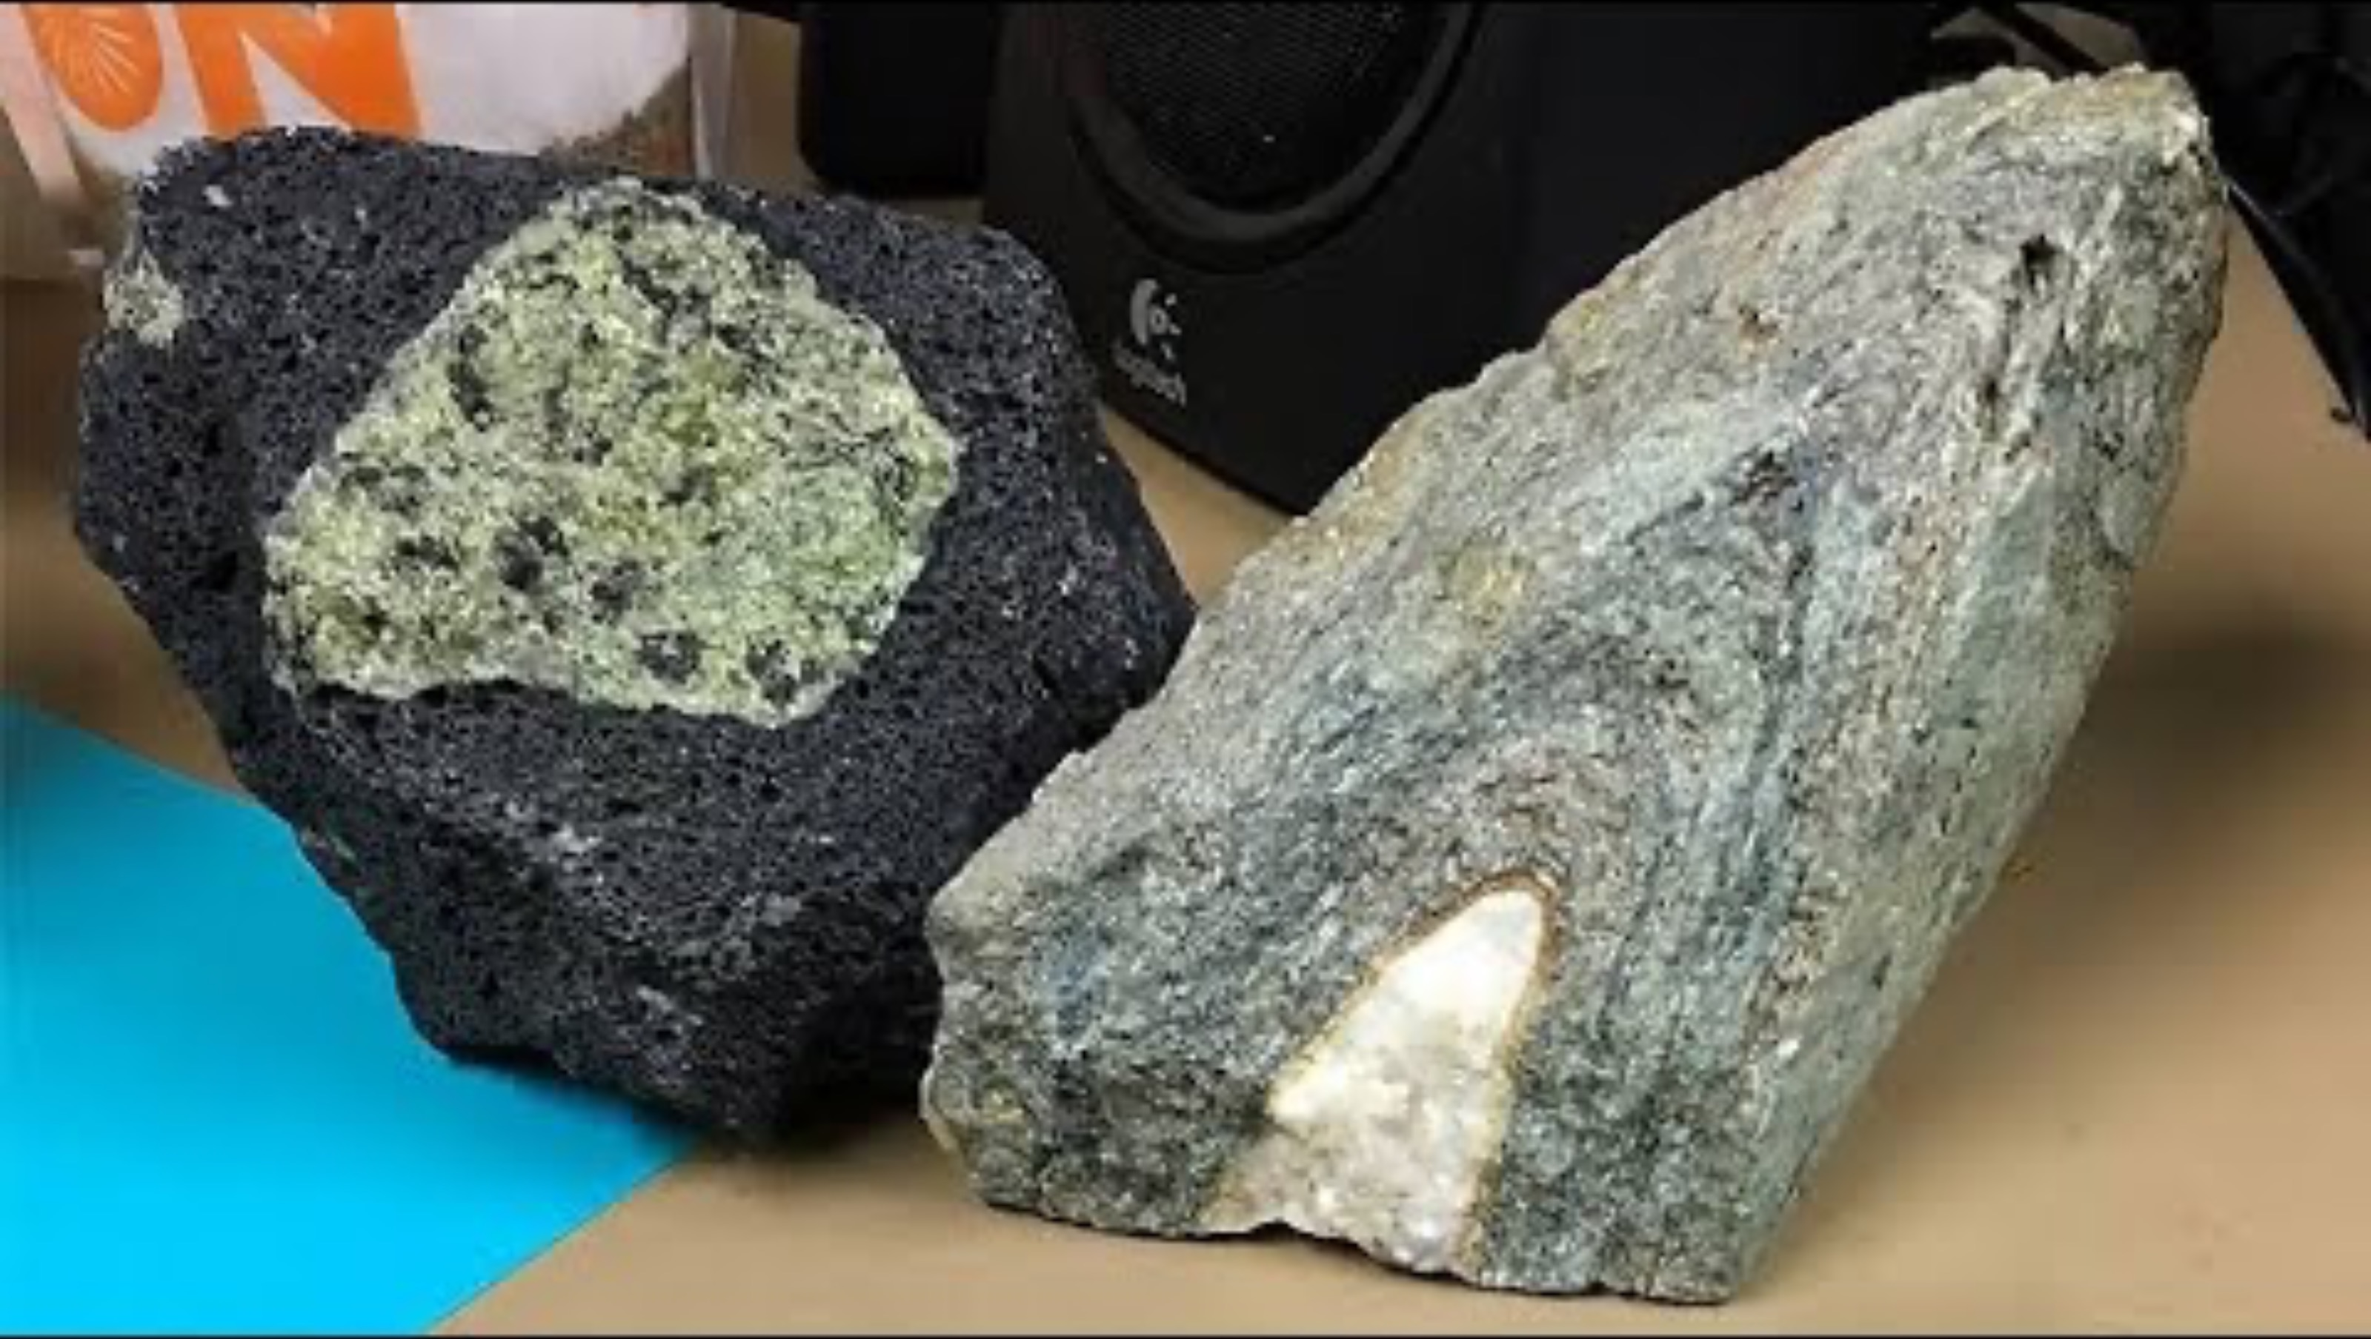
What does xenolith mean?
Alien rock
Plagioclase feldspar
Frozen magma
Calcite
Serpentine
I don’t know. Guess I should have asked?

Slide 71
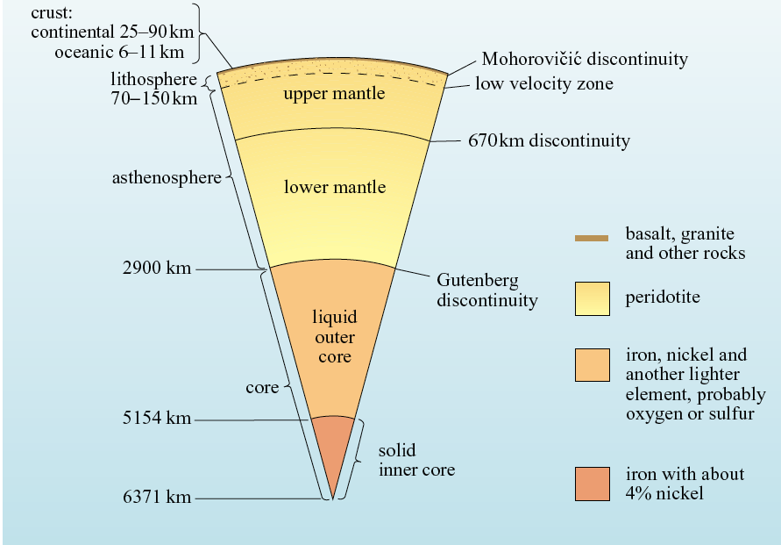
Layers Subdivided
Not to scale!
Notes:
Lithosphere: heat transfer by conduction; asthenosphere: heat transfer by convection.
71

Slide 72
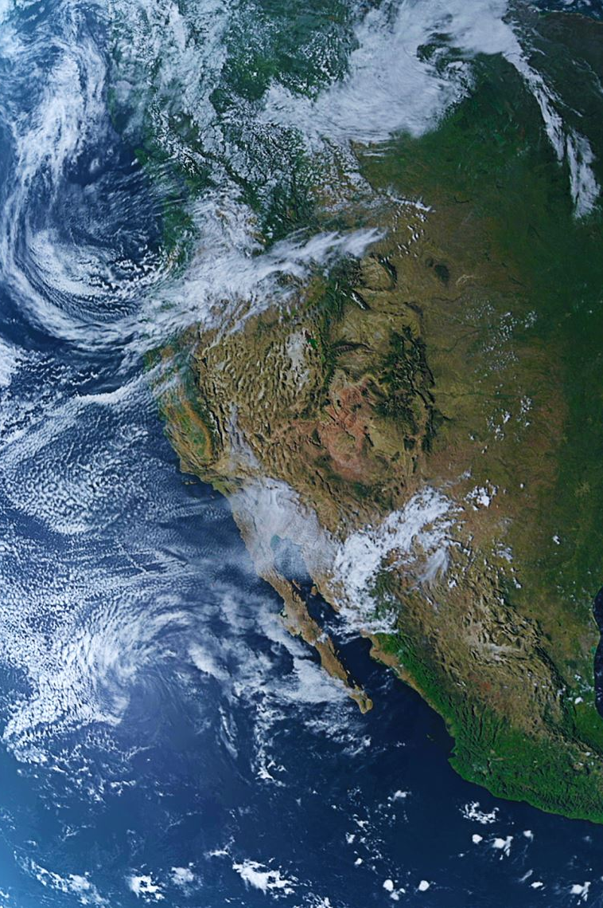
Why does Earth have layers?
Differentiation is the term for denser materials sinking toward the core while lighter materials rise – GRAVITY!
Density driven!
It’s the chemistry that’s differentiated!
Notes:
72

Slide 73
Why is it still molten at the center?
Warning: not molten at most layers… really only at
Outer core and
Liquid magma forms when it depressurizes “quickly” at VERY top of crust (volcanoes)
DEEP TIME should have cooled it off, no?
Notes:
73

