Slide 1






VOICE
PRIVACY

Slide 2

Introduction
Architecture
Technique used
Results exposed
Introduction
The Voice Privacy Challenge aims to anonymize speech while preserving intelligibility. Existing approaches include deep learning-based voice conversion and speaker embedding modification, but deep learning incurs a penalty.
We implemented a signal processing-based approach, modifying acoustic features like pitch, formants, and spectral properties to anonymize speaker identity while keeping speech clear.

Slide 3


Introduction
Architecture
Architecture
Technique used
Results exposed
Input sound
Feature extraction
Anominisation
Output sound

Slide 4
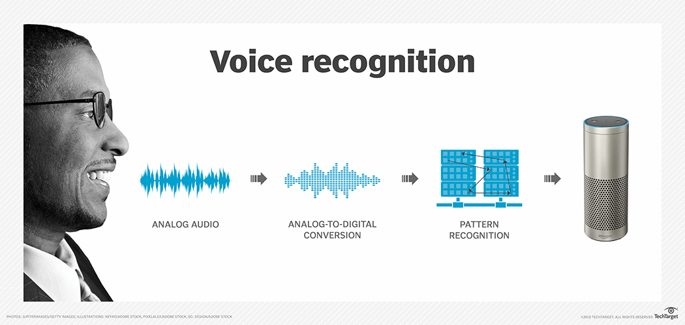
Introduction
Technique
used
Architecture
Technique used
Results exposed
Simulate a Different Vocal Tract
Time-Strech
Formant Shifting
Resampling (Time Stretching)
WSOLA (Waveform Similarity Overlap and Add)
Bandpass Filtering & Frequency Warping
Changes speaking rate without pitch modification
Speaking Rate Estimation
Energy-Based Peak Detection

Slide 5
Introduction
Technique
used
Architecture
Technique used
Results exposed
Alter Speaking Rate and F0
Speaking Rate Modification
Exchanging Formant Bands
Hilbert Transform + Phase Adjustment
Bandpass Filtering + Frequency Band Swapping
Replacing High Frequencies with Noise
Pink Noise Synthesis

Slide 6
Introduction
Architecture
Results exposed
Technique used
Results exposed
Dataset with noise
Dataset without noise
WER: 0.23
EER: 0.30
WER: 0.13
EER: 0.25

Slide 7
VOICE
PRIVACY

