Slide 1

GDG 2015 Dev Festival
Zhang Sichu

Slide 2
微信订餐应用实践

Slide 3

Angular

Slide 4

Cordova

Slide 5
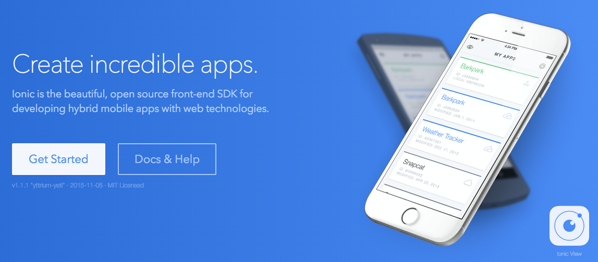
Ionic

Slide 6
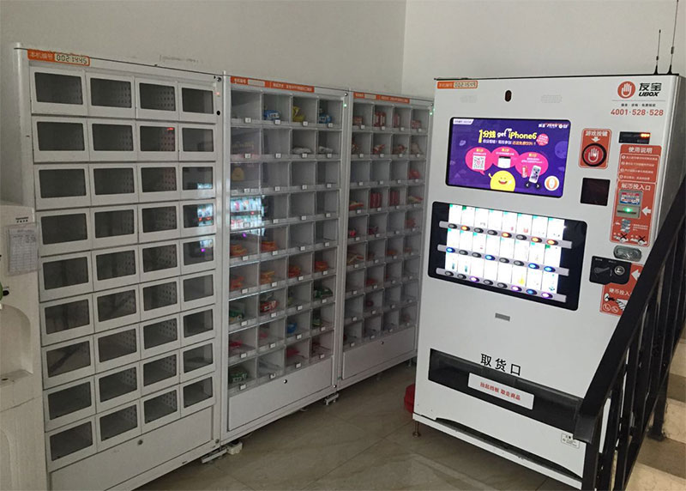
场景

Slide 7
Axure
DEMO

Slide 8
CODE
The UI Angular
Cordova plugin
Publish to emulator
Publish to real machine

Slide 9
Q&A
Thanks

