Slide 1




Welcome to
GDG @ Seneca
Info Session · Fall 2026
Wed, 23 September 2026
Newnham Campus · Helix Conference Room
linktr.ee/senecagdg
Notes:
Start on time even if the room is half empty. People arrive late to the first event of a semester. Say your name, your program, and your year before anything else.

Slide 2

AGENDA
What's GDG on Campus?
1
Tonight's
plan
2
Meet the team
3
Why join
Stick around after if you can. We'll be hanging out and chatting.
4
What's coming up this term
5
Quick live demo
6
How to join
7
Q&A
GDG on Campus · Seneca Polytechnic
02
Notes:
Read it once and move. No times on screen, so the run of show can slip without the slide looking wrong.

Slide 3



01 ABOUT
Supported by Google
A student club, supported by Google
Google gives us the program, the branding, and some resources for events.
Google's community programs →
Run by students
There are GDG on Campus chapters at schools all over the world. We're the one at Seneca.
Students run everything, so we get to pick the events and projects.
Our chapter page →
Heard of GDSC?
That's us. Google Developer Student Clubs got renamed to GDG on Campus in 2024.
Learn by doing
We learn Google tech by making things and helping each other out.
See other chapters →
Google Developer Program →
GDG on Campus · Seneca Polytechnic
03
Notes:
Two sentences on the rebrand, because people search for the old name. Google Developer Student Clubs became GDG on Campus in 2024. If someone in the room remembers GDSC, it is the same program.
Do not spend more than five minutes here. Nobody joins a club because of its org chart.

Slide 4
02 WHO WE ARE
Meet the team
OK
TN
SC
LK
TD
BJ
Osman Kahraman
Thai Nguyen
Stephanie Chinaza
Lucas Krawczak
Tan Dat Ta
Betjoy Jacob
Chapter Lead
Event Coordinator
Event Coordinator
Tech Lead
Tech Lead
Marketing
Want to join the team? We're looking for people every term. Come talk to us after.
GDG on Campus · Seneca Polytechnic
04
Notes:
Thirty seconds each, and give everyone the same three points to hit: name, program, and one thing you have built or want to build. Rehearse this once before the room fills up, because unrehearsed introductions run four minutes each.
Before you present: confirm who is presenting and whether anyone new has joined the team.

Slide 5







03 WHY JOIN
What's in it for you
Workshops and a code jam
A hackathon
People to build with
Hands-on stuff you can actually put on your resume.
We're hoping to run one this term. More info soon.
Side projects are a lot easier when you're not doing it alone.
Google tools and credits
Solution Challenge
Run events yourself
We'll share whatever we get access to through the chapter.
Google's yearly student competition. Find teammates here.
Want experience organizing? We open spots every term.
All our events are free and open to every Seneca student, no matter your program.
GDG on Campus · Seneca Polytechnic
05
Notes:
This is the slide people actually decide on. Slow down.
Be specific instead of general. If you have a number, use it. If the chapter ran an event last term and people shipped something, name the thing.
Do not promise internships. We do not control hiring, and the claim damages trust when it turns out to be untrue.

Slide 6






03 FREE TOOLS, GOOGLE
Free stuff you can use right now
$300
Google AI Studio
Google Colab
Use the Gemini API for free, no card needed
Run Python on a free GPU
Kaggle
Firebase Spark
in Google Cloud credits for new accounts
Free GPU hours every week, plus short courses
Free database and hosting for side projects
And there's an always-free tier that sticks around after the credits are gone.
cloud.google.com/free
Gemini Code Assist
Always-free tier
AI coding help, free for individuals
Keeps working after the $300 is used up
GDG on Campus · Seneca Polytechnic
06
Notes:
The always free tier point is the one worth stressing. Students assume everything stops when the 300 dollars runs out, so they never start.
Before you present: check every quota on this slide. Free tier terms change without warning, and a wrong number on a slide is the thing people remember.

Slide 7

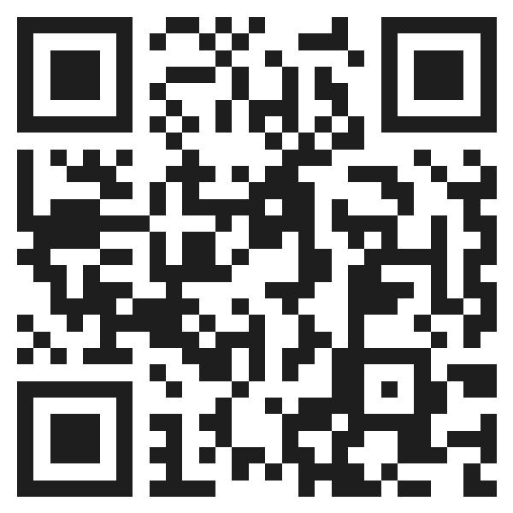






03 FREE TOOLS, GITHUB AND MORE
GitHub Student Developer Pack
Sign up with your school email. Some of the best parts:
GitHub Copilot Pro
JetBrains IDEs
Free while you're a student
All their IDEs, free
Microsoft Azure
DigitalOcean
$100 credit, no card needed
$200 in credits
Get the pack
Namecheap
And more
A free .me domain and SSL
Plus MongoDB Atlas, Notion, Frontend Masters, DataCamp
education.github.com/pack
We're making a how-to guide for this soon.
Also free: AWS Educate · Figma Education · Cloudflare Workers and Pages · Supabase, Vercel, Netlify hobby tiers
GDG on Campus · Seneca Polytechnic
07
Notes:
Most students have heard of the pack and never applied, because the full list is long enough to bounce off. Naming six items works better than pointing at the page.
Put the whole list on the linktree so this slide does not have to be exhaustive, and so it can be corrected later when terms change.
Use a QR code on this slide and the next. Nobody types a URL off a projector.

Slide 8





04 THIS TERM
What's coming up
Web
Cloud
ML and AI
Mobile
DATE TBC
DATE TBC
DATE TBC
Code Jam
Small Hackathon
Cloud Study Jam
Build a quick prototype with Google's AI tools in two hours. There's pizza.
Team up and build something in one event. Still working out the details.
Work through Google Cloud labs. Everyone who joins gets Skills Boost credits.
GDG on Campus · Seneca Polytechnic
08
Notes:
Name the tracks out loud. A student who came for Android needs to hear the word Android.
Only commit to dates you can keep. An event announced and then dropped costs more attendance than an event never announced.
Before you present: add real dates for any of these that are scheduled.

Slide 9
04 SOLUTION CHALLENGE
Google's Solution Challenge
1
Pick a real problem
Something you or people around you actually deal with.
A yearly competition where GDG on Campus students build apps that solve real problems.
2
Build it with Google tech
Teams can have up to four people.
Start looking for a team early
Lots of people find teammates through us.
3
Win prizes
Top teams get prizes, mentorship, and exposure.
GDG on Campus · Seneca Polytechnic
09
Notes:
Check the current cycle's dates and rules on Google's site before you present this.
This is the strongest reason to join in September rather than January, so give it a full slide even if the details are thin.

Slide 10

05 LIVE DEMO
Quick live demo
app.py
10:00
We'll go from an empty file to a small Gemini app. Feel free to follow along.
# pip install google-genai
from google import genai
client = genai.Client()
reply = client.models.generate_content(
model="gemini-2.5-flash",
contents="Pitch GDG in one line",
)
print(reply.text)
Google AI Studio
Nothing to install
No credit card needed
GDG on Campus · Seneca Polytechnic
10
Notes:
Do the demo. A talked-about demo is worth nothing.
Use Google AI Studio, because it needs no credit card and no install, which means people can follow along on a laptop in the room and repeat it later.
Keep it to ten minutes and rehearse the whole thing once against the room's projector and the room's wifi. Have a recorded fallback ready, because campus wifi fails during live demos more often than it should.
End by telling them exactly where the code is, then put that link on the linktree.

Slide 11
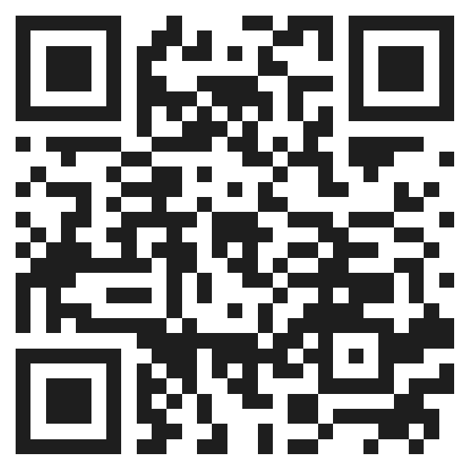




06 JOIN
Where to find us
Join our Discord
Open →
discord.gg/x5NYqqKyAf
Follow us on Instagram
Open →
@senecapolygdg
Follow us on LinkedIn
Open →
Scan me
linkedin.com/company/senecapolygdg
Anyone at Seneca can join, and it's free.
All our links
Open →
linktr.ee/senecagdg
GDG on Campus · Seneca Polytechnic
11
Notes:
Say the free and open line out loud. Business, design, and health students write software too, and they assume a club like this is not for them.
Have the QR code on screen while you say this, and leave it up through Q&A.

Slide 12

06 GET INVOLVED
Want to help out?
Everything here is run by students, and we open up spots every term.
Events
Marketing
Technical content
Plan events, book rooms, and deal with SSF. Usually a few hours a week.
Make posters, run our Instagram, and get the word out.
Put together workshops, demos, and starter code.
Interested? Come talk to us after, or send us a message on Discord.
GDG on Campus · Seneca Polytechnic
12
Notes:
Be honest about the work. Running an event is a few hours a week, mostly email and scheduling.

Slide 13
Questions?
Ask us anything. No question is too small.
What does it cost?
How much time does it take?
Do I need experience?
Is there food?
GDG on Campus · Seneca Polytechnic
13
Notes:
Six minutes. If nobody speaks first, ask the room a question instead. What are you building right now works better than any question about the club.
Have answers ready for the four that always come up: what does it cost, how much time does it take, do I need experience, and is there free food.

