Slide 1

Computer Science 101
Let’s Explore Under the Hood

Slide 2



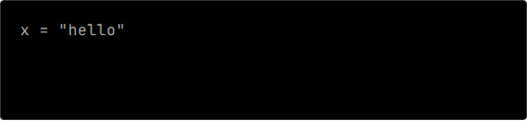
THE LIE WE TELL YOU
High-Level Abstraction
Python Code
In Python, you type print() and magic happens. It's a comfortable illusion.
???
THE BLACK BOX
# Where did this go in memory?
# How many bytes?
# Python hides this.
CPU / RAM

Slide 3

THE SWITCH
Computers don't know "math". They only know electricity. A transistor is a microscopic switch.
0V
0
5V
1
OFF (0V) = 0
ON (5V) = 1

Slide 4



BINARY: THE LANGUAGE OF ON/OFF
1
8
1 Bit
1 Byte
Binary Math
A single switch.
Values: 0 or 1.
8 switches in a row.
Values: 0 to 255.
128 64 32 16 08 04 02 01
0 1 0 0 0 0 0 1
= 65

Slide 5





ASCII: THE AGREEMENT
DEC
BIN
CHAR
65
A
How do we store text? We agree on a map.
DEC
BIN
CHAR
char
65
66
B
// This number is literally 'A'
DEC
BIN
CHAR
33
!

Slide 6


RGB: NUMBERS TO LIGHT
3 Bytes Per Pixel
Every dot on your screen is just three numbers representing intensity.
•
Red (0-255)
•
Green (0-255)
•
Blue (0-255)
pixel[0] = {255, 255, 255};

Slide 7

Intro to C
> Level 1: The Metal Language

Slide 8
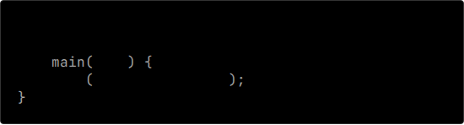
ENTER C
No More Training Wheels
#include
C demands manual control. You must import libraries, define return types, and compile code manually.
int
void
printf
"hello, world\n"

Slide 9
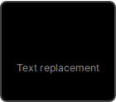
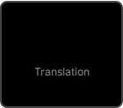
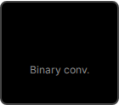
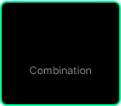
THE COMPILATION PROCESS
Preprocess
Compile
Assemble
Link
#include -> Code
C -> Assembly
Asm -> Object .o
.o + Libraries -> Exe
// The command that does it all
clang -o hello hello.c

Slide 10


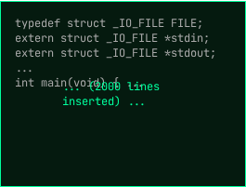
STEP 1: PREPROCESSING
Text Replacement
Lines starting with # are instructions for the preprocessor.
#include literally finds the file stdio.h and copy-pastes its entire contents into your file.

Slide 11


HEADER FILES (.H)
The Promise vs. The Code
THE MENU
THE KITCHEN
int add(int a, int b);
int add(int a, int b) {
return a + b;
}
Header files are like a Menu. They tell the compiler what functions exist (prototypes).
int sub(int a, int b);
The .c files (or libraries) are the Kitchen. They contain the actual implementation details.

Slide 12



STEP 2: COMPILING
Translation to Assembly
The compiler translates C code into Assembly Code.
main:
push rbp
mov rbp, rsp
mov eax, 0
pop rbp
ret
These are low-level CPU instructions (like mov, push, add) that represent the logic of your program, but still in text form.

Slide 13


STEP 3: ASSEMBLING
Binary Conversion
mov eax, 0
ret
The assembler translates Assembly code into Machine Code (Object code).
These are the actual 0s and 1s that the CPU executes. It is no longer readable by humans.
0110100111100010 1010000011110101 0000110010101110

Slide 14

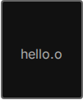
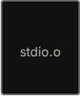
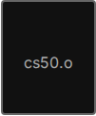
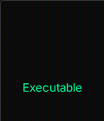

STEP 4: LINKING
+
+
hello
Putting it Together
Your code references functions (like printf) that you didn't write. The Linker combines your object code with the object code of those libraries to create one single executable file.

Slide 15
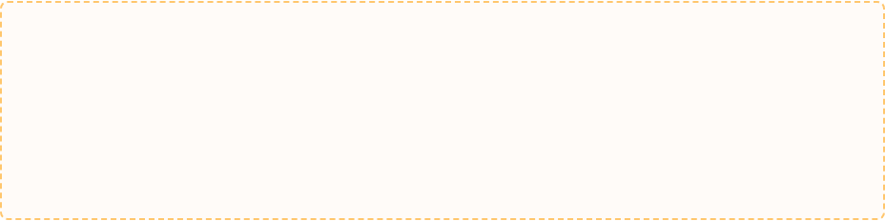

LET'S WRITE CODE
Write a full C program that prints "Hello, C". To visualize the flow

Slide 16
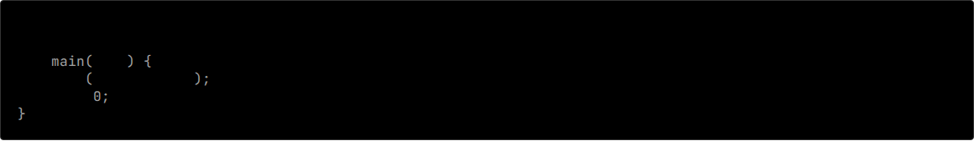
THE SOLUTION
HELLO.C
#include
int
void
printf
"Hello, C\n"
return

Slide 17


TIME TO TEST YOUR KNOWLEDGE
Verify_Knowledge_Base();
Are you ready to prove you understand Compilation & C?

Slide 18

Memory & RAM
> Level 2: The Memory Grid

Slide 19


THE COST OF DATA
Allocation Matters
In Python, numbers grow forever. In C, you have a fixed box size.
If you try to fit a long value into an int box, the data physically won't fit.

Slide 20










8-BIT LIMIT
Integer Overflow
What happens when you add 1 to the max number? It wraps around.
+ 1
This caused the Y2K bug and crashes rockets.

Slide 21



POINTERS: THE POWER OF ADDRESS
What is a Pointer?
A pointer is a variable that stores the address of another variable, not a value.
0x981
0x123
p
n
int
50
0x123
50
int
&n means "Get address of n".
*p means "Go to address p".

Slide 22


SEGMENTATION FAULT
Touching Forbidden Memory
If you try to access an address that doesn't belong to your program (like NULL or random garbage), the OS kills your process instantly.
Access Denied
int
NULL
printf
"%d"
// CRASH!

Slide 23




INPUT: THE ADDRESS OPERATOR
Passing by Reference
To change a variable (like filling it with input), a function needs to know where it lives.
0x123
42
User Types: 42
&
The & operator means "The Address Of".

Slide 24


RAM (The Grid)
> Random Access Memory
Every byte has an address. Every variable lives in a numbered box.

Slide 25





ARRAYS: CONTIGUOUS MEMORY
Back-to-Back
An array is a request for neighboring houses.
0
1
2
3
We can find any item instantly because we know exactly how wide each house is.

Slide 26
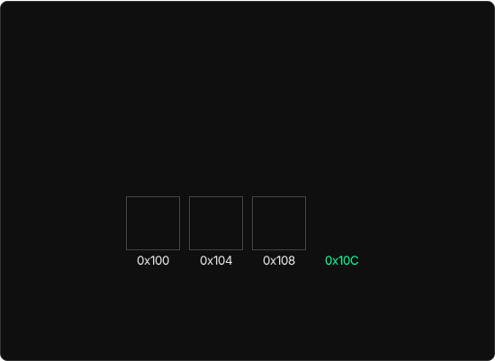



ARRAY ACCESS: THE SECRET FORMULA
Instant Access
How does the computer find scores[100] instantly?
0x100
+
(3 * 4)
=
0x10C
It doesn't "search". It calculates.

Slide 27







STRINGS: THE ILLUSION
No String Type
The Sentinel (\0)
Buffer Overflow
C has no "string". It only has char[] (arrays of characters).
How does the computer know where the text ends? We put a secret 0 byte (NUL) at the end.
If you forget the \0, the computer keeps reading memory. This is how hackers steal data (like Heartbleed).
<-- Vital!

Slide 28
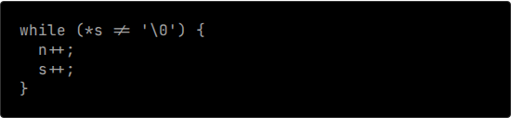





STRING OPS: WALKING MEMORY
How `strlen()` works
The computer doesn't know the length. It has to count.
This is why string operations can be slow if you aren't careful.

Slide 29
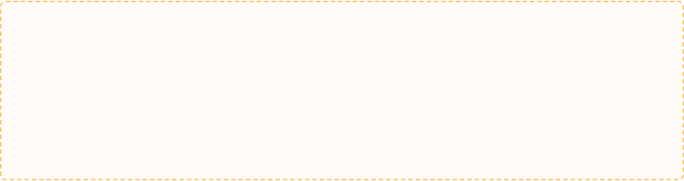
LET'S WRITE CODE
Re-create the function `int my_strlen(string s)`.
Hint: Use a loop and stop when you hit \0.

Slide 30
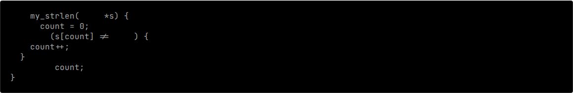
THE SOLUTION
MY_STRLEN
int
char
int
while
'\0'
return

Slide 31




COMMAND LINE ARGUMENTS
What are they?
You can pass data to your program before it runs.
$ ./hello David
0
1
2
argc = 2
•
argc: Argument Count (How many?)
•
argv: Argument Vector (The words)

Slide 32
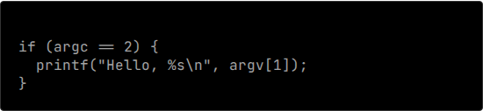
COMMAND LINE ARGUMENTS
Talking to Main
You can pass data to your program before it runs. argv is an array of strings sent by the shell.
•
argv[0]: The program name (e.g. ./hello).
$ ./hello David
0
1
2
•
argv[1]: The first word typed after the command (e.g., David).
•
argv[argc]: Always NULL (End of list).
argc = 2
// Check if user gave a name

Slide 33
LET'S WRITE CODE
Add functionality to existing program to accept command line arg inputs
Hint: Use argv with right index to get the name.

Slide 34
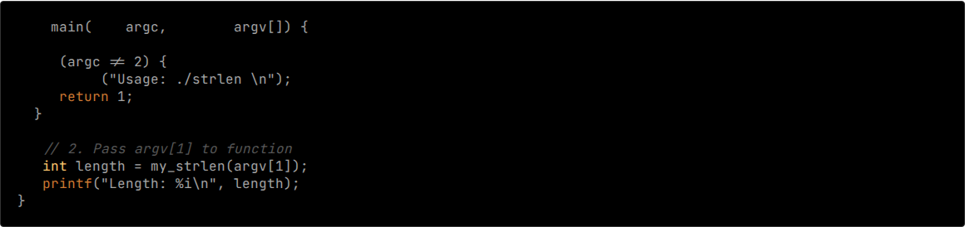
THE SOLUTION
CLI_STRLEN.C
int
int
string
// 1. Validate Input
if
printf

Slide 35



PROBLEM SET 1
Apply what you've learned.
Mission: Build a cash program in C.

Slide 36
PROBLEM SET 2
Apply what you've learned.
Mission: Build a Caesar Cipher in C.

Slide 37
You Are Now Mechanics
You aren't just driving the car anymore. You know how the engine combusts.
// END_OF_SESSION

