Slide 1
BriefFlow AI
Content Brief to Script Pipeline
Agentic AI Hackathon
Team Members-Jagan Kumar Swain and Ratish Ranjan Sahu

Slide 2
Why PS-2
No complex API approvals
Fast integration by using Sheets, Notions , Slack
Maximum Agentic decision making
Low risk of demo failure

Slide 3
Problems to be solved
Manual rewriting: 20-30 min/brief
40-60 briefs/month
4-6 hours delay
Inconsistent interpretation

Slide 4
Objective
Automate end to end pipeline
Reduce delay to seconds
Ensure consistency
Generate ready to use briefs

Slide 5
Agentic System
LLM decides completeness
LLM interprets the intent
LLM routes the workflow
Maximum decisions are agent-driven

Slide 6
System Architecture

Slide 7
Core Agents
Parser: Extract + Validate
Retriever: Fetch brand content
Interpreter: Generate the hooks and tone
Router: Decide next action

Slide 8
Tech Stack
LangGraph (workflow)
Gemini (LLM)
FAISS (memory)
Sheets, Notion , Stack, Airtable
LangSmith (logs)

Slide 9
Workflow
Detect brief
Parse data
Retrieve the content
Interpret it
Route
Generate the output

Slide 10
Edge Cases
Missing fields – Asks for clarifications
Unknown brand – Flag
Scriptwriter unavailable – Fallback
Broke URL – Continue safely

Slide 11
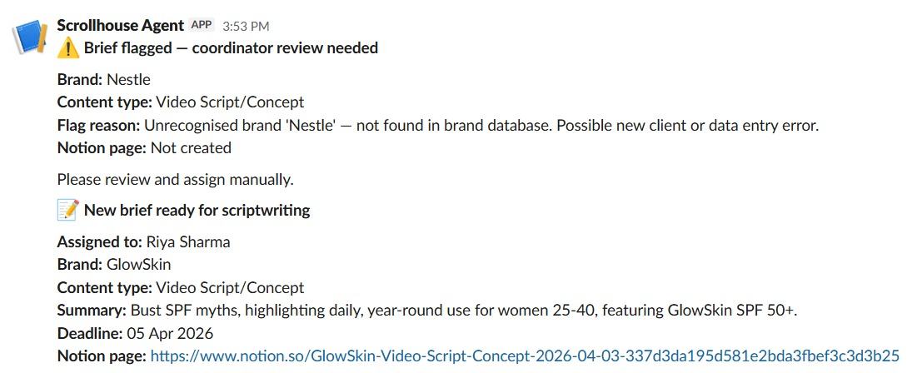
Agent Decision Proof
Parser

Slide 12
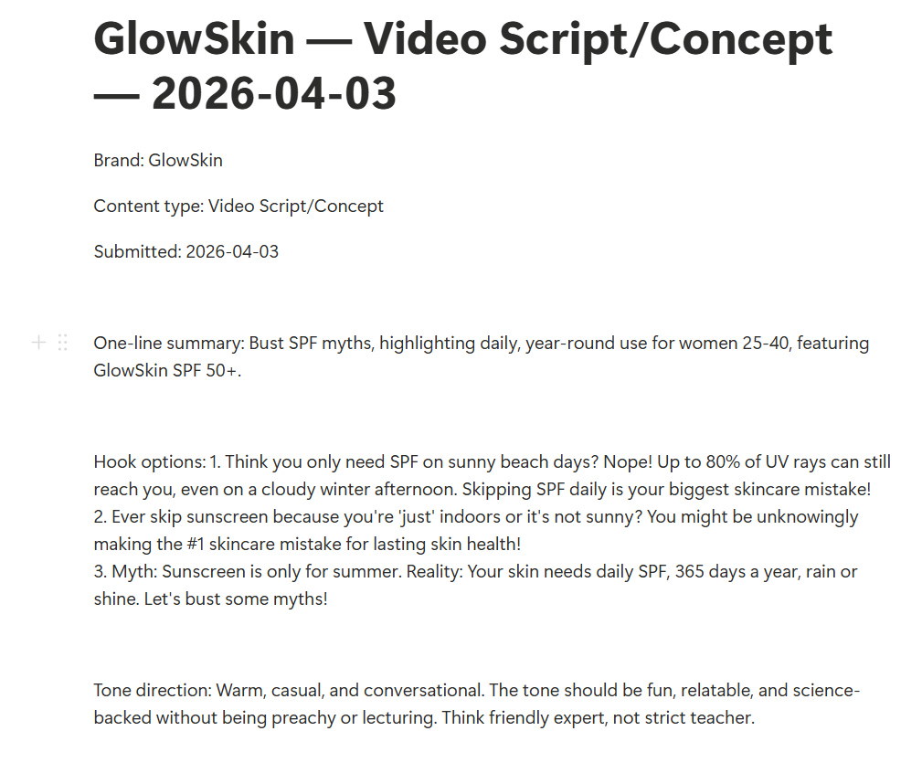
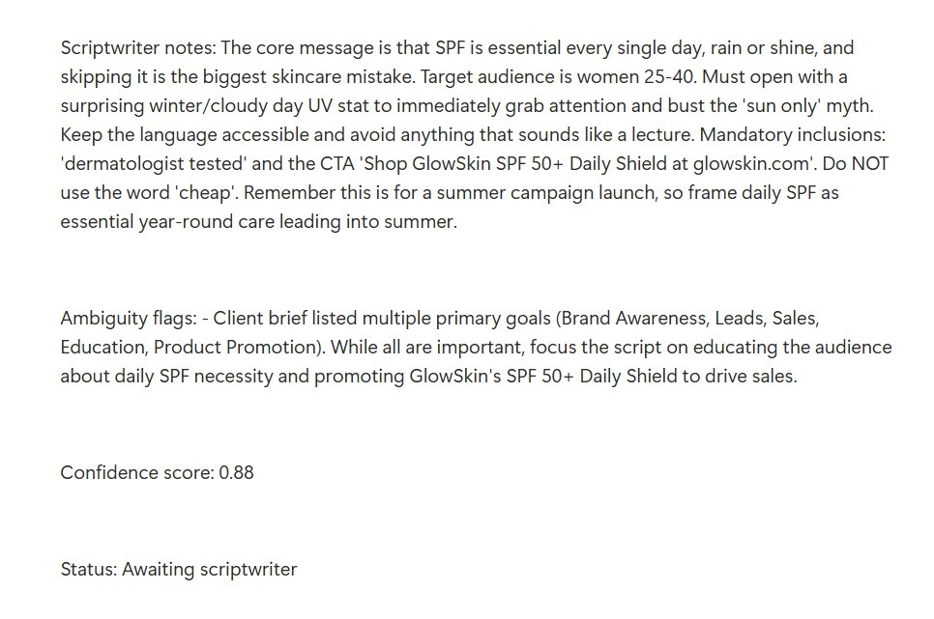
Interpreter

Slide 13
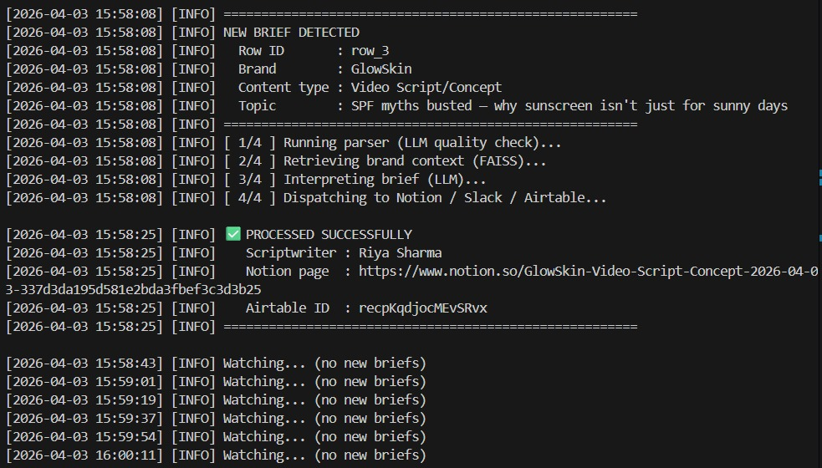
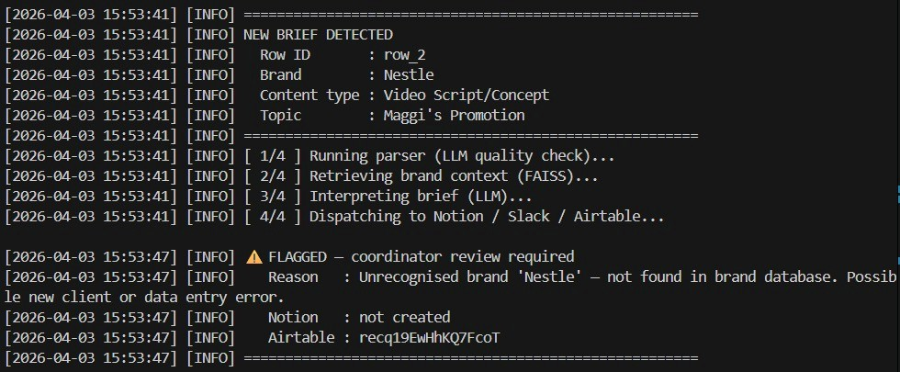
Router

Slide 14
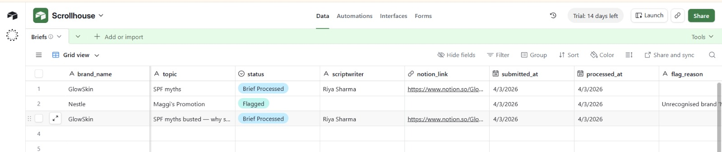
APIs

Slide 15
Why This Scores High
End to end working system
Maximum agentic decisions
Handles edge cases
Clear architecture

