Slide 1
Lecture 2: Numpy, Matplotlib
J. Eldred
MATLAB/Python for Accelerators
February 7-18 2020

Slide 2
2
2
Python Tutorials
Matplotlib tutorial:
https://matplotlib.org/stable/tutorials/index.html
Example of Matplotlib documentation:
https://matplotlib.org/stable/api/_as_gen/matplotlib.pyplot.scatter.html
List of colormaps:
https://matplotlib.org/stable/tutorials/colors/colormaps.html
Example Scripts:
Numpy Basics
Histograms
FFTs
Statistics
Synchroton Light
2
Jeffrey Eldred | MATLAB/Python for Accelerators
Notes:
2
2
2
2
2
2

Slide 3
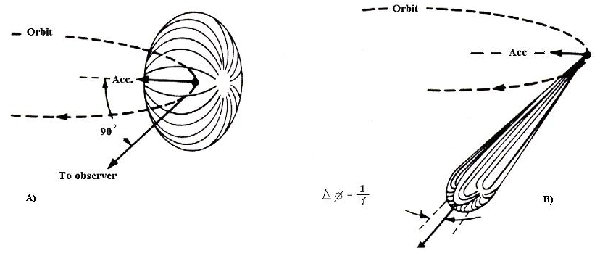
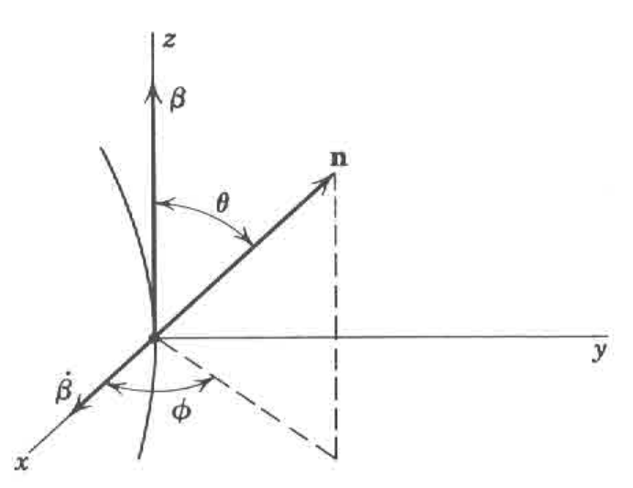
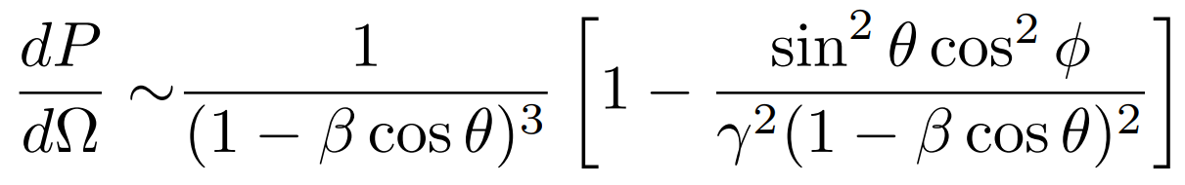
3
3
Synchrotron Light
θ = zenith angle = “latitude”
Φ = azimuthal angle = “longitude”
3
Jeffrey Eldred | MATLAB/Python for Accelerators
Notes:
3
3
3
3
3
3

Slide 4
4
4
Interactive: Topics
Numpy
Appending Lists
Stacking Arrays
Indexing 2D Arrays
Multi-element Operations
Multi-element Inequalities
Not a Number
Matrices
4
Jeffrey Eldred | MATLAB/Python for Accelerators
Notes:
4
4
4
4
4
4

Slide 5
5
5
Interactive: Topics
Matplotlib
Customizing 1D plots
2D Mesh Plots
Quiver Plots
Scatter Plots
5
Jeffrey Eldred | MATLAB/Python for Accelerators
Notes:
5
5
5
5
5
5

