Slide 1
Project Progress

Slide 2
Considering Neutral tweets as Positive
 | TP | FP | Precision
Custom classifier | 428 | 177 | 0.707438
Textblob | 447 | 166 | 0.729201
Precision of custom classifier is 70.74% when we consider neutral tweets as negative tweets.
Precision of Textblob is 72.92% when we consider neutral tweets as negative tweets.

Slide 3
Considering Neutral tweets as Positive
Custom Classifier Precision
Textblob
Precision

Slide 4
Considering Neutral tweets as Negative
 | TP | FP | Precision
Custom classifier | 151 | 68 | 0.689498
Textblob | 183 | 95 | 0.658273
Precision of custom classifier is 68.94% when we consider neutral tweets as negative tweets.
Precision of Textblob is 65.82% when we consider neutral tweets as negative tweets.

Slide 5
Considering Neutral tweets as Negative
Custom Classifier Precision
Textblob
Precision

Slide 6
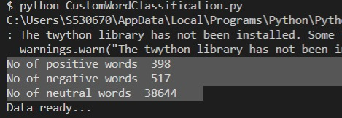
Adding words to dictionary

Slide 7
Attributes of MeToo Tweets
text
lastcontactdate
Lasttimelinepull
lasttimetweetsanalyzed
Numberoftweetsanalysed
Numberoftweetsabouthash
actualtwitterdate
Id
insertdate
twitterhandle
followers
hashtagsearched
Tweetid
dateoftweet

Slide 8
Total number
of tweets:
393869
Notes:
Descriptive
Total
Attributes
Processing data block diagram
Results

Slide 9
Attributes of Hurricane Florence Tweets
Number of tweets per hashtag
Tweet IDs for tweets in dataset
Tweet IDs and URLs for linked media
Number of tweets at a given timestamp
Number of tweets/retweets by day
Number of tweets per username

Slide 10
Total number of tweets:
4971575
Notes:
Descriptive
Total
Attributes
Processing data block diagram
Results

Slide 11
Attributes of Ferguson Tweets
Username
Date
Retweets
Favorites
Text
Geo
Mentions
Hashtags
Id
permalink
Total number of tweets: 45,500

