Slide 1
rbuild
Presentation to
SW Methods Working Group
March 09

Slide 2
rbuild Overview
Same philosophy as smake:
  Define a process, through providing a tool that supports that process
  Enables a best-practice system to be refined, through the experience of different projects
What processes does the rbuild system deal with? There are two (closely related):
  Configuration management
  Building and packaging for release

Slide 3
rbuild Tools
3 Separate but related tools:
  rbuild.py
    Used to perform automated builds
  getprereq.py
    Deals with configuration management
  release.py
    Releases a build

Slide 4
rbuild Tools
getprereq.py
  Performs configuration management, or acts as a wrapper for a configuration management system
  Used in a situation where a project must be built from a primary package combined with (version controlled) pre-requisite packages
  Defines the required versions of pre-requisite packages and how to obtain them
  Controlled from an .XML file within the primary package
  Run as part of an automated rbuild build, but may also be run stand-alone by project team members

Slide 5
rbuild Tools
rbuild.py
  Normally runs on the automated build-and-package system at KL
  Uses getprereq to put your build together
  Deals with version numbering so version numbers:
    can include an auto-incremented build number element
    are available in multiple places:
      doxygen documentation / release notes
      In makefiles
      Within the build-and-package process (for naming packages and publish locations)
  Deals with CVS tagging (integrates with configuration management system): so builds can be reproduced, or used as pre-built pre-requisites
  Only builds when there are changes

Slide 6
rbuild Tools
release.py
  Internal release step
  Manually run by a project member when a build is ready for release
  Having a separate release step means that:
    You can run daily builds and choose any build for release after the event
    Only released packages can be used as pre-requisites by other teams
    Unreleased builds and their associated CVS tags may be automatically and safely “pruned”
  Includes an (optional) process for keeping release notes up-to-date, and “scoring off” the release notes with the version number of each release
  Designed to be resistant to “finger trouble”

Slide 7
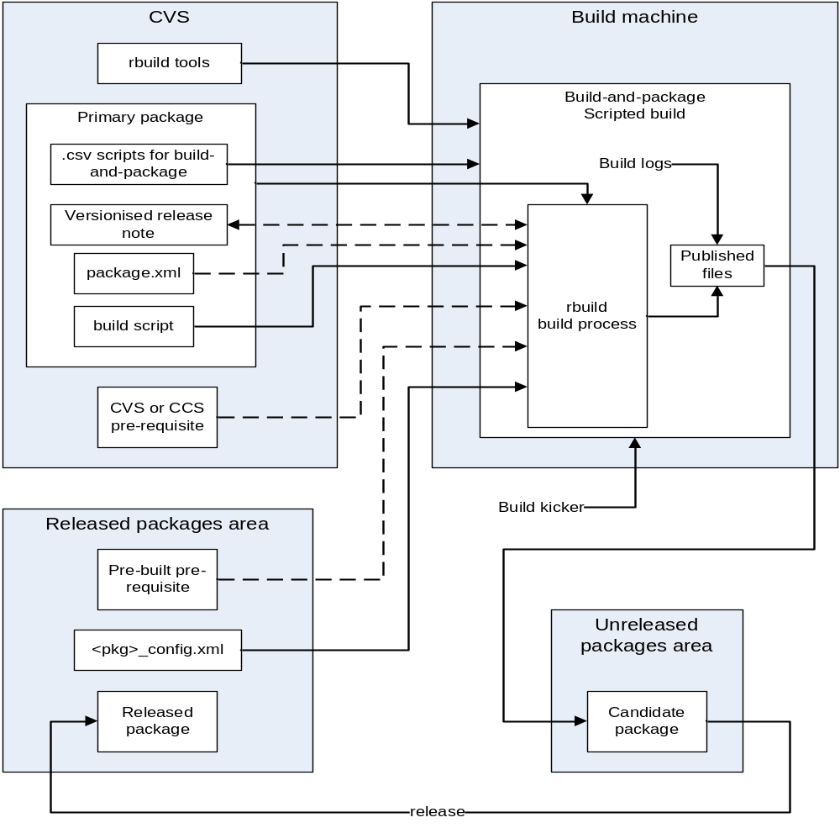
rbuild Process

Slide 8
rbuild Build Sequence
Obtain config from .XML file
Reap the primary package
Check version number of previous build on this branch. Determine if new build is necessary. If so, update version number and write .inc file
Use getprereq.py to obtain pre-requisite packages
Run package release script to build package for all defined configurations
Zip up logs
Rename files to add version number
Tag the primary package with unique version number
Publish to a defined location

Slide 9
The release Step
Check that selected package exists, and not marked FAILED
Determine list of intermediate builds
  (optionally) delete builds and remove associated tags
Prompt user about keeping release notes up-to-date!
(Optionally) “score-off” release notes:
  Check out release notes file, add score-off string, check file back in, move tag, and re-insert into the zipped release package.
Move package to release location
Give user the option to update major version number
Option to delete the build directory in “unpublished” area

