Slide 1

Graduate Directed Project-II Final Project Presentation
- By Team Bearcats (Group-03)
Aditya Jyothi Swaroop Malireddy
Phanivardhan Gurram
Raja Srikar Karthik Chinta
Sangeetha Detne
Pravalika Kawali

Slide 2
Contents
Problem Statement
Functional Requirements
Non-Functional Requirements
Tools and Technologies
Architecture Pattern
Demo
Test Reports
Our Solution also provides
Suggested features
Conclusion

Slide 3
Problem Statement
Our client is Leslie Chandler, Associate Director Academic Success and Retention
Here we are dealing with the problems related to Northwest Success 360 (Starfish Application) reports
Client have issues in pulling the required data from the application
Aditya Jyothi Swaroop

Slide 4
Functional Requirements
Client must upload excel sheet as input
Client must retrieve summary reports
Client must add, delete or manage users
Aditya Jyothi Swaroop
Notes:
1. User Account Management
2. Admin Account Management
3. Import Report Data into Application
4. Report Generation
5. Data filters based on user preferences

Slide 5
Non-Functional Requirements
Performance
Operational
Security
Availability
Backup
Scalability
Phanivardhan Gurram

Slide 6
Tools and Technologies
Node.js, Passport, Material UI
MySQL (very light weight server)
Frameworks: Bootstrap(open source)
Phanivardhan Gurram

Slide 7
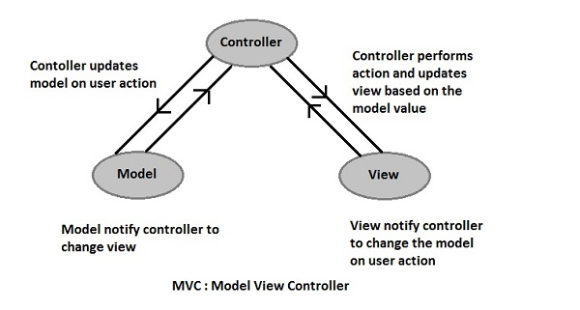
MVC Architecture
https://www.google.com/search?q=mvc+architecture&rlz=1C1GCEB_enUS821US821&source=lnms&tbm=isch&sa=X&sqi=2&ved=0ahUKEwiP_aDvzYLfAhWEKewKHfOICw0Q_AUIDigB&biw=1366&bih=626#imgrc=ivD_m3hvAb4NuM:
Phanivardhan Gurram

Slide 8
Demo
Srikar and Sangeetha

Slide 9
Test Reports
We have almost covered all test cases.
file:///C:/Users/s530668/Desktop/GDP-II/GDPTeamBearcats/src/GDP-Node/mochawesome-report/mochawesome.html
Sangeetha Detne
Notes:
We have tested the each page the request and response from the server gave positive results.

Slide 10
Our Solution also provides..
Uploading activity report, asynchronously in less than 10s
Single page user interface
Any user can retrieve meeting reports till date
It provides student flag reports
All the passwords and sessions are encrypted using SHA1 algorithm
All the users are completely controlled by admin
Pravalika Kawali

Slide 11
Suggested Features
Get all reports based on department
Our application supports super user role, this can be implemented by explicitly mentioning admin role
Pravalika Kawali

Slide 12
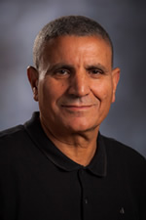
Conclusion
We are thankful to Dr. Aziz fellah for providing valuable suggestions and supporting us throughout this project
Our team has worked collaboratively and contributed individual efforts on this project to make it success
Pravalika Kawali

