Slide 1
WeCelebrate
Group 10
E/11/064
E/11/452
E/11/487

Slide 2
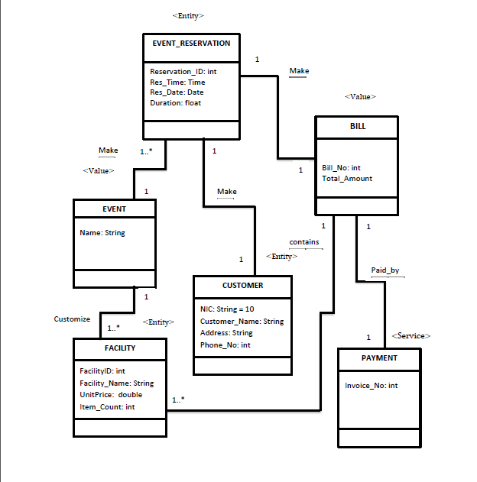
Domain Model

Slide 3
Business Constraints
Only one event from each type of events can be reserved within the period on which it is reserved

Slide 4
Service objects implemented in the infrastructure layer
Payment_Gateway service
Database Handling

Slide 5
DEMO

