Slide 1
Dart Week 3

Slide 2
Overview
Classes
Constructors
private members
Static members
Inheritance
Interfaces
Mixins
Extensions
Async

Slide 3
If the slide is orange, you can ask questions at the end of the slide. If it isn’t, please wait.
Questions from last session

Slide 4
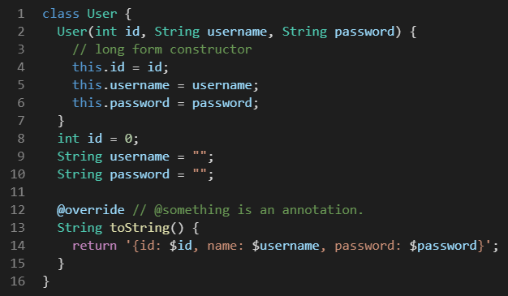
Classes
Classes are an abstraction to bundle related functions and data together
Who doesn’t know what classes are yet?
Contain data members
Member functions
constructors
Long form constructors
Don’t use these by default

Slide 5
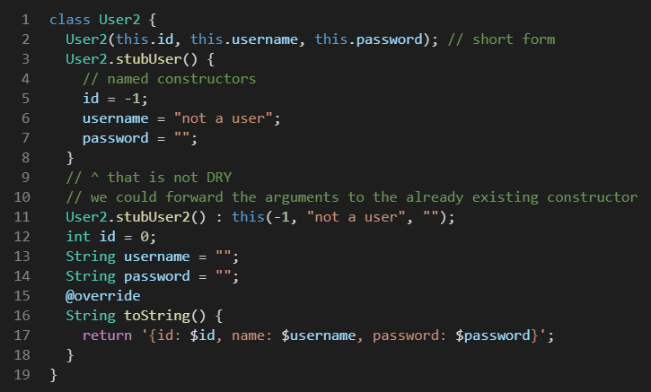
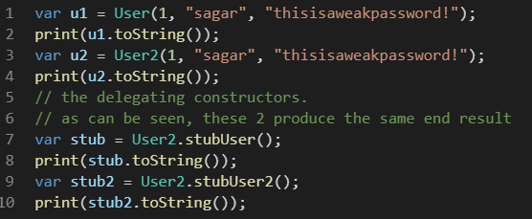
Classes: constructors
Named constructors
Short form constructor
Delegating constructor

Slide 6
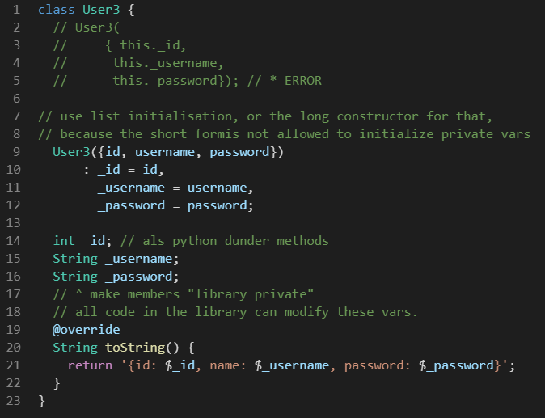
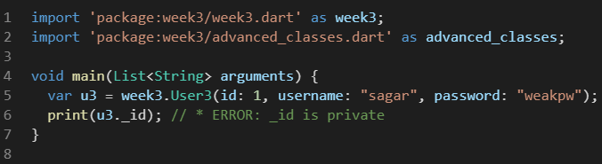
Classes: Constructor and private members
List initialization, similar to C++
Private variables
Require an _underscore
Are only private outside the library
Why do we want them?
Interfaces/api
Hide implementation details
Prevent users from using your classes in unintended and wrong ways

Slide 7
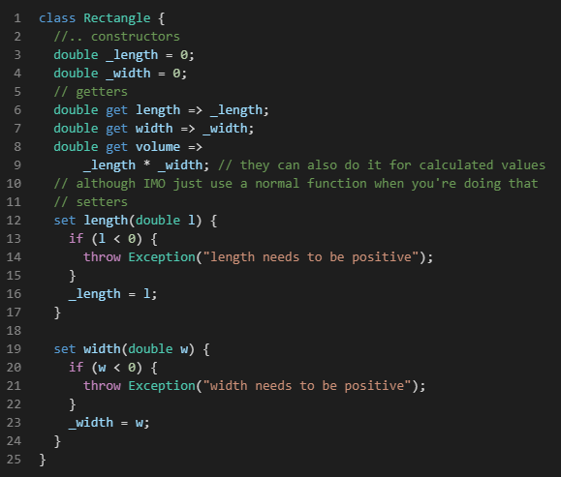
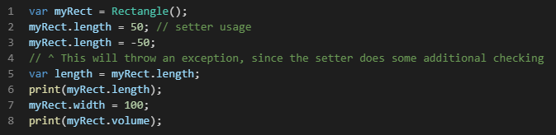
Classes: getters and setters
Getters
Setters

Slide 8
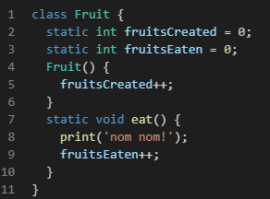
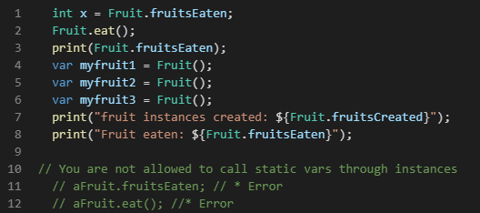
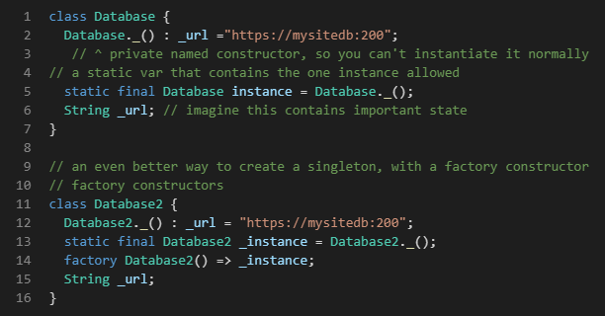
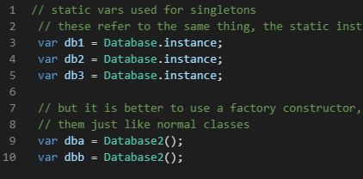
Classes : static variables
Static variables
Often used for singletons
Factory method

Slide 9
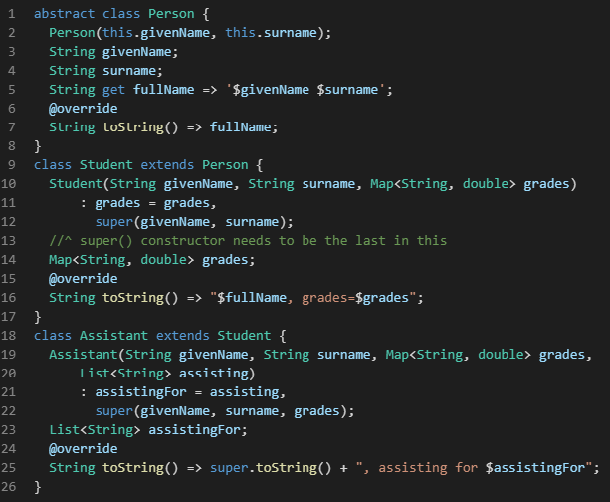
Classes: Inheritance
Inheritance
Override
Superclasses and subclasses
Super()
Abstract classes

Slide 10
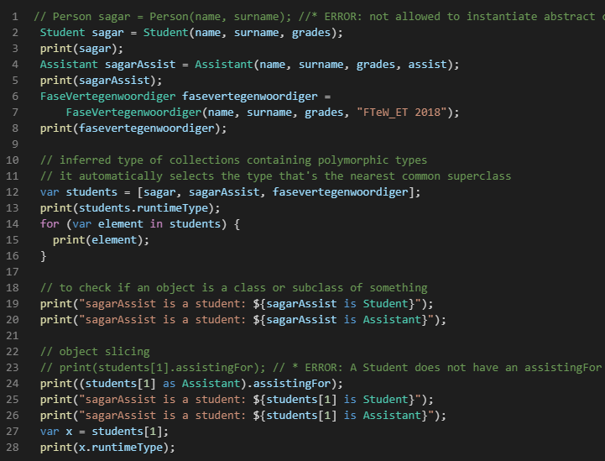
Classes: Inheritance
Abstract classes
Polymorphism
How to check types
Object slicing

Slide 11
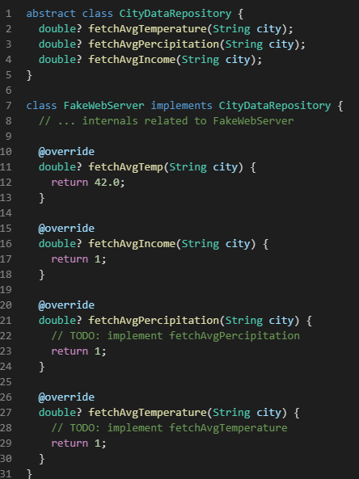
Classes: Interfaces
Interfaces vs inheritance
“has a ” relationship vs “is a”
For specifying the contract/api/interface
You can only inherit from one class, but can use multiple interfaces.
The class using an interface does not have access to any of the implementation details (variables, implementation of methods). You must override all methods provided by an interface
You can use both interfaces and inheritance:
Class Subclass extends Superclass implements Interface
Interfaces in this context vs normal programming
Often used to add GUI, data retrieval methods to a class. Also for mocking during testing.

Slide 12
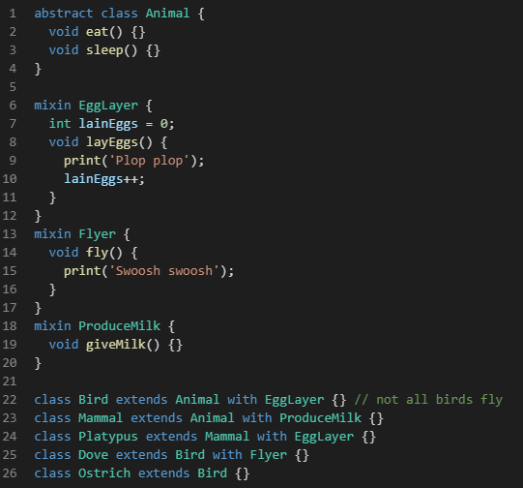
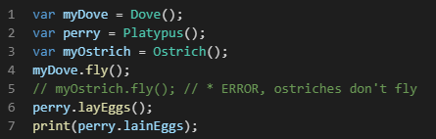
Classes: Mixins
Difference between mixins and interfaces
No need to overwrite mixin methods
Mixins are for sharing implementations and code reuse, while interfaces are for specifying the contract/api

Slide 13
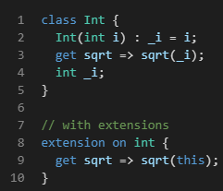
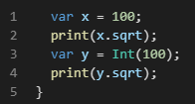
Classes: extensions
For adding new functionality to existing classes without creating new classes
Without them, you create wrappers around them
Used for classes from libraries, classes you did not create yourself.

Slide 14
comparison
 | multiple | need to overwrite | Purpose
Inheritance | No | No, only when desired | Contract specification, abstraction, DRY
Interface | Yes | Yes | Specifying the contract/interface
Mixin | Yes | No, only when desired | DRY
extension | Yes, but don’t | No. You can, but don’t | Addding functionality without creating new classes

Slide 15
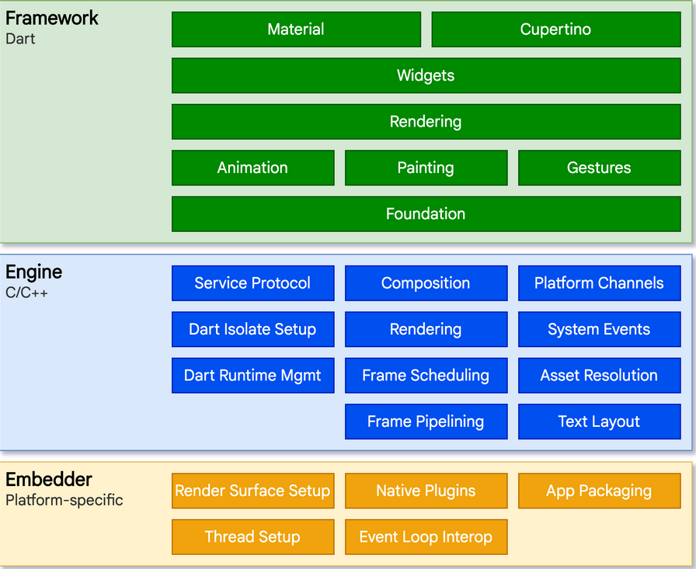
Flutter: intro & architecture
Flutter is a cross platform UI toolkit (mobile, desktop, web)
Compiled to machine code or JS
Layers:
No privileged access to layers below
Everything in the framework level is optional
To the OS, a flutter app is just a native app
Embedder is written in OS-appropriate language(Java/C++, Objective C, C++)
Engine provides low-level implementation of Flutter’s core API (graphics, I/O, Dart runtime env)
Engine is exposed to flutter through dar:ui, wrapping underlying C++ code into Dart classes

Slide 16
Flutter: architecture
Reactive user interfaces:
Decoupling UI from underlying state.
Create UI description with API
Framework creates/updates UI when needed
Widgets (like React components) are classes which propagate state changes downstream to draw the UI
Widgets:
Building block of UI
Composed of other widgets, and has access to the context of it’s parent all the way to the root widget
A few concepts responsible for a lot.
Class hierarchy is shallow but broad (lots of subclasses each level, not a lot of levels)
You override the build method to determine it’s appearance
Notes:
RUI: In most traditional UI frameworks, the user interface’s initial state is described once and then separately updated by user code at runtime, in response to events.
W: concepts responsible for a lot:
A widget represents drawing to the screen, layout, interactivity, state management, theming, animations, nav.
Animation layer, Animations and Tweens are responsible for everything there.
RenderObjects describe layout, painting, accessability.

Slide 17
Flutter: widgets
Overriding the build() method of widgets returns an element tree
For example: a horizontal layout with some buttons in it.

