Slide 1
Dart Week 2

Slide 2
Overview
Classes
Constructors
private members
Static members
Inheritance
Interfaces
Mixins
Extensions
Async

Slide 3
If the slide is orange, you can ask questions at the end of the slide. If it isn’t, please wait.
Questions from last session

Slide 4
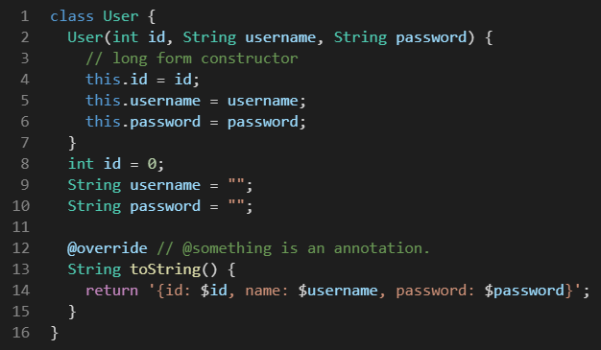
Classes
Classes are an abstraction to bundle related functions and data together
Who doesn’t know what classes are yet?
Contain data members
Member functions
constructors
Long form constructors
Don’t use these by default

Slide 5
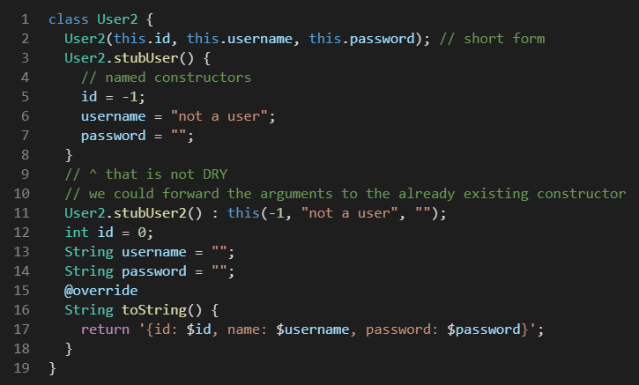
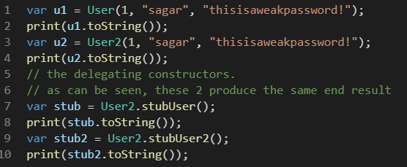
Classes: constructors
Named constructors
Short form constructor
Delegating constructor

Slide 6
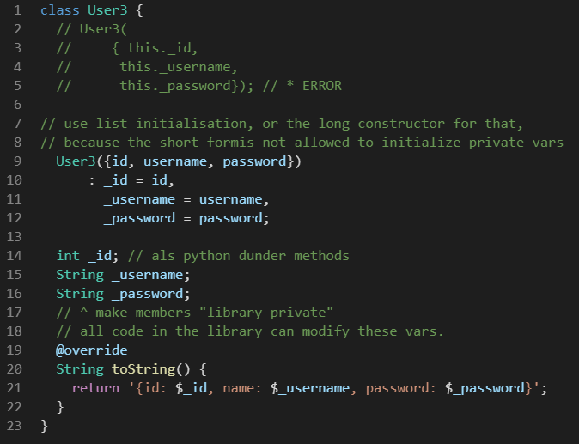
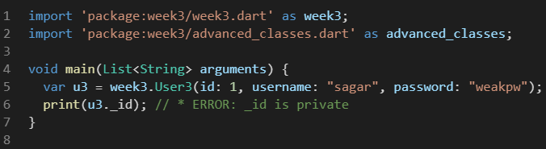
Classes: Constructor and private members
List initialization, similar to C++
Private variables
Require an _underscore
Are only private outside the library
Why do we want them?
Interfaces/api
Hide implementation details
Prevent users from using your classes in unintended and wrong ways

Slide 7
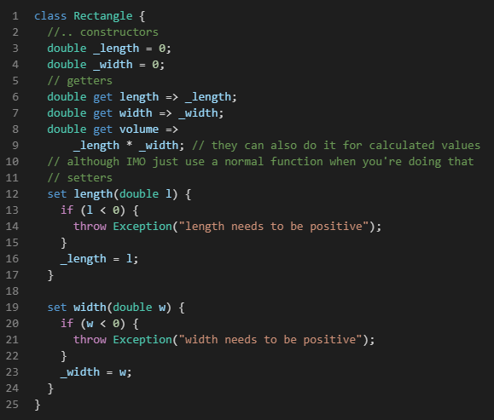
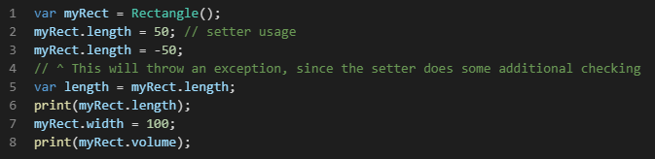
Classes: getters and setters
Getters
Setters

Slide 8
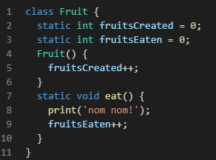
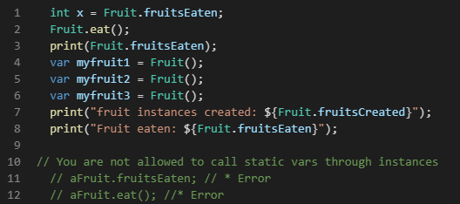
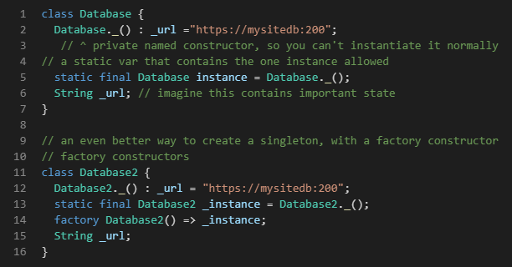
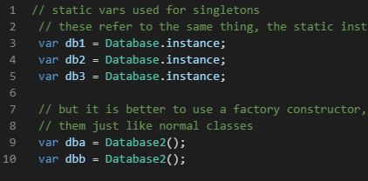
Classes : static variables
Static variables
Often used for singletons
Factory method

