Slide 1
Dart Week 2

Slide 2
Overview
How to create and run your project
Manage dependencies
Quick overview of operators
Strings
Flow control
Other collections besides string
Functions
classes

Slide 3
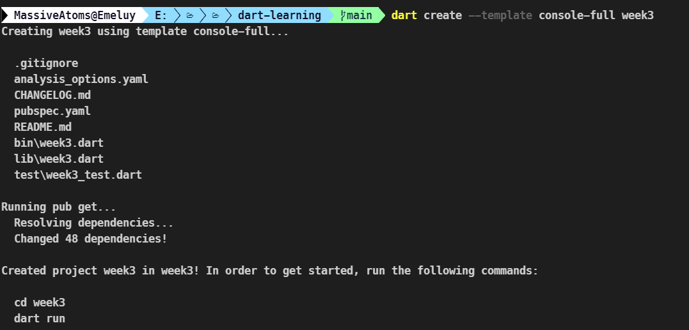
How start a dart project
On the command line:
dart create –template <template name> <project name>
Open die folder in je IDE

Slide 4
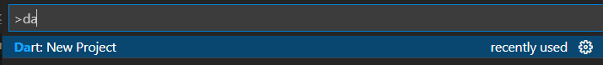
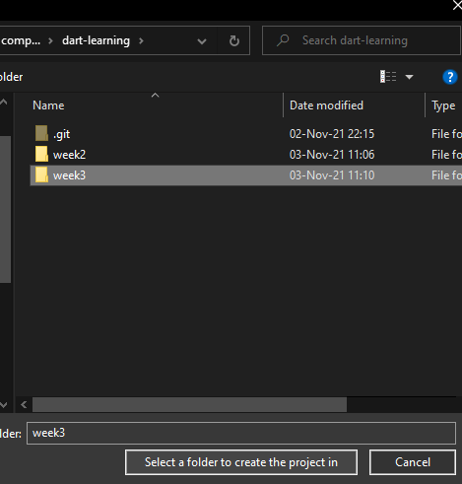
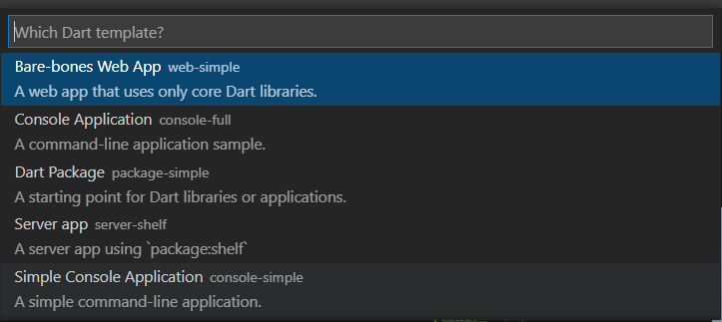

How to start a dart project in vscode
1
3
2
4

Slide 5
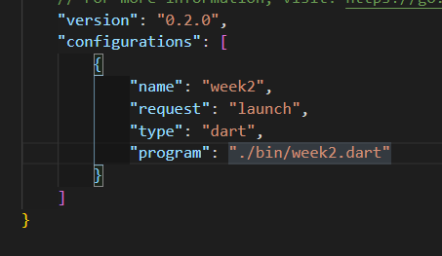
Running your code
On the command line:
Dart ./bin/<project_name>.dart <optional cli arguments>
Or on vscode:
Add program to launch options
Press F5 to run

Slide 6
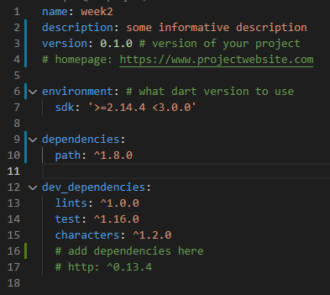
How do you download dependencies
>=1.2.3
>=1.2.3
Edit pubspec.yaml
Version syntax
^1.2.0 means anything from 1.2.0 to 2
1.2 means exactly version 1.2
>=1.2 means any version greater than 1.2
There’s >, <, <= as well
>1.2 <=3.0

Slide 7
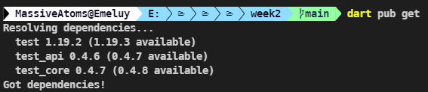

Run “dart pub get”
Vscode automatically runs the command when you save the file
You could click here as well

Slide 8
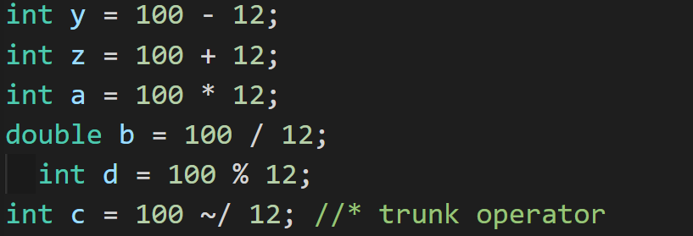
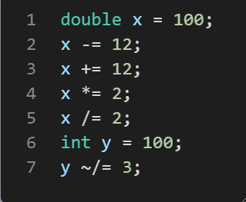
Arithmic operators
De bekende operators:
[+, -, %, *, /]
nieuwe: trunk operator: ~/
Hetzelfde als // in python
Het returnt een integer
Deze shorthands

Slide 9
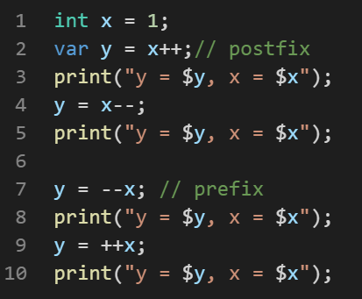
Arithmetic operators
Increment en decrement
Postfix en prefix

Slide 10
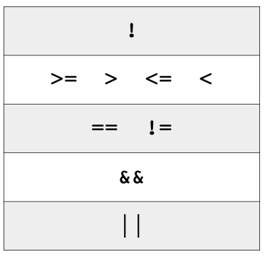
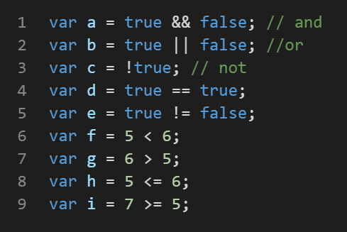
Logical and relational operators
&& || ! == != < > <= >=
Operator precedence

Slide 11
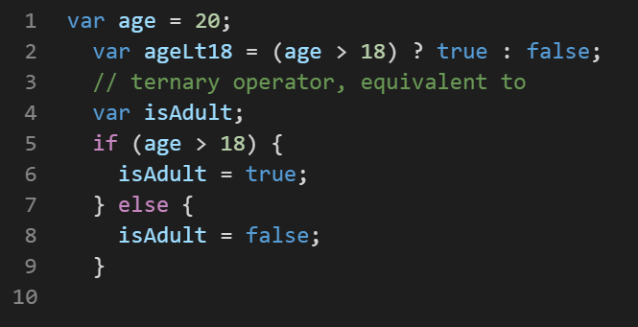
Logical and relational ops: Ternary operator
Ternary operator:
(condition) value if true : value if false

Slide 12
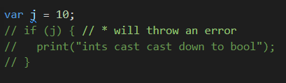
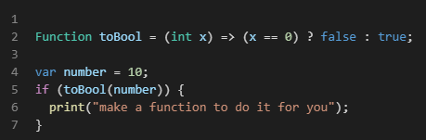
Int doesn’t automatically cast down to bool
BAD
Do something like this

Slide 13

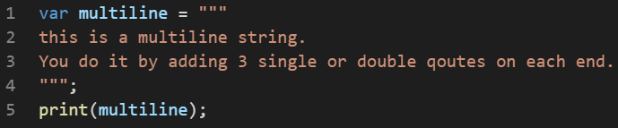
Strings
Strings zijn uit-16 code points under the hood
Gebruik de “characters” library als je human readable characters nodig hebt
Guess the output?
Multiline strings

Slide 14
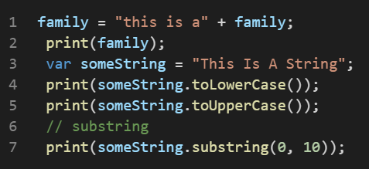
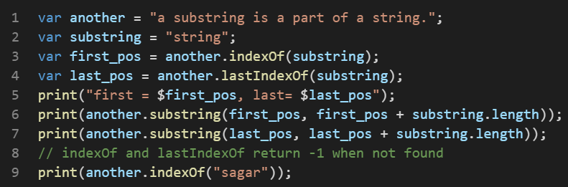
Common string operations
Concatenating, upper/ lowercasing, slicing
Finding first and last occurrence

Slide 15
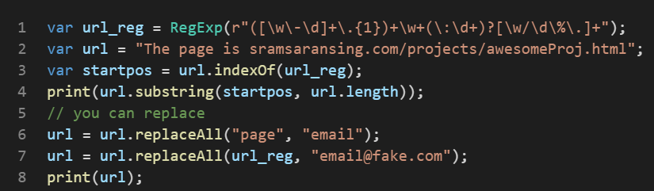
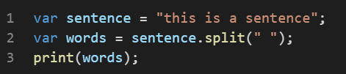
Common string operations
They also take regex
You can split strings
More, but you can google

Slide 16
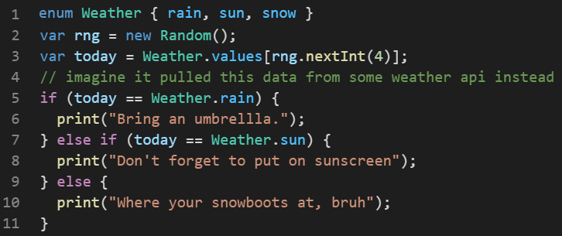
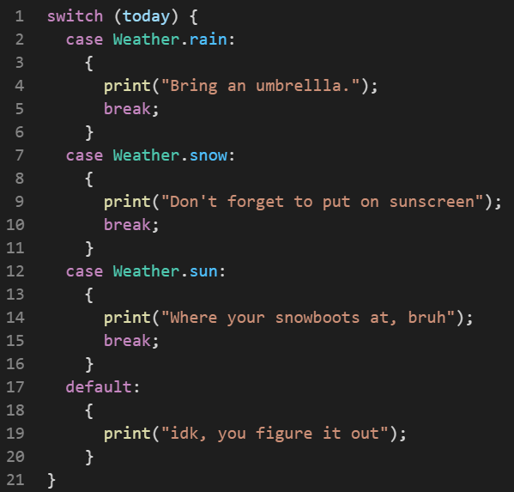
Control flow: if/else if/else, switch
Pretty much identical

Slide 17
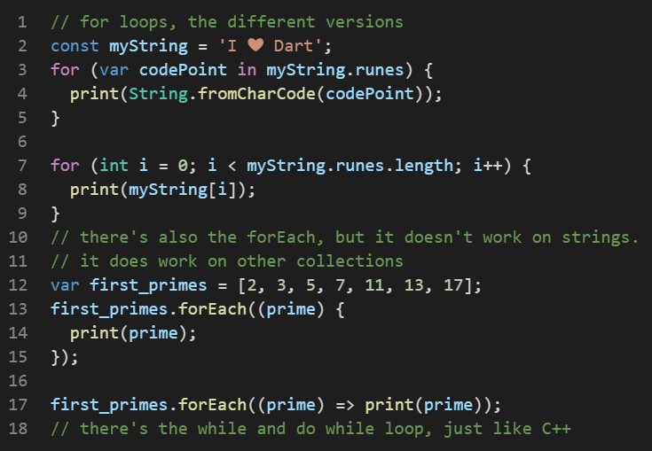
Control flow: for loops
Short method
Longer method
forEach
forEach oneliner

Slide 18
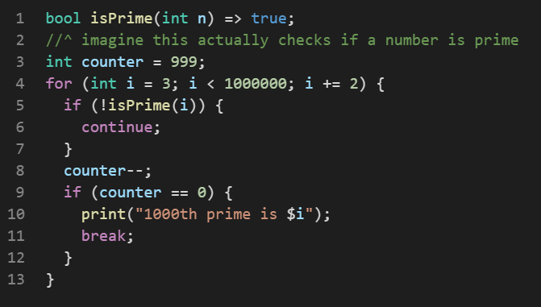
Control flow: continue and break
Continue: stop executing this iteration, go to the next one inmediately
Break: stop looping
Other control flow: while and do while.

