Slide 1
Dart Week 2

Slide 2
Overview
How to create and run your project
Manage dependencies
Quick overview of operators
Strings
Flow control
Other collections besides string
Functions
classes

Slide 3
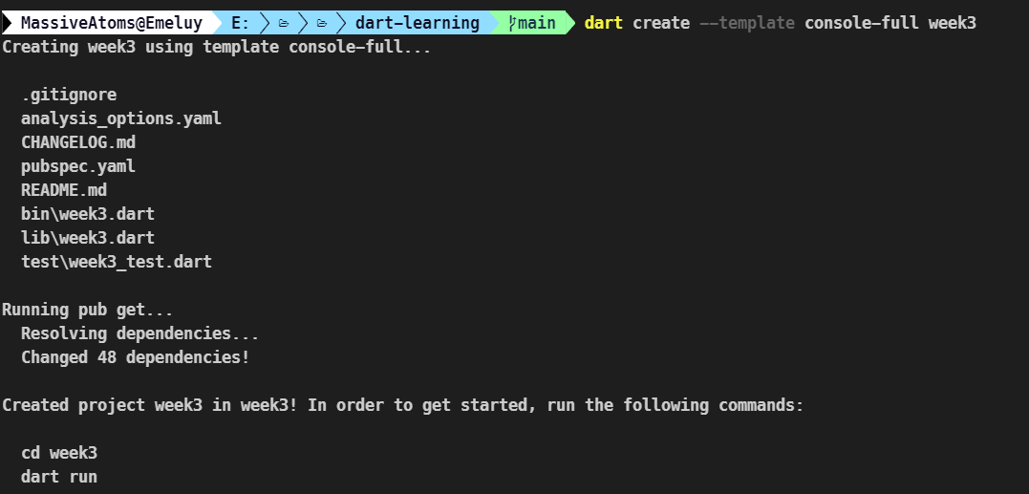
How start a dart project
On the command line:
dart create –template <template name> <project name>
Open die folder in je IDE

Slide 4
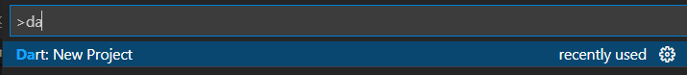
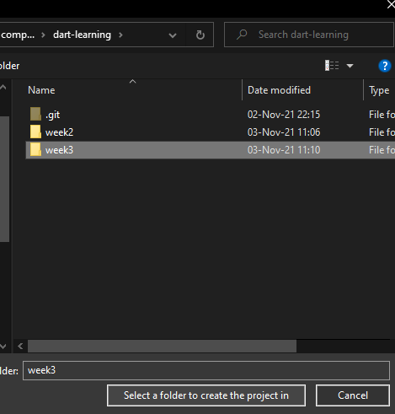
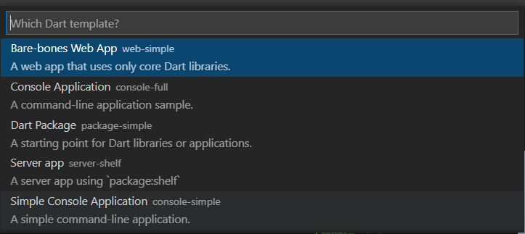

How to start a dart project in vscode
1
3
2
4

Slide 5
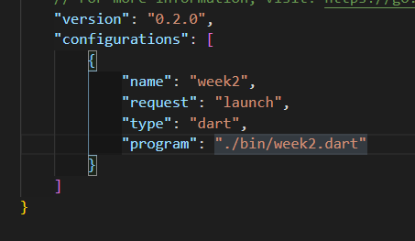
Running your code
On the command line:
Dart ./bin/<project_name>.dart <optional cli arguments>
Or on vscode:
Add program to launch options
Press F5 to run

Slide 6
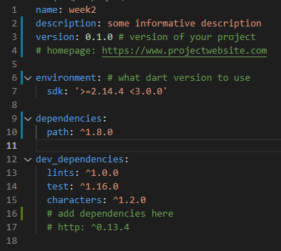
How do you download dependencies
>=1.2.3
>=1.2.3
Edit pubspec.yaml
Version syntax
^1.2.0 means anything from 1.2.0 to 2
1.2 means exactly version 1.2
>=1.2 means any version greater than 1.2
There’s >, <, <= as well
>1.2 <=3.0

Slide 7
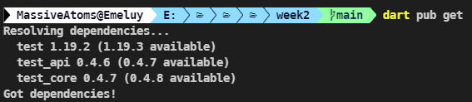

Run “dart pub get”
Vscode automatically runs the command when you save the file
You could click here as well

Slide 8
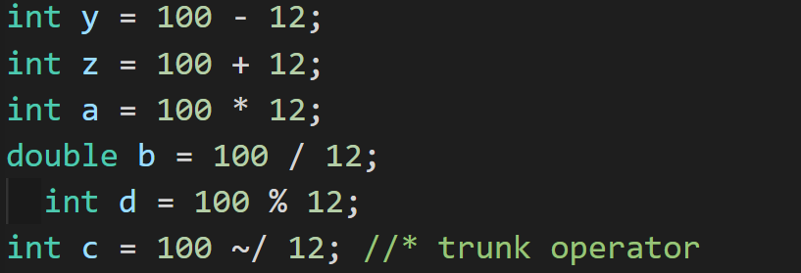
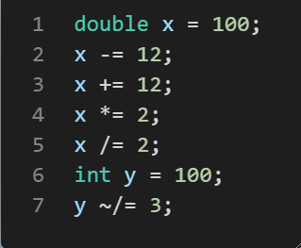
Arithmic operators
De bekende operators:
[+, -, %, *, /]
nieuwe: trunk operator: ~/
Hetzelfde als // in python
Het returnt een integer
Deze shorthands

Slide 9
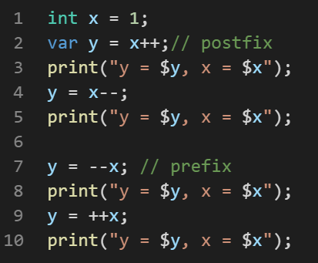
Arithmetic operators
Increment en decrement
Postfix en prefix

Slide 10
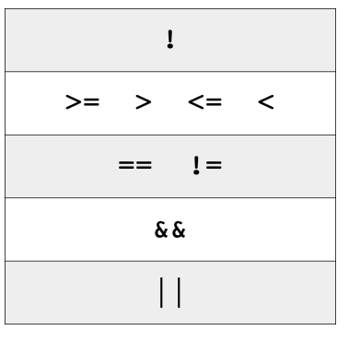
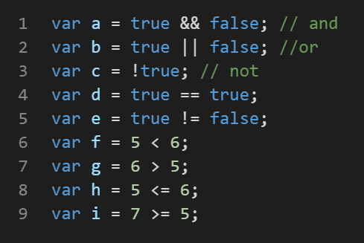
Logical and relational operators
&& || ! == != < > <= >=
Operator precedence

Slide 11
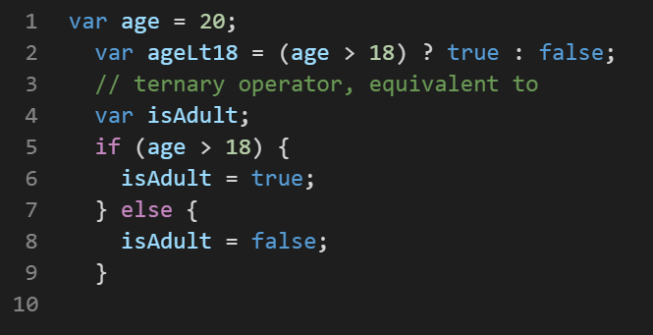
Logical and relational ops: Ternary operator
Ternary operator:
(condition) value if true : value if false

Slide 12
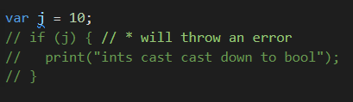
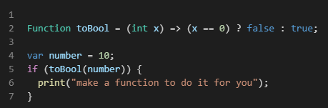
Int doesn’t automatically cast down to bool
BAD
Do something like this

Slide 13

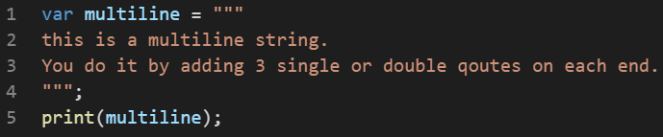
Strings
Strings zijn uit-16 code points under the hood
Gebruik de “characters” library als je human readable characters nodig hebt
Guess the output?
Multiline strings

Slide 14
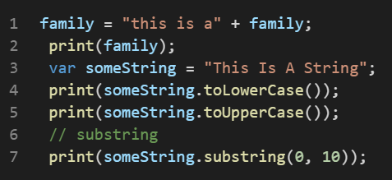
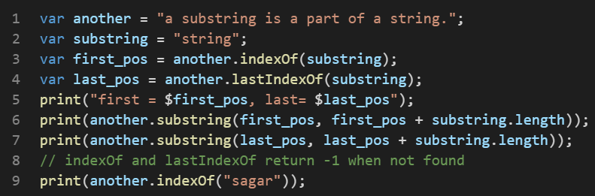
Common string operations
Concatenating, upper/ lowercasing, slicing
Finding first and last occurrence

Slide 15
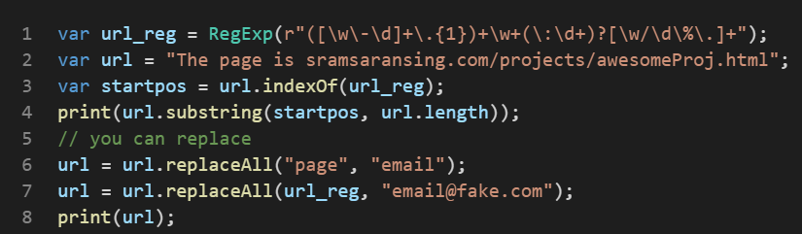
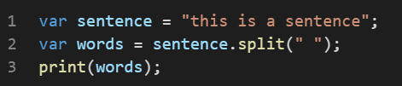
Common string operations
They also take regex
You can split strings
More, but you can google

Slide 16
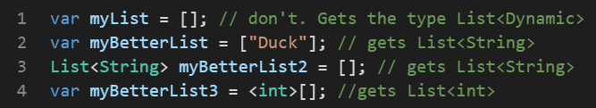
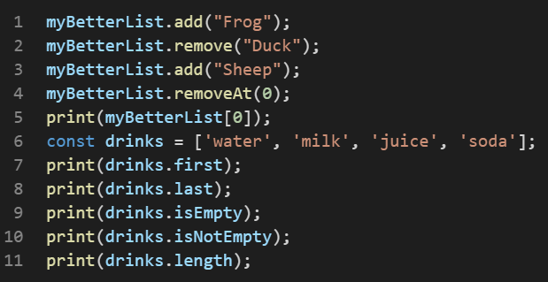
Collections: List
Zet type info voor je collections
Common List operations
Gebruik .length niet om te checken of iets leeg is of niet

Slide 17
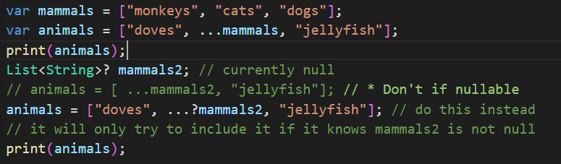
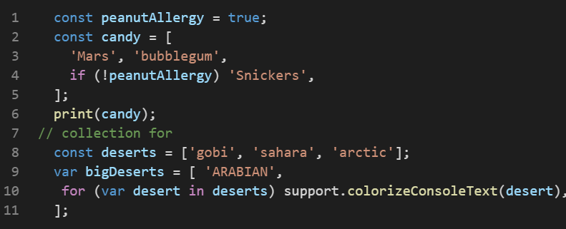
Lists
Spread operator
Collection if
Collection for

Slide 18
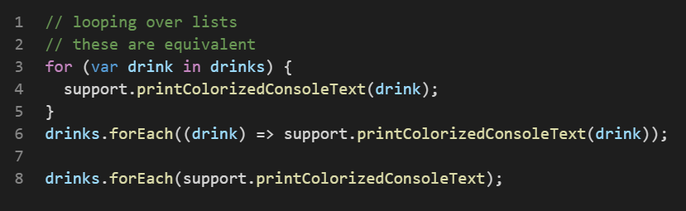
Lists
Looping

Slide 19
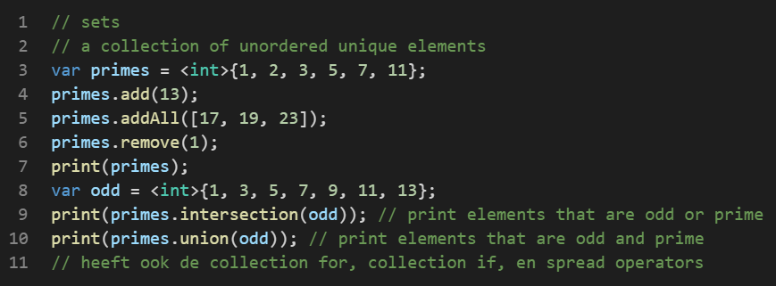
Collections: Sets
Common operations
Loop over them like lists

Slide 20
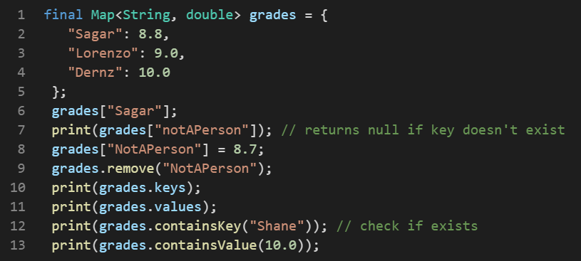
Collections: Map
Common operations

Slide 21
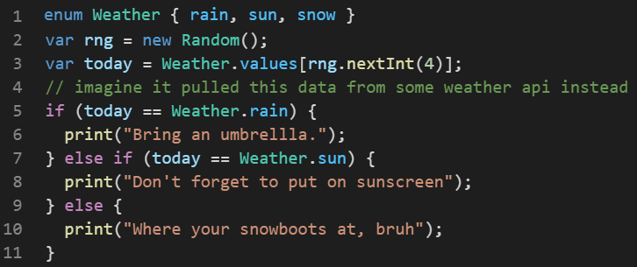
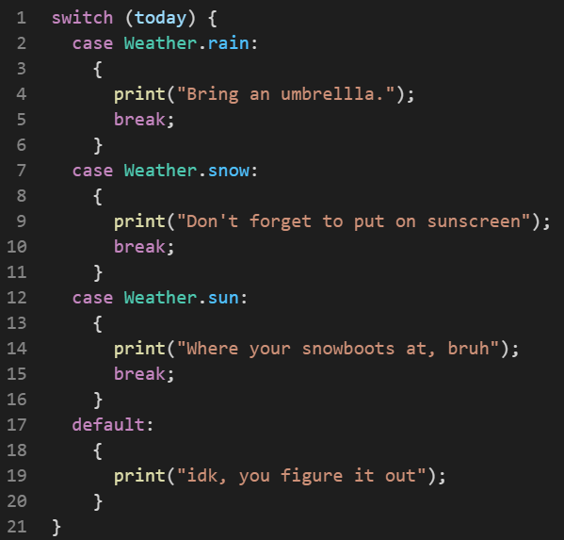
Control flow: if/else if/else, switch
Pretty much identical

Slide 22
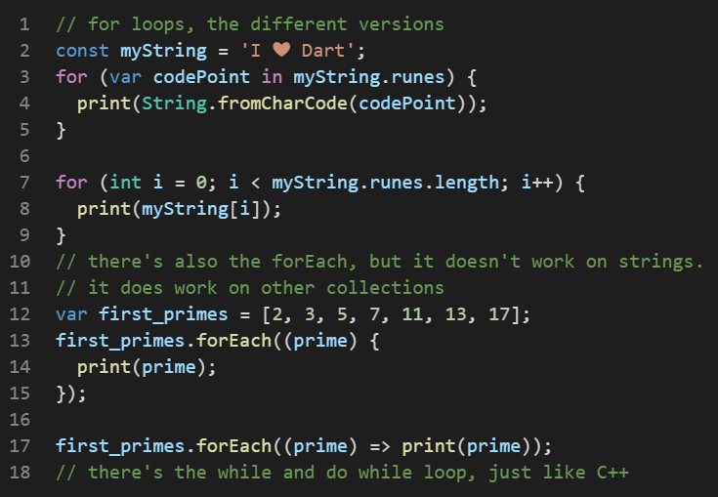
Control flow: for loops
Short method
Longer method
forEach
forEach oneliner

Slide 23
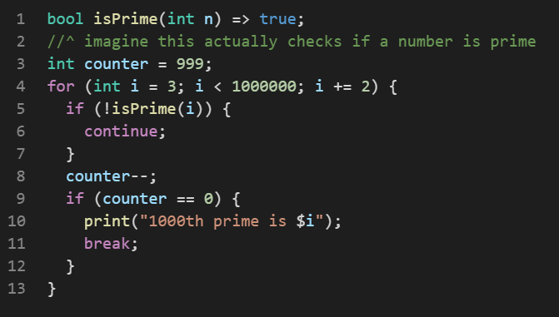
Control flow: continue and break
Continue: stop executing this iteration, go to the next one inmediately
Break: stop looping
Other control flow: while and do while.

