Slide 1
Dart Week 2

Slide 2
Overview
How to create and run your project
Manage dependencies
Quick overview of operators
Strings
Collections
Flow control
Functions

Slide 3
If the slide is orange, you can ask questions at the end of the slide. If it isn’t, please wait.
Questions from last session

Slide 4
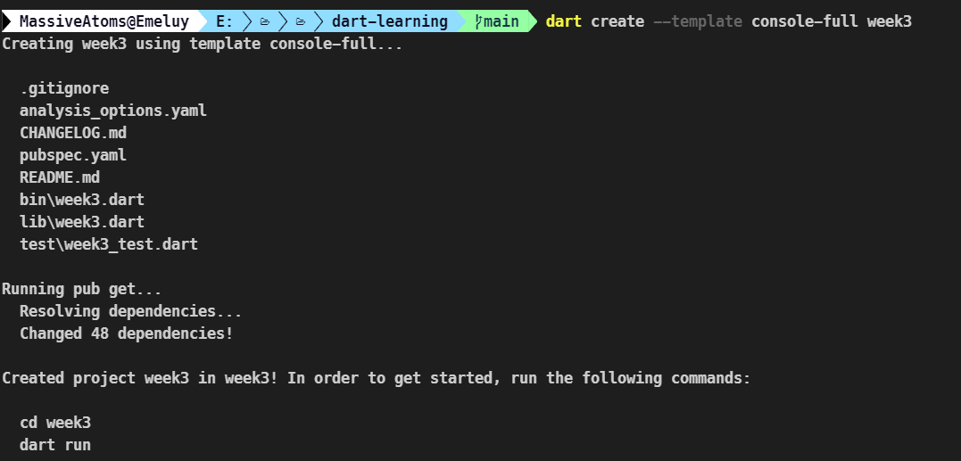
How start a dart project
On the command line:
dart create –template <template name> <project name>
Open die folder in je IDE

Slide 5
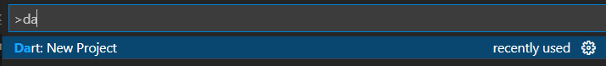
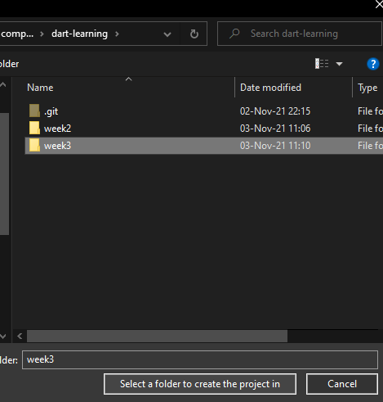
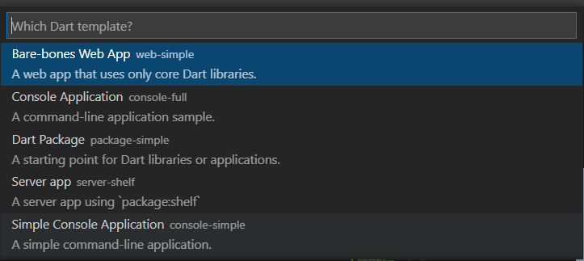

How to start a dart project in vscode
1
3
2
4

Slide 6
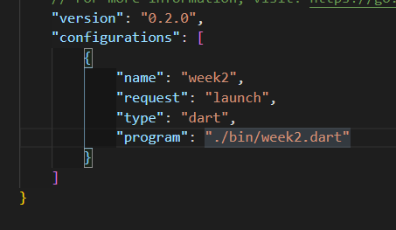
Running your code
On the command line:
Dart ./bin/<project_name>.dart <optional cli arguments>
Or on vscode:
Add program to launch options
Press F5 to run

Slide 7
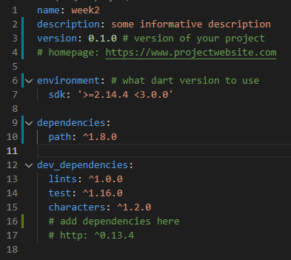
How do you download dependencies
>=1.2.3
>=1.2.3
Edit pubspec.yaml
Version syntax
^1.2.0 means anything from 1.2.0 to 2
1.2 means exactly version 1.2
>=1.2 means any version greater than 1.2
There’s >, <, <= as well
>1.2 <=3.0
any

Slide 8
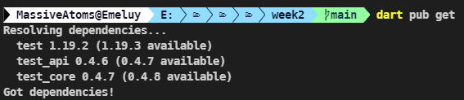

Dependencies
Run “dart pub get”
Vscode automatically runs the command when you save the file
You could click here as well

Slide 9
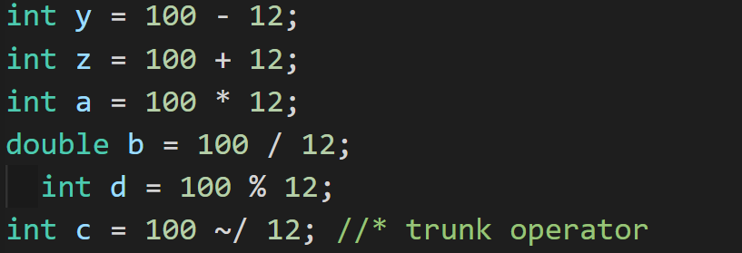
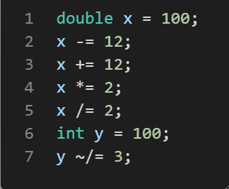
Arithmetic operators
The usual operators:
[+, -, %, *, /]
new: trunk operator: ~/
Same as // in python
Integer division
These shorthands exist

Slide 10
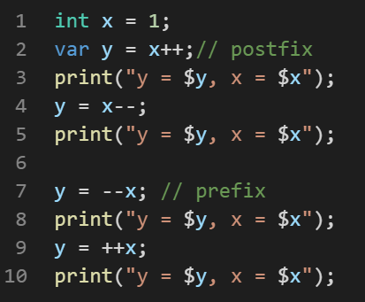
Arithmetic operators
Increment and decrement
Postfix and prefix

Slide 11
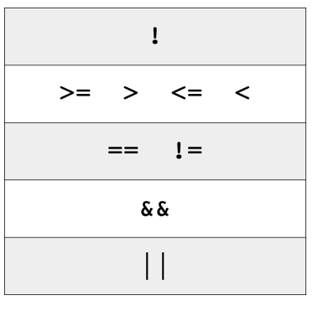
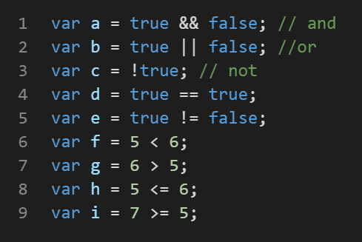
Logical and relational operators
&& || ! == != < > <= >=
Operator precedence
There are bitwise operators if you need them

Slide 12
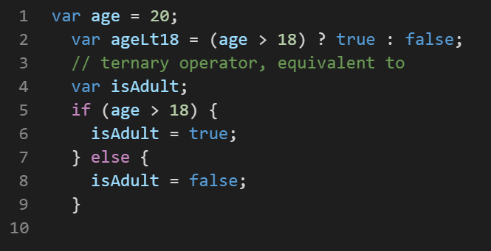
Logical and relational ops: Ternary operator
Ternary operator:
(condition) value if true : value if false

Slide 13
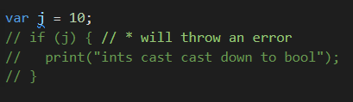
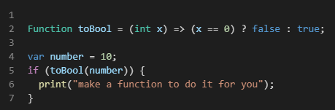
Int doesn’t automatically cast down to bool
BAD
Do something like this

Slide 14

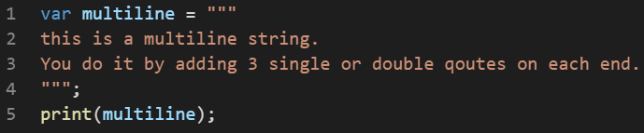
Strings
Strings are an array of UTF-16 code points under the hood
Use the “characters” library to get the number of human readable characters
Guess the output?
Multiline strings

Slide 15
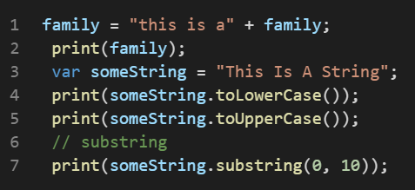
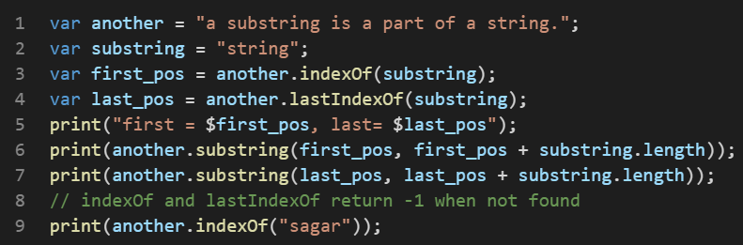
Common string operations
Concatenating, upper/ lowercasing, slicing
Finding first and last occurrence

Slide 16
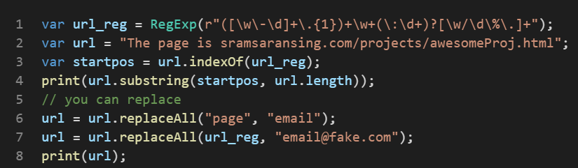
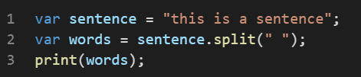
Common string operations
They also take regex
You can split strings
More, see google

Slide 17
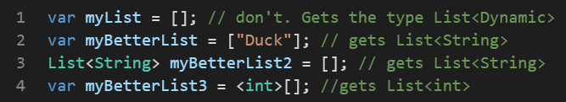
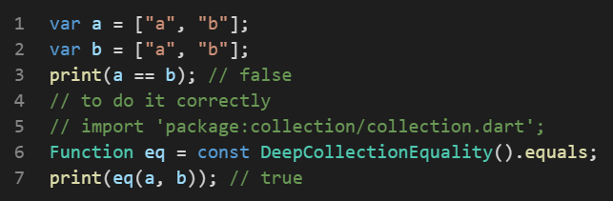
Collections: the data structures lib in dart
Specify type info for your collections when creating empty ones
Do not use == to check equality between collections
Import collection
Define the following function
Call equality(a, b) instead of
a == b

Slide 18
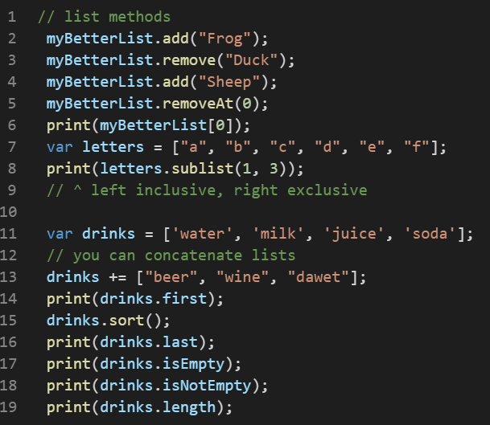
Collections: List
Common List operations
Do not use .length to check if a collection is empty.

Slide 19
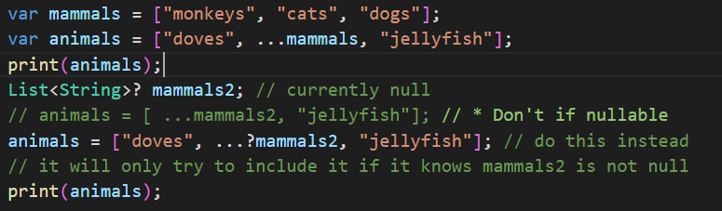
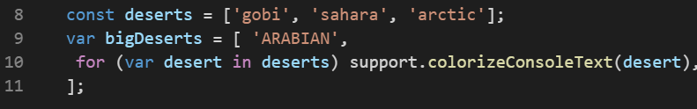
Lists
Spread operator
Collection for

Slide 20

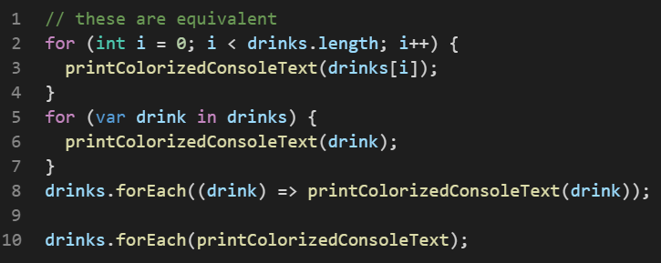
Lists
Looping

Slide 21
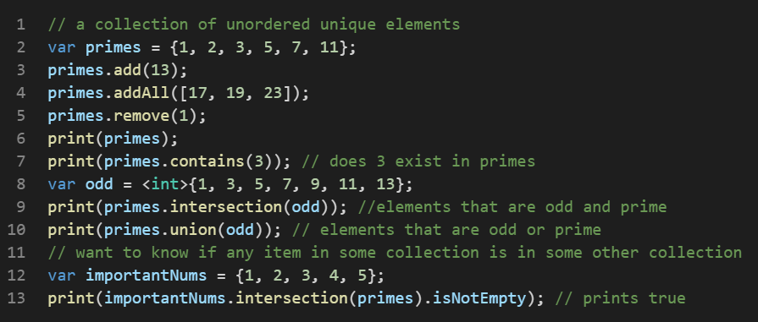
Collections: Sets
Sets are often used when you want unique items, don’t need ordering, and when you need to check if something exists in a collection
Common operations
Loop over them like lists

Slide 22
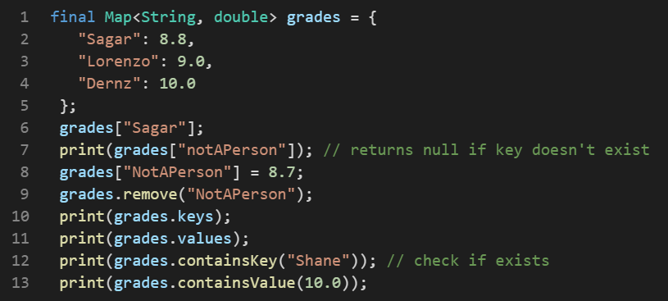
Collections: Map
Maps are for associative data, and fast lookups
Common operations

Slide 23
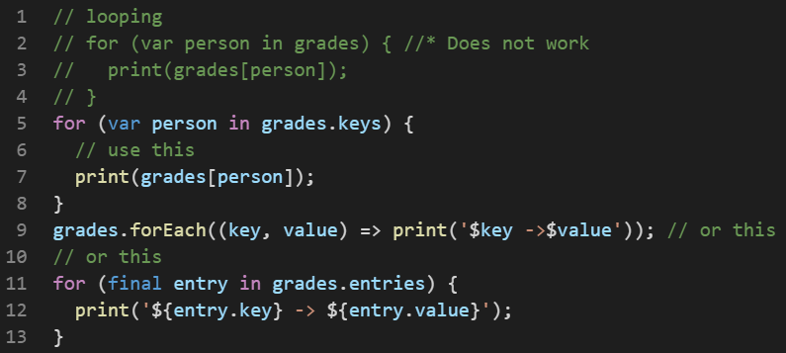
Collections: Map
Looping over a map

Slide 24
Other collections
Double linked list
Queue
Linked list
Trees

Slide 25
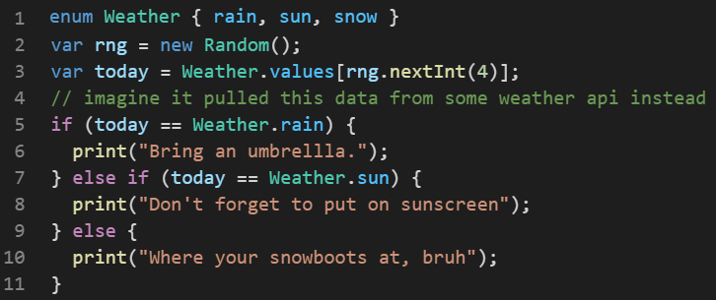
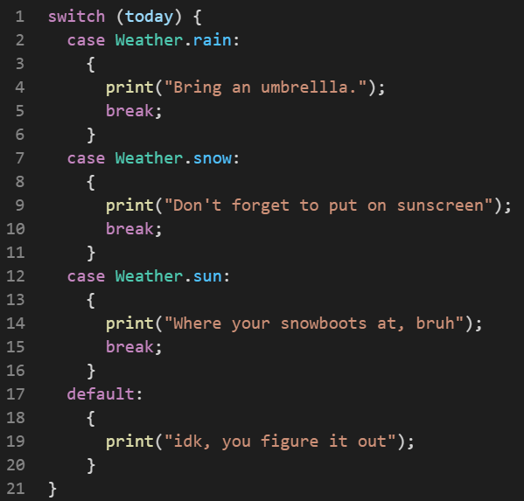
Control flow: if/else if/else, switch
Pretty much identical

Slide 26
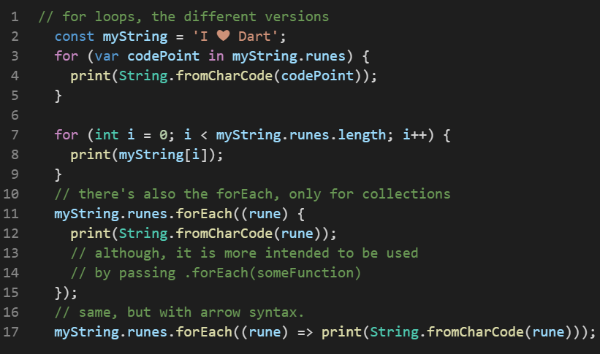
Control flow: for loops
Short method
Longer method
forEach
forEach oneliner

Slide 27
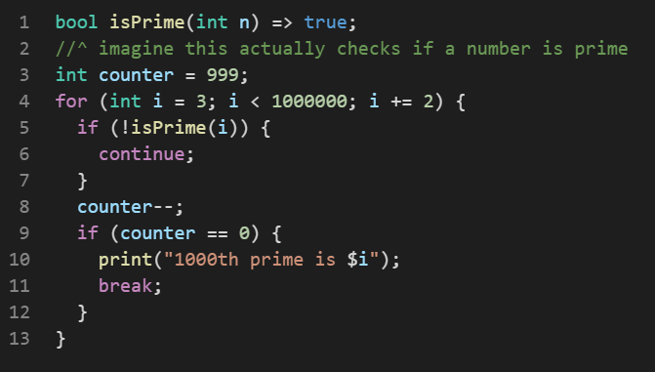
Control flow: continue and break
Continue: stop executing this iteration, go to the next one inmediately
Break: stop looping
Other loops: while and do while.

Slide 28
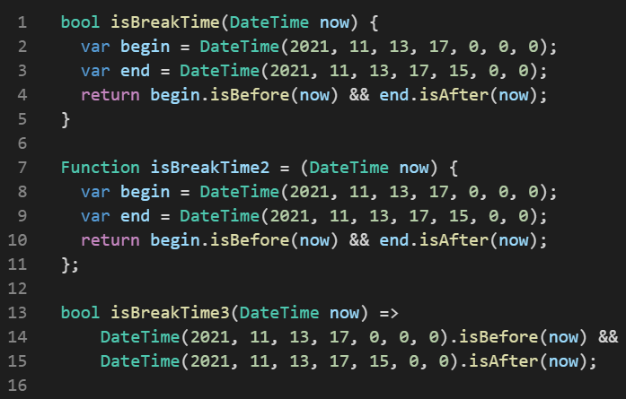
Functions
All 3 of these are equivalent
The standard function declaration
Anonymous functions can be assigned to a variable.
Although, if you must do that, just use the standard function declaration
Arrow functions (only for short
One liners, unlike here)

Slide 29
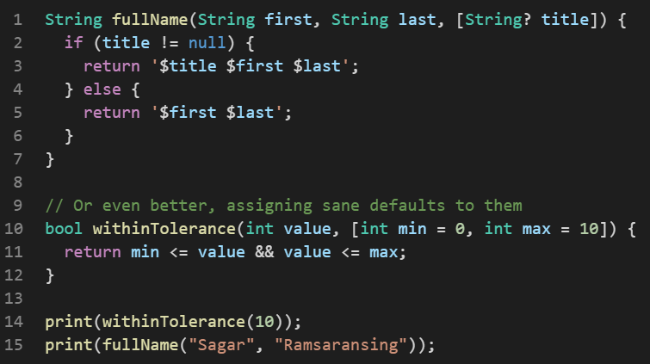
Functions: parameters
Optional parameter
Or by assigning sane defaults
Then you can call them like this

Slide 30
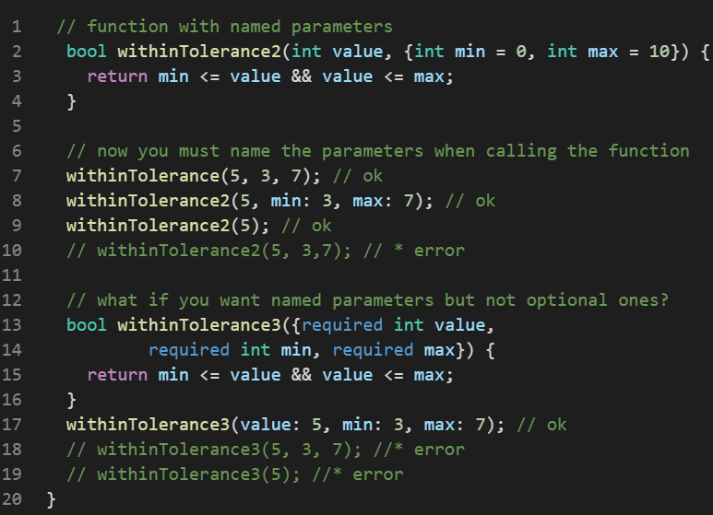
Functions: parameters
Named optional parameters
You have to specify arg name when passing them
Named but required

Slide 31
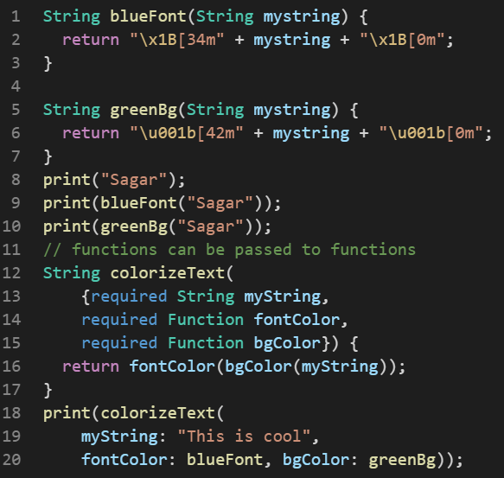
Functions
Functions can be passed as arguments

Slide 32
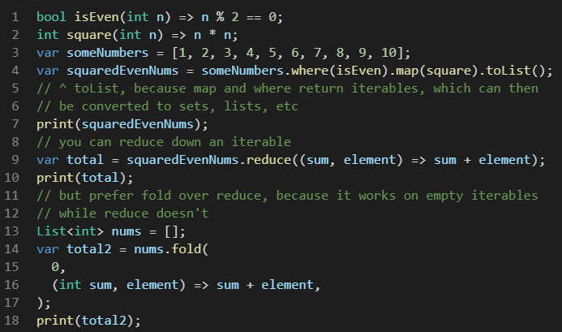
Functions as arguments
Another example
Map
Where
Reduce
fold

Slide 33
Exercises
There are 3 exercises
They each take 10-15 mins to make
Form a pair with someone for each exercise
Make them
Ask questions anytime
We’ll go over 1 or 2 solutions for each exercise

