Slide 1
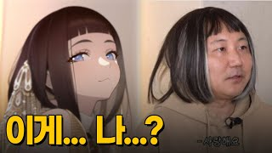
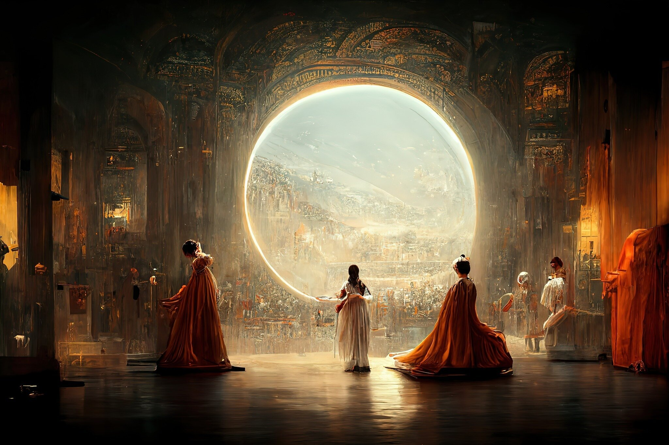
Have you seen it
Jason Allen's AI-generated work "Théâtre D'opéra Spatial“
주호민 AI 미소녀 만들기 대작전

Slide 2
Latent Diffusion
Why AI pops into my algorithm

Slide 3
Contents
1
1. Super Brief Intro of Deep Learning
2
2. What is Diffusion Model and its Limits
3. Latent Diffusion
3
4. LET ME USE IT
4

Slide 4

1. Super Brief Intro of Deep Learning
X, Wₜ
Forward pass
Loss
Backward pass
X, Wₜ₊₁
WANT TO MINIMIZE!

Slide 5
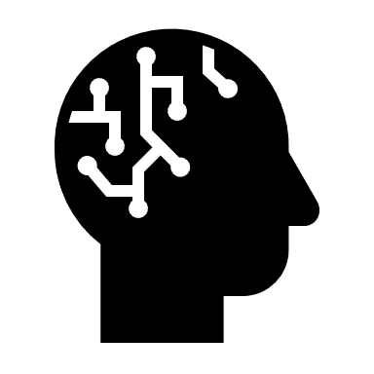


1. Super Brief Intro of Deep Learning
X, W
Iter == T

Slide 6
1. SBIDL - Summary
WANT TO MINIMIZE THE LOSS BY ITERATION

Slide 7
2. What is Diffusion Model
Break & Restore

Slide 8



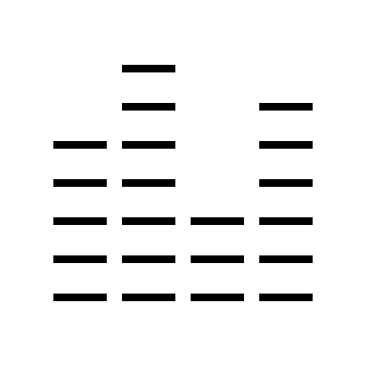
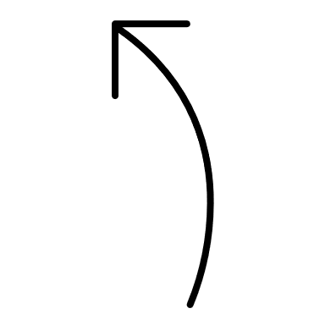
2. What is Diffusion Model
Diffusion Model
1.
input
output
We do noising
2.
Noising
Original image

Slide 9
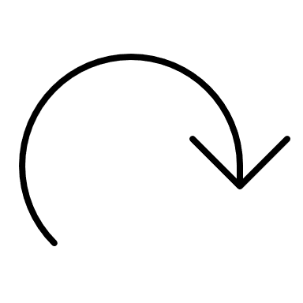
2. What is Diffusion Model
Denoising
With iterate
Generated image

Slide 10
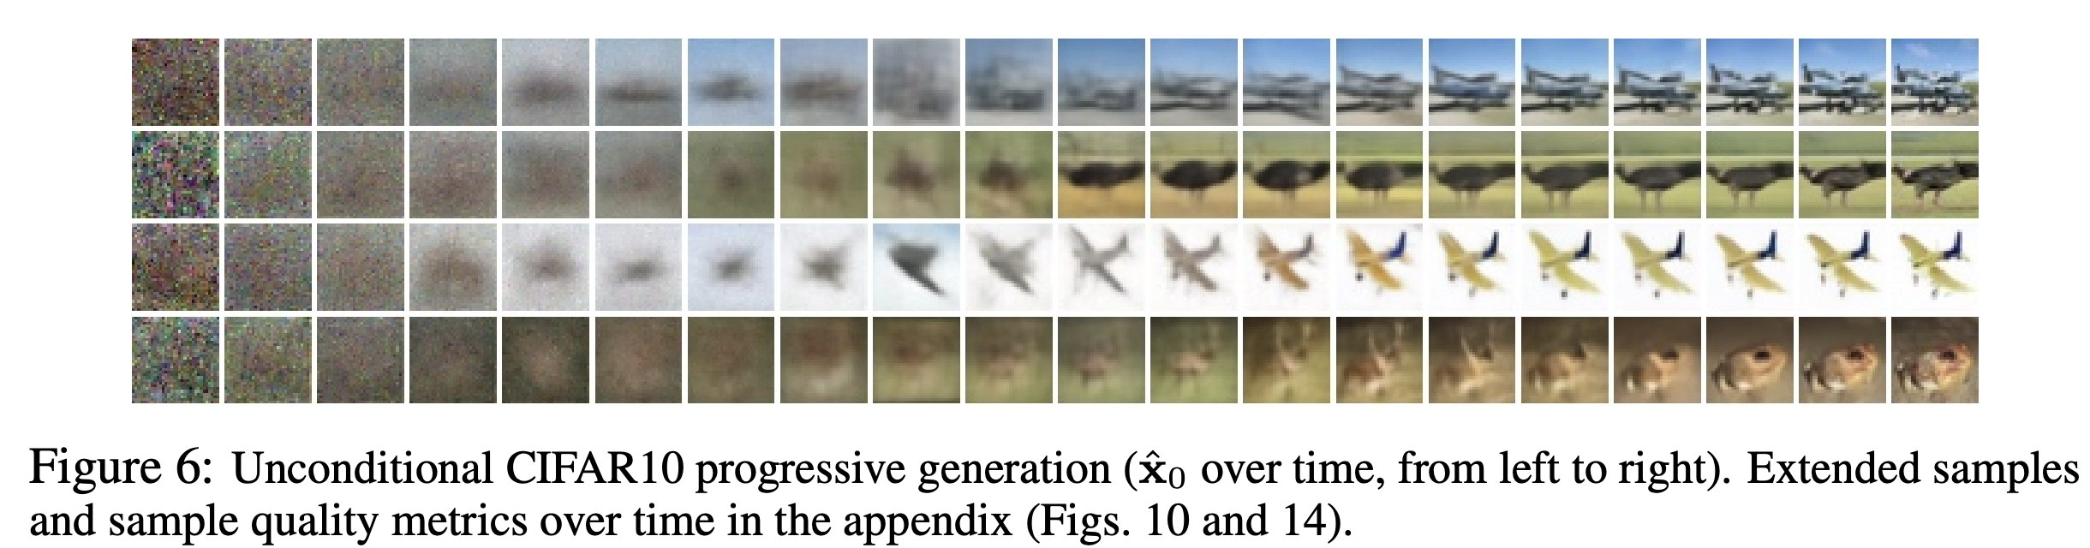
2. What is Diffusion Model
Denoising Diffusion Probabilistic Models
-Jonathan Ho, Ajay Jain, Pieter Abbeel

Slide 11
2. Limit – size of image
Size of training data: 128,000 = 1000 x 2^7
Size of image: 512 x 512 = 2^18
Information in a pixel: 256 + 256 + 256 = 3 x 2^8
~ 2.4 x 10^10
+ consider epoch, # of weights

Slide 12
3. Latent Diffusion
M
T
Diffusion in Latent Space
W
T
F

Slide 13
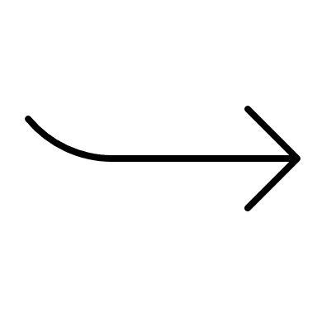
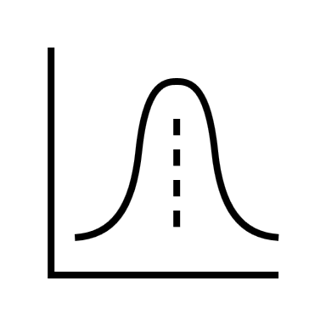
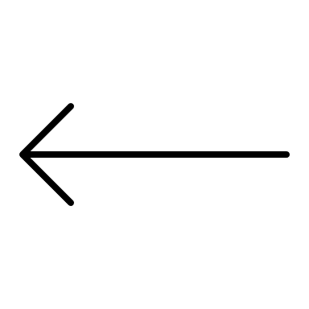

VAE = Variant Auto Encoder,
but also generates new data
Some Image
Or other kind of data
Deep learning model
Which uses probability
Low-dimensional data
New Image

Slide 14

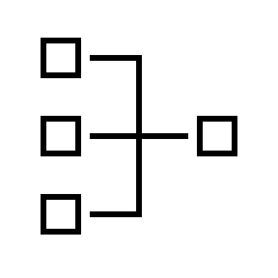


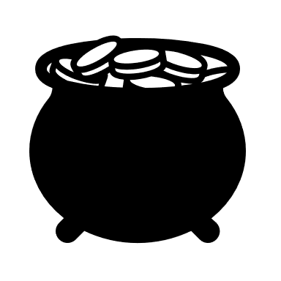
3. Latent Diffusion
LATENT SPACE
Noising
text
Denoising + Mixing

Slide 15
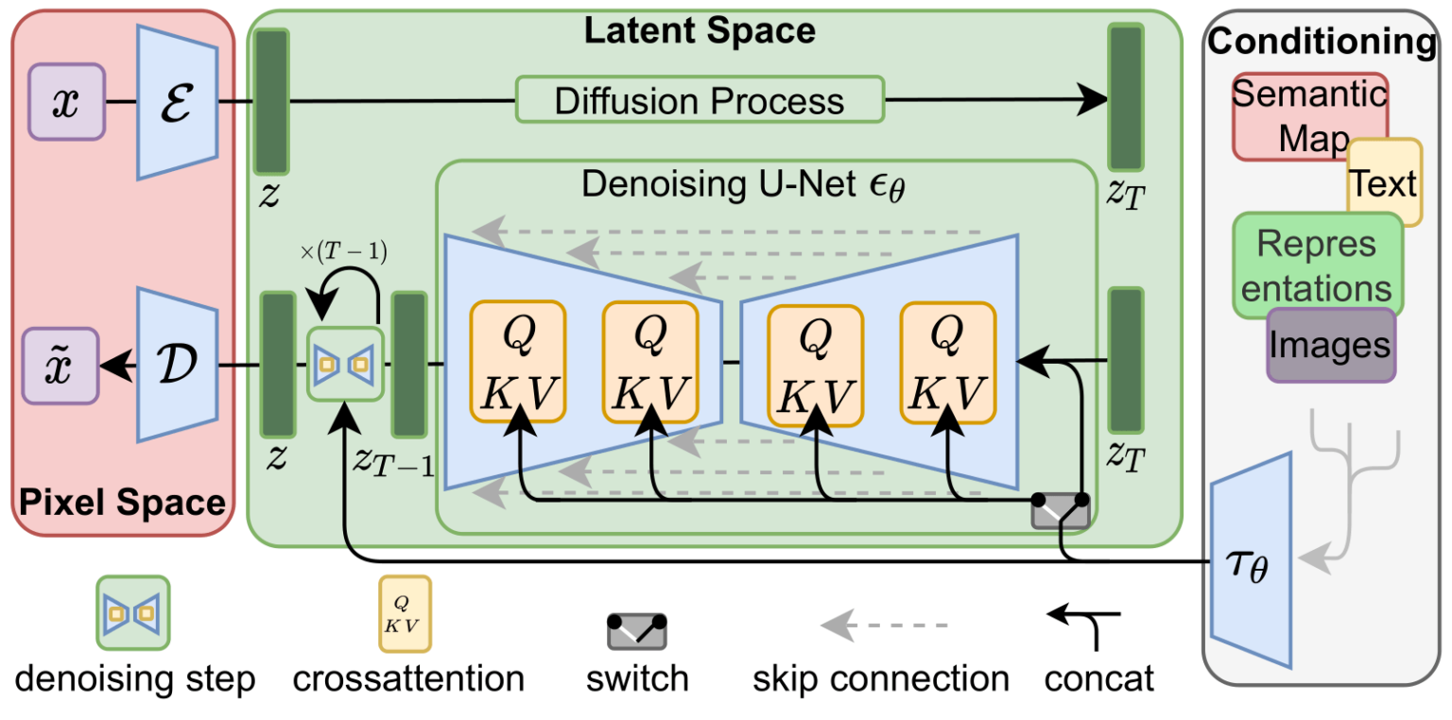
Lesson 1

Slide 16
4. Use It!
Stable Diffusion

Slide 17

Lesson 1
Open!
The compony that invented latent diffusion make a model called stable diffusion with MIT license
Lawfree
According to Korea law, using this kind of AI is out of the law.

Slide 18
Thanks
Please keep this slide for attribution.

Slide 19

Question

