Slide 1
Spring Study Week 1. JDBC와 JPA

Slide 2
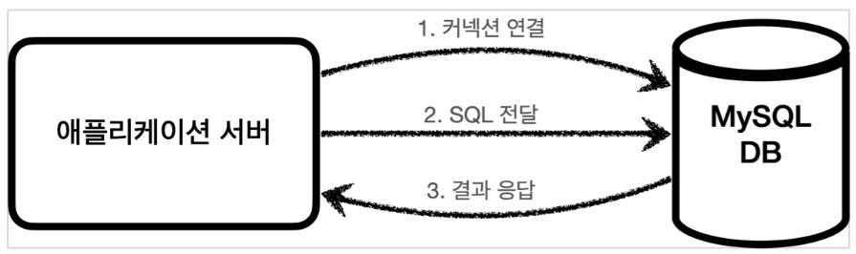
JAVA - Database
Notes:
dskasdkfkdsafkads

Slide 3
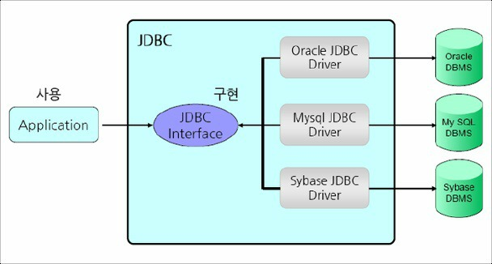
JDBC Java DataBase Connectivity
Notes:
dskasdkfkdsafkads

Slide 4
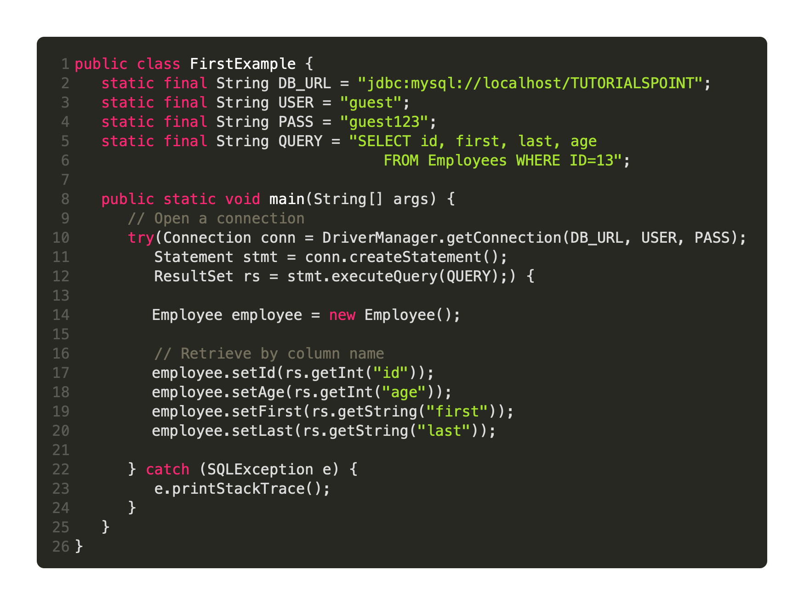
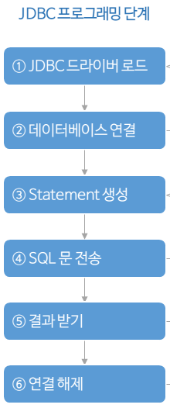
JDBC Java DataBase Connectivity
Notes:
dskasdkfkdsafkads

Slide 5
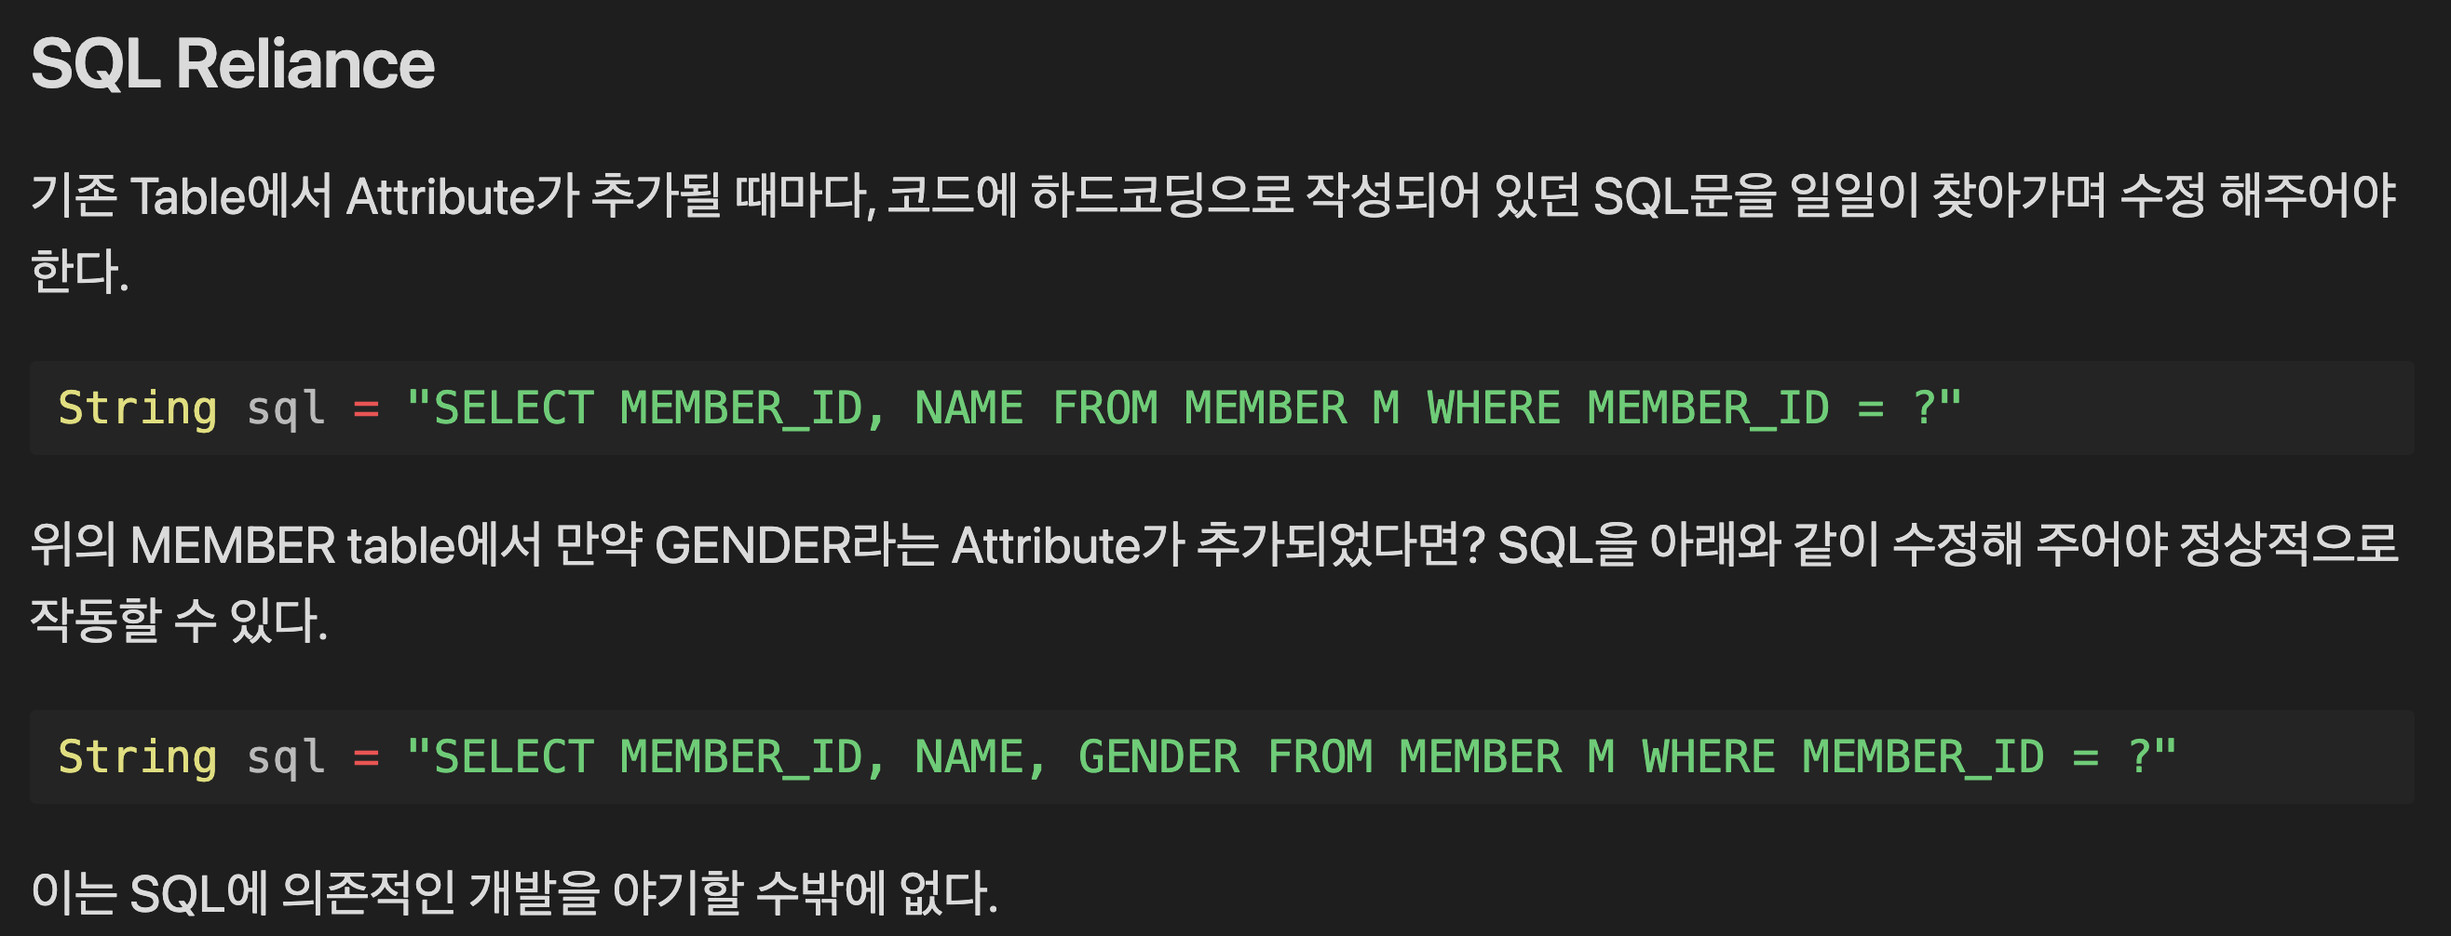
JDBC Java DataBase Connectivity
Notes:
dskasdkfkdsafkads

Slide 6
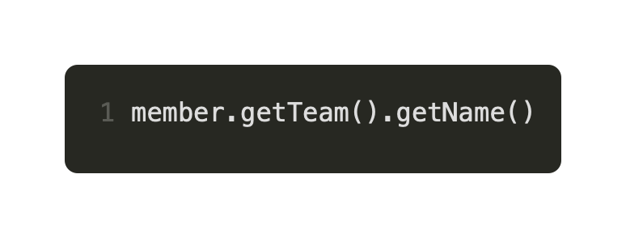
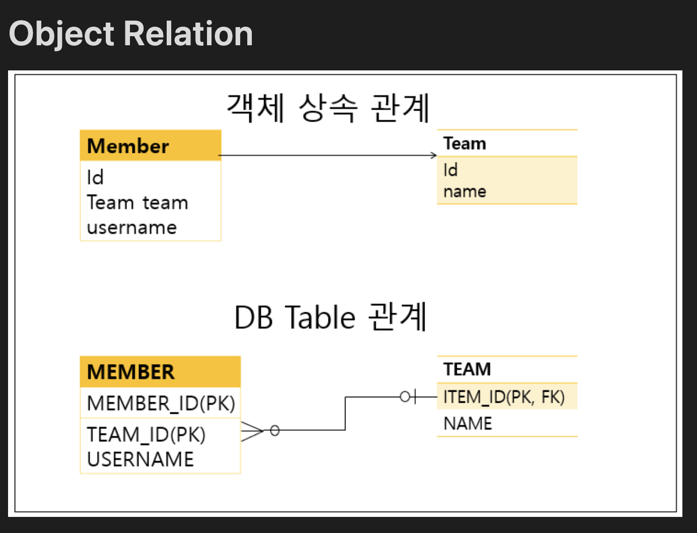
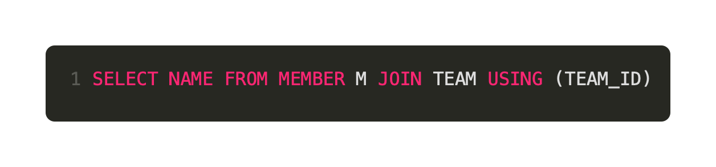
JDBC Java DataBase Connectivity
연관
Notes:
dskasdkfkdsafkads

Slide 7
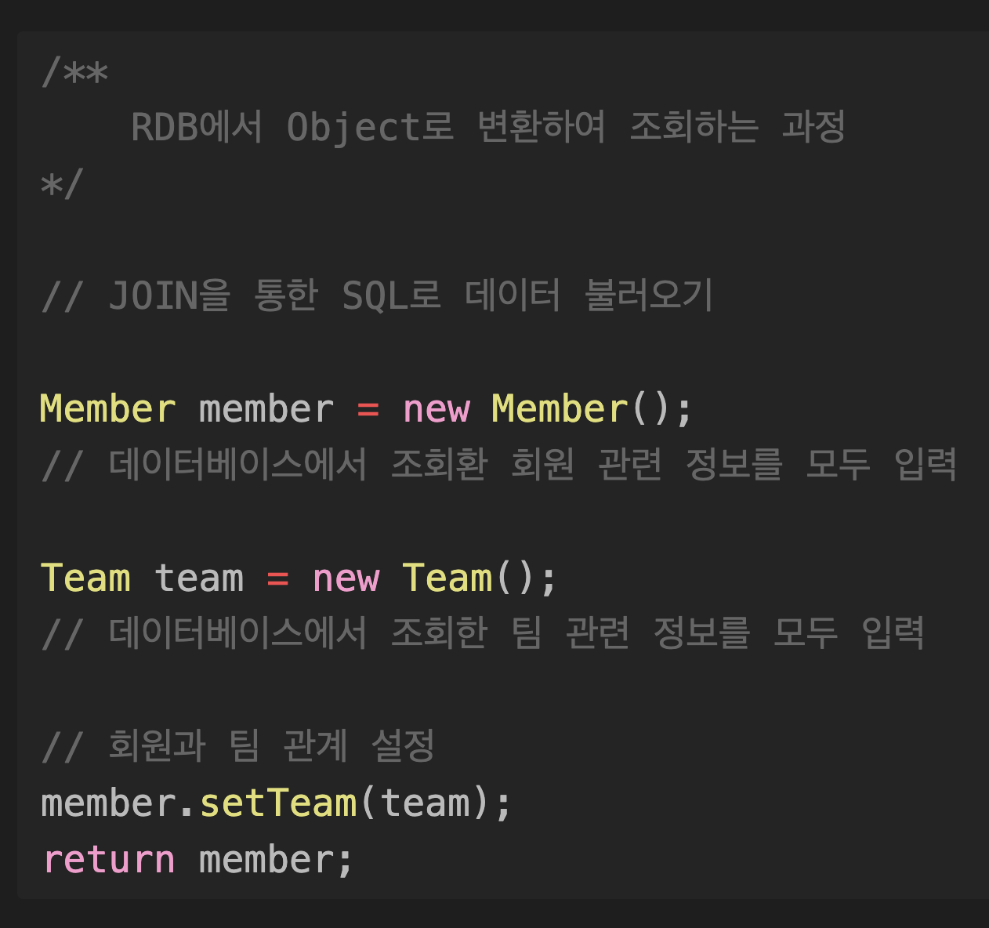
JDBC Java DataBase Connectivity
연관
Notes:
dskasdkfkdsafkads

Slide 8
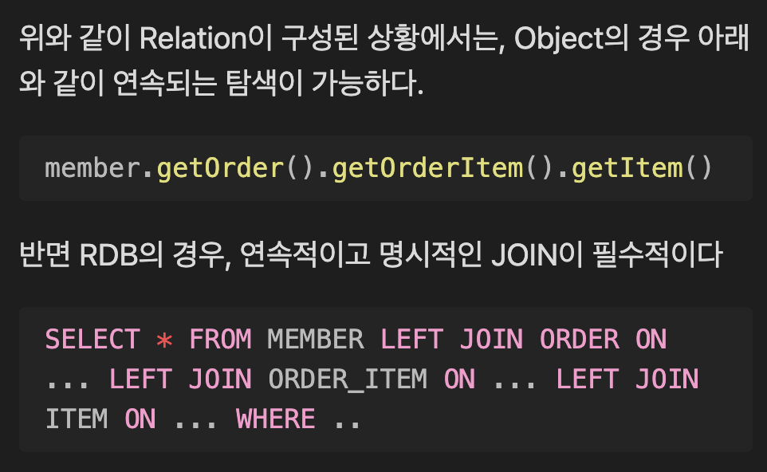
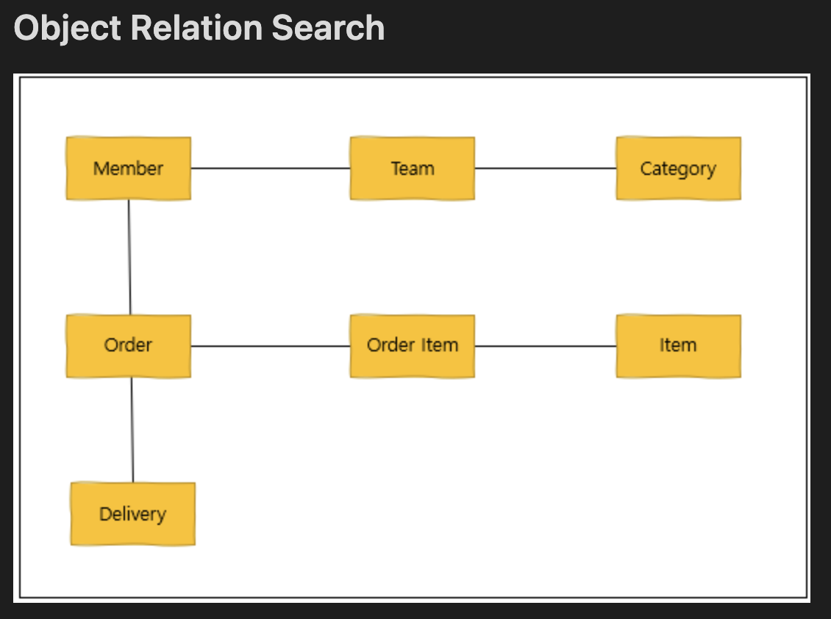



JDBC Java DataBase Connectivity
Notes:
dskasdkfkdsafkads

Slide 9
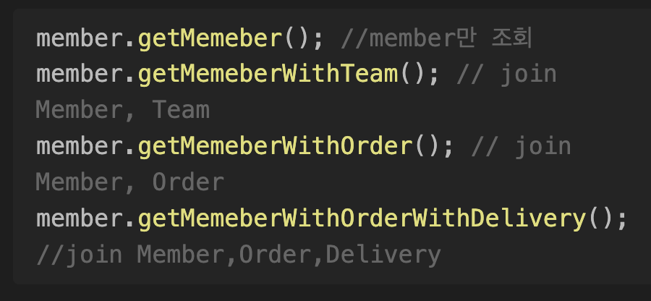
JDBC Java DataBase Connectivity
Notes:
dskasdkfkdsafkads

Slide 10
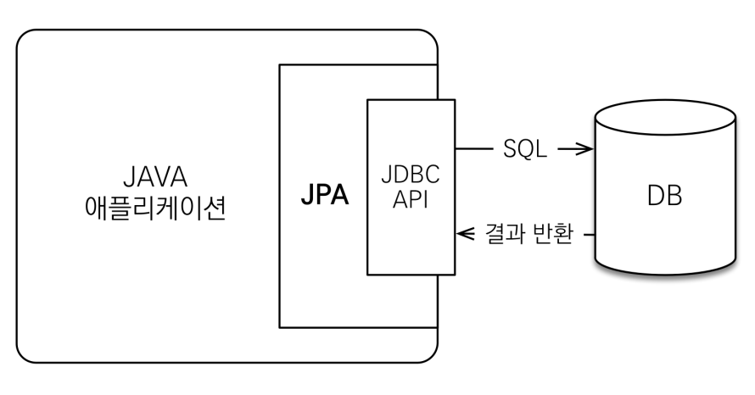
JPA Java Persistence API
Notes:
dskasdkfkdsafkads

Slide 11
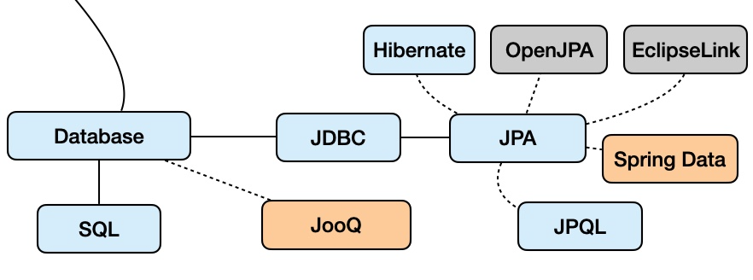
JPA Java Persistence API
Notes:
dskasdkfkdsafkads

Slide 12
JPA Java Persistence API
Notes:
dskasdkfkdsafkads

Slide 13
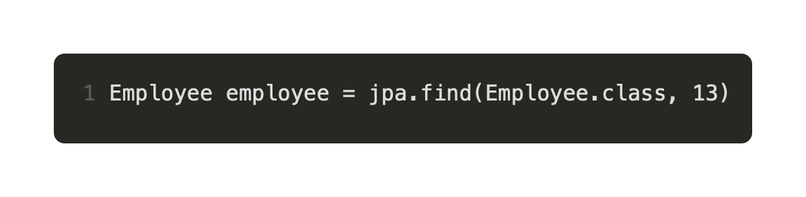
JPA Java Persistence API
Notes:
dskasdkfkdsafkads

Slide 14
JPA Java Persistence API
SQL Independent
Inheritance
Relation
Notes:
dskasdkfkdsafkads

Slide 15
Thank You :)
Notes:
sdafdsasdfa

