Slide 1

Mini Project Week 02
Basic 2조: 김예림, 한유진

Slide 2
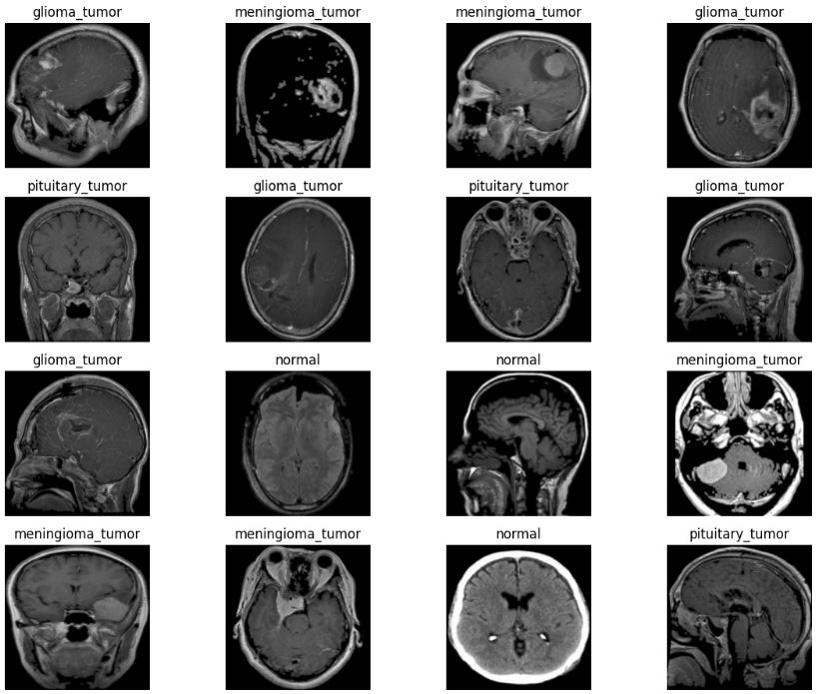
Goal
Glioma Tumor
Meningioma Tumor
Pituitary Tumor
Normal

Slide 3
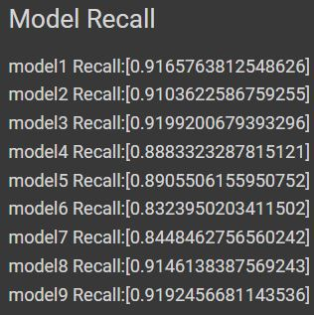
Use Different Model
ResNet50
ResNet101
ResNet152
VGGNet16
VGGNet19
MobileNet
MobileNetV2
MobileNetV3Small
MobileNetV3Large

Slide 4
Use Different Model
ResNet50
ResNet101
ResNet152
VGGNet16
VGGNet19
MobileNet
MobileNetV2
MobileNetV3Small
MobileNetV3Large

Slide 5
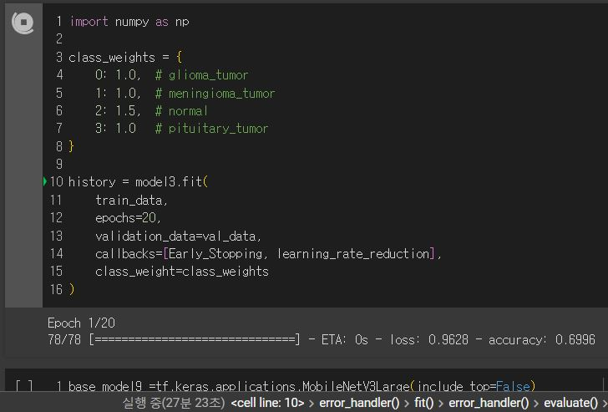
Data Preprocess - Class Weight

Slide 6
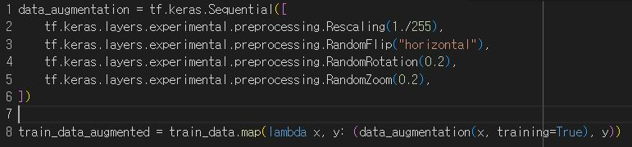
Data Preprocess - Data Augmentation

