Slide 1

ML/DL Study W02
XOR – Neural Networks
Forward/Back Propagation
Sigmoid VS Relu
Xavier VS He
Drop out
Batch Normalization

Slide 2
XOR – NN

Slide 3
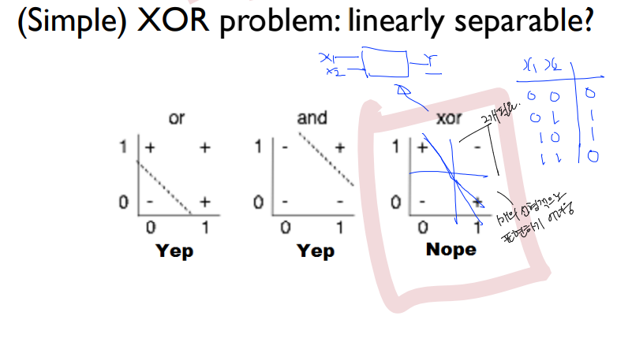
XOR

Slide 4
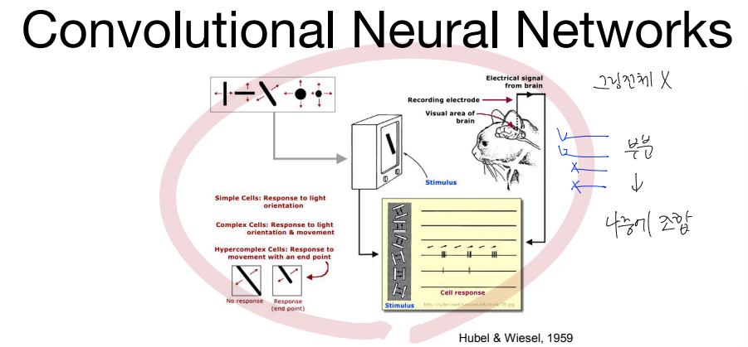

Slide 5
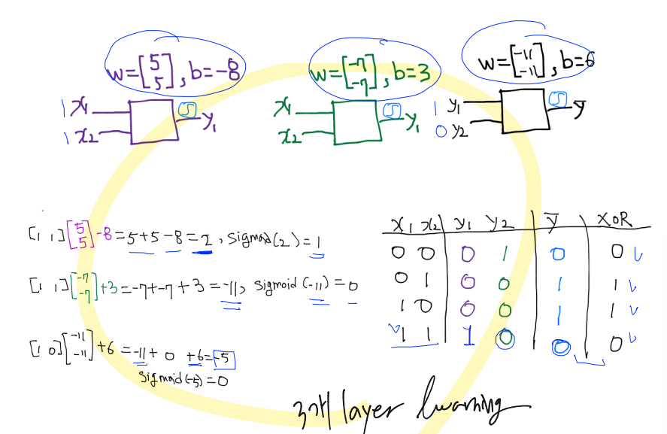

Slide 6
K = tf.sigmoid(tf.matmul(X, W1) + b1)
Hypothesis = tf.sigmoid(tf.matmul(K, W2) + b2)

Slide 7
Forward/Back Propagation

Slide 8
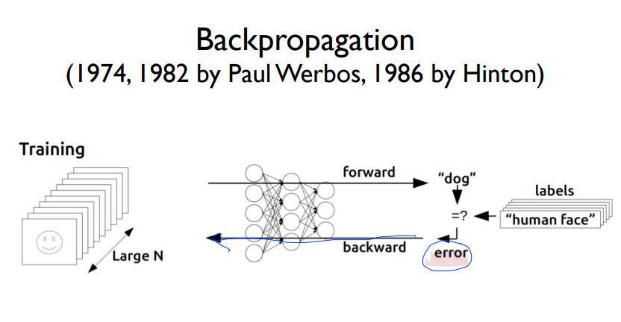
Forward/Back Propagation

Slide 9
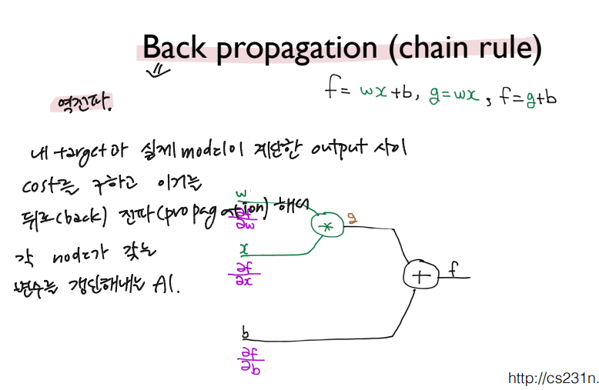
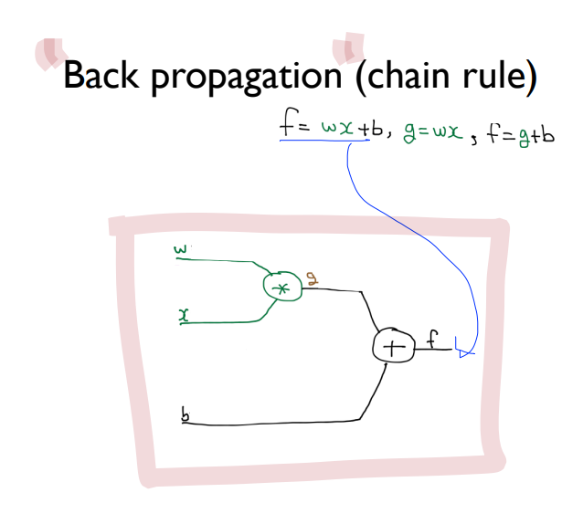
Forward/Back Propagation

Slide 10
Sigmoid VS Relu

Slide 11
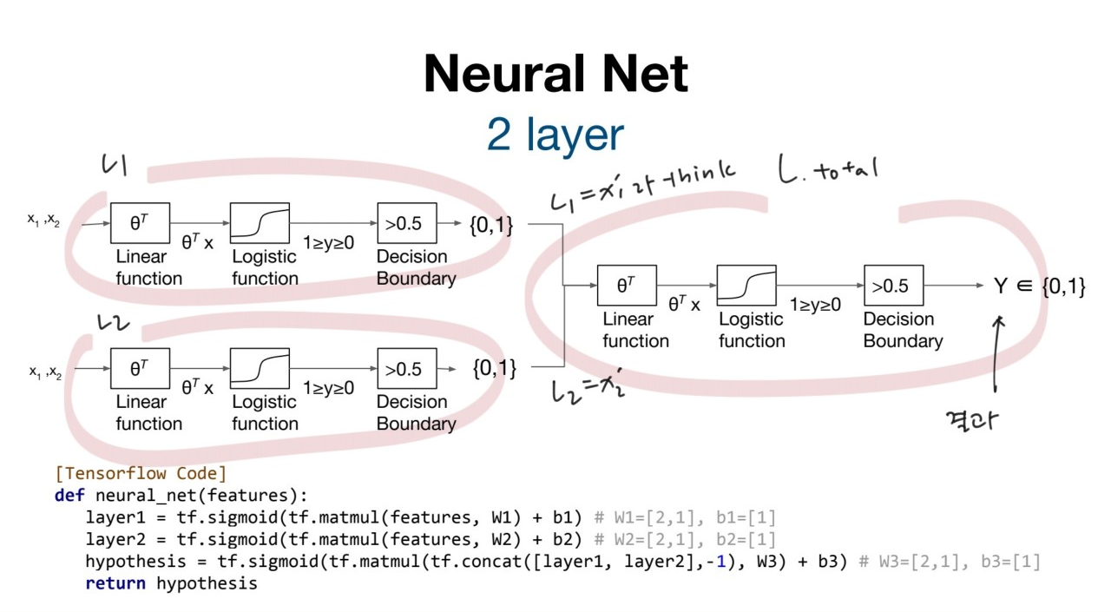
Sigmoid

Slide 12
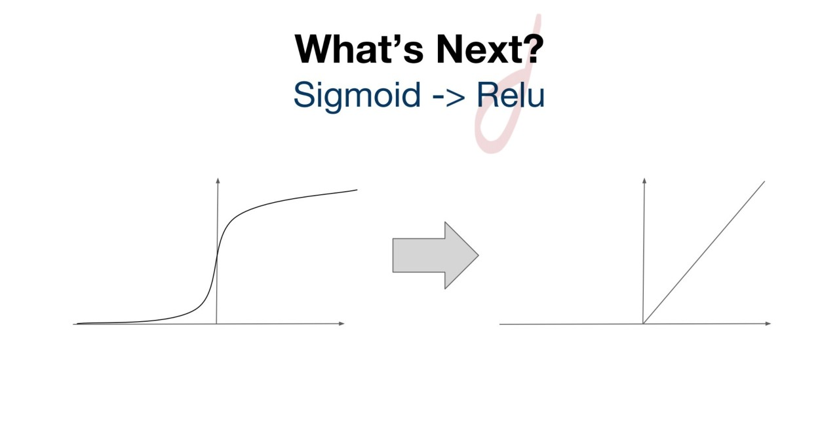
Sigmoid

Slide 13
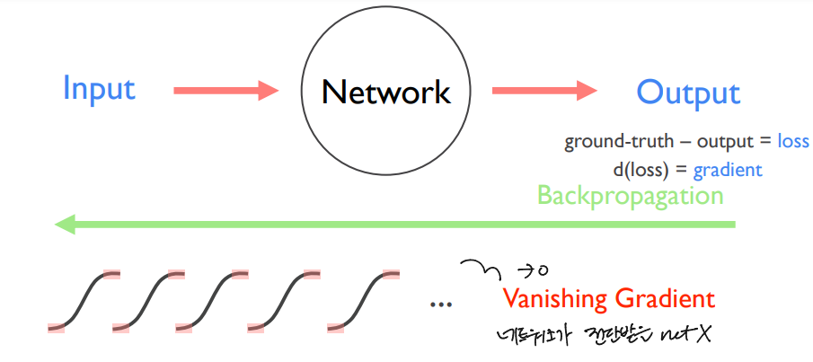
Problem of Sigmoid

Slide 14
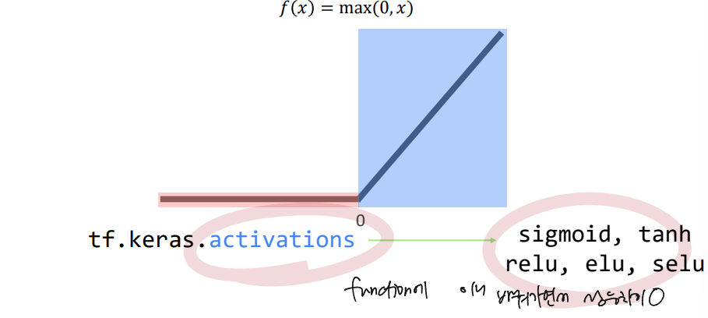
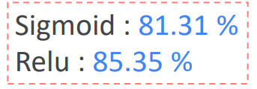
Why Relu?

Slide 15
Weight Initialization

Slide 16
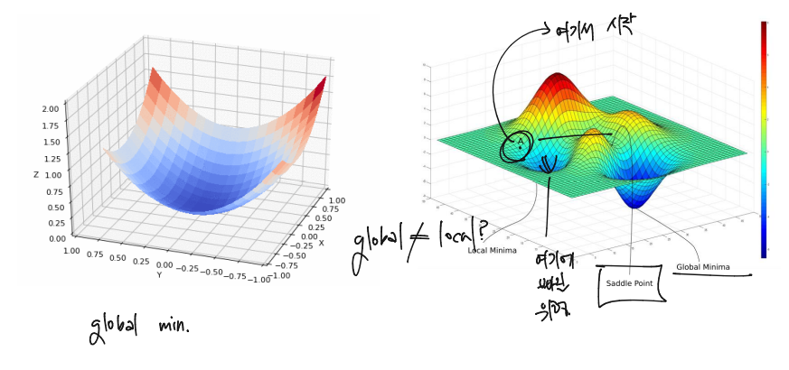
Xavier VS He

Slide 17

Xavier VS He
# Create network
weight_init = tf.keras.initializaers.RandomNormal()
weight_init = tf.keras.initializaers.glorot_uniform()
weight_init = tf.keras.initializaers.he_uniform()

Slide 18
Drop out

Slide 19
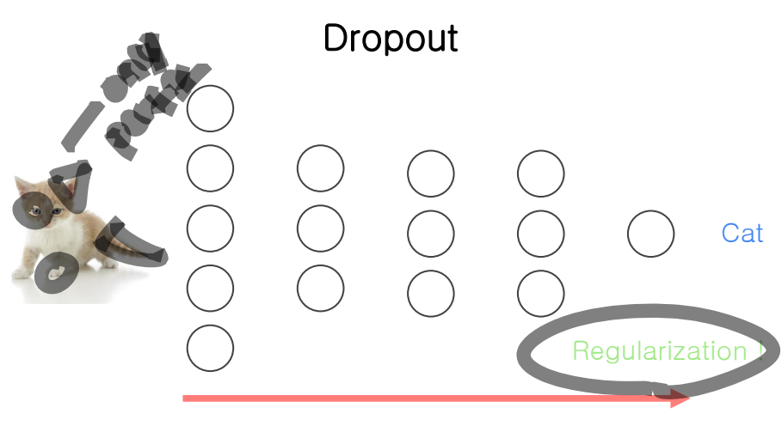
Drop out

Slide 20
Batch Normalization

Slide 21
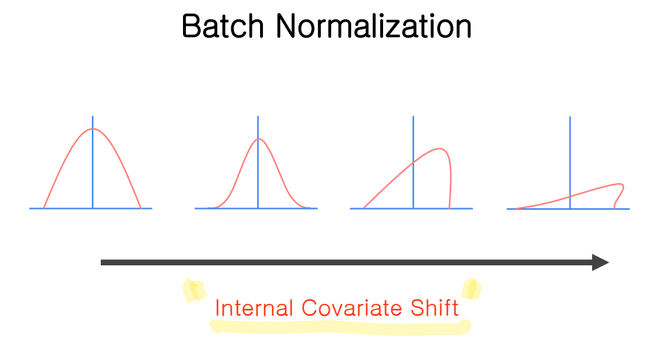
Batch Normalization

Slide 22
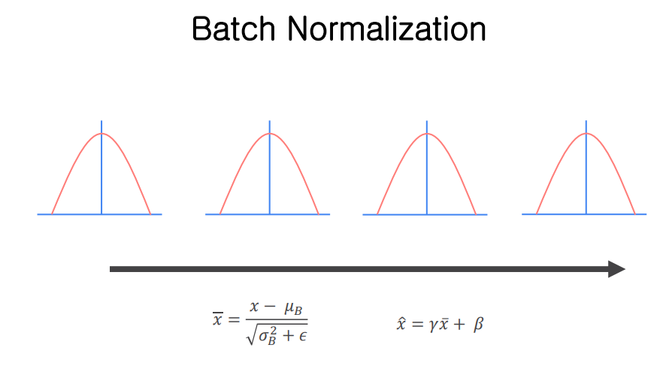
Batch Normalization

