Slide 1

ML/DL Study W01
Basic Concepts of ML
Linear Regression
How to minimize cost
Multi-variable linear regression
Logistic Regression

Slide 2
Basic Concepts of ML

Slide 3
What is ML?
Training Data Set의 형태 → Supervised Learning vs Unsupervised Learning
ML
Regression
Binary Classification
Multi-label Classification
Supervised Learning

Slide 4
Linear Regression

Slide 5
Linear Regression
Cost H(x) – y

Slide 6
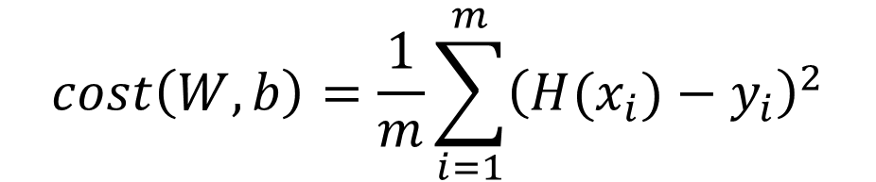
Linear Regression
$$cost\left(W,b\right)=\frac{1}{m}\sum_{i=1}^{m}{{\left(H(x_{i})−y_{i}\right)}^{2}}$$

Slide 7
How to minimize cost

Slide 8
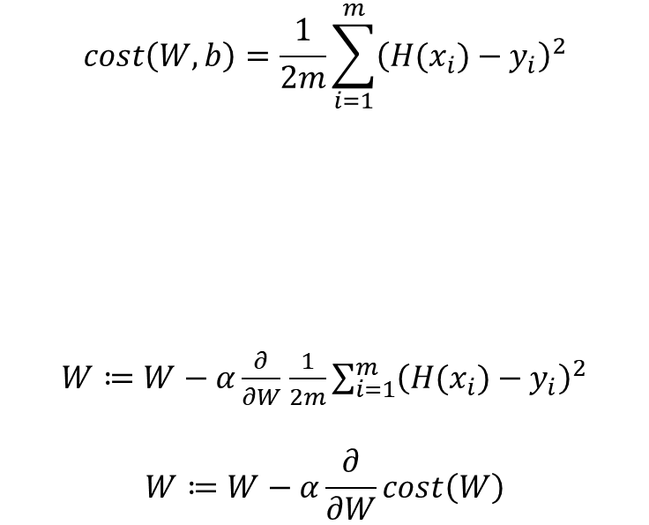
Goal : Minimize cost
$$cost\left(W,b\right)=\frac{1}{2m}\sum_{i=1}^{m}{{\left(H(x_{i})−y_{i}\right)}^{2}}$$
$W≔W−α\frac{∂}{∂W}$ $\frac{1}{2m}\sum_{i=1}^{m}{{\left(H(x_{i})−y_{i}\right)}^{2}}$
$$W≔W−α\frac{∂}{∂W}cost\left(W\right)$$

Slide 9
Goal : Minimize cost
Local minimum =/ Global minimum
Local minimum = Global minimum

Slide 10
Multi-variable linear regression

Slide 11

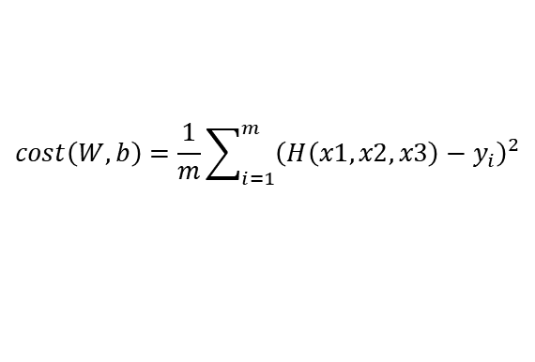
Multi-variable linear regression
x1 | x2 | x3 | y(final)
73 | 80 | 75 | 152
93 | 88 | 93 | 185
89 | 91 | 90 | 180
Hypothesis
$$H\left(x1, x2, x3\right)=w1x1+w2x2+w3x3+b$$
$$H\left(X\right)=XW$$
Cost function
$$cost\left(W,b\right)=\frac{1}{m}\sum_{i=1}^{m}{{\left(H\left(x1,x2,x3\right)−y_{i}\right)}^{2}}$$
Gradient descent

Slide 12
Logistic Regression

Slide 13


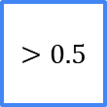
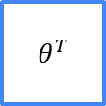
Logistic Regression
Linear ~ Continuous (Measured)
Logistic ~ Discrete (Counted)
Binary Classification
$$g\left(z\right)=\frac{1}{1+e^{−z}}$$
$$θ^{T}$$
$$>0.5$$
X
Y $∈\{0,1\}$
Linear
function
Logistic
function
Decision
Boundary

