Slide 1



Slide 2



Great job

Slide 3





What is next ?

Slide 4



Competition

Slide 5


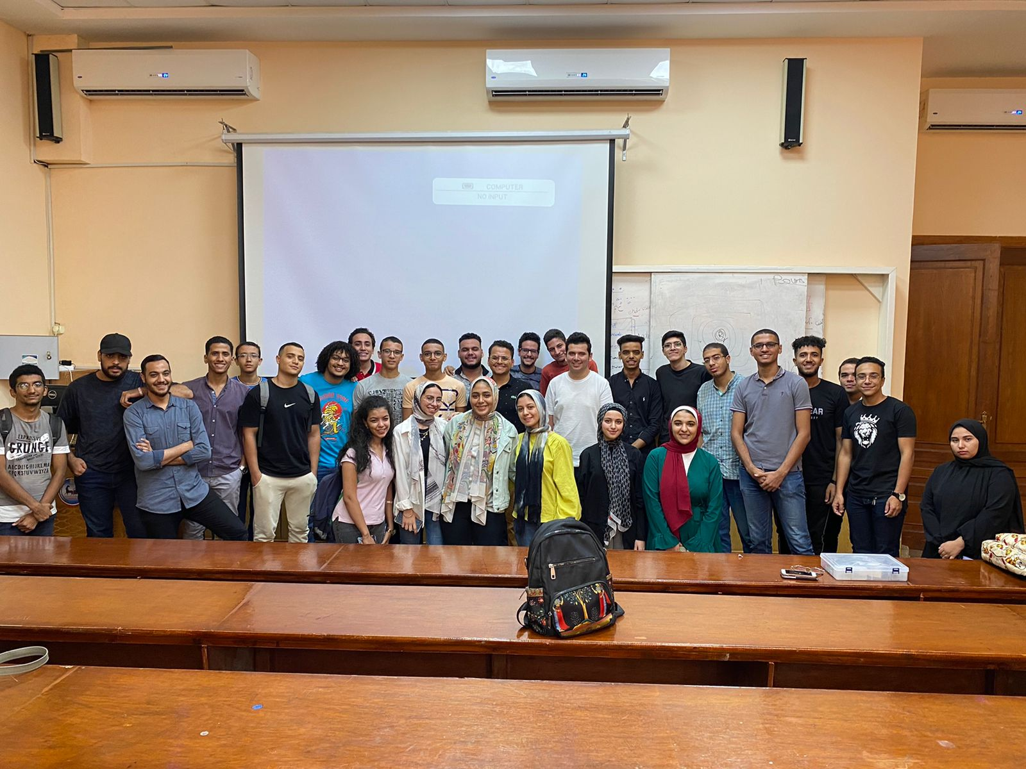


Google developer student club
Google Developer Student Club(GDSC) is a program supported by Google that aims to empower students with knowledge and resources in the field of technology.
Through the program, students can access workshops, training, and other events related to various Google technologies

Slide 6
Competition stages
Stage 1
Stage 2
Stage 3

Slide 7


Stage 1
Presentation

Slide 8
Your presentation should include
1. introduction
2. Define problem
3. Solution
4. How it work
5. component
6.Circuit design
7.Project visualization
8.Future work
9.Q/A

Slide 9
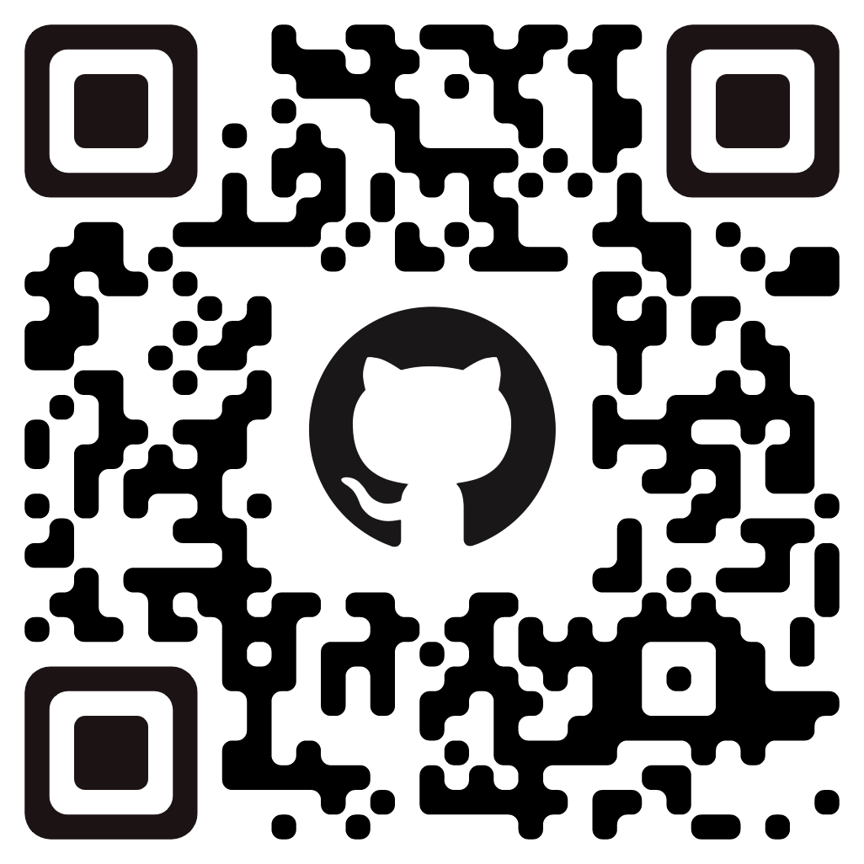


Begin by introducing yourself and your project.
State your name, age, passion, and experience. Additionally, please provide us with your contact information such as your GitHub and LinkedIn accounts using a QR code.
provide us with a brief introduction to your project. Explain its function and how the idea came to you.

Slide 10
Define problem
define the problem that led you to undertake this project. Your definition should include
case study
The history of the problem
explanation of why this project is necessary.

Slide 11
Solution
Kindly provide the following information:
What is the proposed solution?
A comprehensive explanation of how you conceptualized the idea for this solution.
Why do you believe that this solution is a suitable option for addressing the current problem?
A detailed explanation of the proposed solution, including how it works and any potential strength points .This will ensure that all stakeholders have a thorough understanding of the solution and its potential impact.

Slide 12
How it work ? (Flow chart )
Flowcharts are visual representations of a project's processes using diagrams.
They enable a clear and concise understanding of the project's processes.
Flowcharts facilitate the identification of areas for improvement or optimization.
They are an effective communication tool for explaining complex ideas and workflows.
Flowcharts enable effective communication with stakeholders and team members.

Slide 13
Example (distance alarm sensor)
start
read distance value from ultrasonic sensor
If distance <15
Turn on buzzer
(make alarm sound)
yes
No
Turn off buzzer

Slide 14
Component
Provide a detailed description of the components used.
Explain the reasoning behind the selection of each component.
Outline the specific function of each component.
Provide a brief explanation of how each component works.
Ensure that stakeholders have a comprehensive understanding of the components and their impact on the project.

Slide 15
Circuit design
Present a picture of the circuit design.
Provide a detailed explanation of the circuit's functionality.
Ensure that the explanation is clear and concise.
Facilitate comprehension for individuals who may not have a technical background.

Slide 16
Project visualization
Provide a picture of your graduation project.
Showcase the functionality of the project through a video.
Ensure that the video is of high quality and clearly highlights the project's unique features and advantages.
Enable stakeholders to gain a comprehensive understanding of the project through both visual and audio means.

Slide 17
Future work
Present your future plan for upgrading the project.
Outline the specific improvements you aim to make to enhance the solution.
Demonstrate a proactive approach towards ensuring ongoing success.
Ensure that the plan is comprehensive and feasible.
Align the plan with the overall goals and objectives of the project.

Slide 18
Q/A
Allow the audience to ask questions related to your project idea.
Enable the audience to gain a deeper understanding of the solution.
Address any concerns or uncertainties that the audience may have.
Create a supportive environment for questions.
Ensure that each inquiry is addressed respectfully and thoroughly.

Slide 19
Stage 2
Competition

Slide 20
Time
Date
25/3/2023
As the competition is taking place online, kindly ensure that your camera is functional and that you are adequately prepared, organized, and dressed in appropriate attire. It is worth noting that your graduation project presentation will be recorded.

Slide 21
Score
Project
Circuit design
Code
presentation
discussion
35
point
10
point
10
point
35
point
10
point

Slide 22
Stage 3
Certificate

Slide 23
Certificate
The certifying authority for the accomplishment of the project is Google Developer Student Club.
A certificate of accomplishment will be issued if the score achieved is greater than or equal to 60%.
The certificate will include the name of the diploma, the name of the recipient, and their score.
The certificate serves as recognition of the recipient's achievements.
The certificate is a testament to the effort and dedication invested in the project.

Slide 24


Thank You

