Slide 1


Slide 2

DATA ENGINEERING TRACK
INTRODUCTION WHAT IS DATA ENGINEERING??

Slide 3
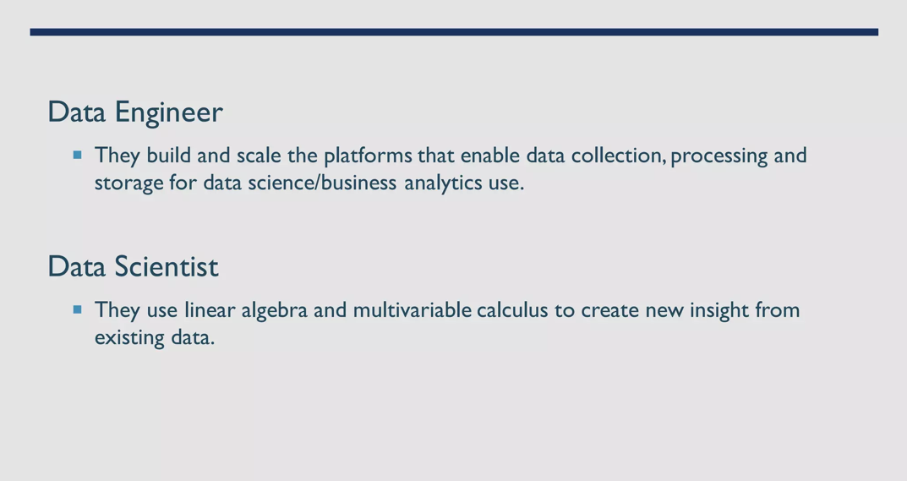

Slide 4
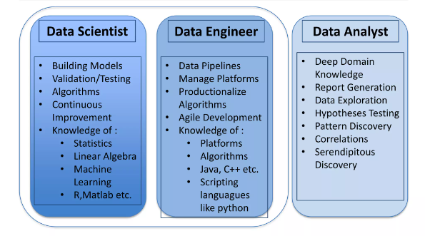

Slide 5

WHY DATA ENGINEERING
Data Reliability and Quality
Efficient Data Processing
Scalability and Performance

Slide 6
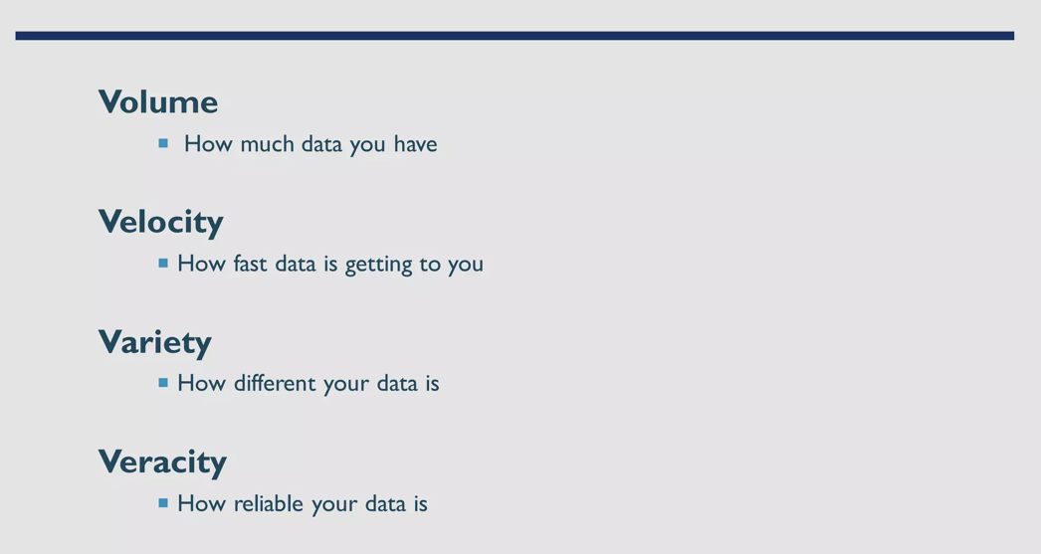
BIG DATA PROPERTIES

Slide 7
Data engineering PROCESS OUTLINE
Data collection
Data Cleaning/Transformation
Data Storage
Data Integration/Processing
Data Modelling
Data Governance and Security
Data Monitoring & Management
Data Delivery and Reporting
Automation and Orchestration
Recovery and Backup

Slide 8
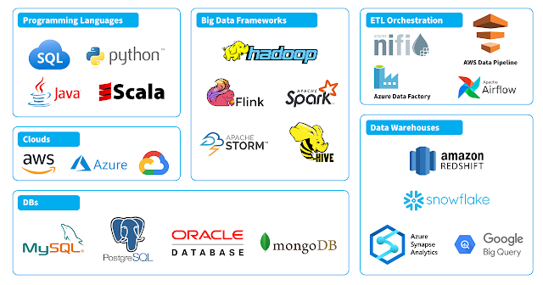

TOOLS, FRAMEWORKS AND CLOUD

Slide 9

QUESTIONS??
Register for Google Cloud Data Engineering Career Path here :
https://www.cloudskillsboost.google/?qlcampaign=5p-EDUCR-DSC-MENASEP-99
Register on GitHub
FESTUSMAITHYA264@GMAIL.COM

Slide 10
Thank you

