Slide 1
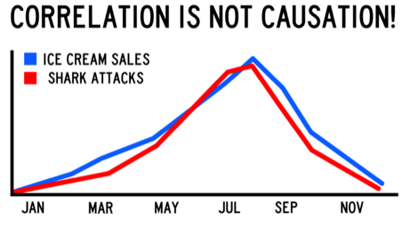
Intro & Review ENVS225 Exploring the Social World
Gabriele Filomena
gfilo@liverpool.ac.uk
Notes:
Explain change of example

Slide 2
Quantitative Data Block: General Info
Lecture + Lab Sessions:
Friday 11 – 1 pm
Week 8 -> Central Teaching Hub, PCTC

Slide 3
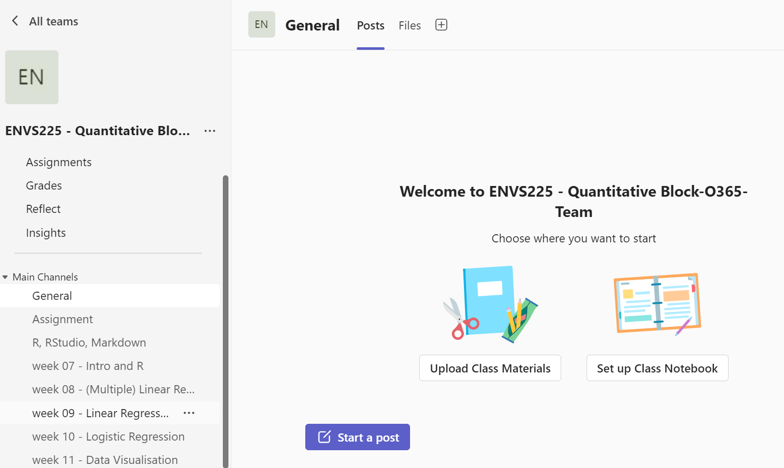
Quantitative Data Block: Questions -> MS Teams
Join the team

Slide 4
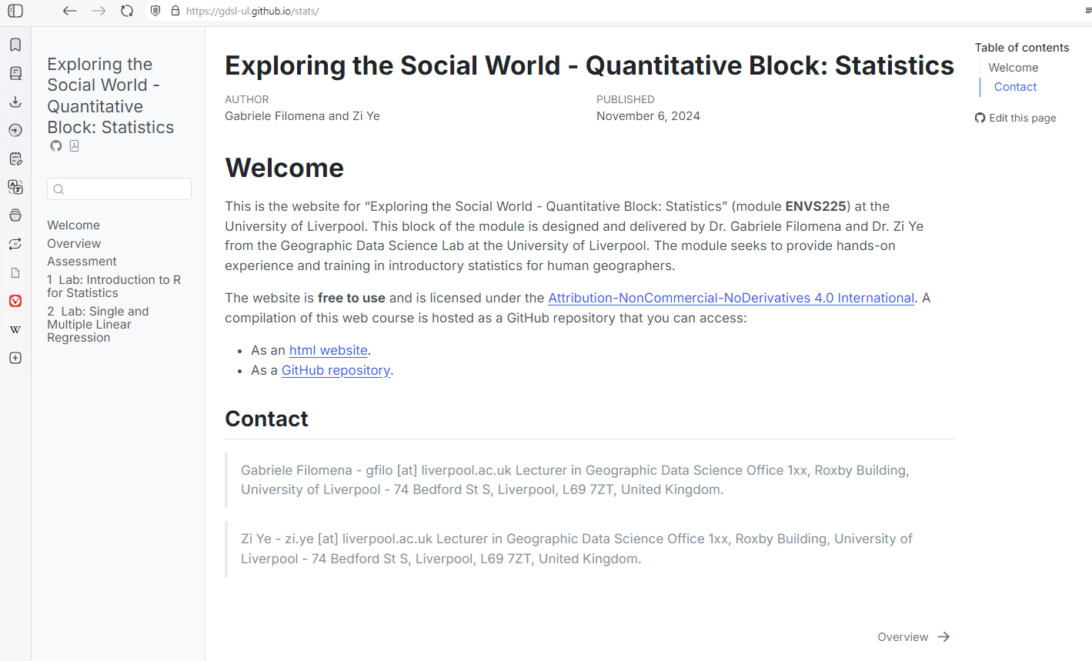
Quantitative Data Block: Webpage
gdsl-ul.github.io/stats/
Material and Labs

Slide 5
Quantitative Data Block: Assignment
Writing a research report using one of the regression techniques learned during the module. The report should have the following sections: an introduction, a brief literature review, methods and data, results and/or discussion, and discussion or/and conclusion.
See webpage

Slide 6
Qualitative
Quantitative
- Looks at how and why
- Work with measurements
- Includes interviews, reviews and observations
- Not biased
Include surveys and controlled experiments
- Produces observations, notes and descriptions
- Yield actionable results
- Produce numbers that can be turned into statistics
- Looks for patterns or themes
Looks for statistical
relationships
Notes:
NUANCES

Slide 7
Why Both?
Jobs
Holistic understanding of problems
Dissertation
Better appreciation of what Geographers do

Slide 8
Learning goals
Understand how to explore a dataset, containing a number of observations described by a set of variables.
Demonstrate an understanding in the application and interpretation of commonly used quantitative research methods.
Demonstrate an understanding of how to work with quantitative data to address real-world research questions.

Slide 9
7 | Introduction & Review | GF
8 | Single & Multiple Linear Regression | GF
9 | Multiple Linear Regression with Dummy Variables | ZY
10 | Logistic Regression | ZY
11 | Data Visualisation | GF
12 | Summary and Assessment Support | ZY

Slide 10
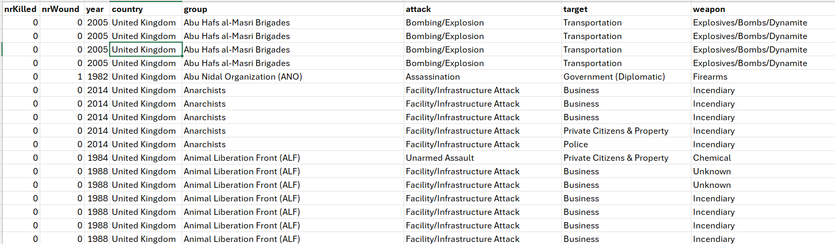
What are we going to work with?

Slide 11
Descriptive Statistics

Slide 12
Descriptive statistics
Help us summarize the characteristics of our data/observations
They form the initial step in a statistical analysis
We get information about the centrality (e.g., mean, median)
We get information about the variability (e.g., variance, standard deviation)

Slide 13
Mean
Mean is another word for average.
Most commonly used statistic that tells us about the centre of a data set.
It is the average of the numbers in your dataset.
The sum of all values divided by the number of observations.

Slide 14
Median
It is the middle point of your ordered data.
If one orders the observations:
1,3,5,8,10
The median is the number in the middle
When the observations are even:
1,3,5,6,8,10
Average the mid values -> 5.5

Slide 15
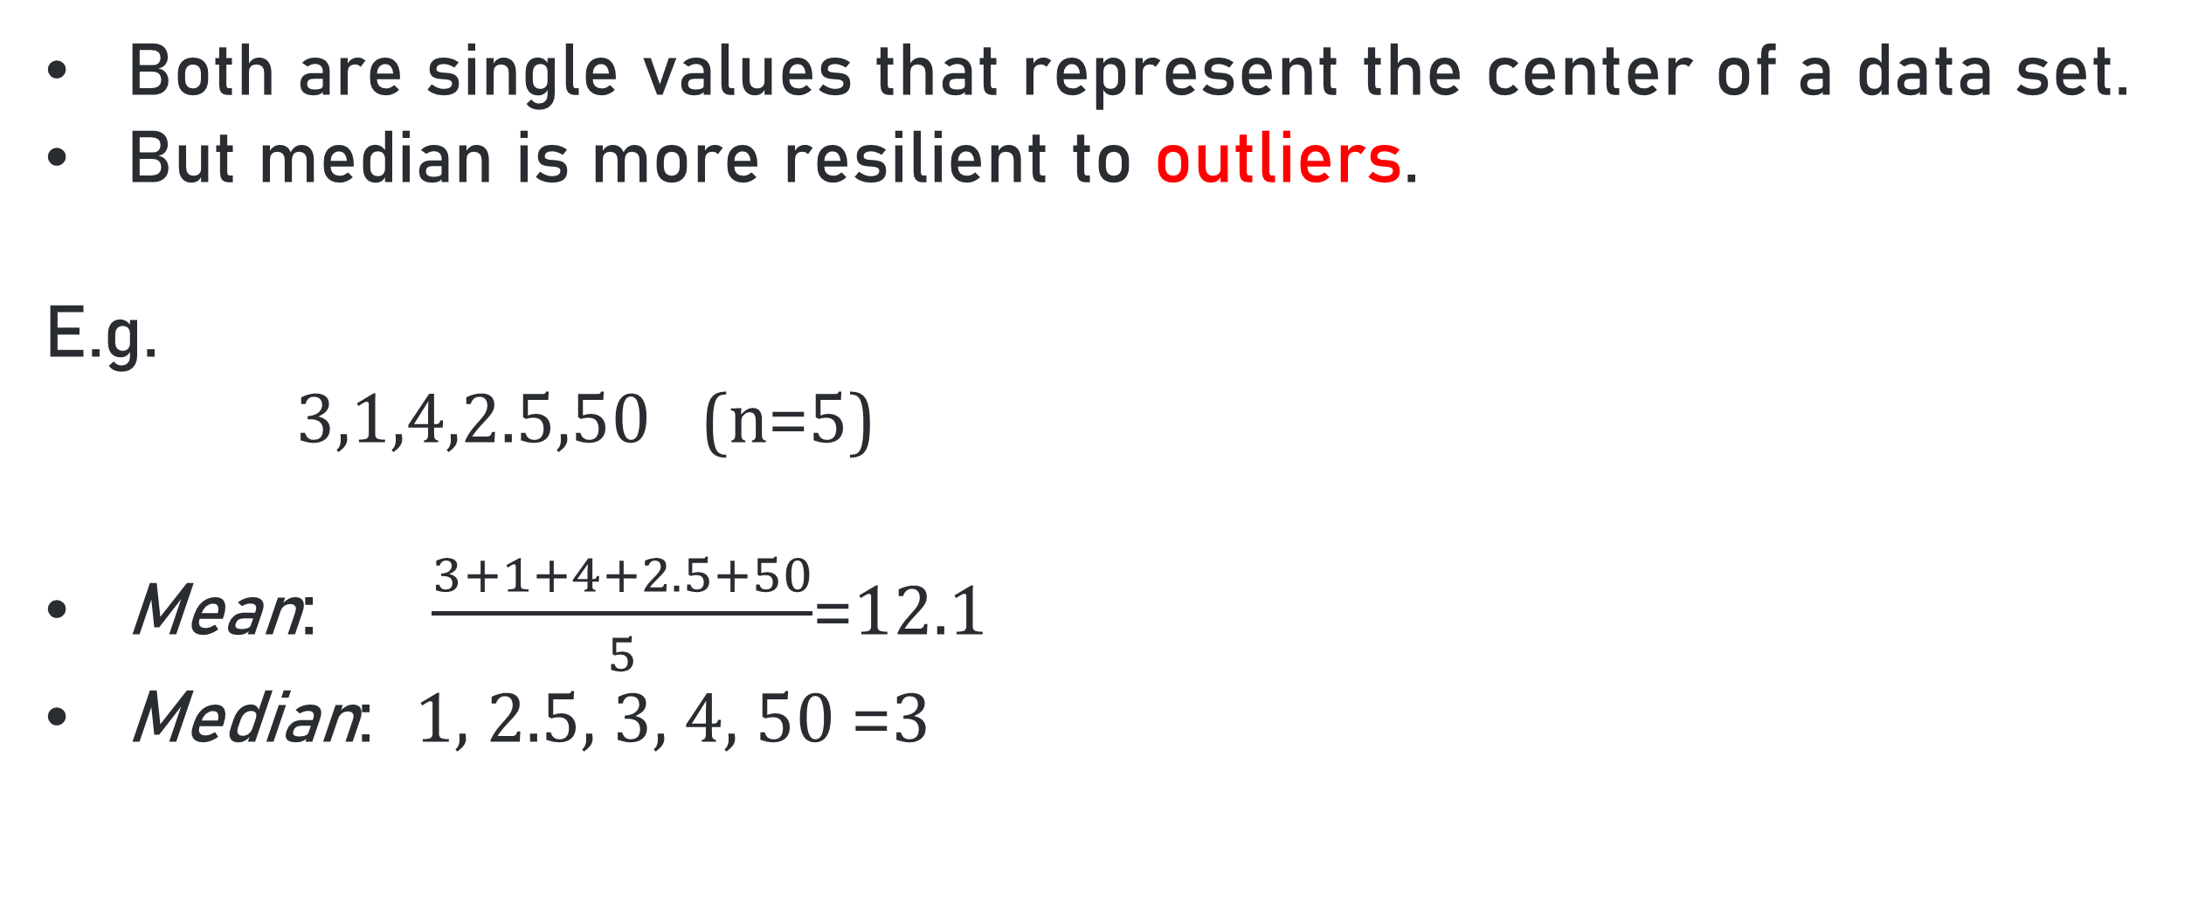
Difference between Mean and Median
Both are single values that represent the center of a data set.
But median is more resilient to outliers.
E.g.
3,1,4,2.5,50 (n=5)
Mean: $\frac{3+1+4+2.5+50}{5}$=12.1
Median: 1, 2.5, 3, 4, 50 =3

Slide 16
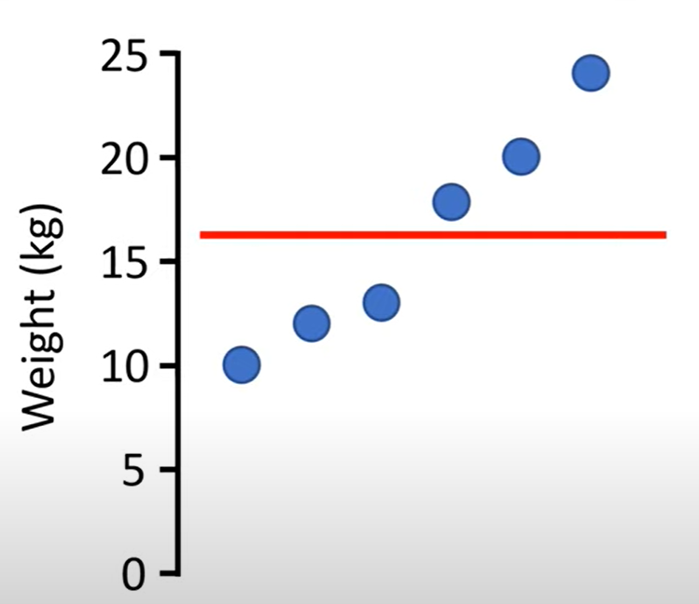
Variance ($s^{2}$ )
A measure to show how spread out our observations are
Based on the distance of each observation from the mean
The average of the squared differences from the mean.

Slide 17
Standard deviation (s)
The square root of variance
The result is in the same measurement units as our data (e.g., kg).
This makes it easier to interpret and understand the spread of the data than variance alone.
Small value indicates data are gathered close to the mean
Large value indicates data are gathered far from the mean

Slide 18
Correlation
Describes an association between variables.
When one variable changes, so does the other.
Covariation, rather than a direct causal link.
Examples:
Ice cream sales and shark attacks.
Time spent in shops and temperature.

Slide 19
Associations between Variables

Slide 20
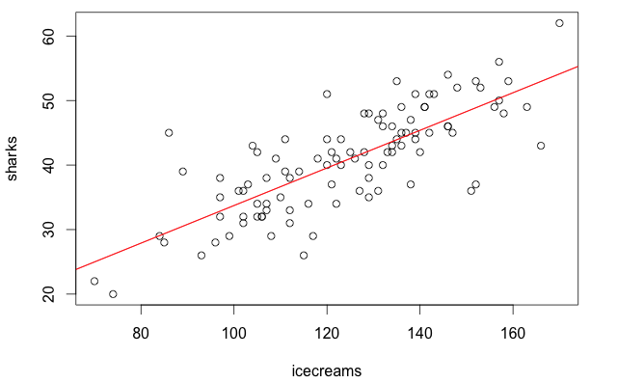
What is Correlation?

Slide 21
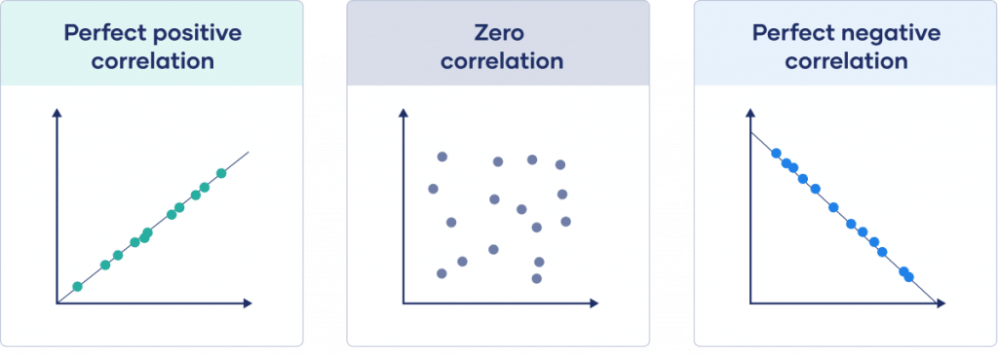
Pearson Correlation
The Pearson correlation coefficient (r) measures the strength and direction of the relationship between Continuous variables.
r = 1
r = 0
r = -1
Same direction
Opposite direction

Slide 22
Single Linear Regression
Regression is used to study the relationship between two variables.
How a change in one variable (e.g., someone’s exercise habits) can predict the outcome of another variable (e.g., general health).
DEPENDENT <- INDEPENDENT VARIABLES
=
OUTCOME/RESPONSE <- PREDICTOR/EXPLANATORY

Slide 23
Examples
IQ affects income (IQ is the IV and income is the DV)?
Study time affects grades (hours of study time is the IV and average grade is the DV)?
Exercise affects blood pressure (hours of exercise is the IV and blood pressure is the DV)?

Slide 24
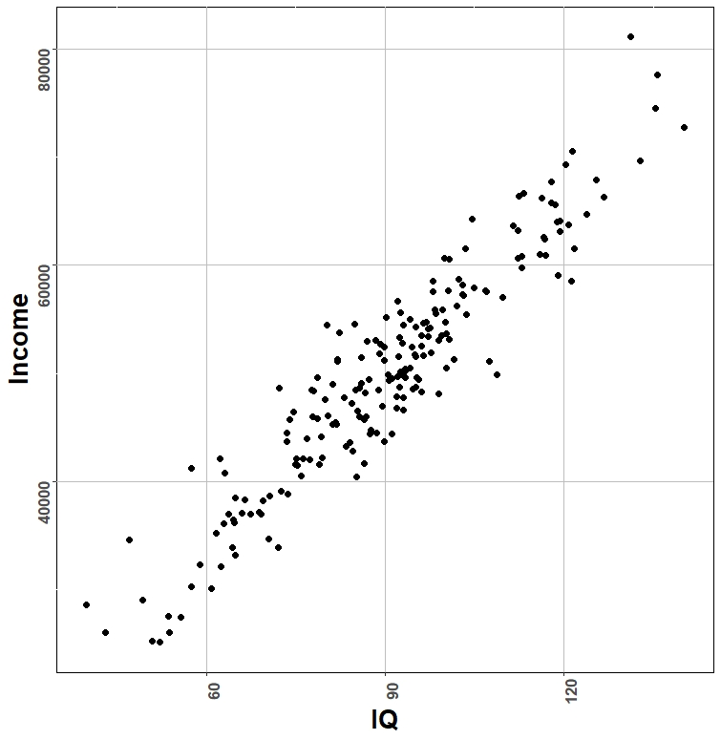
Displaying the data
When both the DV and IV are numerical, we can represent data in the form of a scatterplot.

Slide 25
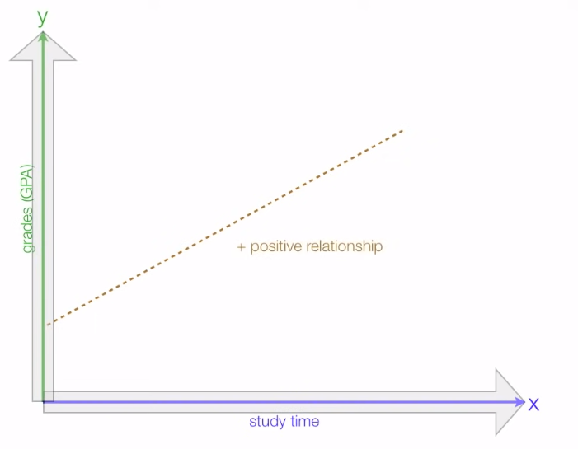
Single Linear Regression
Straight line prediction model.
As an independent variable changes, what happens to the dependent variable?
Notes:
Graphs from: https://www.youtube.com/watch?v=zPG4NjIkCjc

Slide 26
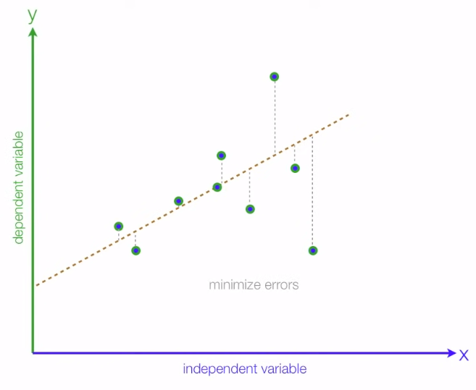
y: The dependent variable. The outcome we are trying to explain based on the independent variable.
x: The independent variable used to explain changes in the dependent variable.
β0​: The intercept of the regression line. It represents the expected value of y when x is 0.
β1​: The slope of the regression line. It represents the change in y for a one-unit increase in x.
ϵ: The error term (or residual). It represents the part of y that cannot be explained by the linear relationship with x.
y = 𝛽0 + 𝛽1 * x + e
grades
study time
Notes:
Error -> This accounts for the variability in yyy that is due to other factors not included in the model.
A positive β1​ means that as x increases, y tends to increase, while a negative β1​ means that as x increases, y tends to decrease.

Slide 27
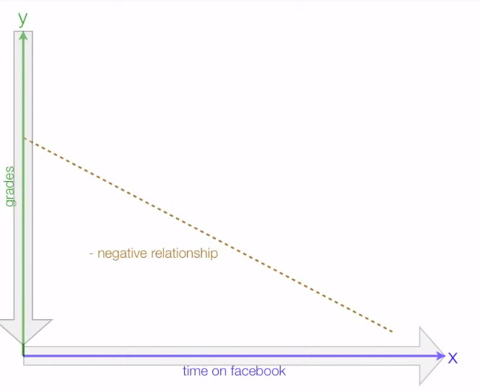
y = 𝛽0 - 𝛽1 * x + e

Slide 28
Correlation vs Single Linear Regression
Correlation quantifies the strength and direction of the linear relationship between two variables but doesn't give information about the equation of the line.
Single Linear Regression goes further by providing an equation that describes the linear relationship.
Single Linear Regression models the relationship between two variables.

Slide 29
Week 7 Task
Read the paper Defining Research Questions on Canvas.
Familiarise yourself with R.
Complete today’s practice.
See you on Friday

Slide 30
Sources & Credits
Graph Types, Sean Raleigh Westminster University https://rpubs.com/VectorPosse/graph_types
Fundamentals of Data Visualization,” published by O’Reilly Media, Inc https://clauswilke.com/dataviz/index.html

