Slide 1
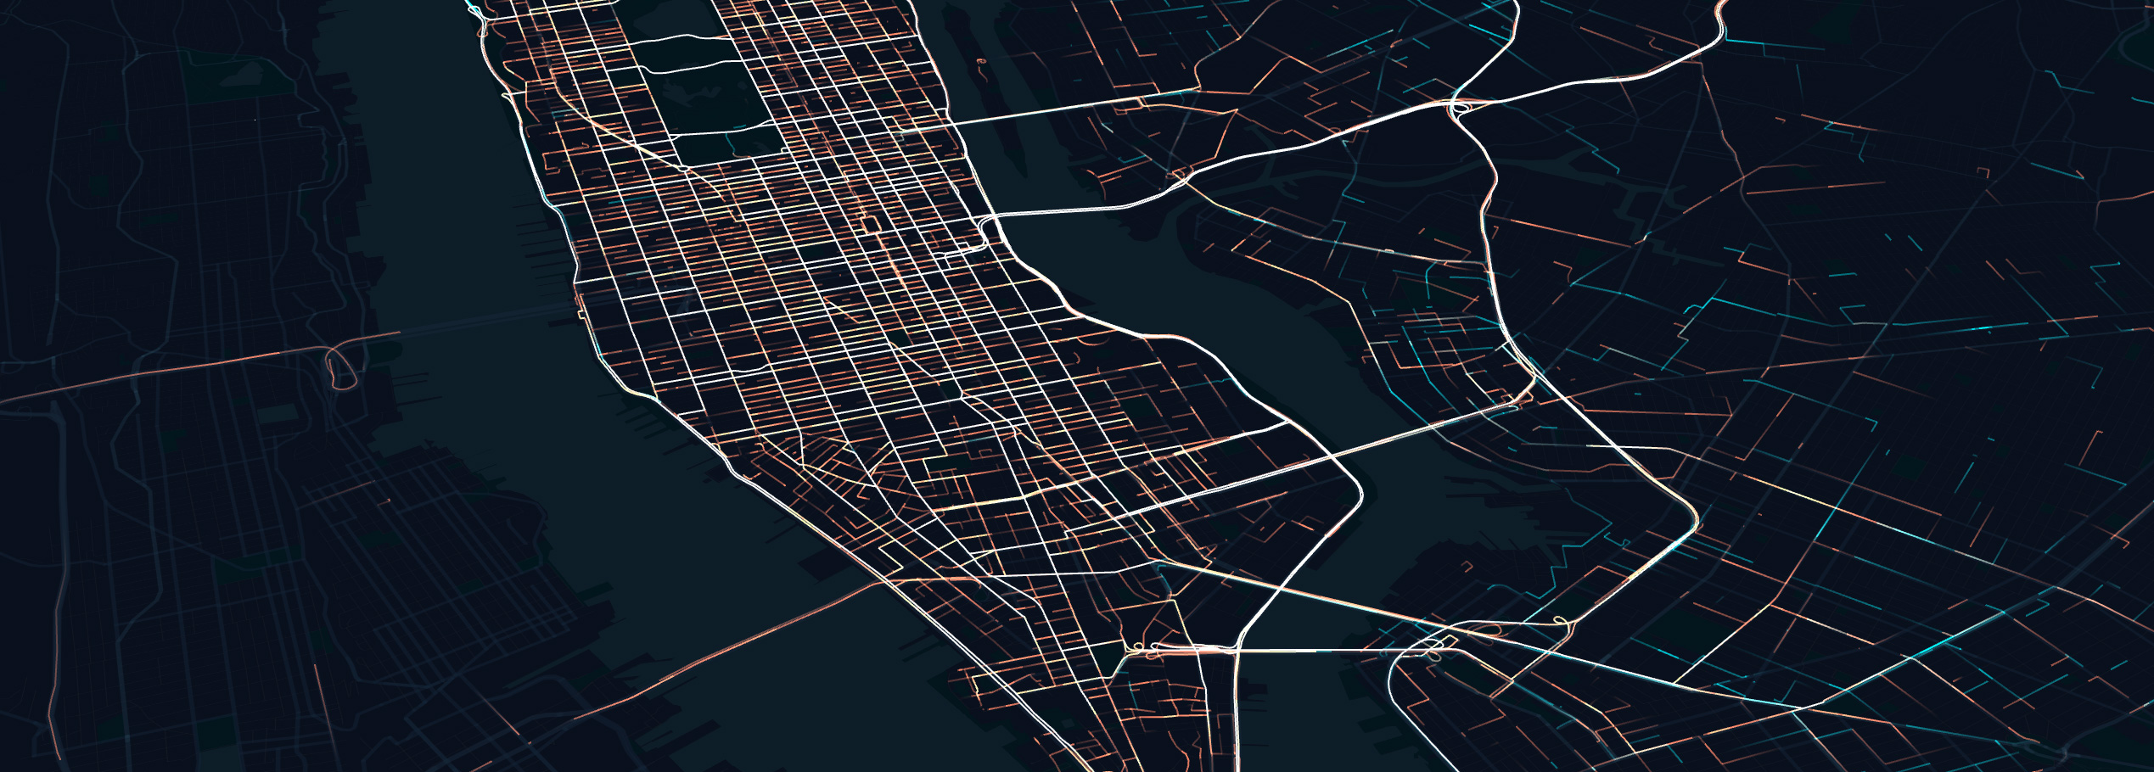
Advanced tools and Assignment II ENVS456 – week 9 Gabriele Filomena
Source: https://classic.yarnpkg.com/en/package/deck.gl

Slide 2
Reflections on Assignment I
Lectures/Lab sessions are building blocks.
Data sources (Kaggle, data aggregators, etc.)
“intermediate maps”, lack of context.
Think about interactivity.
References.

Slide 3
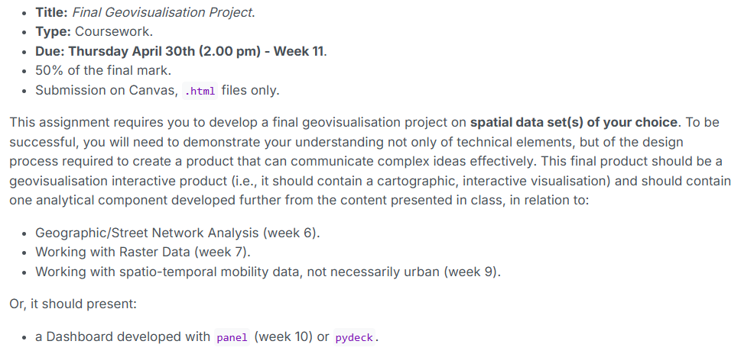
Towards Assignment II

Slide 4
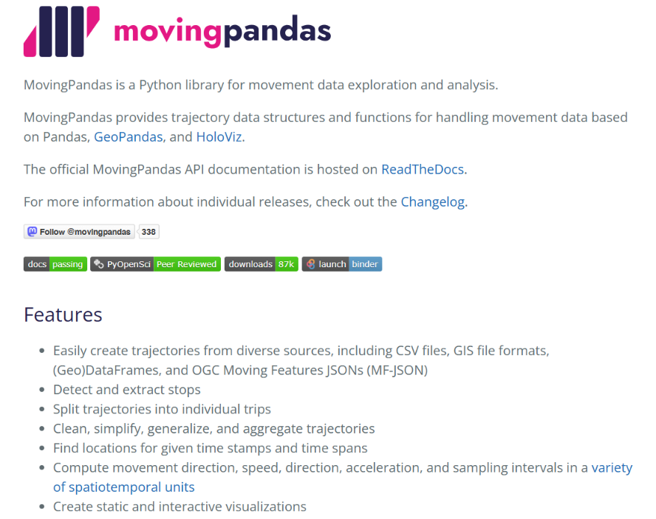

Slide 5
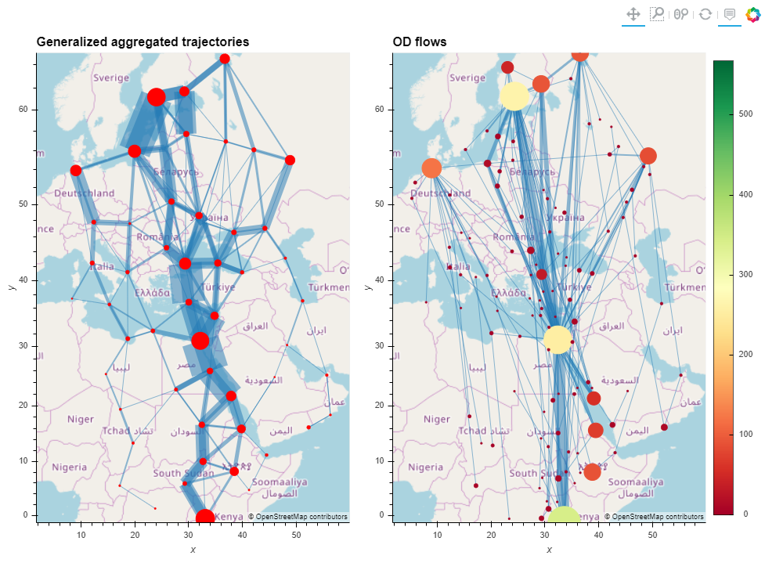
Urban Mobility Analysis
Movement Data Analysis

Slide 6
Other tools

Slide 7
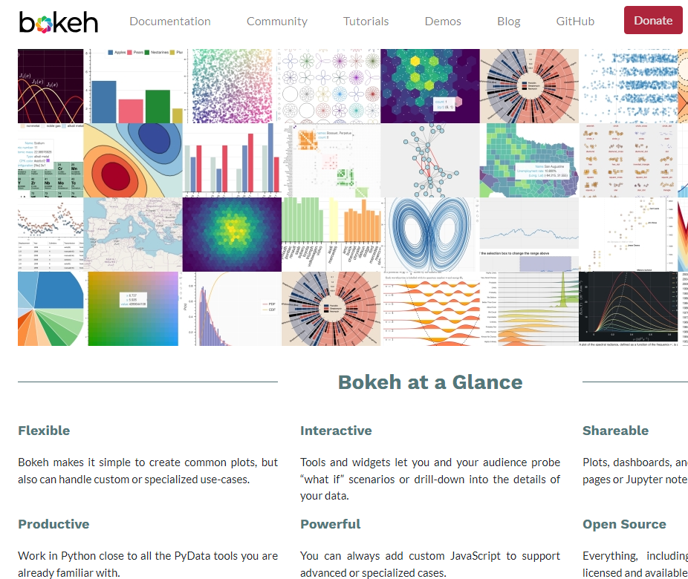
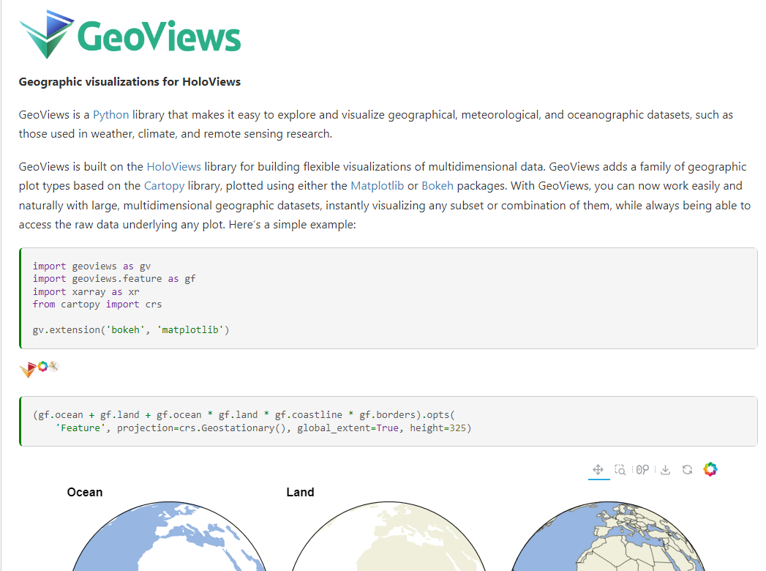
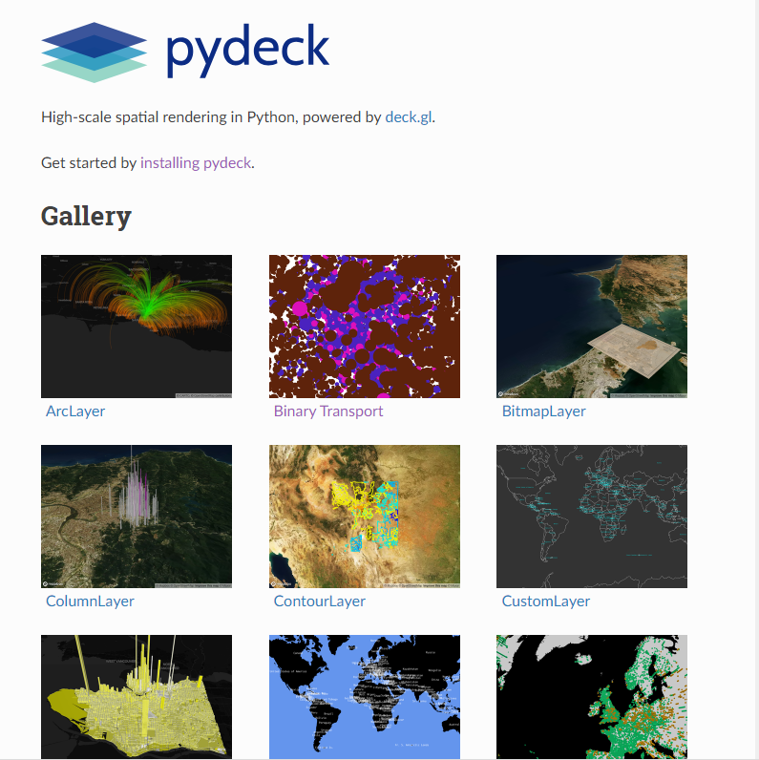

Slide 8
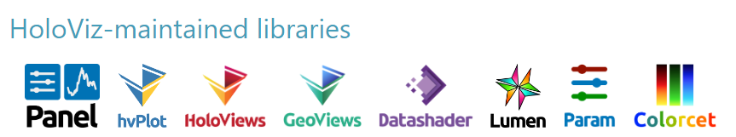
GeoViews
Designed to simplify the exploration and visualisation of geographic datasets in Python.
Supports geographic data handling, including the display and combination of spatial layers.
Enables interactive spatial analysis, making it easier to explore patterns and relationships.

Slide 9
pydeck
WebGL-powered visualisation library designed to display large geospatial datasets. A Python wrapper around the JavaScript library deck.gl.
Rich layered visualisation: supports a wide range of layers for points, flows, paths, polygons, heatmaps, hexagons, and 3D representations.
Interactivity: supports pan/zoom, hover, tooltips, and other features.
Large dataset visualisation: particularly strong for rendering large spatial datasets efficiently in the browser.
Customisation: detailed control over visual properties such as colour, size, elevation, opacity, and styling logic.
Notes:
high performance in rendering complex and large-scale geospatial datasets
multi-dimensional visualizations with ease.
This approach significantly improves performance and responsiveness when dealing with big data.

Slide 10
Tool | Best use in practice | Coding power | Main strength | Main limitation | Use case
GeoPandas + Folium | Quick interactive maps to share in notebooks or HTML | High for map personalisation | Easy control of tiles, popups, tooltips, choropleths, GeoJSON styling, layer controls, plugins | Less suitable for very large or visually complex analytical displays | Census map, accessibility map, OD points with popups, interactive coursework deliverable
GeoViews | Exploratory analysis when the data have extra dimensions beyond just geometry | High for exploratory plotting | Strong when combining map layers with dimensions such as time, variable, band, ensemble, and when projection matters | More overhead than Folium | Climate/environmental raster + boundaries + stations; time-varying spatial analysis in notebooks
pydeck | High-performance visualisation of large point, path and flow datasets | High for large spatial datasets | Rich layer catalog and strong rendering for dense data, trajectories, arcs, columns, hexagons, trips | Less convenient than Folium for classic interactive maps | GPS traces, OD flows, large point clouds, mobility dashboards

