Slide 1
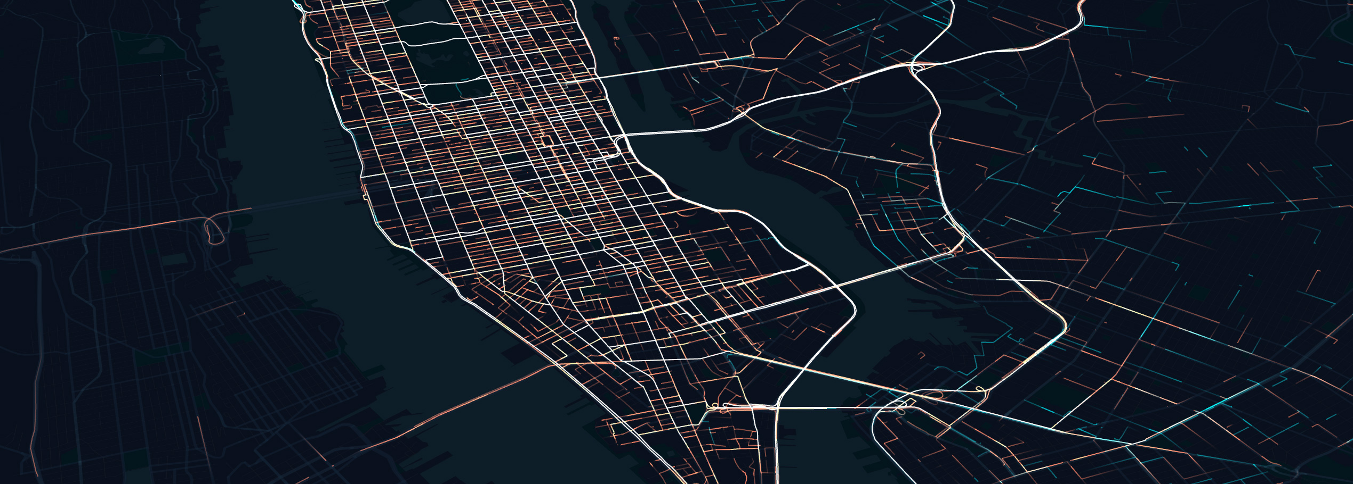
Advanced Topics, Other Tools and Assignment II ENVS456 – week 9 Gabriele Filomena
Source: https://classic.yarnpkg.com/en/package/deck.gl

Slide 2
Agenda
Assignment I…
Towards Assignment II
Other Visualisation tools
Animation and GPS Tracks -> Lab

Slide 3
Bokeh. A visualization library
Data visualisation.
Versatile, high-performance rendering capabilities over large datasets or real-time data streams.
Variety of output formats (HTML, notebook, etc.).
Designed to generate interactive plots, dashboards, and data applications.
Strengths: customizable, great for creating complex and interactive visualizations.
Use Case: Ideal when you need detailed control over interaction capabilities or when working with web-based dashboards.

Slide 4
HoloViews
Built on top of Bokeh and Matplotlib.
Strengths: Highly abstract and lets you build complex visualizations easily. It automatically handles the plotting backend it uses (like Bokeh, Matplotlib).
Use Case: Perfect for exploratory data analysis where you want to create informative visualizations rapidly with less focus on the minute details of plot appearance.

Slide 5
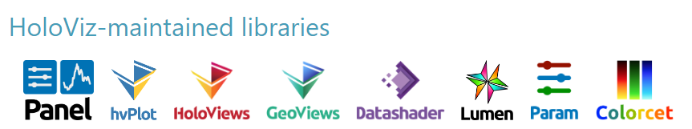
GeoViews
Built on top HoloViews designed to make it easier to explore and visualize geographical datasets
Geographic data handling.
Strengths: Integrates seamlessly with the HoloViews workflow for plotting geographical data effectively.

Slide 6
pydeck
WebGL-powered visualization library designed to display large geospatial datasets. Python wrapper around the JavaScript library Deck.gl
Rich Layered Visualizations: Supports a variety of layers.
Interactivity: The library leverages Deck.gl's interactivity features.
Large Data Handling: Pydeck excels at handling large datasets.
Customization: Pydeck allows for detailed customization of visual elements.
Notes:
high performance in rendering complex and large-scale geospatial datasets
multi-dimensional visualizations with ease.
This approach significantly improves performance and responsiveness when dealing with big data.

Slide 7
