Slide 1
English Local Authority Digital Maturity
Jonathan Hunt
Regional Relationship Manager SW Government Digital Service
Notes:
I carried out a Stakeholder mapping exercise of local authorities to assess their levels of digital maturity. This process was to allow us to see where the strengths and weaknesses lay and where we could target our support most effectively to get the greatest impact
Our mapping has covered 301 local authorities across all regions outside of London

Slide 2

Stakeholder Mapping
Stakeholder mapping of local authorities to be able to assess a perceived level of digital maturity
Have high awareness/engagement. Ability to influence.
Have desire for change and are beginning to build digital understanding & capability
Likely to use big suppliers. Stuck in legacy systems
Notes:
We had an idea about whether they would sit within the digital pyramid shown. This has those with a high level of digital maturity, and hence those that are able to influence and guide others, at the very top. In the middle tier would sit those who have started their digital journey and have an understanding of what may be required to move themselves forward but need some assistance in doing so and then the final tier where LA’s who have probably not started their digital transformation and are still reliant on big suppliers and legacy systems sit. I then mapped the findings back into this model.

Slide 3
Methodology
Based on the following 5 principles from the Local Digital Declaration
Evidence of being user centred
Evidence of using digital standards
Evidence of best practice for data sharing
Evidence of strong digital leadership
Evidence of working in the open
Notes:
As a starting point for the stakeholder assessment it made sense to use the five principles of the Local Digital Declaration, namely:
Evidence of being user centred
Evidence of using digital standards
Evidence of best practice for data sharing
Evidence of strong digital leadership
Evidence of working in the open

Slide 4
Metrics
Evidence of being user centred
Evidence of user research carried out or included in documentation
They employ a user researcher or have user research team
Evidence of using digital standards
They have adopted an Agile methodology
Use or make Open Source code
Have adopted a cloud first approach
Prioritise SME
Notes:
From these principles I could create a series of metrics, for which the data could be found publicly, and could be used to score the stakeholders. For these I looked at their user research practices, their adoption of Agile and Cloud First approaches. Use of Open Source code and prioritising SME’s in their procurement.

Slide 5
Metrics Continued
Evidence of best practice data sharing
Published information on data sharing
Evidence of best practice data sharing happening
Evidence of strong digital leadership
A publicly available Digital Strategy
Clear responsibility and visible leaders either politically or corporately
Evidence of working in the open
Frequent stakeholder communication via blogs or social media
Evidence of wider networking
Notes:
It also covered published information and evidence of data sharing, digital strategies and demonstrating leadership either politically with dedicated portfolios or corporately with a specific directorate . And finally whether there is evidence of them working collaboratively and communicating their work to their own stakeholders.

Slide 6
Comparison Data
To allow for analysis of themes, data outside of the maturity score has also been included. These are:
Local Digital Declaration Signatory
Budgets
Population
Deprivation
Notes:
During this process it was an opportunity to also include some additional data that would allow for some comparison and analysis on themes and trends to see if there were any drivers to LA’s being more digitally mature. So data was also collected on whether they were a signatory to the Local Digital Declaration, their budgets, population and indices of multiple deprivation.

Slide 7
Classification
A RAG rating alongside a numerical value from 0-2 for each metric
Their numerical total then allows us to create a Digital Maturity Score
Notes:
So to start being able to score the LA’s I used a RAG rating alongside a numerical value. So Red-0, Amber-1 and Green-2 for each metric.If evidence that all the metrics are being completed it would then allow a maximum score of 24. What it doesn’t do though is make a comment on the quality of the work that is taking place though. Just that it is happening

Slide 8
Caveat
All information is a judgement and is reliant on publicly available material. The stakeholders may have evidence that they are doing some of these tasks but this is not readily evidenced by them in the open.
Notes:
It is crucial point to note is that this has been done without any input from LA’s. This is only using publicly available information and some LA’s may have evidence that they are doing something in these areas. But, as Open Source, Data Sharing, Visible Leadership and regular communication are fundamental within the mapping these authorities would still score lower than others.

Slide 9
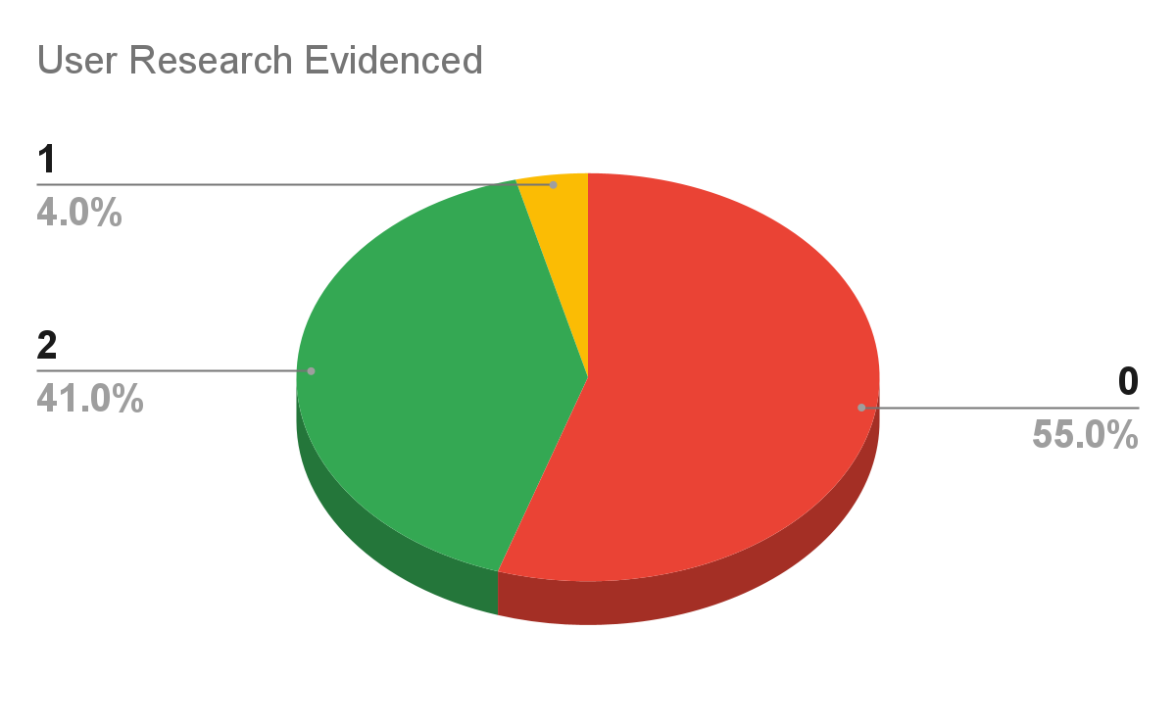
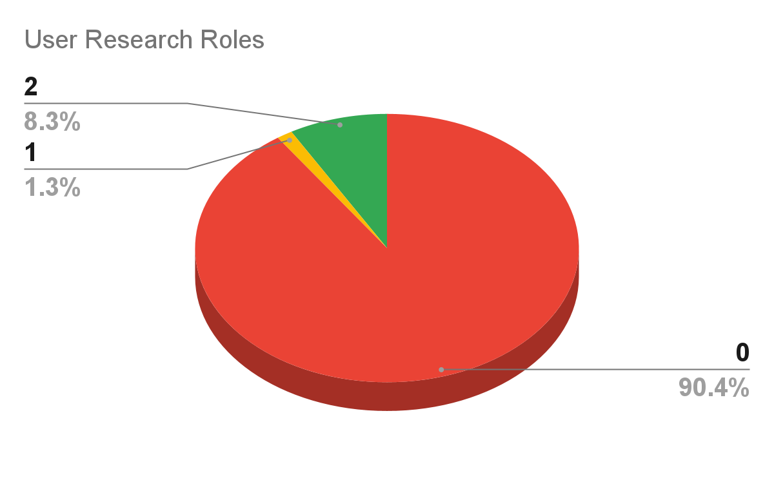
Initial Findings
Notes:
These are the headline results for each of the 12 metrics that we looked out for the 301 local authorities.
Just over half, at 55%, are not evidencing User Research in their development or transformation and this is in part explained by that 90% don’t evidence they have specific roles or teams embedded within their structure for user research

Slide 10
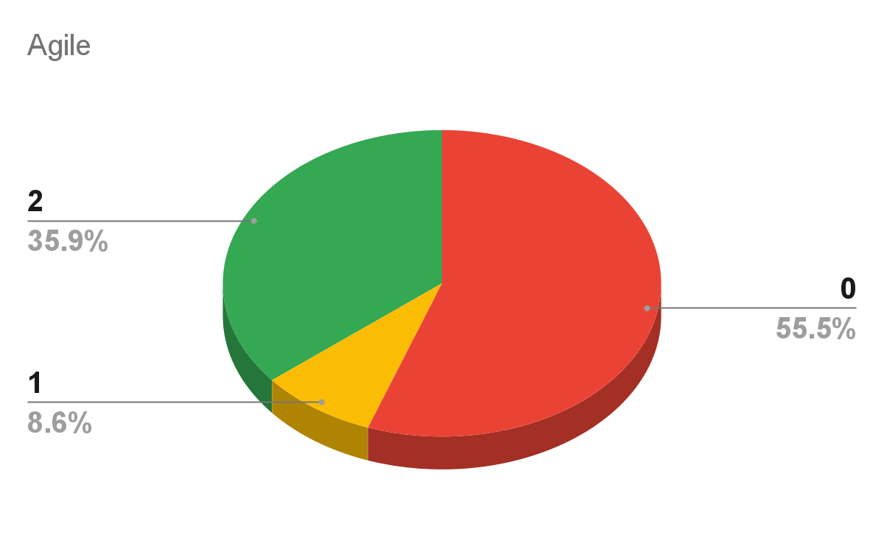
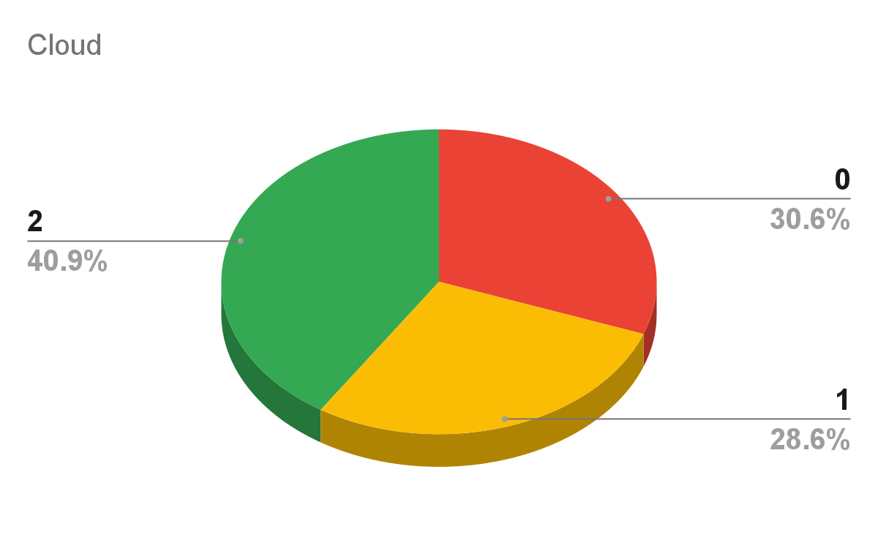
Initial Findings
Notes:
When we compare digital standards there is a mixed picture. Agile has not been adopted or considered in over half of LAs.
Cloud first is the default approach for 40% of LA’s with another 28% moving towards it being their goal. This does leave 30% of local authorities who are not considering the cloud first approach at the moment

Slide 11
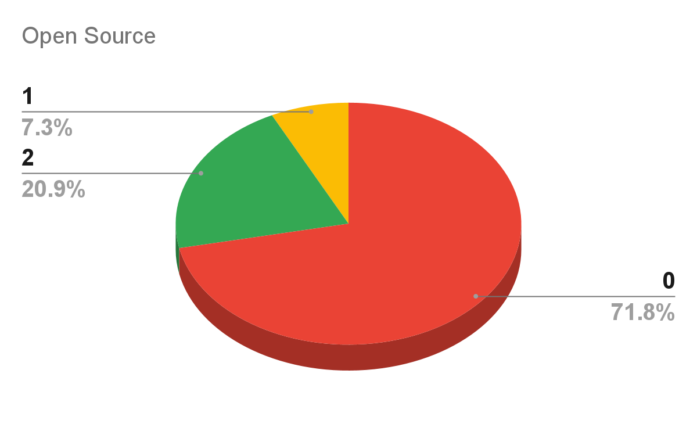
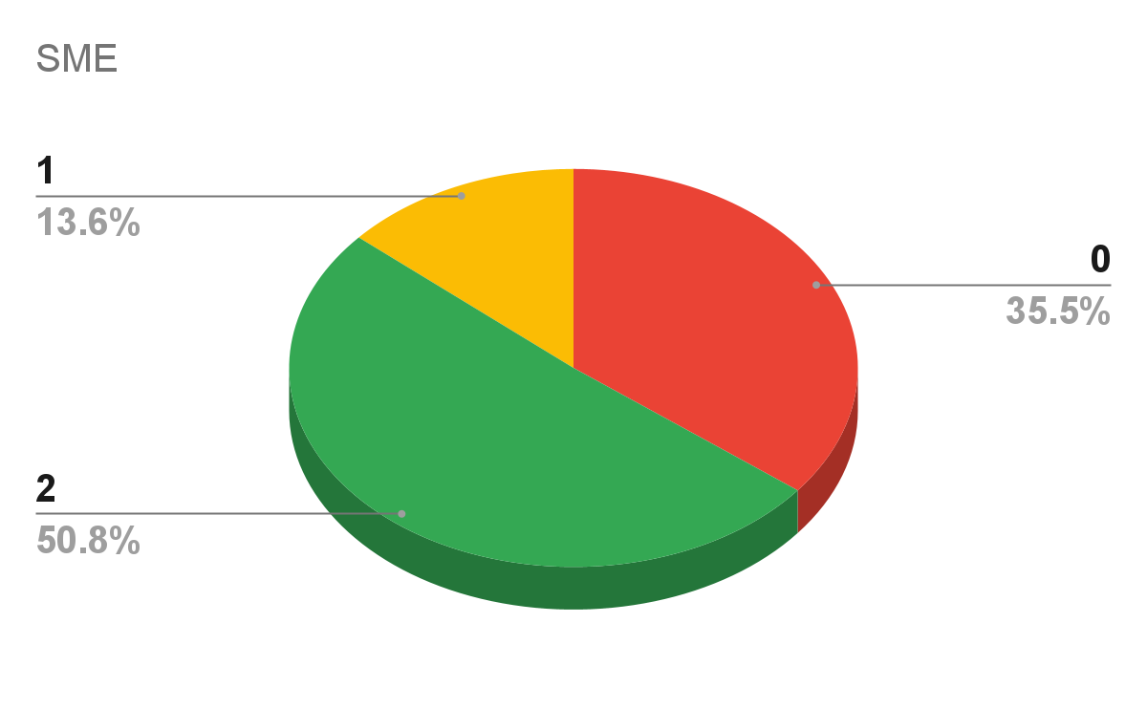
Initial Findings
Notes:
Over 70% don’t use or release in Open Source. But there has been a shift towards councils prioritising SMEs in their procurement with over 50% using SME’s for more than half of their needs, and this is taken from the Digital Marketplace spend analysis.

Slide 12
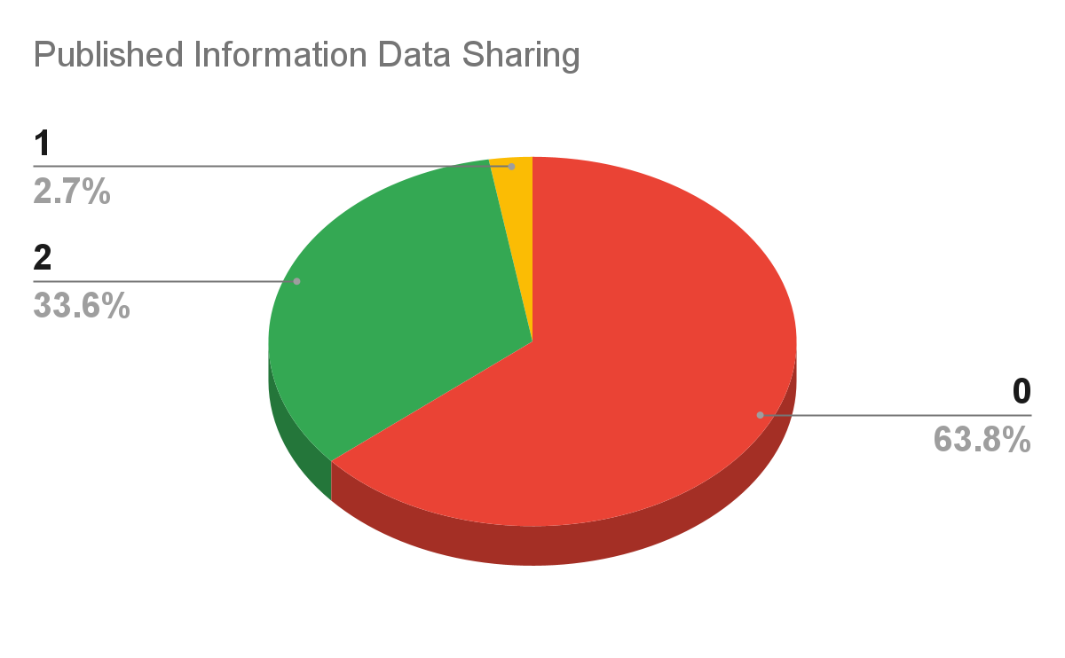
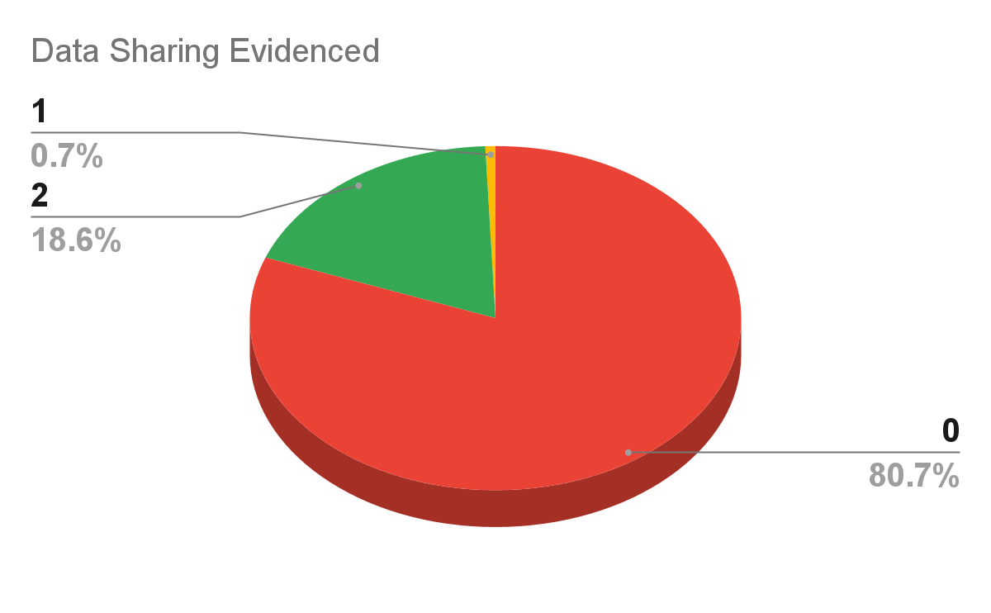
Initial Findings
Notes:
Only ⅓ of local authorities have clear published information on how they plan to share data successfully with partners and less than 20% can then evidence that this is happening in practice.

Slide 13
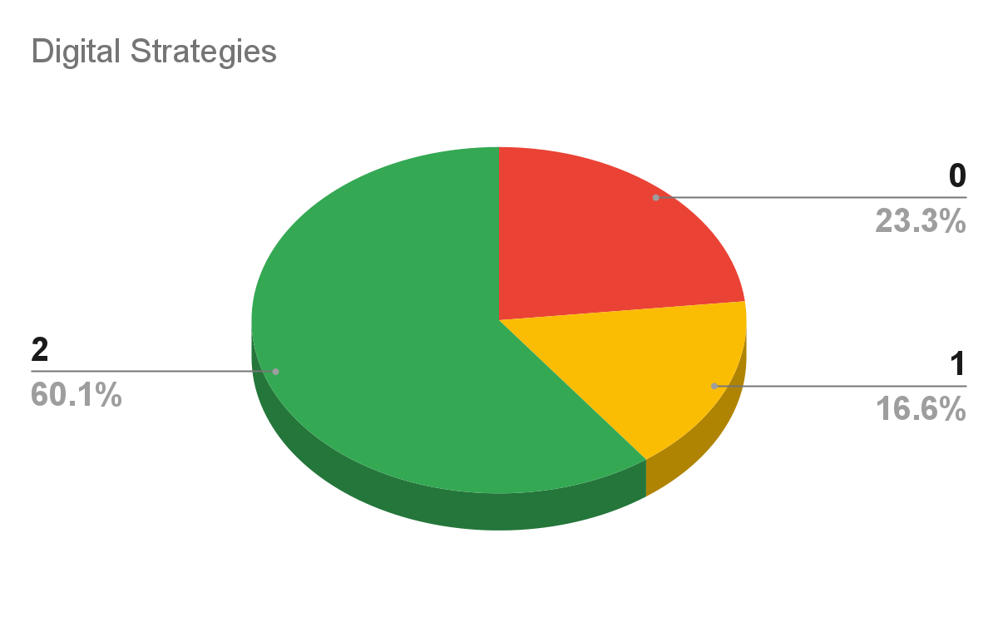
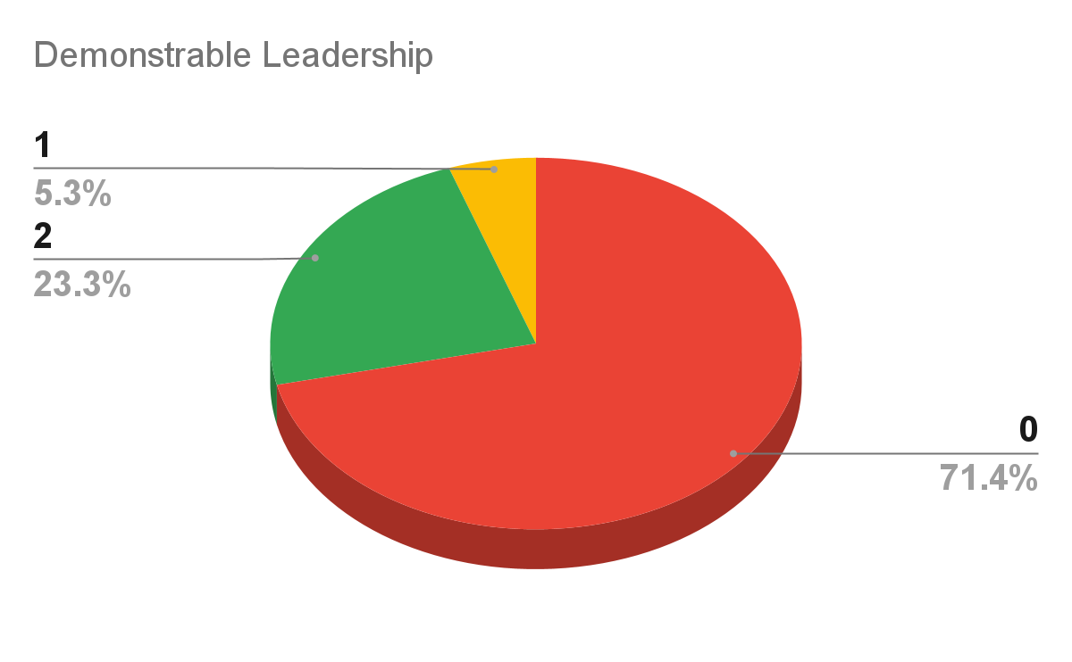
Initial Findings
Notes:
60% of LA’s have a current digital strategy in place, and a further 16% have a plan that is now out of date, which is shown by the Amber rating for these. A large proportion of these were due to be refreshed in 2020 so Covid19 may be the cause for the delay in these refreshes.
Visible or demonstrable Leadership is where many authorities fall down with this not showing in over 70% of cases. This is shown by a lack of reporting to cabinet/scrutiny or public showings from either officers or elected members. It would be expected the strategies would be signed off by cabinet or full council but with digital they are often signed off under delegated decisions by officers. The best authorities in this category have a dedicated directorate to Digital Transformation and/or a Cabinet portfolio

Slide 14
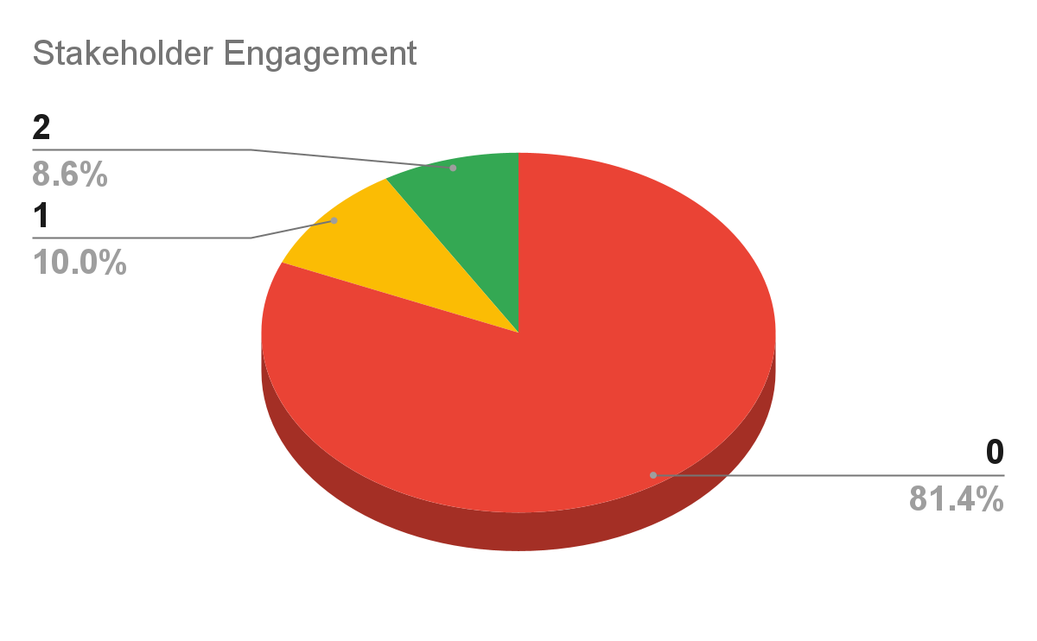
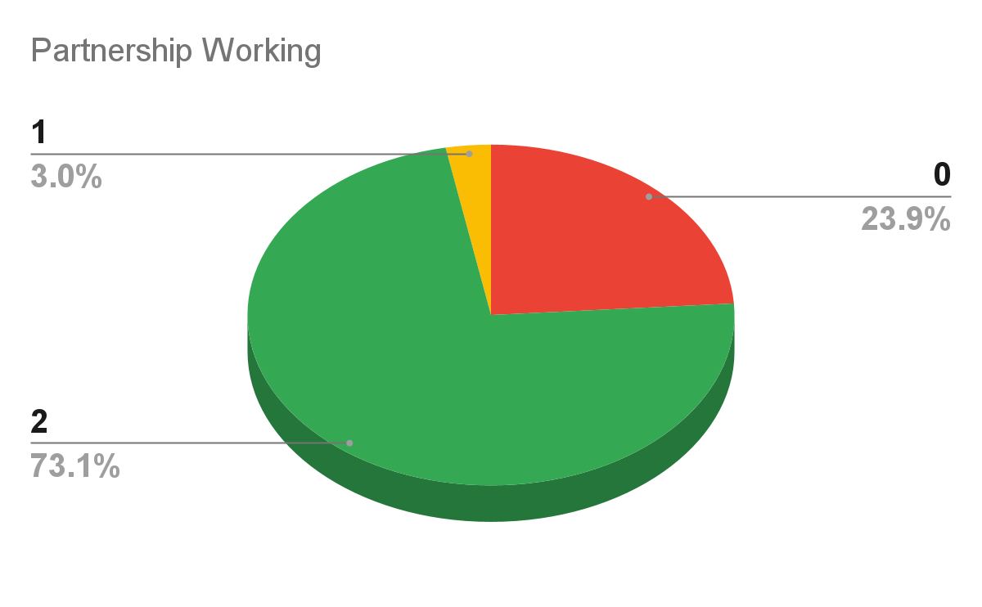
Initial Findings
Notes:
Frequent stakeholder engagement on digital transformation, via blogs newsletters or social media, is rare across these regions with over 80% not demonstrating it but evidence of working outside their own organsiation is much stronger with nearly 3/4 actively doing this and This ranges from districts within a county working together to some great national collaboration.

Slide 15
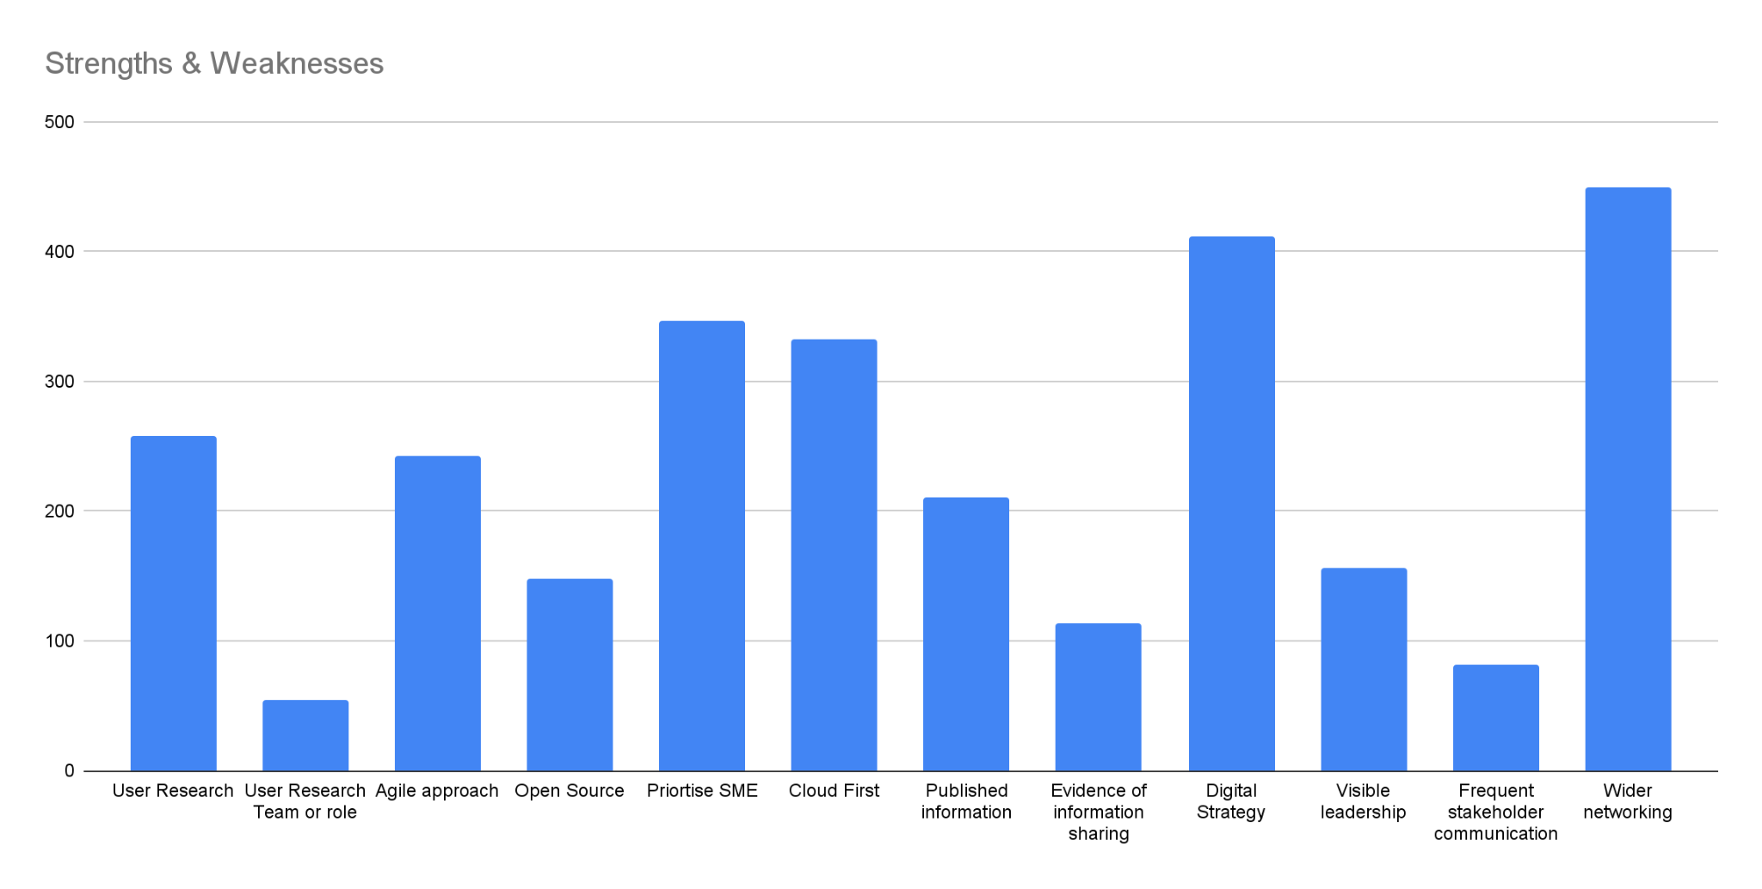
Strengths & Weaknesses
Notes:
When all pulled together we can then see the strengths and weaknesses as a whole across these stakeholders and as we saw on the previous slides Working together and strategies is a strength but Communication, visible leadership and embedding DDaT roles a lot weaker

Slide 16
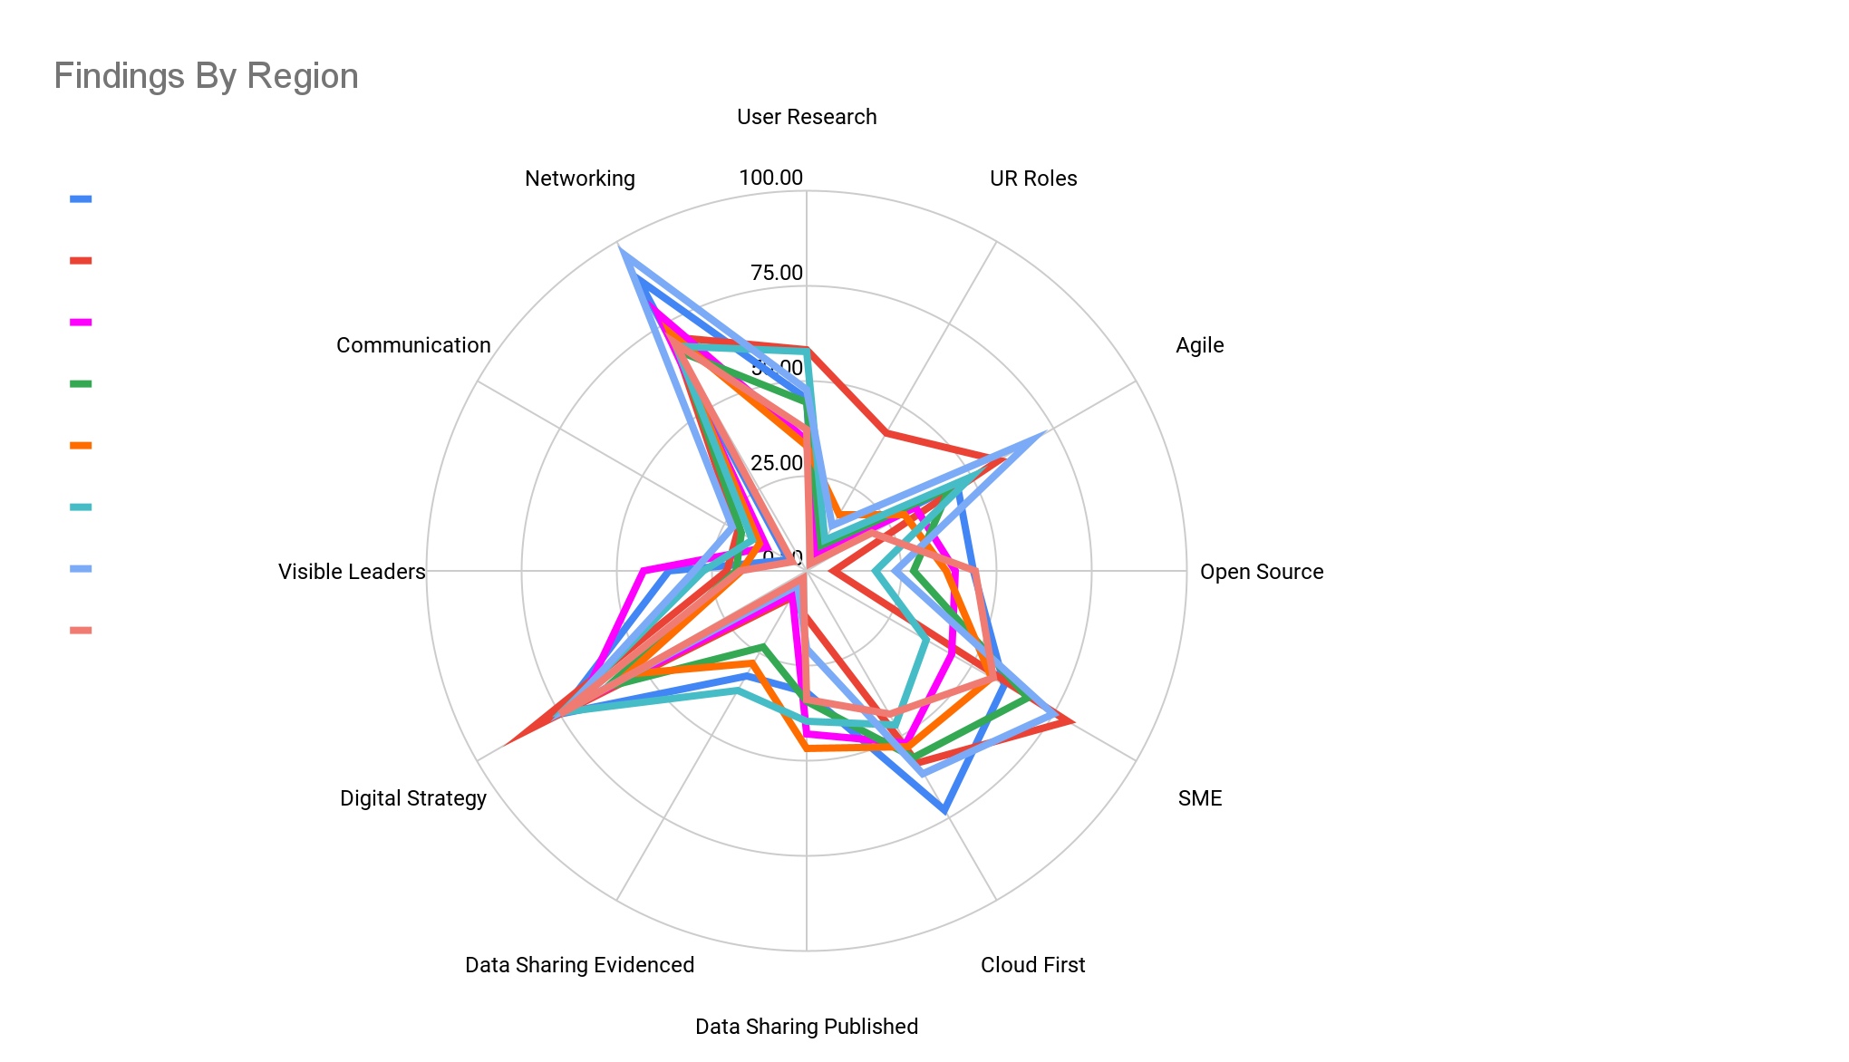
Regional Comparisons
Notes:
While we were mapping we were able to look at the individual regions as well to see if there were specific regional issues where some would be stronger or weaker in certain metrics than others. But, as we can see when all mapped on top of each other on this radar chart we can see that there is a common pattern across all of them with weaknesses and strengths in similar places

Slide 17
Digital Maturity
24 (maturity score 17+)
139 (maturity score 9-16)
138 (maturity score 0-8)
Mean score 9.31
Notes:
There was a maximum digital maturity score of 24. This was simply split into thirds with 17+ being top tier, 8 and below the bottom and the rest in the middle tier to see how they would look when put back into our initial pyramid model. 24,, came out in the top tier, 139 in the middle and 138 at the bottom. The average score was 9.31 which put it very near the bottom of the second tier. If we wanted to target this top tier for ability to influence and to test out new proposals we would need to be aware of the very small size of this group and that we don’t over burden them to their detriment to try and benefit others

Slide 18
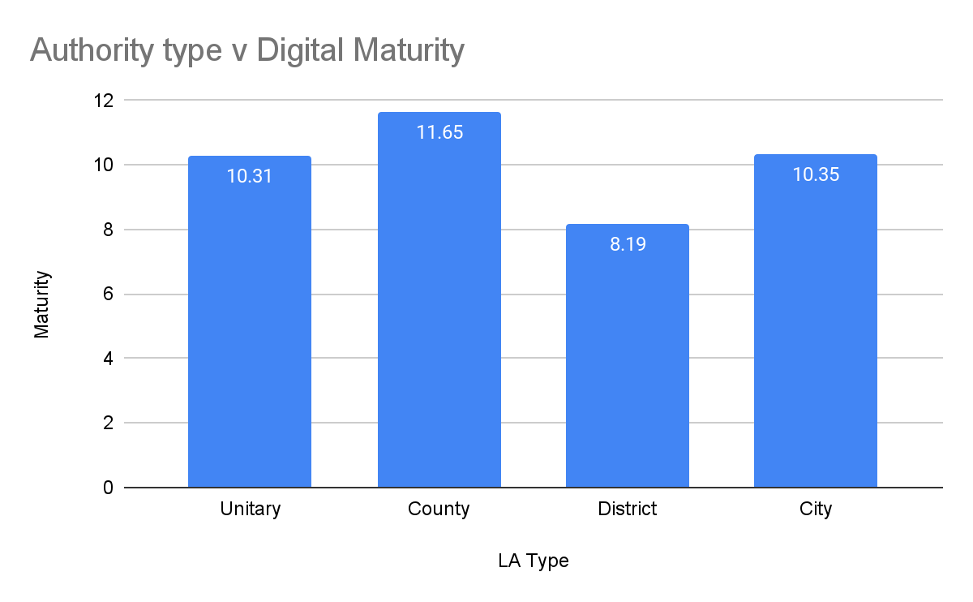
Analysis by Local Authority Type
Top LA’s by type
Unitary
County
Unitary
Borough
Met District
County
Notes:
Across the country, on average, County Councils came out as being the highest scorers. They were followed by City and Unitary authorities. District councils scored significantly lower.

Slide 19
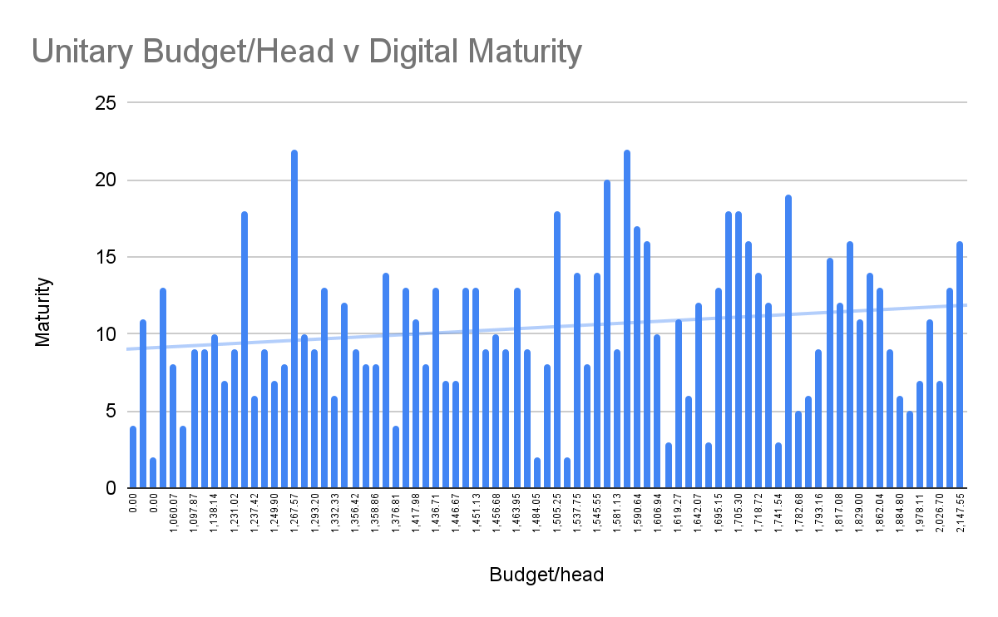
Comparative Data
Notes:
Then we have the slides on the comparison data I mentioned earlier. When we compare the digital maturity scores mapped against budgets you can see that this isn’t a main driver towards maturity. There is a very slight upward trend but many high scoring authorities have small budgets,

Slide 20
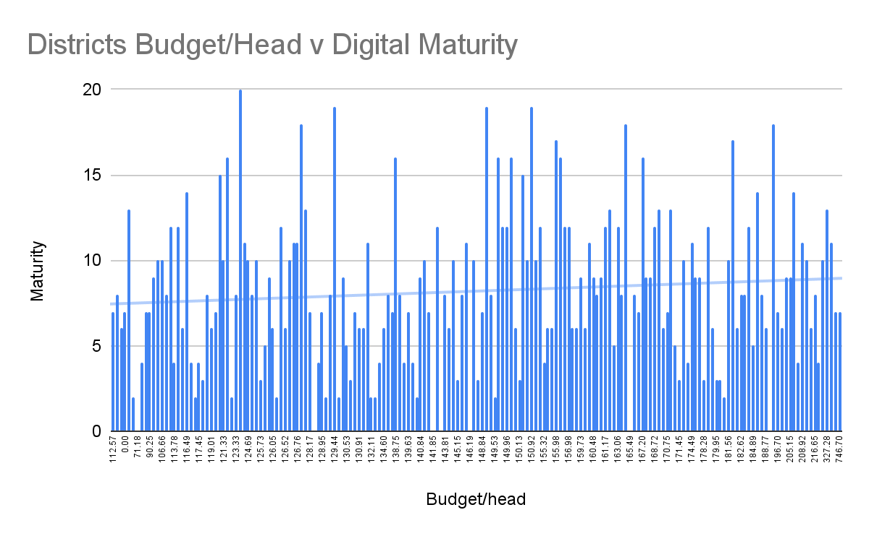
Comparative Data

Slide 21
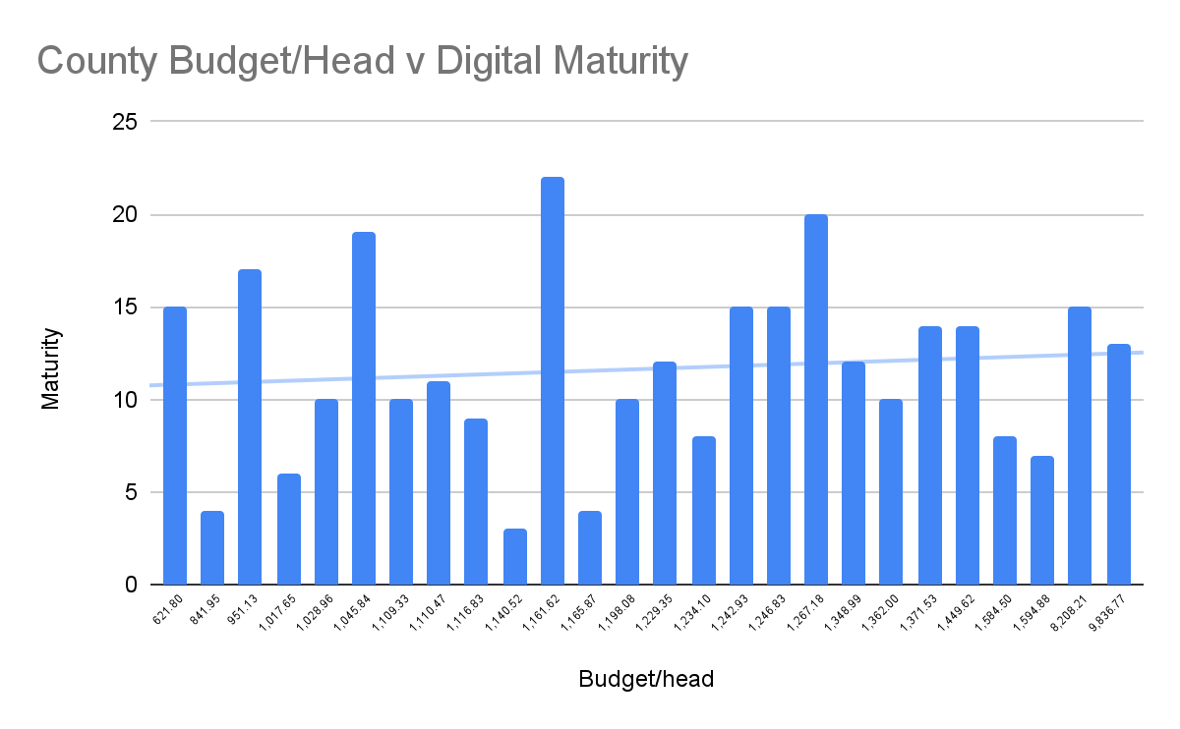
Comparative Data

Slide 22
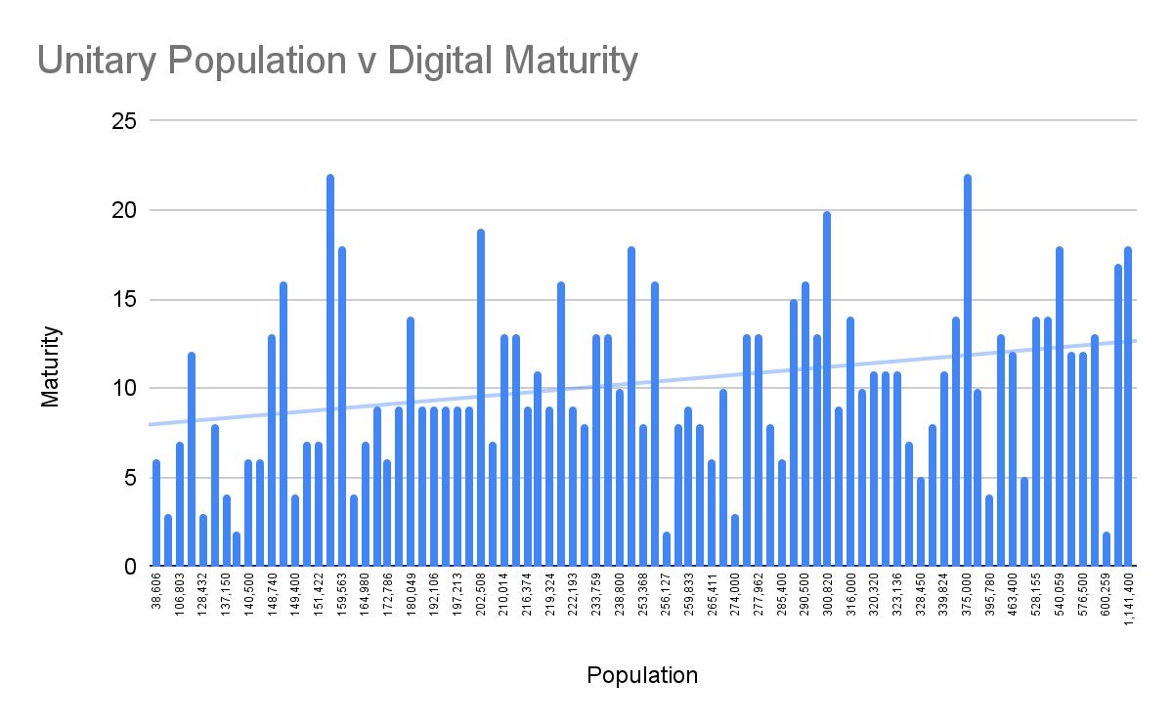
Comparative Data
Notes:
Where there was a bigger trend was when we looked at the overall population of an authority against the digital maturity score. This was the same for all types of local authority. Ways to communicate and offer services over larger populations?

Slide 23
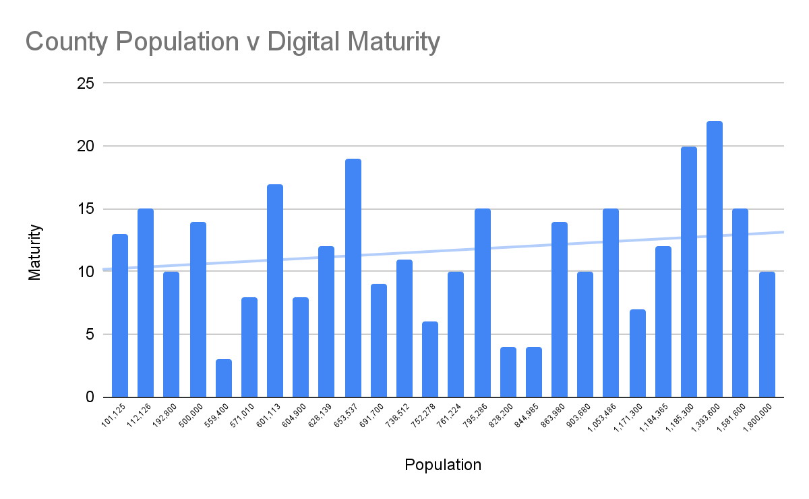
Comparative Data

Slide 24
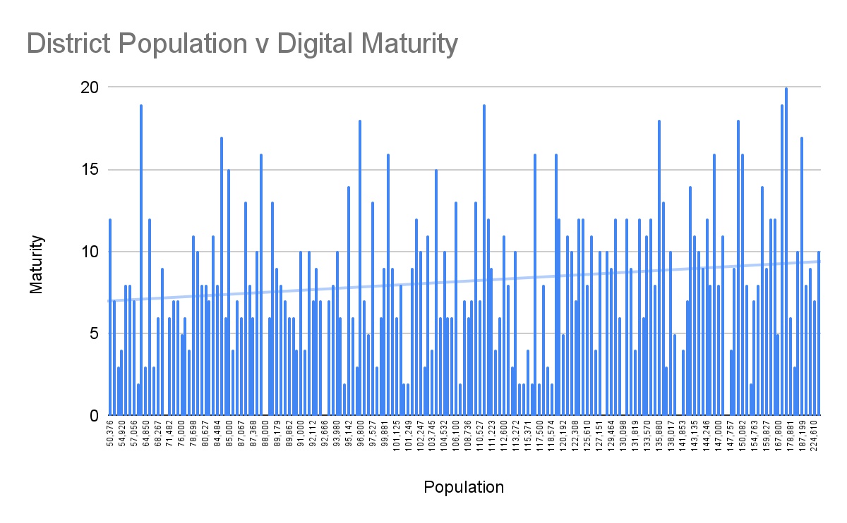
Comparative Data

Slide 25
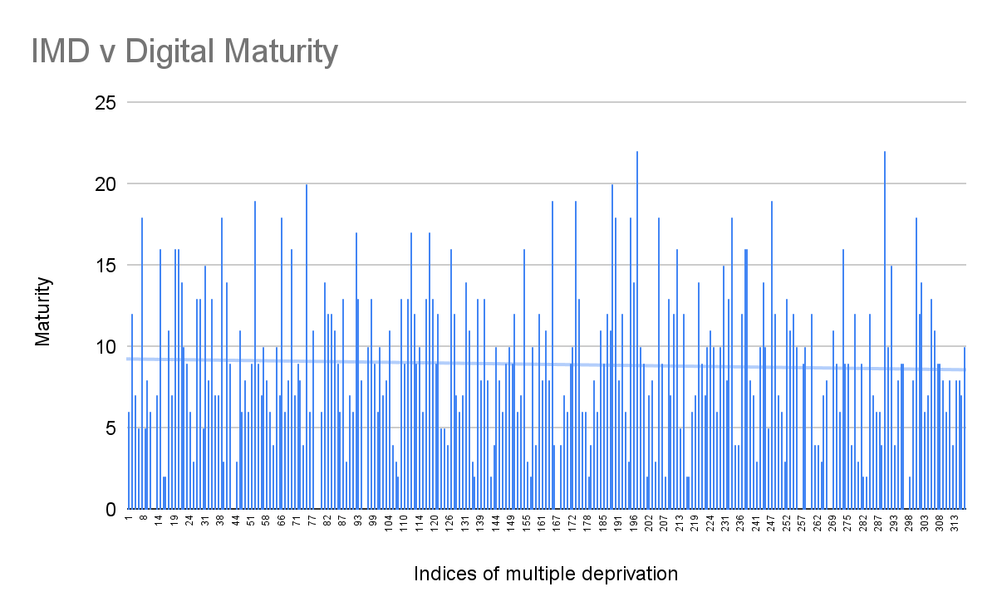
Comparative Data
Notes:
The next comparison was on the effect on digital maturity by an areas level of deprivation. So we mapped the maturity against the indices of multiple deprivation as well. There is no clear correlation between the two and you can see a mixture of digital maturities throughout the deprivation range

Slide 26
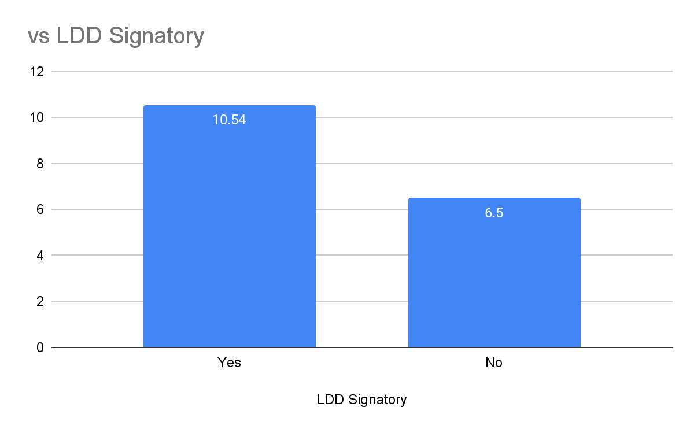
Comparative Data
Notes:
And then finally I looked at those who were signatories to the local digital declaration it was an average score of 10.54 for those who had signed against 6.5 for those who hadn’t. This means there was a 60% higher average score for those that had signed up to the declaration.

Slide 27
Early Conclusions
Analysis of mapping to date
Partnerships & Agreements
People & Leadership
Notes:
There are different ways to interpret these but it's important to say that at this time it is looking at correlations in the data only and not causation. It makes sense that a more digitally mature authority would be in a better position to sign up to the declaration.
From the findings so far there does appear to be a slight correlation between population and digital maturity but any trends in budgets and deprivation are very minor.
The areas where authorities scored lowest were around having user research roles or teams, demonstrating digital leadership and stakeholder communication.
The absence of user research or DDaT roles, generally recognised as being due to not having the financial resources, isn’t as detrimental as expected. There are regions where user research and insights work is carried out across multiple authorities. This enables them to use a UCD approach to services even when they don’t directly have user researchers employed. This collaboration and partnership working negates the impact of not having the roles embedded. Collaboration is key within the Local Digital Declaration and these findings also support why signatories to the declaration had such a higher score to those that didn’t
There appears to be a connection between good leadership and stakeholder communication. Good leadership can be through having a dedicated Director for digital or an elected member with responsibility for digital. The majority of the top scoring authorities have one of these roles and this is backed up with good communication. It is rare to see this though and does separate the high maturity authorities and the lowest scoring ones. It seems sensible to link these roles with good communication as they are the ones demonstrating the work they are doing and showing accountability.
While visible leadership could be either elected members or officers the presence of a dedicated accountable elected member is unusual. But, the top five local authorities all had an elected member portfolio for digital. In a political environment, where you will be scrutinised, having these roles could be seen as a way of driving change. It also gives visibility to digital transformation and ensures buy-in from elected members. Authorities that could demonstrate the visible leadership scored 50% higher than those that didn’t.
Recent research from Citrix has shown that less than half of Local authorities in the UK employ a Chief Digital Officer What I found during this mapping is even those that do have this role it can sit very low down an organisations structure which dilutes it’s impact. The top performing authorities have this role at the very top of their organisations to drive change.
There are lots of factors which can affect an authorities digital maturity but the running theme through this work is how important the right people are. Those who are able to see the benefits of wider collaboration work and are visible enough to be held accountable for the transformation journey. When this happens there is a real possibility of seeing a jump in digital maturity.

