Slide 1
1 Introdunction

Slide 2
Probability theory is the study of the mathematical law of random phenomena. It is interesting that such an important branch of mathematics, was originated from the study of problem gambling.
Around in 1654, Pascal and Fermat discussed a similar "reasonable allocation to bet" problem in a series of communications. This problem can be simplified as two people A and B throw a coin. Regulation is that if it is head, A get 1 point, if it is tail, B get 1 point. The one who get 3 points early will win. Assume that when A has 2 points, B has 1 point, gamble suspended for some reason. How to find a fair method to distribute bet?

Slide 3
it ends as much as twice and the results are two situations which are equiprobable.
Situations | 1 | 2 | 3 | 4
Winner | AA | AB | BA | BB
A get all bet with the three kinds of situations and B get all bet only with the last situation. So A should get 3/4 of the bet and B should get 1/4 of the bet.

Slide 4
2 Probability
What is probability?
The term probability refers to the study of randomness and uncertainty.
In any situation in which one of a number of possible outcomes may occur, the theory of probability provides methods for quantifying the changes, or likelyhoods, associated with the various outcomes.

Slide 5
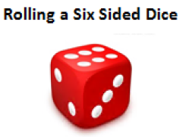
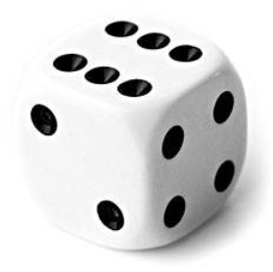

2.1 Sample Spaces
Experiment
An experiment is any action or process whose outcome is subject to uncertainty,
Example

Slide 6


Sample Space
Definition 2.1.1 The set of all possible outcomes of a statistical experiment is called the sample space.
Each outcome in a sample space is called a sample point of the sample space.
Example 2.1.1 Consider the experiment of tossing a dice. If we are interested in the number that shows on the top face, the sample space would be
$$S_{1}=\left\{1,2,3,4,5,6\right\}$$
If we are interested only in whether the numbers is even or odd, the sample space is simply
$$S_{2}=\left\{even,odd\right\}$$

Slide 7
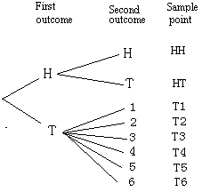

Example 2.1.3 An experiment consists of flipping a coin and then flipping it a second time if a head occurs. If a tail occurs on the first flip then a dice is tossing once. To list the elements of the sample space providing the most information,
we construct a diagram of Fig 2.1.1, which is called a tree diagram. Now the various paths along the branches of the tree give the distinct sample points. Starting with the top left branch and moving to the right along the first path, we get the sample point HH, indicating the possibility that heads occurs on two successive flips of the coin. The possibility that coin will show a tail followed by a 4 on the toss of the die is indicated by T4. Thus the sample space is
$$S=\{HH,HT,T1,T2,T3,T4,T5,T6\}$$
Fig .2.1.1 Tree diagram for Example 2.1.3

Slide 8
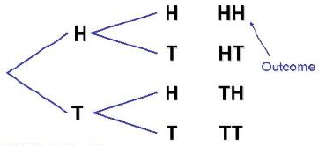
2.2 Events
Definition 2.2.1 An event is a subset of a sample space.
Example
Flipping Two Coins
S={HH, HT, TH, TT}
countable

Slide 9
Example 2.2.1 Given the sample space S={t|t≥0}. where t is the life in hours of a certain bulb, we are interest in the event B that a bulb burnt out before 200 hrs, i.e. the subset B={t|0≤t<200} of S.
Example 2.2.2 Assume that the unemployment rate r of a region is between 0 and 15%，i.e. we have the sample space S={r|0≤r≤0.15}. If the event C “unemployment rate is low” means that r≤0.04, then we have the subset C={r|0≤r≤0.04} of S.

Slide 10
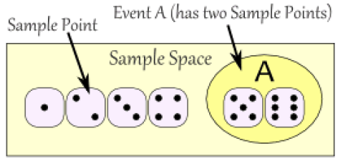
Experiment: Rolling a six sided dice
S={1, 2, 3, 4, 5, 6}
Event A: the number of result is at least 5
A={5, 6}

Slide 11

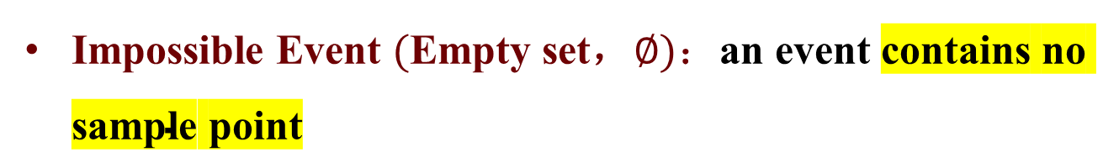
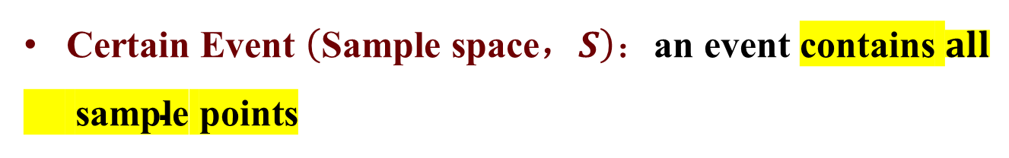
Impossible Event and Certain Event
Experiment: Rolling a six sided dice
S={1, 2, 3, 4, 5, 6}
Event B: the number of result is negative
B={ }
Event C: the number of result is at least 1
C={1, 2, 3, 4, 5, 6}
=S

Slide 12
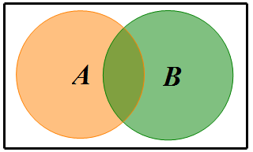
Operations of Events
Intersection, A ∩ B: The set of outcomes that belong to both A and B.
A ∩ B = {x | x∈A and x∈B}
A ∩ B
The intersection occurs if and only if both event A and B occur.

Slide 13
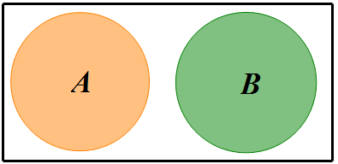
Event A and B have no common outcomes, and cannot occur simultaneously.

Slide 14

Union, A ∪ B: The set of outcomes that belong to either A or B. A∪B = {x | x∈A or x∈B}
A∪B
The union occurs if and only if either A or B (or both) occurs.

Slide 15


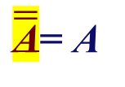
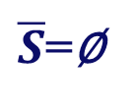
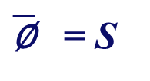
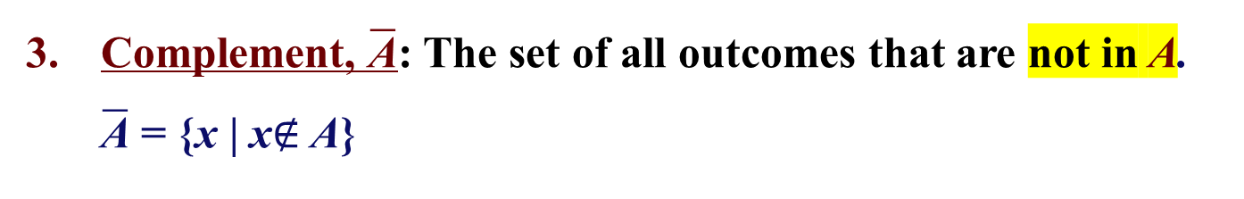
Complement, $\overline{\text{A}}$: The set of all outcomes that are not in A. $\overline{\text{A}}$ = {x | x$∉$ A}
The complement of A occurs if and only if A doesn’t occur.

Slide 16
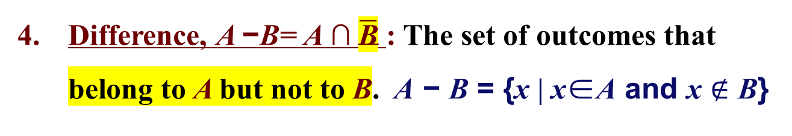
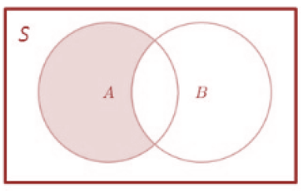
The difference A − B occurs if and only if A occurs but B doesn’t occur.

Slide 17
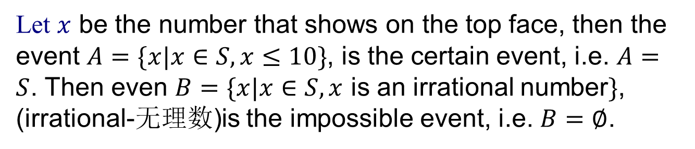
Example 2.2.3: Rolling a Dice
The sample space S={ 1, 2, 3, 4, 5, 6 }
Let $x$ be the number that shows on the top face, then the event $A=\{x|x∈S,x≤10\}$, is the certain event, i.e. $A=S$. Then even $B=\{x|x∈S,x$ is an irrational number$\}$, (irrational-无理数)is the impossible event, i.e. $B=∅$.

Slide 18
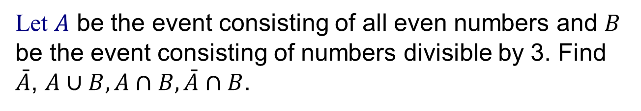
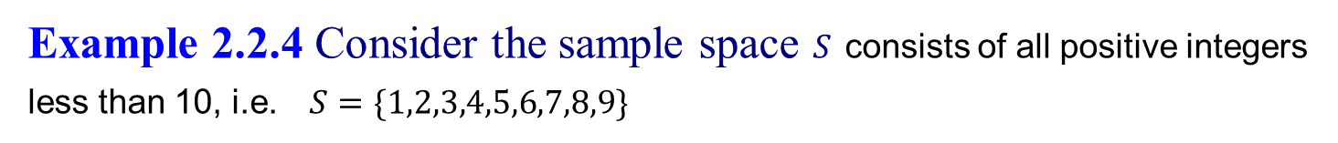
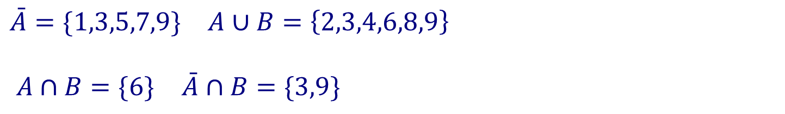
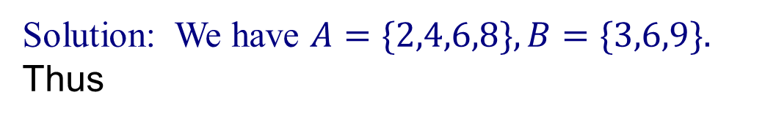
Example 2.2.4 Consider the sample space $S$ consists of all positive integers less than 10, i.e. $S=\{1,2,3,4,5,6,7,8,9\}$
Let $A$ be the event consisting of all even numbers and $B$ be the event consisting of numbers divisible by 3. Find $\bar{A}$, $A∪B,A∩B,\bar{A}∩B$.
Solution: We have $A=\{2,4,6,8\},B=\{3,6,9\}.$ Thus
$\bar{A}=\{1,3,5,7,9\}$ $A∪B=\left\{2,3,4,6,8,9\right\}$
$A∩B=\{6\}$ $\bar{A}∩B=\{3,9\}$

Slide 19
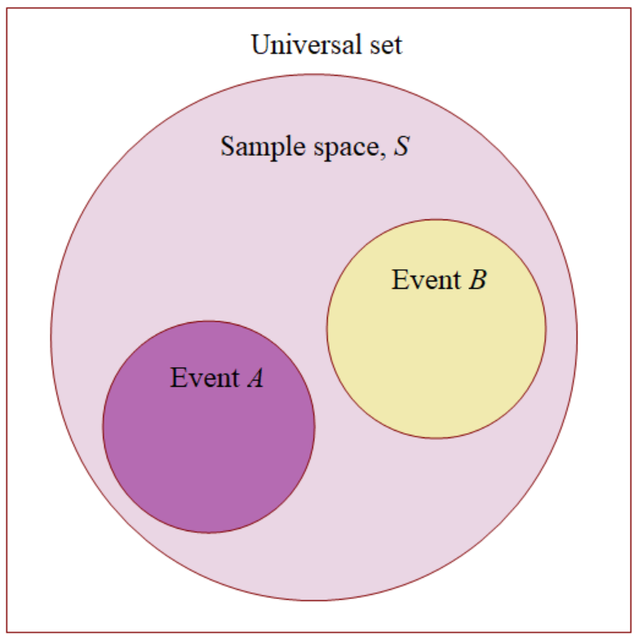
an event is equivalent to a set.
The relationship between events and the corresponding sample space can be illustrated graphical by means of Venn diagrams. In a Venn diagram, we represent the sample space by a rectangle and represent events by circles drawn inside the rectangle.
Venn diagram: Geometric representation of sets and their operations.
Venn diagram can be used to depict a sample space, an event and the related concepts.

Slide 20

Example 2.2.5 In Figure 2.2.1
$A∩B$ = regions 1 and 2, $A∪D$ = regions 1,2 ,3 ,4 ,5 and 7,
$A∪B∩\bar{D}$ = regions 2, 6 and 7
Fig 2.2.1 Venn diagram of Example 2.2.5

Slide 21
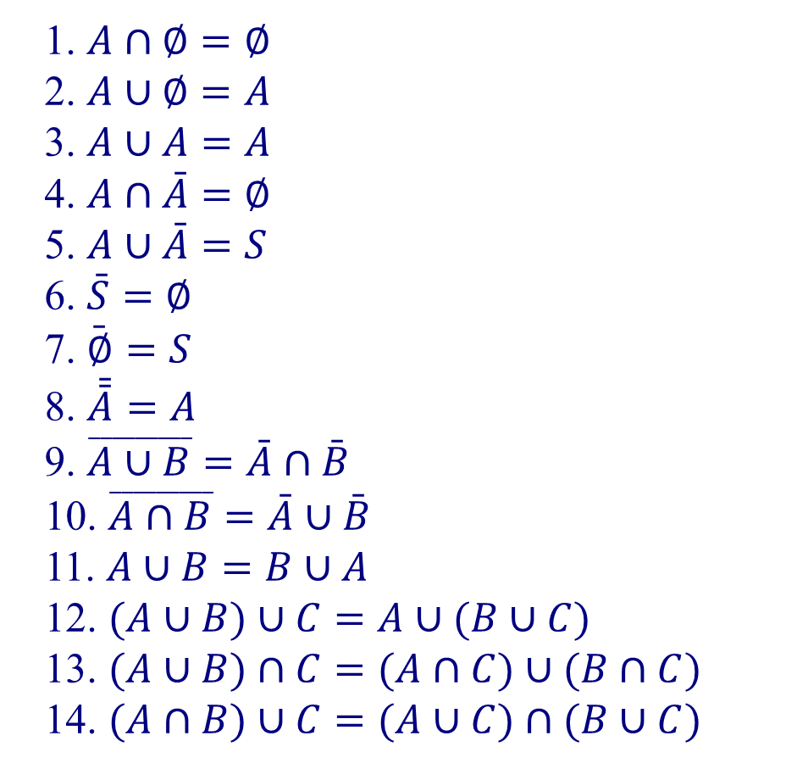
The following list summarizes the rules of the operations of events.
1. $A∩∅=∅$
2. $A∪∅=A$
3. $A∪A=A$
4. $A∩\bar{A}=∅$
5. $A∪\bar{A}=S$
6. $\bar{S}=∅$
7. $\bar{∅}=S$
8. $\bar{\bar{A}}=A$
9. $\overset{_________}{A∪B}=\bar{A}∩\bar{B}$
10. $\overset{_________}{A∩B}=\bar{A}∪\bar{B}$
11. $A∪B=B∪A$
12. $(A∪B)∪C=A∪(B∪C)$
13. $(A∪B)∩C=(A∩C)∪(B∩C)$
14. $(A∩B)∪C=(A∪C)∩(B∪C)$

Slide 22
2.3 Probability of Events
relative frequency --------probability
Considering an Example.
We plant 100 untreated cotton seeds.
If 49 seeds germinate, that is, if there are 49 success (by success in statistics we mean the occurrence of the event under discussion) in 100 trials, we say that the relative frequency of success is 0.49.
If we plant more and more seeds, a whole sequence of values for the respective relative frequencies is obtained. In general, these relative frequencies approach a limit value, we call this limit the probability of success in a single trial. From the data of Table 2.3.1 it appears that the relative frequencies are approaching the value 0.51, which we call the probability of a cotton seedling emerging from an untreated seed.

Slide 23
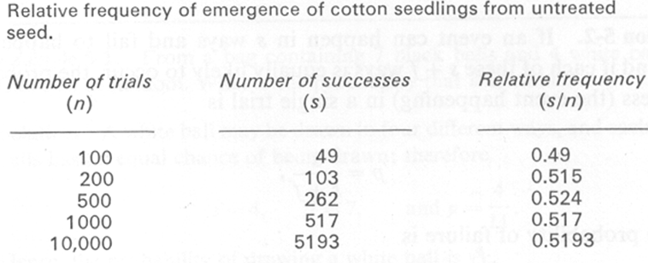
relative frequencies are approaching the value 0.52

Slide 24
Definition 2.3.1 If the number of successes in n trails is denoted by s, and if the sequence of relative frequencies s/n obtained for larger and larger value of n approaches a limit, then this limit is defined as the probability of success in a single trial.
By the definition, the probability of the certain event is 1, since its relative frequency is always 1. Similarly, the probability of the impossible event is 0, and the probability of any event is always between 0 and 1.
Note. In this definition , the word“limit” has a meaning which is different from the meaning you may have learned in calculus. We will discuss this problem later.

Slide 25
Example 2.3.1 Select 200 bulbs produced by company X at random of them 150 having life longer than 300hrs. Find the probability that the bulbs produced by company X have life longer than 300hrs.
Solution. p=150/200=0.75

Slide 26
2.”equally likely to occur”------probability
In many cases, the probability may be stated without experience. If we toss a properly balanced coin, we believe that the probability of getting a head is 0.5. We make this statement since in tossing a properly balanced coin, only two outcomes are possible and both outcome are equally likely to occur.
Definition 2.3.2 If a sample space S consists of N sample points, each is equally likely to occur. Assume that the event A consists of n sample points, then the probability p that A occurs is
p=P(A)=n/N (2.3.1)

Slide 27
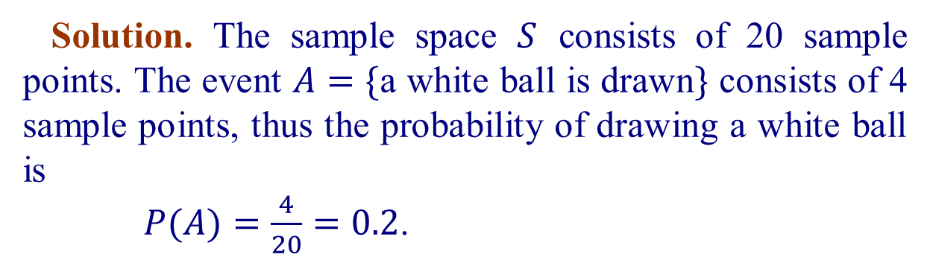
It should be pointed out that this definition is in a sense circular in nature, since the expression “equally likely to occur” itself involves the idea of probability. However, since this term is generally intuitively understood, the concept of “equally likely” will be left undefined.
Example 2.3.2 From a bag containing 7 black balls, 4 white balls and 9 red balls, a ball is drawn at random. What is the probability that it is white?
Solution. The sample space $S$ consists of 20 sample points. The event $A=\{$a white ball is drawn$\}$ consists of 4 sample points, thus the probability of drawing a white ball is
$P(A)=\frac{4}{20}=0.2$.

Slide 28





Example 2.3.3 In a single throw of two dice what is the probability of getting (a) a total of 9; (b) a total greater than 9?
Solution The sample space is
$S=\{(m,n)|m,n$ are positive integers $≤6\}$
thus $S$ consists of 36 sample points .
Let $A=\{$getting a total of 9$\}$,
$B=\{$getting a total greater of 9$\}$
Then we have
$$A=\left\{\left(3,6\right) , \left(4,5\right) , \left(5,4\right) , \left(6,3\right)\right\}$$
$$B=\left\{\left(4,6\right) , \left(5,5\right) , \left(6,4\right) , \left(5,6\right) , \left(6,5\right) , \left(6,6\right)\right\}$$
Thus
$P(A)=\frac{4}{36}=\frac{1}{9}$ , $P(B)=\frac{6}{36}=\frac{1}{6}$.
where $p(A)$ is the probability that the event $A$ occurs .

Slide 29
Example 2.3.4 Consecutively draw ball
From a big pack which contains a white balls and b black balls, a ball is consecutively draw at random. what is the probability that the ball which be drawn in m-th time is white?
Permutation：
Let A={a white ball is drawn in m-th times}
N= A _{a+b} =(a+b)！
n=a·A_{a+b-1} =a (a+b－1)！
P(A)=
Combination：

Slide 30
Birthday Paradox
In a set of n randomly chosen people (n is less than 365), what is the probability that some pair of them having the same birthday?
Let A={at least one pair of the n people having the same birthday}.
Then A’ = {all the n people have different birthday}.
n | 10 | 20 | 23 | 30 | 40 | 50
P(A) | 0.12 | 0.41 | 0.51 | 0.71 | 0.89 | 0.97

Slide 31


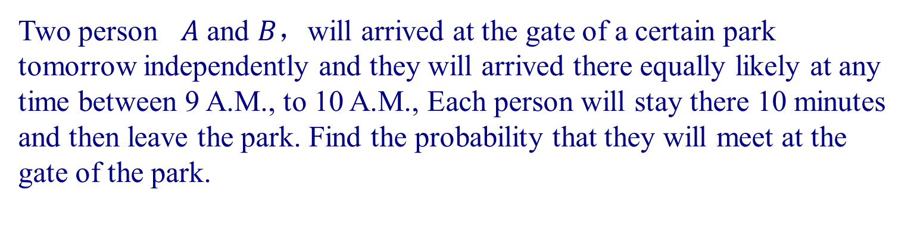
Example 2.3.7.
Two person $A$ and $B$，will arrived at the gate of a certain park tomorrow independently and they will arrived there equally likely at any time between 9 A.M., to 10 A.M., Each person will stay there 10 minutes and then leave the park. Find the probability that they will meet at the gate of the park.
Solution.
Let $t_{A}$, $t_{B}$ be the time A, B arriving the gate, resp., then our sample space is a square
$$S=\left\{\left(t_{A} , t_{B}\right) | 9 | ≤t_{A}t_{B}≤10\right\}$$
Fig 2.3.1 A sample space contained in R2.

Slide 32
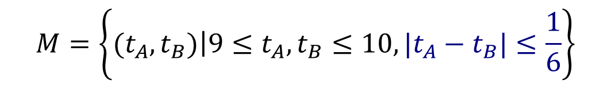

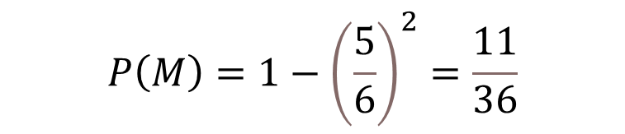


Let M be the event that A and B will meet at the gate, then M will be occur if and only if $|t_{A}−t_{B}|≤\frac{1}{6}$, i.e.(Fig 2.3.1)
$$M=\left\{\left.(t_{A},t_{B})\right|9≤t_{A},t_{B}≤10,|t_{A}−t_{B}|≤\frac{1}{6}\right\}$$
In this problem, the expression “equally likely to occur” means that “The probability that the sample point is located in a special region $M⊂C$ is proportional to the area of $M$”.
Again, since the certain event S has area $1$, thus the probability of M is equal to the area of $M$,
i.e.
$$P\left(M\right)=1−{\left(\frac{5}{6}\right)}^{2}=\frac{11}{36}$$

Slide 33
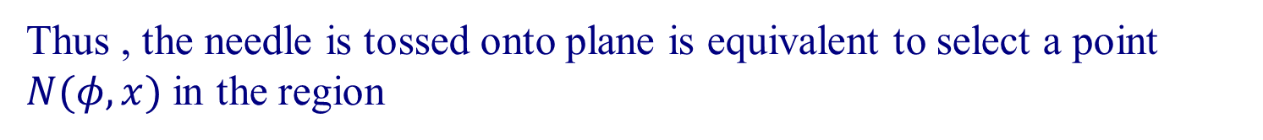

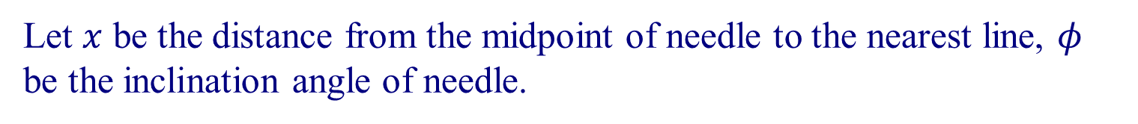
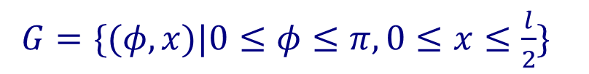

Example 2.3.8 Buffon’s needle
Consider a plane, ruled with equidistant parallel lines, where the distance between the lines is a. A needle of length l (l<a) is tossed onto the plane. What is the probability that the needle intersects one line.
Solution.
Let $x$ be the distance from the midpoint of needle to the nearest line, $φ$ be the inclination angle of needle.
Then $0≤φ≤π,0≤x≤\frac{l}{2}$.
Thus , the needle is tossed onto plane is equivalent to select a point $N(φ,x)$ in the region
$G=\{(φ,x)|0≤φ≤π,0≤x≤\frac{l}{2}\}$
in the $Oφx$plane. Since the needle intersects with one line if and only if
$x≤\frac{l}{2}\sin{φ}$ ,

Slide 34
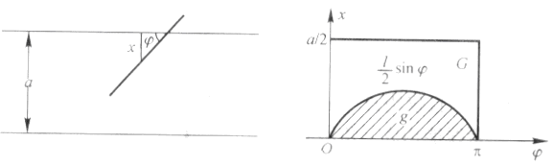


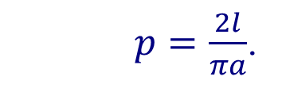


$$g=\left\{\left(φ , x\right) | x≤\frac{l}{2}\sin{φ}\right\}$$
i.e. $N$ is in the region
Since
Area$(G)=\frac{a}{2}π,$
Area$(g)=\int_{0}^{π}{\frac{l}{2}\sin{φ}dφ=l,}$
$p=\frac{2l}{πa}$.
So the probability required is

Slide 35
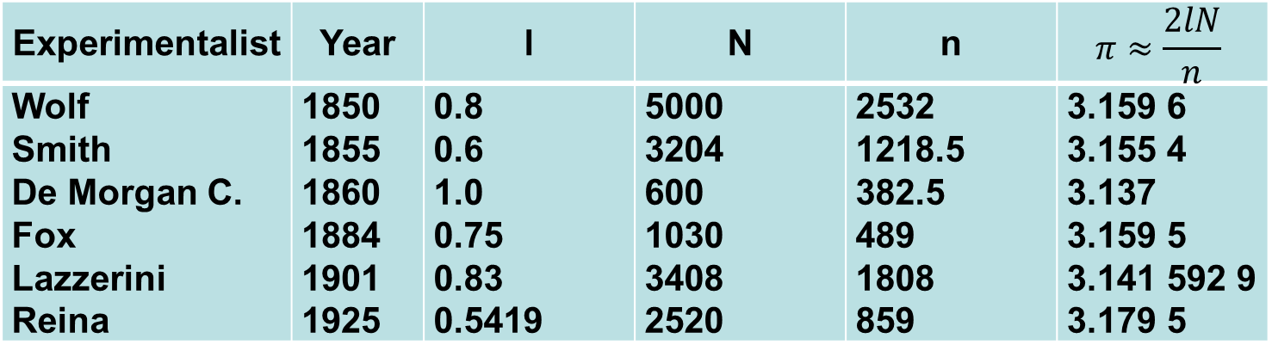
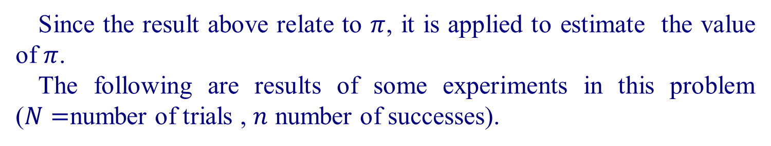
Since the result above relate to $π$, it is applied to estimate the value of $π$.
The following are results of some experiments in this problem ($N=$number of trials , $n$ number of successes).
Experimentalist | Year | l | N | n | $$π≈\frac{2lN}{n}$$
Wolf Smith De Morgan C. Fox Lazzerini Reina | 1850 1855 1860 1884 1901 1925 | 0.8 0.6 1.0 0.75 0.83 0.5419 | 5000 3204 600 1030 3408 2520 | 2532 1218.5 382.5 489 1808 859 | 3.159 6 3.155 4 3.137 3.159 5 3.141 592 9 3.179 5

Slide 36

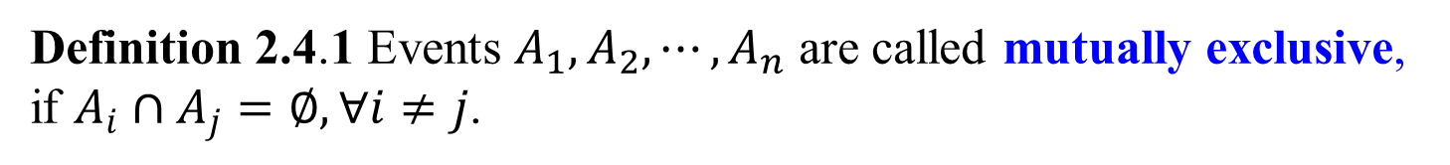
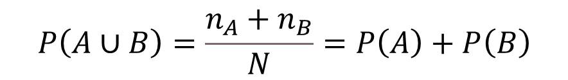
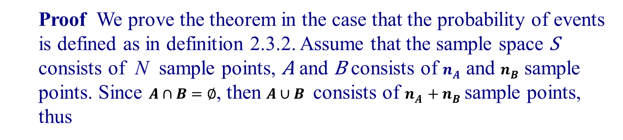
2.4 Laws of probability
In real world problems, situations are more complicate than the examples in previous sections. To find the probability in these cases, we need the laws of probability.
Definition 2.4.1 Events $A_{1},A_{2},⋯,A_{n}$ are called mutually exclusive,
if $A_{i}∩A_{j}=∅, ∀i≠j$.
Theorem 2.4.1 If A and B are mutually exclusive, then
$P(A∪B)=P(A)+P(B)$ (2.4.1)
Proof We prove the theorem in the case that the probability of events is defined as in definition 2.3.2. Assume that the sample space S consists of N sample points, A and B consists of $n_{A}$ and $n_{B}$ sample points. Since $A∩B=∅$, then $A∪B$ consists of $n_{A}+n_{B}$sample points, thus
$$P\left(A∪B\right)=\frac{n_{A}+n_{B}}{N}=P\left(A\right)+P\left(B\right)$$

Slide 37

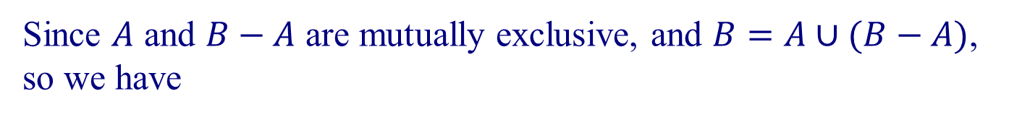
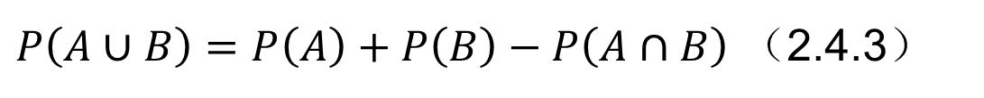

Corollary 1 If $A⊂B$, then $P(B−A)=P(B)−P(A)$. （2.4.2）
Proof
Since $A$ and $B−A$ are mutually exclusive, and $B=A∪(B−A)$, so we have
$P(B)=P(A)+P(B−A)$, i.e.$P(B−A)=P(B)−P(A)$.
Corollary 2 For any two events $A$ and $B$
$P\left(A∪B\right)=P\left(A\right)+P\left(B\right)−P\left(A∩B\right)$ （2.4.3）
Proof Since $A−(A∩B)$ and $B$ are mutually exclusive events, and
$(A−(A∩B))∪B=A∪B$, so we have
$$P\left(A∪B\right)=P\left(A−\left(A∩B\right)\right)+P\left(B\right)$$
$$=P\left(A\right)+P\left(B\right)−P\left(A∩B\right)$$

Slide 38
Fig 2.4.1 Additive law of probability

Slide 39
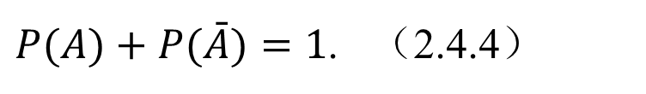
Corollary 3 For any event A, we have
$P(A)+P(\bar{A})=1$. （2.4.4）
For more than two mutually exclusive events, we have a similar theorem.
Theorem 2.1 and corollary 2 are called the additive laws of probability(fig.2.4.1).
generalizing (2.4.3):
$$P\left(A∪B∪C\right)=P\left(A\right)+P\left(B\right)+P\left(C\right)−P\left(AB\right)−P\left(AC\right)−P\left(BC\right)+P\left(ABC\right)$$

Slide 40
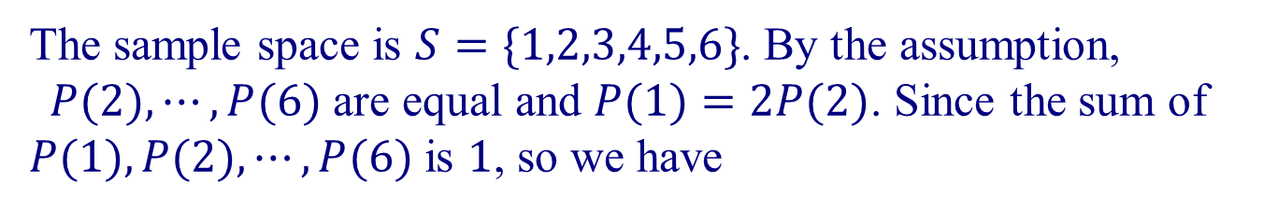
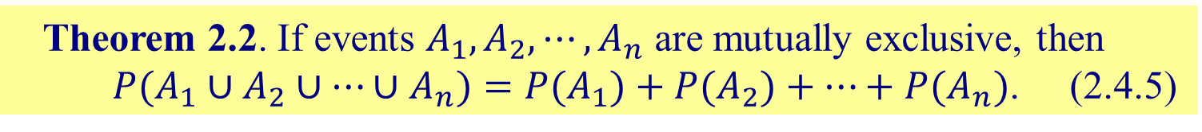
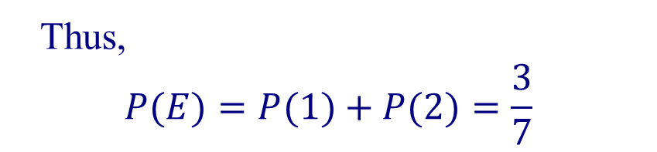
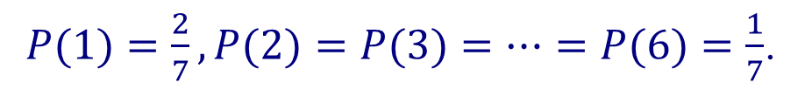
For more than two mutually exclusive events, we have a similar theorem.
Theorem 2.2. If events $A_{1},A_{2},⋯,A_{n}$ are mutually exclusive, then
$P(A_{1}∪A_{2}∪⋯∪A_{n})=P(A_{1})+P(A_{2})+⋯+P(A_{n})$. (2.4.5)
Example 2.4.2 A die is loaded in such a way that the number 1 is twice as likely to occur as other numbers. Find the probability of the event E that a number less than 3 occurs in a single toss.
Solution
The sample space is $S=\{1,2,3,4,5,6\}$. By the assumption, $P(2),⋯,P(6)$ are equal and $P(1)=2P(2)$. Since the sum of $P(1),P(2),⋯,P(6)$ is $1$, so we have
$P(1)=\frac{2}{7},P(2)=P(3)=⋯=P(6)=\frac{1}{7}$.
Thus,
$$P(E)=P(1)+P(2)=\frac{3}{7}$$

Slide 41


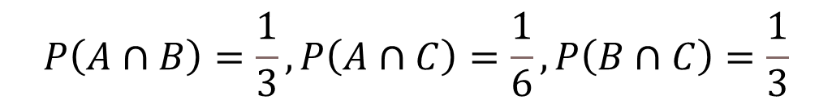
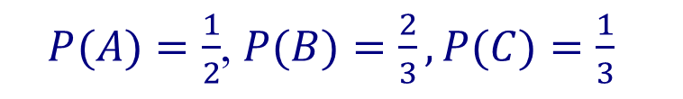

Example 2.4.3 Tossing a fair die, let x be the number occurs. Find the probability of the following events:
$A=\{x$ is even $\}$ $B=\{x≥3\}$ $C=\{x$ is divisible by 3$\}$
and $A∩B$, $B∩C$, $A∩C$.
Solution.
Since $A=\{2,4,6\},B=\{3,4,5,6\},C=\{3,6\}$
Thus
$P(A)=\frac{1}{2}$, $P(B)=\frac{2}{3},P(C)=\frac{1}{3}$
$$P\left(A∩B\right)=\frac{1}{3},P\left(A∩C\right)=\frac{1}{6},P\left(B∩C\right)=\frac{1}{3}$$
In this example, we have
$P(A∩B)=P(A)P(B)$ $,P(A∩C)=P(A)P(C)$
but $P(B∩C)≠P(B)P(C)$
Thus, we introduce the following important definition.

Slide 42
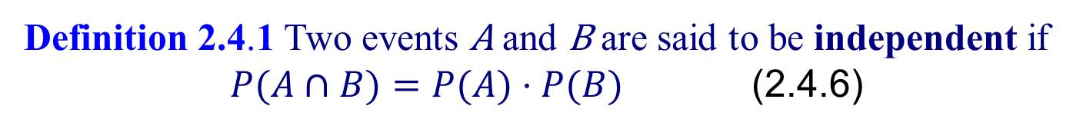
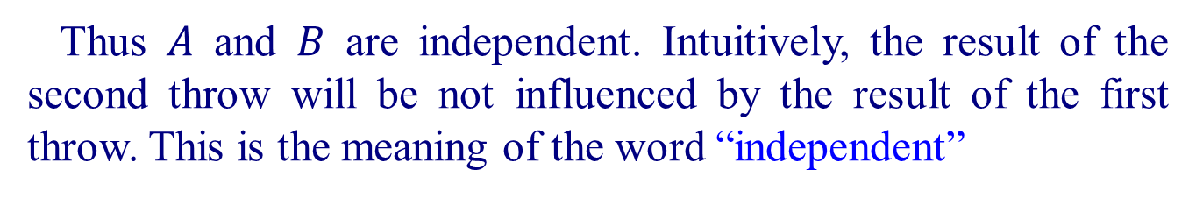
Definition 2.4.1 Two events A and B are said to be independent if
$P(A∩B)=P(A)⋅P(B)$ (2.4.6)
Example 2.4.4 A die is tossed twice. Let A, B be the event that a 3 occurs on the first throw and a 5 occurs on the second throw, respectively., then we have
$P(A)=\frac{1}{6},P(B)=\frac{1}{6},P(A∩B)=\frac{1}{36}=P(A)P(B)$.
Thus $A$ and $B$ are independent. Intuitively, the result of the second throw will be not influenced by the result of the first throw. This is the meaning of the word “independent”

Slide 43

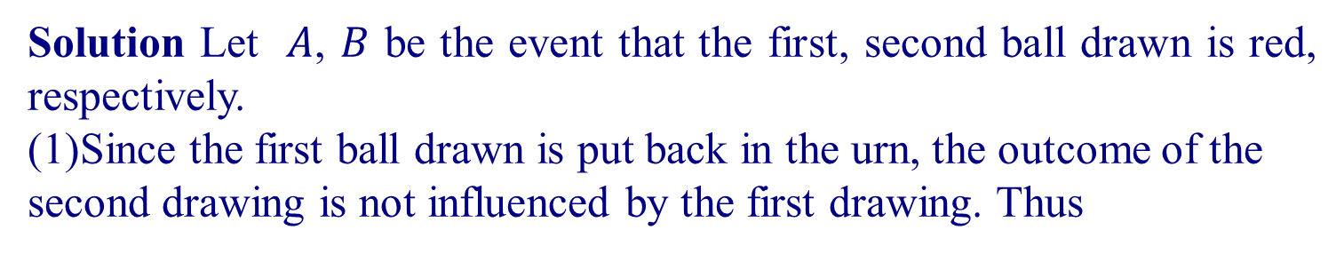
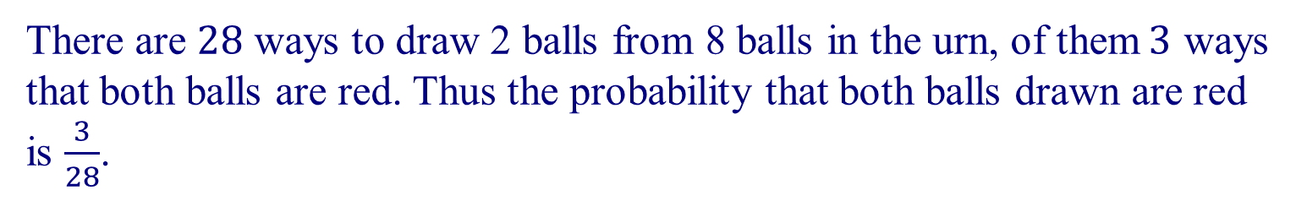
Example 2.4.5 Draw two balls in successive from an urn containing 3 red balls and 5 white balls. Find the probability that the two balls drawn are red.
(1)if the first ball drawn is put back in the urn;
(2)if the first ball drawn is not put back.
Solution Let $A$, $B$ be the event that the first, second ball drawn is red, respectively.
(1)Since the first ball drawn is put back in the urn, the outcome of the second drawing is not influenced by the first drawing. Thus
$P(A∩B)=P(A)⋅P(B)=\frac{3}{8}⋅\frac{3}{8}=\frac{9}{64}$.
(2) In this case, the outcome of the second drawing is influenced by the first drawing, so we have to find the sample space directly.
There are $28$ ways to draw 2 balls from 8 balls in the urn, of them$3$ ways that both balls are red. Thus the probability that both balls drawn are red is $\frac{3}{28}$.

Slide 44




Example 2.4.7 From a box containing 5 white balls, 4 black balls and 3 red balls, 3 balls are drawn at random. Find the probability that 2 are white and 1 is black.
（1）if each ball is returned before the next is drawn;
（2）if the 3 balls are drawn successively without replacement.
Solution (1)For each drawing, the probability that a white ball, black ball or red ball is drawn is, resp.,
$P(W)=\frac{5}{12}$, $P(B)=\frac{4}{12}$, $P(R)=\frac{3}{12}$
In this case, the first draw, second draw and third draw are independent, thus.
$P($2 white and 1 black$)=3{\left(\frac{5}{12}\right)}^{2}\left(\frac{4}{12}\right)=\frac{5}{144}$，
(2)The sample space consists of all combinations of 12 balls taken 3 balls at a time, and we have $C_{5}^{2}C_{4}^{1}=40$ success ways, so
$P($2 white and 1 black$)=\frac{C_{5}^{2}C_{4}^{1}}{C_{12}^{3}}=\frac{1}{33}$

Slide 45

2.5. Conditional Probability
The probability of an event is frequently influenced by other events.
For example,
Consider a statistic class consists of 150 students, of them 100 major in engineering. In the final exam, 36 get the grade A, include 26 major in engineering. Then for the whole class, the probability of getting an A is $36/150=0.24$, but for the students major in engineering, the probability is $26/100=0.26$. We called it the conditional probability for students getting an A given that he(her) is major in engineering.
Note that in this example, we have two sample space, one is the whole class, another is the students major in engineering. Thus ,in a real world problem, we often need to discuss several sample space all together ,you should be careful not to confuse them.

Slide 46





Let $A=\{\text{students} \text{major} \text{in} \text{engineering}\}$, $P(A)=\frac{100}{150}$
$B=\{\text{students} \text{getting} \text{an} \text{A}\}$, then
$A∩B=\{\text{students} \text{major} \text{in} \text{engineering} \text{and} \text{getting} \text{an} \text{A}\}$.
Thus, $P(A)=100/150=2/3,P(A∩B)=26/150=13/75$
The conditional probability of the even $B$, given $A$, is denoted by $P(B|A)$.
In the reduced sample space $A$, the subset of students getting an $A$ is exactly $A∩B$, thus
$$P\left(B | A\right)=\frac{26}{100}=0.26$$
On the other hand, we can write
$P(B|A)=\frac{26}{100}=\frac{\frac{26}{150}}{\frac{100}{150}}=\frac{P(A∩B)}{P(A)}$.

Slide 47




Definition 2.5.1 The conditional probability of B, given A, denoted by $P(B|A)$, is defined by
$P(B|A)=\frac{P(A∩B)}{P(A)}$ if $P(A)>0$. (2.5.1)
Example 2.5.1 Let the adults in a small town are categorized according to sex and employment status as follows:
Employed Unemployed Total
Male 420 80 500
Female 180 220 400
Total 600 300 900
If $M=\{\text{male}\}\text{, }F=\{\text{female}\}\text{, }E=\{\text{employed}\}\text{, }U=\{\text{unemployed}\},$
Find $P(M)\text{, }P(E|M)\text{, }P(F|U)$.
Solution

Slide 48




Example 2.5.3 From a deck of 52 cards a card is withdrawn at random and not replaced. A second card is then drawn. Find the probability that the first card is an ace and the second a king?
Solution Let $A=\{\text{the} \text{first} \text{card} \text{is} \text{an} \text{ace}\}$, $K=\{\text{the} \text{second} \text{card} \text{is} \text{a} \text{king}\}$.
Then $P(A)=4/52=1/13$, After an ace is drawn, the probability of getting a king is 4/51,
i.e. $P(K|A)=4/51.$ Thus, the probability that the first card is an ace and the second a king is
$$P\left(A∩K\right)=P\left(A\right)P\left(K | A\right)=\frac{1}{13}⋅\frac{4}{51}=\frac{4}{663}$$

Slide 49





In previous section, we defined events $A$, $B$ to be independent if and only if
$$P\left(A∩B\right)=P\left(A\right)⋅P\left(B\right)$$
Thus
$P(B|A)=\frac{P(A∩B)}{P(A)}=P(B)$.
This means that, if $A$ and $B$ are independent, then the probability of $B$ is unchanged whether $A$ occurs or not, that is the reason that the word “independent” used.
The notion of conditional probability provides the capability of reevaluating the probability of an event in light of additional information, i.e., when another event has occurred. The probability $P(A|B)$ is an “updating” of $P(A)$ based on the knowledge that $B$ has occurred.
P(A)------ a prior probability
P(A/B)---- a posterior probability

Slide 50

Thus, definition 2.4.1 can be restated as:
Two events $A$ and $B$ are independent if and only if
$$P\left(B | A\right)=P\left(B\right)$$
Example 2.5.4 An electrical system consists of 3 components A1,A2 and A3 (Figure 2.5.1). The system works if $A_{1}$ works and at least one of $A_{2}$ and $A_{3}$ work. The reliability (probability of working) of $A_{1},A_{2}$ and $A_{3}$ are 0.9, 0.8 and 0.7, respectively. Find the probability that (a)the entire system works, (b)the component $A_{3}$ does not work ,given that the entire system work. Assume that the components work independently.
Figure 2.5.1 An electrical system

Slide 51



Solution In this system, $A_{1}$ and the subsystem $A_{2}$ and $A_{3}$ constitute a serial circuit system, the subsystem $A_{2}$ and $A_{3}$ itself is a parallel circuit system.
Thus the event that the system works is the event $A_{1}∩(A_{2}∪A_{3})$, and the event that the system work but $A_{3}$ does not work in the even $A_{1}∩A_{2}∩{\bar{A}}_{3}$.
(a) $P(A_{1}∩(A_{2}∪A_{3}))=P(A_{1})P(A_{2}∪A_{3})$
$$=P\left(A_{1}\right)⋅\left(1−P\left({\bar{A}}_{2}∩{\bar{A}}_{3}\right)\right)=P\left(A_{1}\right)⋅\left(1−P\left({\bar{A}}_{2}\right)⋅P\left({\bar{A}}_{3}\right)\right)$$
$$=0.9\left(1−\left(0.2\right)\left(0.3\right)\right)=\left(0.9\right)\left(0.94\right)=0.846$$
(b)$P(A_{3} \text{does} \text{not} \text{work}| \text{system} \text{works})=\frac{P(A_{1}∩A_{2}∩{\bar{A}}_{3})}{P(A_{1}∩(A_{2}∪A_{3}))}$
=$\frac{P(A_{1})P(A_{2})P({\overline{A}}_{3})}{0.846}=\frac{(0.9)(0.8)(0.3)}{0.846}=0.255$.

Slide 52

Theorem 2.5.1 If $A_{1},A_{2},⋯,A_{k}$ are events, then
$$P\left(A_{1}∩A_{2}∩⋯A_{k}\right)=P\left(A_{1}\right)⋅P\left(A_{2} | A_{1}\right)⋅P\left(A_{3} | A_{1}∩A_{2}\right)⋯P\left(A_{k} | A_{1}∩A_{2}∩⋯∩A_{k−1}\right)$$
If the events $A_{1},A_{2},⋯,A_{k}$ are independent, then for any subset $\{i_{1},i_{2},⋯,i_{m}\}⊂\{1,2,⋯,k\}$,

Slide 53



Example 2.5.5 What is the probability that among 23 randomly selected people at least two have birthdays falling on the same day, i.e. on the same month and day (not necessary the same year )?
Solution Let $A$ be the event discussed. Then the complement $\bar{A}$ is that all 23 people have birthdays falling on different days of the year. Assume that each year has 365 days and that the probability of a person having a birthday on any of these days is the same. All 23 people will have different birthdays if all of the following 23 dependent events occur: the first person has a birthday on any day of the year, which occurs with probability 1; the second person has a birthday on any day of the year except the birthday of the first person, for which the probability is 364/365; the third person has birthday on any day of the year except these of the first two person ,for which the probability is 363/365, and so on. Therefore
$P(\bar{A})=1⋅\frac{364}{365}⋅\frac{363}{365}⋯\frac{343}{365}=0.493$
and
$P(A)=1−P(\bar{A})=0.507$

Slide 54




Example 2.5.6
Three people A, B and C are playing a game. They toss a die in order. The first one to get a 2 wins. What are their respective chances of winning?
Solution First we determine the probability p_{A} that A will win. In the first round, the probability that A will win is 1/6. If no one wins in the first round (the probability is $(\text{5/6})^{3}$, and if A win in the second round (the conditional probability is 1/6), then the probability of A win in the second round is $(\text{5/6})^{3}(1/6)$.
Similarly, if we denote the event that $A$ wins in the $k$ -th round by $A_{k}$, then
$P_{A}=\sum_{k=1}^{∞}{{\left(\frac{5}{6}\right)}^{3k−3}\left(\frac{1}{6}\right)}=\frac{36}{91}$.
Similarly, the probability the B or C win are
$P_{B}=\frac{30}{91}, P_{C}=\frac{25}{91}$.
Note Here we have a sample space consist of infinitely many sample points, and infinitely many mutually exclusive events, but the laws of probability are still valid.

Slide 55




Example 2.5.7 A die is tossed, by x we denote the number that shows on the top face. Consider the events
$A=\{x|x$ is even $\}$ $B=\{x|x≤2\}$
Discuss the independency of $A$ and $B$ if
all numbers are equally likely to occur;
$1$ is twice as likely to occur as other numbers.
Solution (a)Now we have $A∩B=\{2\},P(A)=\frac{1}{2},P(B)=\frac{1}{3}$
$$P\left(A∩B\right)=\frac{1}{6}=P\left(A\right)⋅P\left(B\right)$$
Thus $A$ and $B$ are independent.
(b) In this case
$P(A)=\frac{3}{7}$ $P(B)=\frac{3}{7}$, $P(A∩B)=\frac{1}{7}≠P(A)⋅P(B)$
Thus $A$ and $B$ are not independent.
Note From this example, we know that the word “independent” shall be used carefully.

Slide 56
2.6 Bayes’ Rule
Let us consider the following example.
Example 2.6.1 In a calculus class, 45%, 30%, 25%, of students major in mechanical engineering, electrical engineering and civil engineering, respectively. In the final exam, 20% of students major in mechanical engineering, 25% of students major in electrical engineering, 10% of students major in civil engineering got grade A.
select a student randomly from this class ,what is the probability that he(she) got an A in the exam?
Select a student who got an A at random, what is the probability that he(she) is major in civil engineering?
Solution.
Let M={ a student who is major in mechanical engineering}
E={ a student who is major in electrical engineering}
C={ a student who is major in civil engineering}
Then P(M)=0.45, P(E)=0.30, P(C )=0.25,

Slide 57

$M∪E∪C=S$, $M∩∪=∅, M∩E=∅, E∪C=∅$
hence P(M)+P(E)+P(C )=1
A= { a student who got an A in the exam}
P(A/M)=0.20, P(A/E)=0.25, P(A/C)=0.10
$$A=A∩S=A∩\left(M∪E∪C\right)=AM+AE+AC$$
P(A)=P(AM+AE+AC)=P(AM)+P(AE)+P(AC)
(a)In this class, the probability that a student who is major in mechanical engineering and got an A is P(M)P(A/M)=(0.45)(0.20)=0.09
Similarly, the probability that a student is major in electrical engineering and got an A is P(E)P(A/E)=(0.30)(0.25)=0.075
The probability that a student who is major in civil engineering and got an A is P(C )P(A/C)=(0.25)(0.10)=0.025
Thus, the probability that a student got an A is
P(A)=$0.09+0.075+0.025=0.19$

Slide 58


(b)We need to find the conditional probability that a student is major in civil engineering given he(she) got an A ,so the probability is
P(C/A)=$\frac{0.025}{0.19}=0.13$
This example suggests the following theorems, which are very useful in statistics.
The first theorem is theorem of the total probability.
A set of events $B_{1},B_{2},⋯,B_{k}$ is called a partition of the sample space $S$, if they are mutually exclusive and their union is $S$.

Slide 59

Theorem 2.6.1.(Theorem of total probability)
If the events $B_{1},B_{2},⋯,B_{k}$ constitute a partition of the sample space S such that $P(B_{j})≠0$ for $j=1,2,⋯,k,$ than for any event $A$ of $S$,
$P\left(A\right)=\sum_{j=1}^{k}{P\left(A∩B_{j}\right)}=\sum_{j=1}^{k}{P\left(B_{j}\right)}P\left(A∩B_{j}\right)$ (2.6.1)

Slide 60








Example 1 In a certain assembly plant, three machines $B_{1}, B_{2}{, B}_{3}$ make 30%, 45%,and 25%, respectively, of the products. From past experience that 2%, 3%, and 2% are defective products. A product is randomly selected.
What is the probability that it is defective?
Solution :
Define A={the product is defective}，
$B_{i}$={the product is made by $B_{i}$}, i=1, 2, 3
P($B_{1}$) = 0.3
P($B_{2}$) = 0.45
P($B_{3}$) = 0.25
P($A|B_{1}$) = 0.02
P($A|B_{2}$) = 0.03
P($A|B_{3}$) = 0.02
P($A$) = P($A|B_{1}$)P($B_{1}$) + P($A|B_{2}$)P($B_{2}$) + P($A|B_{3}$)P($B_{3}$)
= 0.02×0.3 + 0.03×0.45 + 0.02×0.25 = 0.0245

Slide 61












Example 1 In a certain assembly plant, three machines $B_{1}, B_{2}{, B}_{3}$ make 30%, 45%,and 25%, respectively, of the products. From past experience that 2%, 3%, and 2% are defective products. A product is randomly selected. If it is defective, what is the probability that it was made by $B_{3}$?
Solution :
Define A={the product is defective}，
$B_{i}$={the product is made by $B_{i}$}, i=1, 2, 3
P($B_{1}$)=0.3
P($B_{2}$)=0.45
P($B_{3}$)=0.25
P($A|B_{1}$)= P($A|B_{3}$)= 0.02
P($A|B_{2}$)=0.03
P($A$)=P($A|B_{1}$)P($B_{1}$)+P($A|B_{2}$)P($B_{2}$)+P($A|B_{3}$)P($B_{3}$)
= 0.02×0.3+0.03×0.45+0.02×0.25=0.0245
P($B_{3}|A$) =
=
$$\frac{\text{P}\text{(}A\text{∩}B_{3}\text{)}}{\text{P}\text{(}A\text{)}}$$
$$\frac{\text{P}\text{(}A|B_{3}\text{)}\text{P}\text{(}B_{3}\text{)}}{\text{P}\text{(}A|B_{1}\text{)}\text{P}\text{(}B_{1}\text{)+}\text{P}\text{(}A|B_{2}\text{)}\text{P}\text{(}B_{2}\text{)+}\text{P}\text{(}A|B_{3}\text{)}\text{P}\text{(}B_{3}\text{)}}$$
=
$$\frac{\text{0.02×0.25}}{\text{0.0245} }$$
$$≈0.2041$$

Slide 62



In real world problems, it is important to calculate a posterior probability from given a prior probability. Such a formula is called Bayes’ formula.
Theorem 2.6.2 If the events $B_{1},B_{2},⋯,B_{k}$ constitute a partition of the sample space S such that $P(B_{j})≠0$ for $j=1,2,⋯,k,$ than for any event A of S, $P(A)≠0$,
$P(B_{i}|A)=\frac{P(B_{i})P(A|B_{i})}{\sum_{j=1}^{k}{P(B_{j})P(A|B_{j})}}$. for $i=1,2,⋯,k$ (2.6.2)
The probability $P(B)$ is a prior probability.
(the probability of the occurrence of an event $B$ before any experiment have take place; according it is called a prior probability)
$P(B|A)$ is posterior probability

Slide 63



Example 2.6.4
Test employed in the detection of a particular disease are 90% effective; they fail to detect it in 10% of the cases. In persons free of the disease, the tests indicate 1% to be affected and 99% not to be affected. From a large population, in which only 0.2% have the disease, one person is selected at random, is given the tests, and presence of the disease is indicated. What is the probability that the person is affected?
Solution. Let
$A=\{$the person have the disease$\}$
T=$\{$persons given the tests and presence of the diseased is indicated$\}$
Then we have
$P(A)=0.002 ,P(T|A)=0.9 ,P(T|\overline{A})=0.01$
So by Bayes’ formula
$$P\left(A | T\right)=\frac{P\left(A\right)P\left(T | A\right)}{P\left(A\right)P\left(T | A\right)+P\left(\overline{A}\right)P\left(T | \overline{A}\right)}$$
=$\frac{0.002⋅0.9}{0.002⋅0.9+0.998⋅0.01}=\frac{0.0018}{0.01178}=0.15$
Thus, the probability that the person is really affected is only 15%.

Slide 64


Exercises
3. One door hides a car, two hide goats. The contestant (选手) chooses any door. Host (主持人) always opens a different door with a goat. (He can do this because he knows where the car is.) The contestant is then allowed to switch doors if she wants. What is the best strategy for winning a car? (a) Switch (b) Don’t switch (c) It doesn’t matter
Solution :
P(Car ) = 1/3
P(Car | switch) = 1/3 · 0 + 2/3 · 1 = 2/3
The answer is (a) Switch

