Slide 1
3. Random Variables

Slide 2
3.1 Definition of Random Variables
In engineering or scientific problems, we are not only interested in the probability of events, but also interested in some variables depending on sample points.
For example, we maybe interested in the life of bulbs produced by a certain company, or the weight of cows in a certain farm, etc. These ideas lead to the definition of random variables.

Slide 3
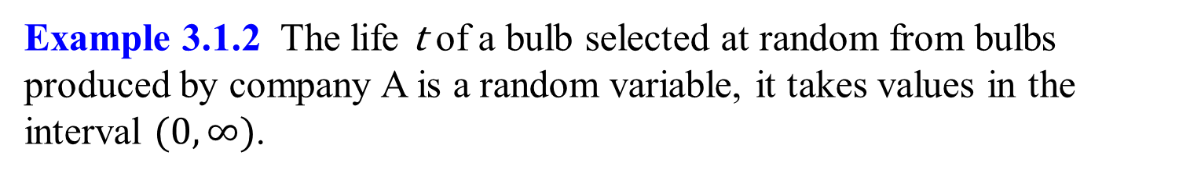
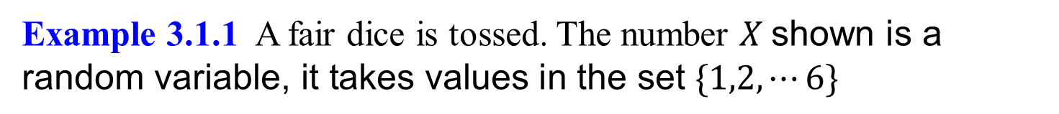
1. random variable definition
Definition 3.1.1 A random variable is a real valued function defined on a sample space; i.e. it assigns a real number to each sample point in the sample space.
Example 3.1.1 A fair dice is tossed. The number $X \text{shown} \text{is} \text{a} \text{random} \text{variable}\text{, }\text{it} \text{takes} \text{values} \text{in} \text{the} \text{set} \{1,2,⋯6\}$
Example 3.1.2 The life t of a bulb selected at random from bulbs produced by company A is a random variable, it takes values in the interval $(0,∞)$.
Since the outcomes of a random experiment can not be predicted in advance, the exact value of a random variable can not be predicted before the experiment, we can only discuss the probability that it takes some value or the values in some subset of R.

Slide 4
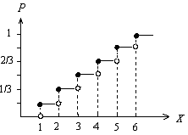
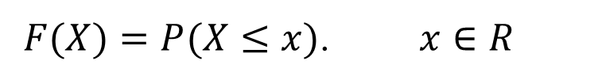
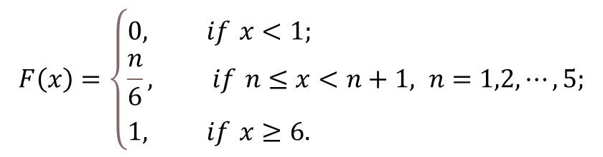

2. Distribution function
Definition 3.1.2 Let X be a random variable on the sample space S. Then the function
$F(X)=P(X≤x)$. $x∈R$
is called the distribution function of $X$
Note The distribution function $F(X)$ is defined on real numbers, not on sample space.
Example 3.1.3 Let X be the number we get from tossing a fair dice. Then the distribution function of X is (Figure 3.1.1)
$$F\left(x\right)=\left\{\begin{aligned}&0, if x<1; \\ &\frac{n}{6}, if n≤x<n+1, n=1,2,⋯,5; \\ &1, if x≥6.\end{aligned}\right.$$
Figure 3.1.1 The distribution function in Example 3.1.3

Slide 5
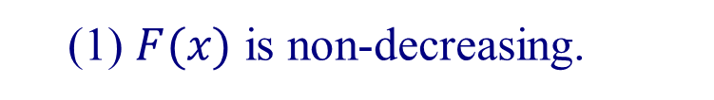
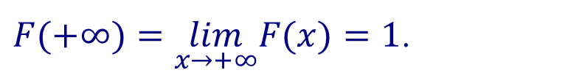
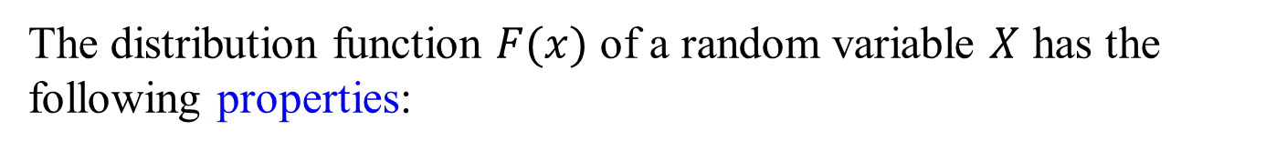

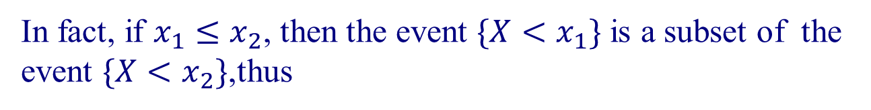
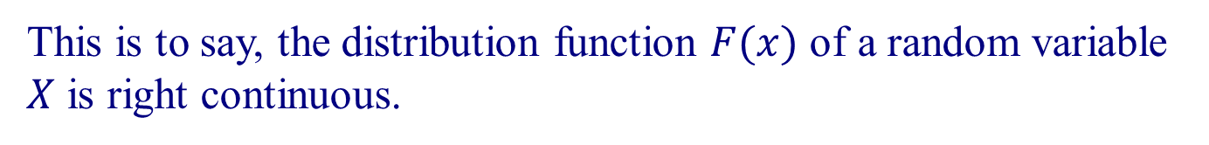
3. Properties
The distribution function $F(x)$ of a random variable $X$ has the following properties:
(1) $F(x)$ is non-decreasing.
In fact, if $x_{1}≤x_{2}$, then the event $\{X<x_{1}\}$ is a subset of the event $\{X<x_{2}\}$,thus
$$F\left(x_{1}\right)=P\left(X<x_{1}\right)≤P\left(X<x_{2}\right)=F\left(x_{2}\right)$$
(2)$F(−∞)=\lim_{x→−∞}F(x)=0$,
$F(+∞)=\lim_{x→+∞}F(x)=1$.
(3)For any $x_{0}∈R$, $\lim_{x→x_{0}+0}F(x)=F(x_{0}+0)=F(x_{0})$.
This is to say, the distribution function $F(x)$ of a random variable $X$ is right continuous.

Slide 6
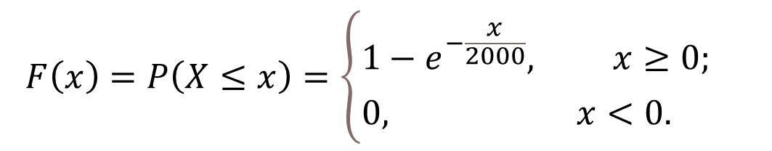
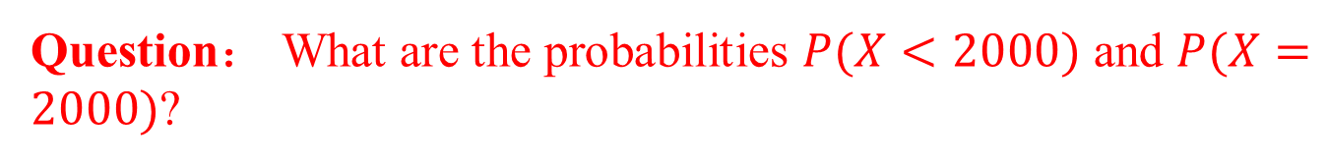
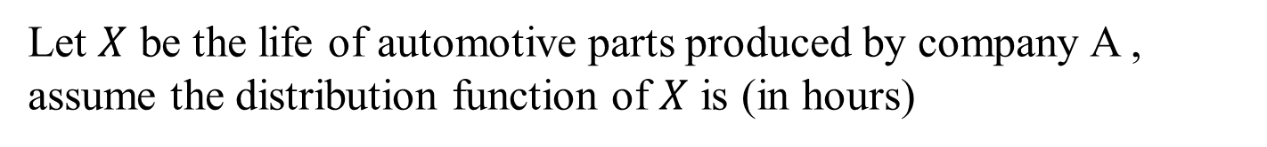
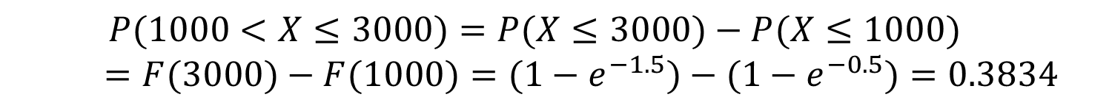

Example 3.1.4
Let $X$ be the life of automotive parts produced by company A , assume the distribution function of $X$ is (in hours)
$$F\left(x\right)=P\left(X≤x\right)=\left\{\begin{aligned}&1−e^{−\frac{x}{2000}}, x≥0; \\ &0, x<0.\end{aligned}\right.$$
Find $P(X≤2000)$,$P(1000<X≤3000)$.
Solution
By definition,
$P(X≤2000)=F(2000)=1−e^{−1}=0.6321$.
$$P(1000<X≤3000)=P(X≤3000)−P(X≤1000)$$
$=F(3000)−F(1000)=(1−e^{−1.5})−(1−e^{−0.5})=0.3834$
Question： What are the probabilities $P(X<2000)$ and $P(X=2000)$?

Slide 7
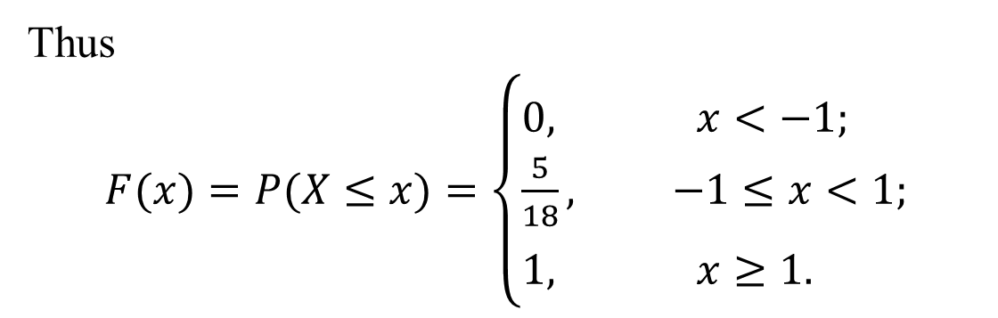
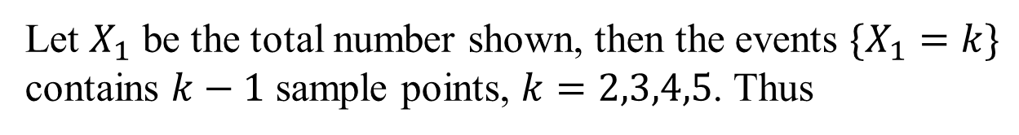
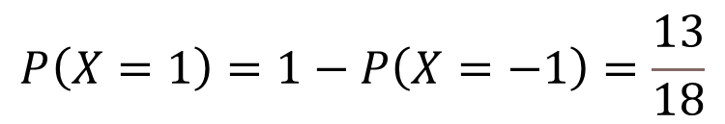
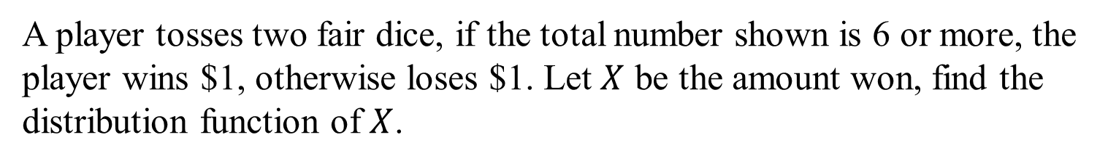

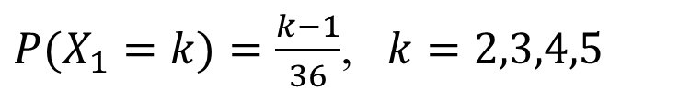
Example 3.1.5
A player tosses two fair dice, if the total number shown is 6 or more, the player wins $1, otherwise loses $1. Let $X$ be the amount won, find the distribution function of $X$.
Solution
Let $X_{1}$ be the total number shown, then the events $\{X_{1}=k\}$ contains $k−1$ sample points, $k=2,3,4,5$. Thus
$P(X_{1}=k)=\frac{k−1}{36}$, $k=2,3,4,5$
And
$\{X=−1\}=\bigcup_{k=2}^{5}{\{X_{1}=k\}}$
so $P(X=−1)=\sum_{k=2}^{5}{P(X=k)}=\frac{5}{18}$
$$P\left(X=1\right)=1−P\left(X=−1\right)=\frac{13}{18}$$
Thus
$F(x)=P(X≤x)=\left\{\begin{aligned}&0, x<−1; \\ &\frac{5}{18}, −1≤x<1; \\ &1, x≥1.\end{aligned}\right.$

Slide 8
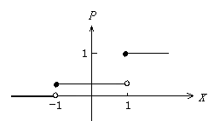
Figure 3.1.2 The distribution function in Example 3.1.5

Slide 9
The distribution function of random variables is a connection between probability and calculus. By means of distribution function, the main tools in calculus, such as series, integrals are used to solve probability and statistics problems.

Slide 10
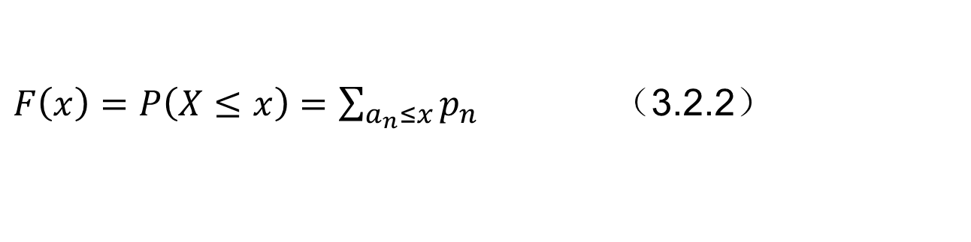
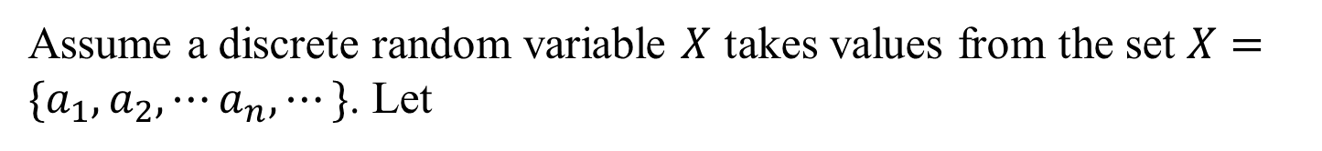

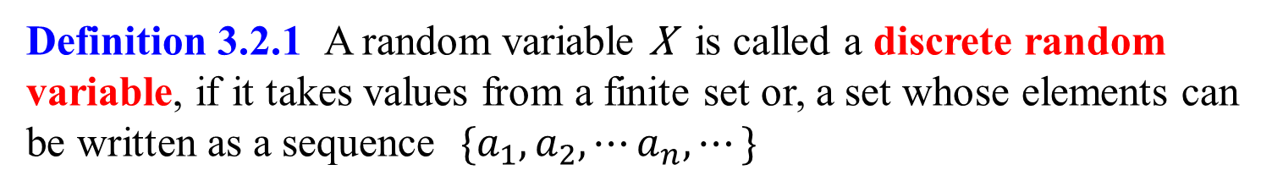
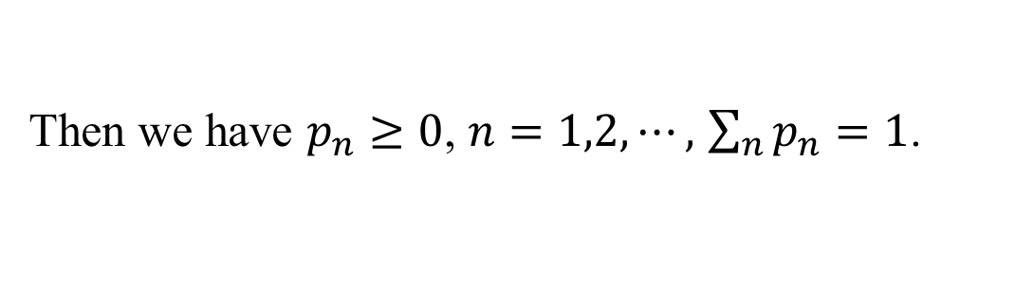
3.2 Discrete Random Variables
In this book, we study two kinds of random variables.
Definition 3.2.1 A random variable X is called a discrete random variable, if it takes values from a finite set or, a set whose elements can be written as a sequence $\{a_{1},a_{2},⋯a_{n},⋯\}$
Assume a discrete random variable $X$ takes values from the set $X=\{a_{1},a_{2},⋯a_{n},⋯\}$. Let
$P\left(X=a_{n}\right)=p_{n}$ $n=1,2,⋯.$ （3.2.1）
Then we have $p_{n}≥0$, $n=1,2,⋯,$ $\sum_{n}{p_{n}}=1$.
the probability distribution of the discrete random variable $X$
And the distribution function of $X$ is given by
$F\left(x\right)=P\left(X≤x\right)=\sum_{a_{n}≤x}{p_{n}}$ （3.2.2）

Slide 11
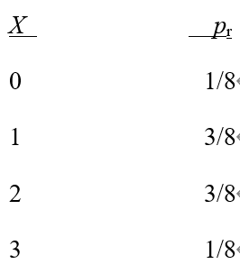
In general, it is more convenient to use (3.2.1) instead of (3.2.2). Equation (3.2.1) is called the probability distribution of the discrete random variable X.
Example 1
For an experiment in which a coin is tossed three times (or 3 coins are tossed once), construct the distribution of X. (Let X denote the number of head occurrence)
Solution
n=3, p=1/2

Slide 12
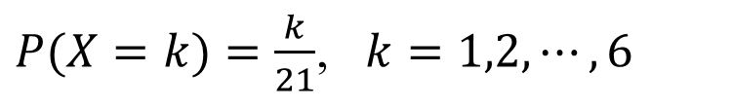
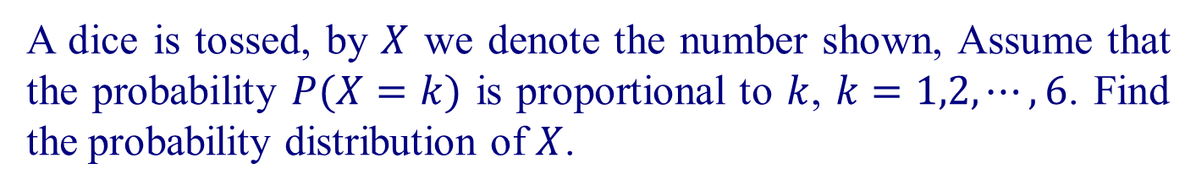

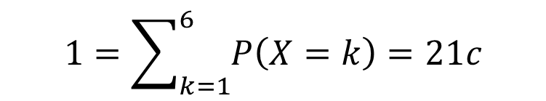
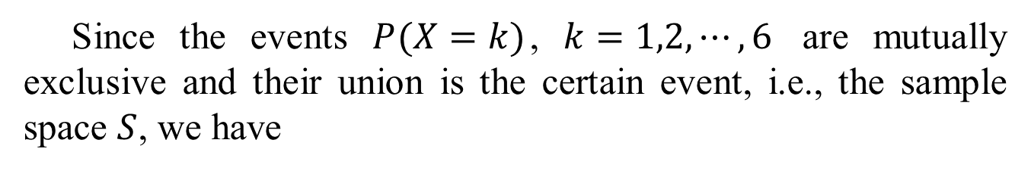
Example 3.2.1
A dice is tossed, by $X$ we denote the number shown, Assume that the probability $P(X=k)$ is proportional to $k$, $k=1,2,⋯,6$. Find the probability distribution of $X$.
Solution Assume that
$P(X=k)=ck$, $c=$constant, $k=1,2,⋯,6$.
Since the events $P(X=k)$, $k=1,2,⋯,6$ are mutually exclusive and their union is the certain event, i.e., the sample space $S$, we have
$$1=\sum_{k=1}^{6}{P\left(X=k\right)=21c}$$
thus $c=\frac{1}{21}$.
The probability distribution of X is (Figure 3.2.1)
$P(X=k)=\frac{k}{21}$, $k=1,2,⋯,6$
Figure 3.2.1 Probability distribution in Example 3.2.1

Slide 13
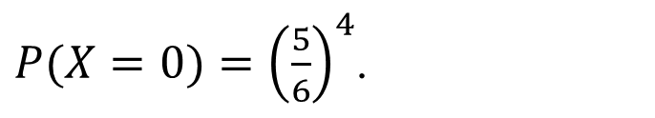
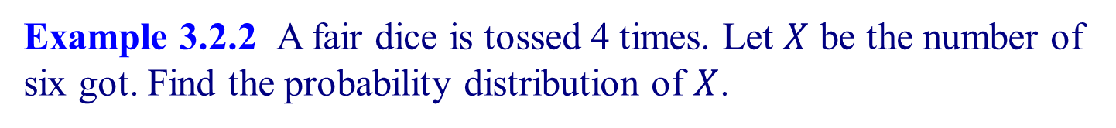
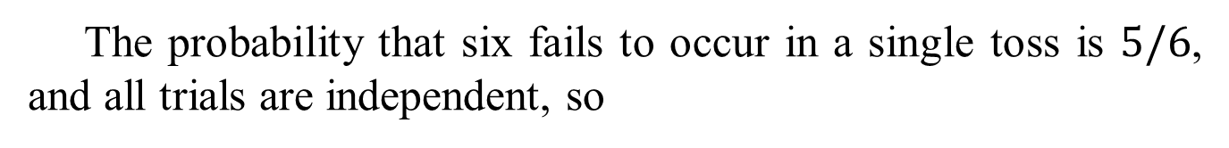
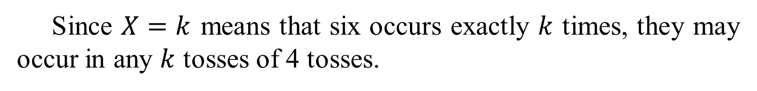
Question. What is the difference between distribution functions and probability distributions
Binomial distribution
Example 3.2.2 A fair dice is tossed 4 times. Let $X$ be the number of six got. Find the probability distribution of $X$.
Solution. The possible values of $X$ are $0,1,2,3,4$.
First we find the probability $P(X=0)$.
Since $X=0$ means that no six occur in 4 tosses.
The probability that six fails to occur in a single toss is $5/6$, and all trials are independent, so
$P(X=0)={\left(\frac{5}{6}\right)}^{4}$.
Now consider the probability $P(X=k)$, $k=1,2,3,4$.
Since $X=k$ means that six occurs exactly $k$ times, they may occur in any $k$ tosses of 4 tosses.

Slide 14

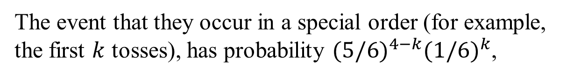
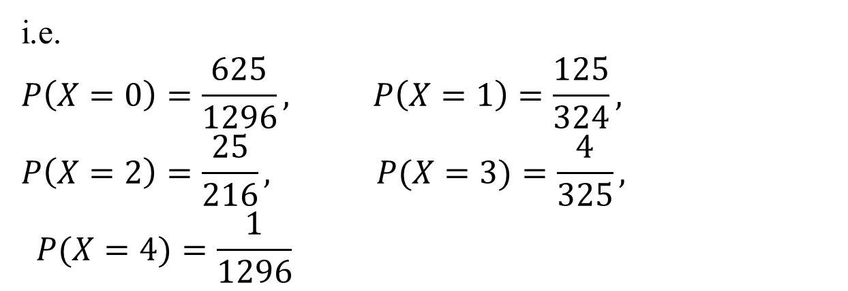

The event that they occur in a special order (for example, the first $k$ tosses), has probability $(5/6)^{4−k}(1/6)^{k}$,
and we have $C_{4}^{k}$ such combinations. Thus
$P(X=k)=C_{4}^{k}(5/6)^{4−k}(1/6)^{k}$
i.e.
$$P\left(X=0\right)=\frac{625}{1296}, P\left(X=1\right)=\frac{125}{324},$$
$$P\left(X=2\right)=\frac{25}{216}, P(X=3)=\frac{4}{325},$$
$$P(X=4)=\frac{1}{1296}$$

Slide 15
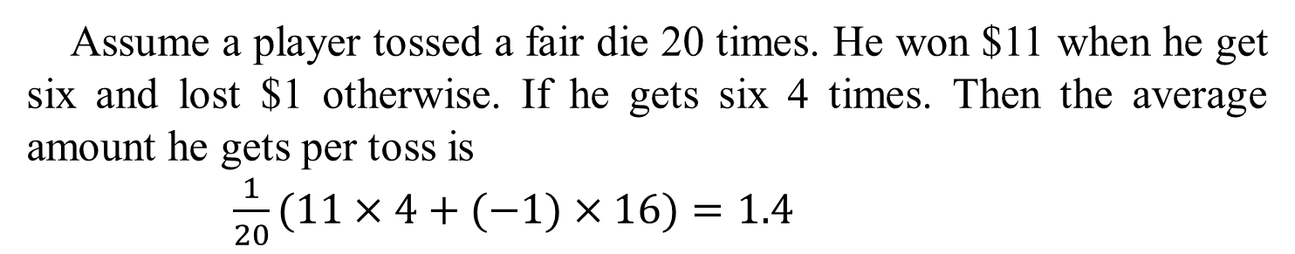
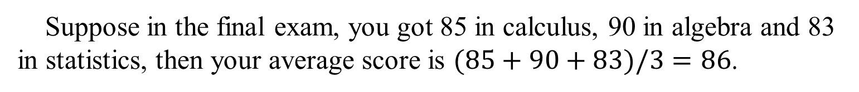
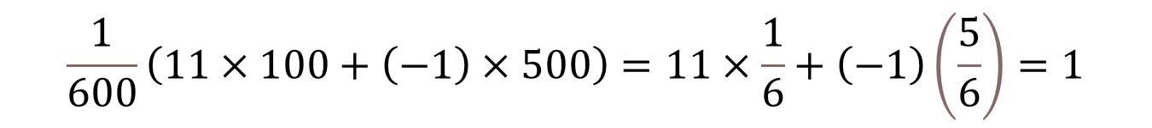
3.3. Expectation and Variance
1．Expectation (mean)
Suppose in the final exam, you got 85 in calculus, 90 in algebra and 83 in statistics, then your average score is $(85+90+83)/3=86$.
Assume a player tossed a fair die 20 times. He won $11 when he get six and lost $1 otherwise. If he gets six 4 times. Then the average amount he gets per toss is
$\frac{1}{20}(11×4+(−1)×16)=1.4$
Consider the future games. Since we cannot predict the outcome of the game, we cannot predict the exact amount he will win in the game.
But we can predict the average amount he will win. Assume he tosses the die 600 times, in average, six will occur 100 times, thus, the average amount he will win per toss would be
$$\frac{1}{600}\left(11×100+\left(−1\right)×500\right)=11×\frac{1}{6}+\left(−1\right)\left(\frac{5}{6}\right)=1$$
We say that in average he will win $1 per toss.

Slide 16
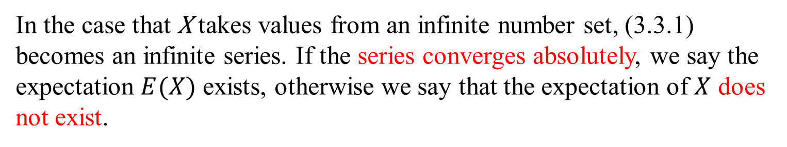
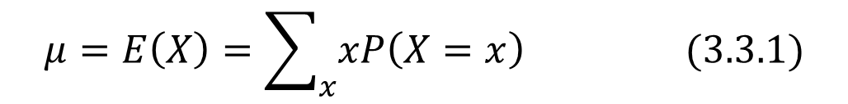
Definition 3.3.1 Let X be a discrete random variable. The expectation or mean of X is defined as
$$μ=E\left(X\right)=\sum_{x}{xP\left(X=x\right)} (3.3.1)$$
Notice
In the case that X takes values from an infinite number set, (3.3.1) becomes an infinite series. If the series converges absolutely, we say the expectation $E(X)$ exists, otherwise we say that the expectation of $X$ does not exist.

Slide 17
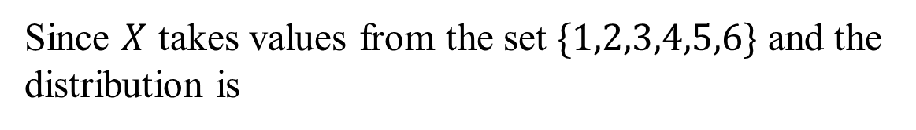
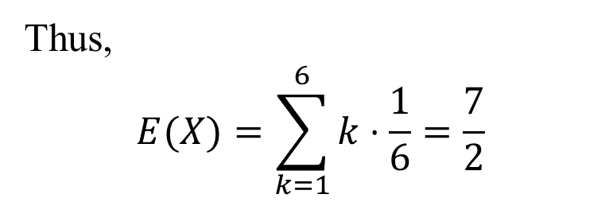
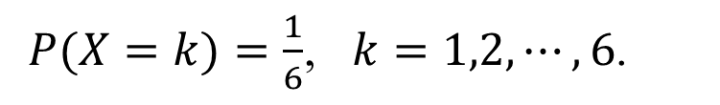
Example 3.3.1
A fair dice is tossed . Find the expectation of spots $X$ shown.
Solution
Since $X$ takes values from the set $\{1,2,3,4,5,6\}$ and the distribution is
$P(X=k)=\frac{1}{6}$, $k=1,2,⋯,6$.
Thus,
$$E(X)=\sum_{k=1}^{6}{k⋅\frac{1}{6}}=\frac{7}{2}$$
If a discrete random variable assume each of its values with an equal probability, we say this probability distribution is a discrete uniform distribution. The distribution in Example 3.3.1 is a discrete uniform distribution.

Slide 18
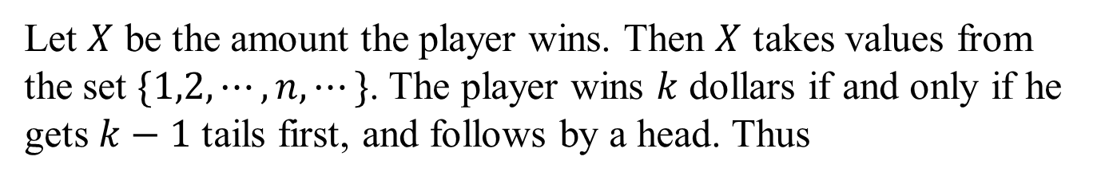
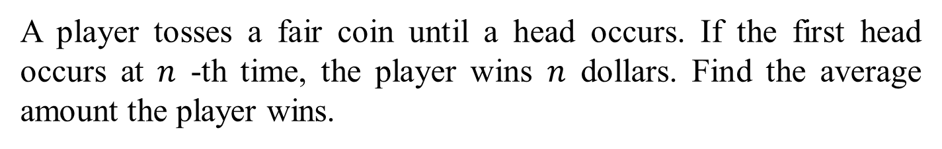
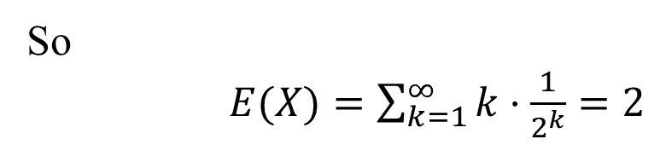

Example 3.3.2
A player tosses a fair coin until a head occurs. If the first head occurs at $n$ -th time, the player wins $n$ dollars. Find the average amount the player wins.
Solution
Let $X$ be the amount the player wins. Then $X$ takes values from the set $\{1,2,⋯,n,⋯\}$. The player wins $k$ dollars if and only if he gets $k−1$ tails first, and follows by a head. Thus
$$P\left(X=k\right)=\frac{1}{2^{k}}$$
So
$E(X)=\sum_{k=1}^{∞}{k⋅\frac{1}{2^{k}}}=2$

Slide 19
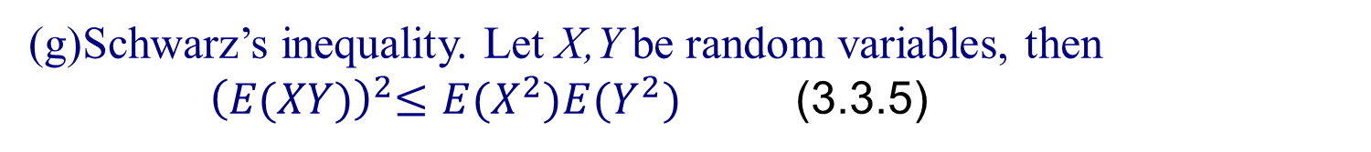
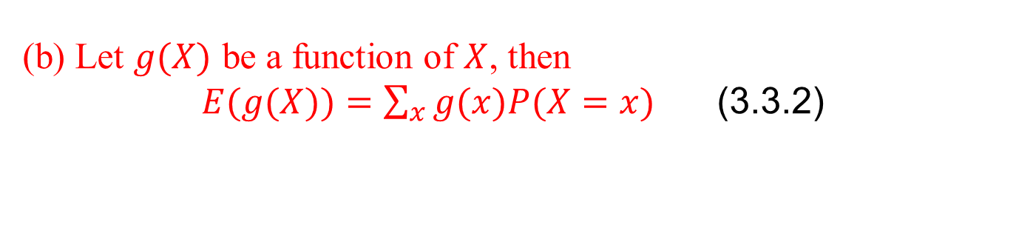
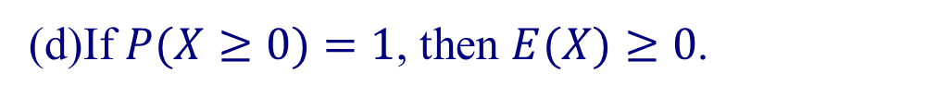
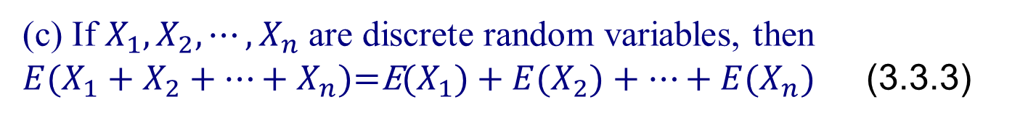

The expectation of discrete random variables has the following properties
Theorem 3.3.1 Let X be a discrete random variable, then (assume all expectations exist):
(a) If $P(X=a)=1$ for some constant $a∈R$, then $E(X)=a$.
(b) Let $g(X)$ be a function of $X$, then
$E(g(X))=\sum_{x}{g(x)P(X=x)}$ (3.3.2)
(c) If $X_{1},X_{2},⋯,X_{n}$ are discrete random variables, then
$E(X_{1}+X_{2}+⋯+X_{n})\text{=}\text{E}(X_{1})+E(X_{2})+⋯+E(X_{n})$ (3.3.3)
(d)If $P(X≥0)=1$, then $E(X)≥0$.
(e) If $P(X≥0)=1$ and $E(X)=0$, then $P(X=0)=1$.
(f) For any constant $b$, $E\left(bX\right)=bE\left(X\right) (3.3.4)$
(g)Schwarz’s inequality. Let X,Y be random variables, then ${ \left(E(XY)\right)}^{2}≤E(X^{2})E(Y^{2})$ (3.3.5)
The equality holds iff $P(X=0)=1$ or $P(Y=aX)=1$ for some constant a.

Slide 20


2．Variance
Except the expectation of a random variable, we are interested in some other quantities related to a random variable. Let’s consider an example.
Example
A cigarette manufacturer tests tobaccos grown from two districts for nicotine contents, obtains the following results
District 1 24, 27, 25, 22, 22 (in milligrams)
District 2 28 ,27, 25, 20, 20
The average nicotine content for both district are the same：
24 milligrams.
But the manufacturer prefer the tobaccos from district 1, because it has smaller dispersion than district 2, i.e., it is more stable.
To measure the dispersion of a data set $X_{1},X_{2},⋯X_{n}$, whose average is $\overline{X}=\frac{1}{n}(X_{1}+X_{2}+⋯+X_{n})$, we use the quantity “variance”, denote by $σ^{2}$, is defined as
$$σ^{2}=\frac{1}{n}\sum_{i=1}^{n}{{\left(X_{i}−\bar{X}\right)}^{2}}$$

Slide 21




For example, if $σ_{1}^{2}$ and $σ_{2}^{2}$ are the variances of nicotine constant for the district 1and 2, resp., then
$$σ_{1}^{2}=3.6$$
$$σ_{2}^{2}=11.6$$
For many purpose it is desirable that a measure of dispersion be expressed in the same unit as the original data, thus the square root of the variance, called standard deviation is used.
Thus for the data set $X_{1},X_{2},⋯X_{n}$, the standard deviation is
$$σ={\left(\frac{1}{n}\sum_{i=1}^{n}{{\left(X_{i}−\bar{X}\right)}^{2}}\right)}^{\frac{1}{2}}$$
To measure the dispersion of random variables, we also use the quantity variance and standard deviation.

Slide 22



Definition 3.3.2 Let $X$ be a discrete random variable, having expectation $E(X)=μ$. Then the variance of $X$, denote by $D(X)$ is defined as the expectation of the random variable $(X−μ)^{2}$
$D\left(X\right)=E\left({\left(X−μ)\right.}^{2}\right)$ (3.3.6)
The square root of the variance $D(X)$, denote by $\sqrt{D(X)}$, is called the standard deviation of $X$:$\sqrt{D(X)}={\left(E{\left(X−μ\right)}^{2}\right)}^{\frac{1}{2}}$ (3.3.7)

Slide 23

The variance of random variable has the following properties.
Theorem 3.3.2 For a discrete random variable X,
(a)$D\left(X\right)=E\left(X^{2}\right)−{\left(E\left(X\right)\right)}^{2} (3.3.8)$
(b) $D(aX+b)=a^{2}D(X)$, $a,b$ are constants. (3.3.9)
(c ) If $D(X)=0$, then $P(X=E(X))=1$, i.e. $X$ is a constant.

Slide 24






Example 3.3.4 A dice is tossed. Find the variance and standard deviation of the spots $X$ shown, if
(a)this die is a fair dice, i.e. the probability distribution of $X$ is
$P(X=k)=\frac{1}{6}$, $k=1,2,⋯,6.$
(b)the probability distribution of $X$ is
X | 1 | 2 | 3 | 4 | 5 | 6
P(X=k) | 0.1 | 0.1 | 0.1 | 0.2 | 0.2 | 0.3
Solution
(a) $E(X)=\frac{7}{2}$.
$$D\left(X\right)=E\left(X^{2}\right)−{\left(E\left(X\right)\right)}^{2}=\sum_{k=1}^{6}{k^{2}}⋅P\left(X=k\right)−{\left(\frac{7}{2}\right)}^{2}=\frac{35}{12}$$
$$\sqrt{D\left(X\right)}=\sqrt{\frac{35}{12}}$$

Slide 25


(b)$E(X)=1⋅0.1+2⋅0.1+3⋅0.1+4⋅0.2+5⋅0.2+6⋅0.3=4.2$
$$E\left(X^{2}\right)=\sum_{K=1}^{6}{k^{2}P\left(X=k\right)}=20.4$$
$$D\left(X\right)=E\left(X^{2}\right)−{\left(E\left(X\right)\right)}^{2}=20.4−4.2^{2}=2.76$$
$$\sqrt{D\left(X\right)}=1.66$$

Slide 26

3.4 Binomial Distributions
An experiment often consists of repeated trials, each with two possible outcomes “success” and “failure”. The most useful application deals with the testing of items as they come off an assembly line, where each test or trial may indicate a defective or a non-defective item. We may choose to define either outcome as a success. The process is referred to a Bernoulli process. Each trial is called a Bernoulli trial.
Consider an experiment consists of $n$ independent repeated trials, each trials result in two outcomes “success” and “failure”, and the probability of success, denote by $p$, remains constant. Then this process is called a Bernoulli process.

Slide 27


Definition 3.4.1 The number $X$ of successes in $n$ Bernoulli trials is called a binomial random variable. The probability distribution of this discrete random variable is called the binomial distribution with parameters $n$ and $p$ , denoted by $B(n,p)$.
The random variable in Example 3.2.2 is an example of binomial random variable.
Theorem 3.4.1 The probability distribution of the binomial distribution with parameters n and p is given by
$P\left(X=k\right)=b\left(k , n , p\right)=C_{n}^{k}p^{k}{\left(\left(1−p）\right.\right)}^{n−k}$
$k=0,1,2,⋯,n$ （3.4.1）

Slide 28


Let $q=1−p$,
the binomial expansion of the expression $(q+p)^{n}$ gives
$$1=\left({\left.q+p\right)}^{n}=C_{n}^{0}q^{n}+C_{n}^{1}pq^{n−1}+⋯+C_{n}^{n}p^{n}\right.$$
$=b(0;n,p)+b(1;n,p)+⋯+b(n;n,p)$.
Each term correspond to various values of binomial distribution, this is the reason that we called it “binomial distribution”.

Slide 29


Example 3.4.1 It is known that 15% of certain articles manufactured are defective, what is the probability that in a random sample of 5 articles
(a ) exactly 2 are defective.
(b) at least 2 are defective.
Solution In this case, $n=5,$ $p=0.15$.
(a) The probability is
$b(2;5,0.15)=C_{5}^{2}(0.15^{2})(0.85^{3})=0.1382$.
(b)The desired probability is the sum of getting 2, 3, 4, 5 defective articles, or, we may first find the probability of the complement event, i.e., getting $0$ or 1 defective article. So, if we denote the number of defective articles by $X$, then we have
$P(X≥2)=1−P(X≤1)=1−0.85^{5}−C_{5}^{1}(0.15)(0.85^{4})=0.1648$.

Slide 30





Example 3.4.2 A man is able to hit a target 7 times of 10 on the average.
(a) Find the probability that he hits the target exactly 3 times in 6 shots;
(b) In how many shots the probability that he hits the target at least one time is greater than 0.95?
Solution (a) The probability is
$b(3;6,0.7)=C_{6}^{3}(0.7^{3})(0.3^{3})=0.1852$.
(b) In $n$ shots, the probability that he hits at least one time is
$1−b(0;n,0.7)=1−0.3^{n}$.
Since when $n≥3$, we have
$1−0.3^{n}≥0.95$,
so in 3 shots, the probability that he hits the target at least one time is
$1−0.3^{3}=0.973>0.95$.

Slide 31


Now we give the expectation and variance of binomial distribution.
Theorem 3.4.2 The expectation and variance of a binomial random variable X with parameters n and p are given by
$E(X)=np,$ $D(X)=np(1−p)$. (3.4.2)
Example 3 The probability that a patient recovers from a rare blood disease is 0.4. If 15 people are known to have contracted this disease,
How many of the 15 patients would be expected to recover?
(b) What the variance of the number of patients recover among the 15?
Solution :
Let X is the number of patients recover among the 15,
X ~ b(x; 15, 0.4)
(a)
$$μ=E(X)=15×0.4 \text{=} 6$$
(b)
$${ σ}^{2 }=D(X)=15×0.4×0.6 \text{=} 3.6$$

Slide 32



3.5 poisson distribution
Definition 3.5.1 A discrete random variable X is called a Poisson random variable, if it takes values from the set $\{0,1,2,⋯\}$, and if
$P(X=k)=p(k;λ)=\frac{λ^{k}}{k!}⋅e^{−λ}$ , $λ>0$ $k=0,1,2,⋯$ (3.5.1)
Distribution (3.5.1) is called the Poisson distribution with parameter λ, denoted by $P(λ)$.
Note that
$\sum_{k=0}^{∞}{P(X=k)}=\sum_{k=0}^{∞}{\frac{λ^{k}}{k!}e^{−λ}}=e^{−λ}\sum_{k=0}^{∞}{\frac{λ^{k}}{k!}}=e^{−λ}⋅e^{λ}=1$.

Slide 33
Here are some examples of Poisson random variables:
(a) the number of radioactive particles passing through a counter in certain time period;
(b) the number of telephone calls received by an office in certain time period;
(c) the number of bacteria in a given culture;
(d) the number of typing errors per page in a certain book.

Slide 34


Example 3.5.1
From a laboratory experiments, it is known that the number $X$ of radioactive particles passing（放射性粒子） through a counter in a given millisecond is a Poisson random variable with parameter $λ=4$. What is the probability that 6 particles enter the counter in a given millisecond?
Solution The probability is
$p(6;4)=\frac{4^{6}}{6!}⋅e^{−4}=0.1042$.

Slide 35



Example 3.5.2
The number $X$ of oil tankers arriving each day at a certain port is a Poisson random variable with parameter 10. What is the probability that on a given day no more than 3 tankers having arrived?
Solution. The probability is
$$P=\sum_{k=0}^{3}{p\left(k ; 10\right)}=\sum_{k=0}^{3}{\frac{10^{k}}{k!}e^{−10}}$$
$=e^{−10}\left(1+10+\left(\frac{1}{2}\right)10^{2}+\left(\frac{1}{6}\right)1000\right)=$0.0103

Slide 36





Theorem 3.5.1 The expectation and variance of a Poisson random variable $X$ with parameter $λ$ are, respectively,
$E(X)=λ$ and $D(X)=λ$. （3.5.2）
Example Find the mean and variance of the random variable X in Example 3.5.1.
X is the number of tankers arriving each day.
Solution :
X ~ p(x; 4)，
$λ\text{=}\text{4}$，
$$μ=E(X)=4$$
$${ σ}^{2}=D(X)=4$$

Slide 37

Theorem 3.5.2
Let $X$ be a sequence of binomial random variables with probability distribution $b(k;n,p_{n})$. If for some constant $λ$, we have $np_{n}→λ$ when $n→∞$, and $p_{n}→0$, then
$b(k;n,p_{n})→p(k;λ)$, when $n→∞$, and $p_{n}→0$.

Slide 38



Example 3.5.4 Suppose that, on average, 1 person in 1000 makes a numerical error in preparing his or her income tax return. If 5000 forms are selected at random and examined, find the probability that 6, 7 or 8 of the forms contain an error.
Solution Let $X$ be the number of forms contain an error, then $X$ has the binomial distribution of parameter $n=5000$ and $p=0.001$.
Using Poisson distribution as approximations, we have
$b(6;5000,0.001)≈p(6,5)=\frac{5^{6}}{6!}⋅e^{−5}=0.1462$;
$b(7;5000,0.001)≈p(7,5)=\frac{5^{7}}{7!}⋅e^{−5}=0.1044$;
$$b\left(8 ; 5000,0.001\right)≈p\left(8,5\right)=\frac{5^{8}}{8!}⋅e^{−5}=0.0653$$

