Slide 1
6. Fundamental Sampling Distributions and Data Descriptions

Slide 2


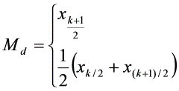



6.1 Analysis of Data
Mean
Median
Mean Deviation
Variance
Standard Deviation

Slide 3
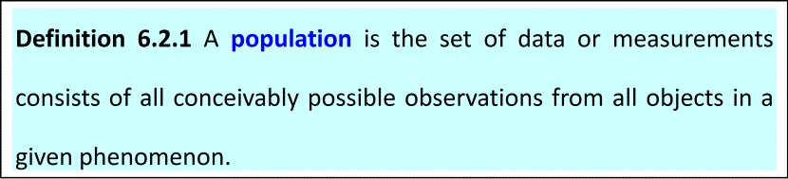
6.2 Random Sampling
Sampling is one of the most important concepts in the study of statistics. We need the fundamental ideas of populations and samples before studying particular statistical descriptions.

Slide 4
A population may consist of finitely or infinitely many varieties. For example, in the study of the grade of Calculus course in some university of the year 2006, the grades of all the students who took this course constitute the population.
This is a finite population. A example is the study of the length of newborns in China.
The population is then the all possible lengths of the newborns in China, in the past, now or in the future. Such population is an infinite one.
Since in many cases we are not able to investigate a whole population we are obliged to get conclusions regarding a population from its samples.

Slide 5
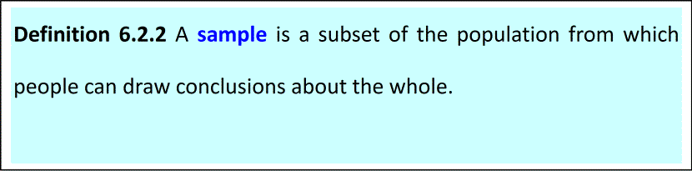
The process of performing an experiment to obtain a sample from the population is called sampling.
The purpose of the sampling is to find out something about the nature of the population.

Slide 6
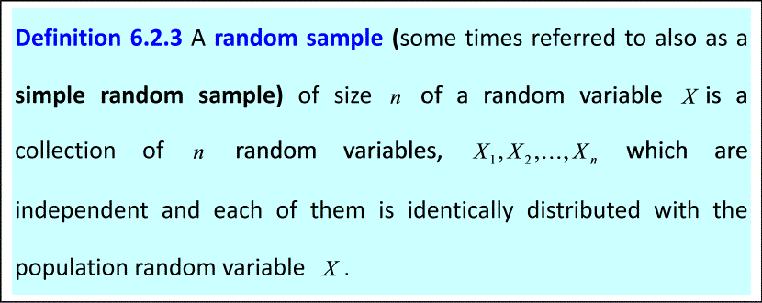




If
is the value of the joint distribution of such a set
of random variables at ，
we can get that
（6.2.1）
in which
is the population distribution at

Slide 7
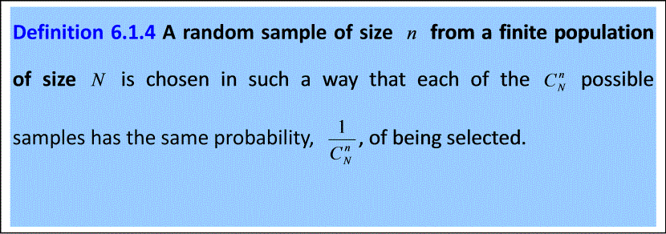

Slide 8
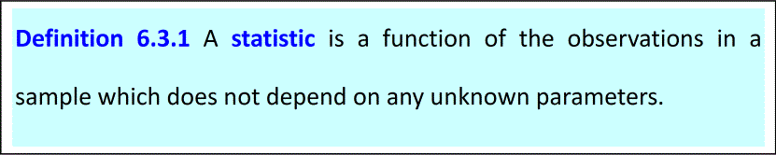
6.3 Statistics
We will discuss the definition of the word statistic and some commonly used statistics in this section.

Slide 9
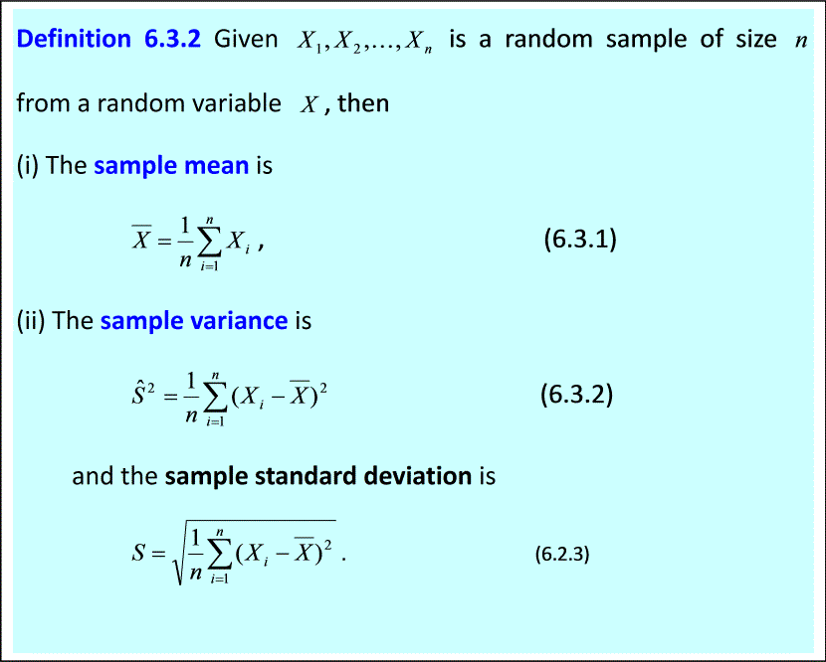

Slide 10


Remark:The sample variance is sometimes defined as
in some books.
Here,
and
are both random variables. Suppose a set of
values of observations of the random sample is
, then the
observation value of
and
are denoted as
In the future, normally we use capital letters to represent random variables and use small letters to represent the observation values.

Slide 11

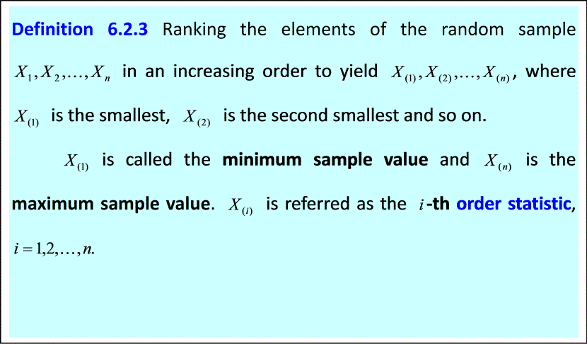
Theorem 6.3.1 If
is the sample variance that is defined in (6.3.2), then

Slide 12
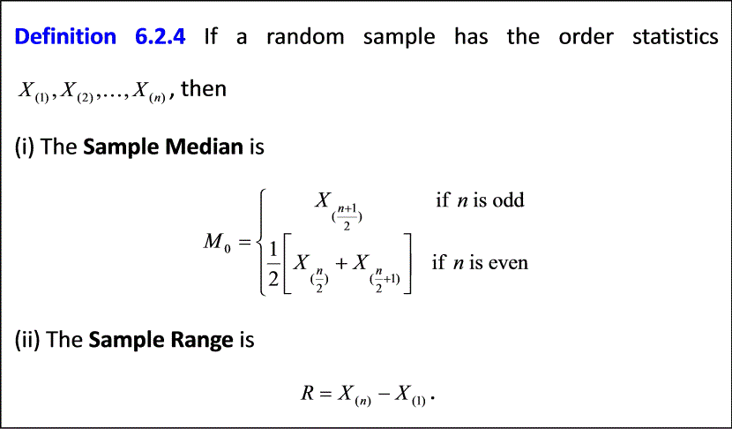
With the definition of the order statistics, we are able to introduce some more terms that are also useful and important.

Slide 13





Example 6.3.1
is a random sample of size 5. If an observation of this
sample yields the values 2, 5, 1, 4, 8. Then, we can get the value of
statistics as the following.
Sample mean:
Sample variance:
: 1, 2, 4, 5, 8
Sample median:
Sample range:

Slide 14



Example 6.3.2We are interested in the distribution of peoples’ age in some city. In our hand, we have a sample of the ages of 50 people who were randomly picked and the data are listed below:
35 23 48 21 15 36 12 3 14 54
21 43 92 15 32 5 71 55 62 24
64 78 50 11 9 43 28 25 34 15
22 30 51 88 16 75 22 27 41 33
45 61 35 28 43 59 38 90 70 6
Find the frequency table and draw the histogram.
Solution.
We find that the minimum sample value in this example is
and the maximum sample value is
So, we choose the range of the frequency table as
and divided it into10 classes: [0, 10), [10, 20), [20, 30), [30, 40), [40, 50),
[50, 60), [60, 70), [70, 80), [80, 90), [90, 100].

Slide 15
Then, we count the number of sample values in each class and get the following frequency table.
Age | Frequency
[0, 10) | 4
[10, 20) | 7
[20, 30) | 10
[30, 40) | 8
[40, 50) | 6
[50, 60) | 5
[60, 70) | 3
[70, 80) | 4
[80, 90) | 1
[90, 100] | 2
Table 6.3.1

Slide 16
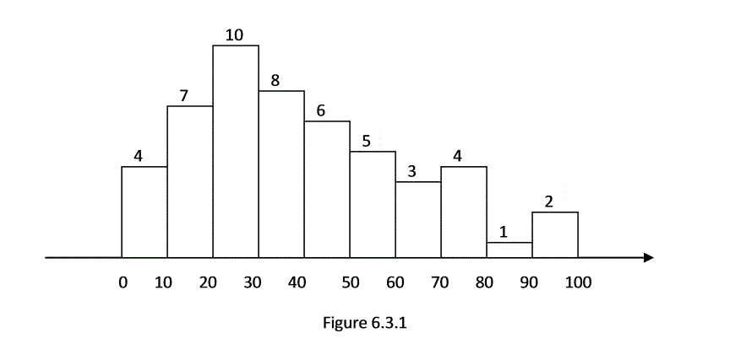
At last, using the horizontal axis to represent the classes and the vertical axis to represent the frequency, we can draw the histogram below.

Slide 17







In summery, for a random sample of size
, the process of drawing a
histogram is as following:
(1)Findthe minimum sample value
and maximum sample value
Decidethe number of classes
(usually between 5 and 20) and then
decide a fitting range
of the frequency table so that
is a little
less than
and
is a little bigger than
.
(2)Insert
points into
:
so that the
range
is divided into
equal length classes:
,
,
,
,
. The length of each class is
.
(3)Count for each class how many sample values are inside this class, and then get the frequency table.
(4)Using the horizontal axis to represent the classes and the vertical axis to represent the frequency, draw the histogram at last.

Slide 18
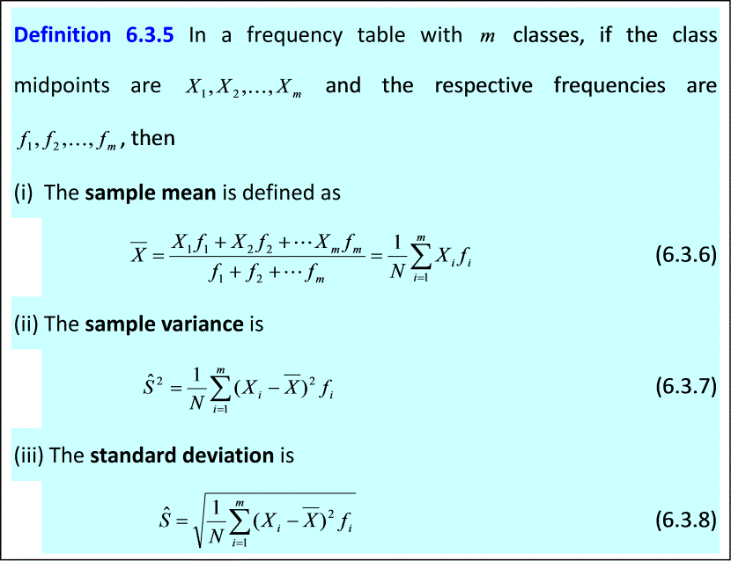

Slide 19

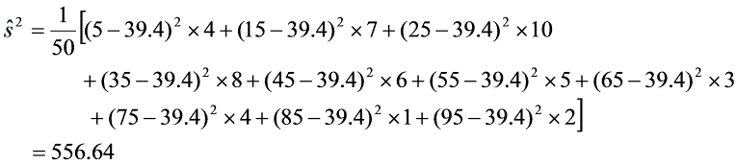
Example 6.3.3 Find the sample mean and the sample variance if we have a random sample that is given in Table 6.3.1.
Solution.By Definition 6.3.5, we get that

Slide 20









6.4 Sample Distributions
It should be kept in mind that a statistic, being computed from samples, is a random variable.
1．sampling distribution of the mean
Theorem 6.3.1 If
is mean of the random sample
of size
from a random variable
which has mean
and the variance
then
and
.
It is customary to write
as
and
as
.
Here,
is called the expectation of the mean.
is called the standard error of the mean.

Slide 21


This formula shows that the standard deviation of the distribution of
decreases when
, the sample size, is increased. It means that when
becomes larger, we can expect that the value of
to be closer to
.
Corollary 6.4.1If
is the mean of a random sample of size
from a population that is a normal distribution
, then
.

Slide 22
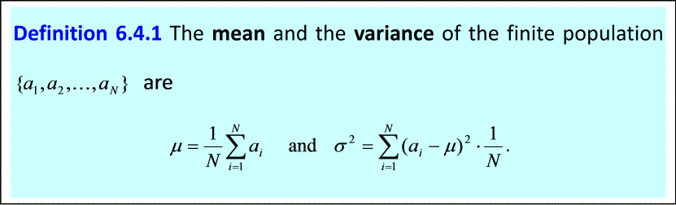

Theorem 6.4.3 If
is mean of a random sample
of size
From a finite population of size
with the mean
and the variance
then
and
.

Slide 23

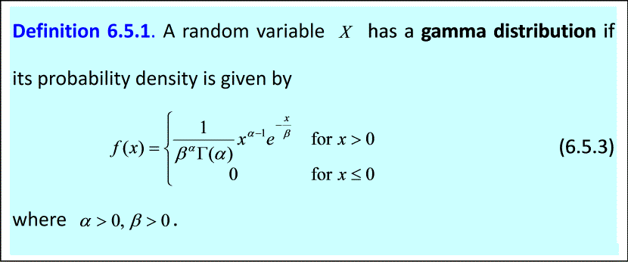




6.5 Chi-square Distributions
1．gamma distribution
gamma function
for
.
Gamma function has a few useful properties, such the recursion formula
Also, when
is a positive integer, we have
At last, an important special value is

Slide 24




Properties
Theorem 6.5.1 The mean and the variance of the gamma distribution
are given by
and
Theorem 6.5.2 If
are independent random variables and
, then
The gamma densities with several special values of
and
are shown in
Figure 6.5.1. The readers can get some idea about the shape of the gamma distribution.

Slide 25
Figure 6.4.1: Graphs of gamma distribution

Slide 26

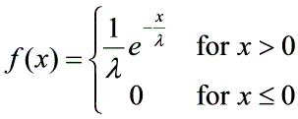



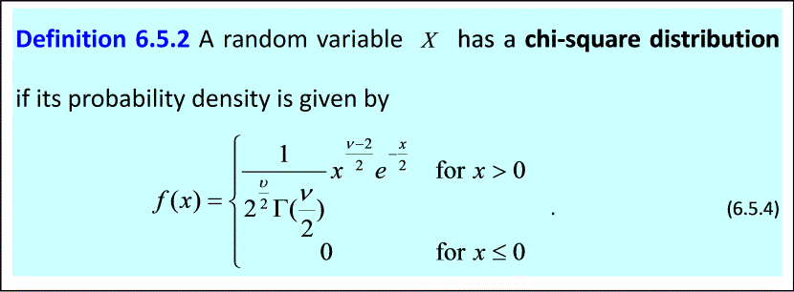
（1）
and
----exponential distribution
the probability density of
is
（2）
and
----chi-square distribution
the parameter
-----degree of freedom

Slide 27
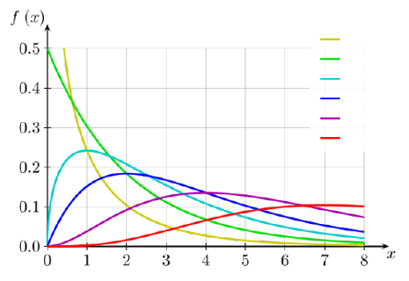

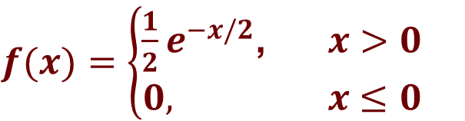

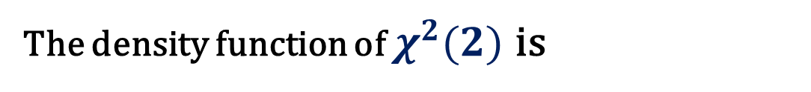




$$v=1$$
$$v=2$$
$$v=3$$
$$v=4$$
$$v=6$$
$$v=9$$
PDF of Chi-squared distributions
$f(x)$ $=\left\{\begin{aligned}\frac{1}{2}e^{−x/2}\text{, } x>0 \\ 0, x≤0\end{aligned}\right.$
The density function of $χ^{2}(2)$ is
$χ^{2}(2)$ is exponential distribution with parameter 2，Exp (2).

Slide 28



We will write
if
is a random variable which follows
a chi-square distribution with the degree of freedom
Corollary 6.5.1 The mean and the variance of the chi-square distribution
is given by
and

Slide 29


The chi-square distribution is closely related to the normal distribution and has many important applications in statistics. Let us list several meaningful properties below.
Theorem 6.5.3 Let
has the standard normal distribution
Then
follows the chi-square distribution with degree of freedom
, in short,
.
Theorem 6.5.4 If
are independent random variables
that each of them has standard normal distribution
, then

Slide 30


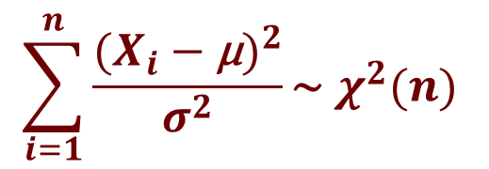

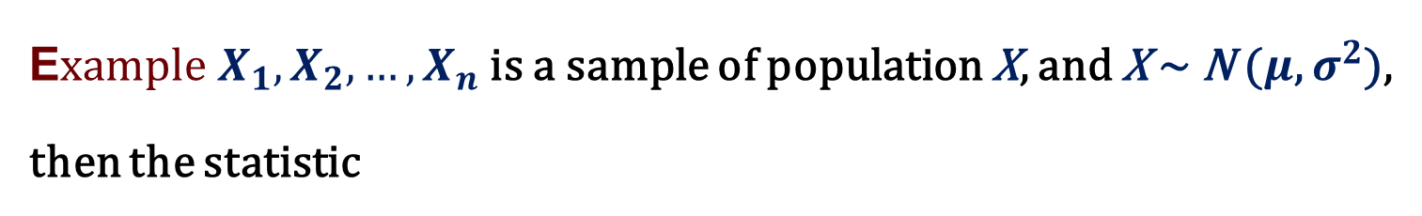

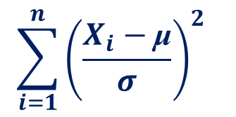

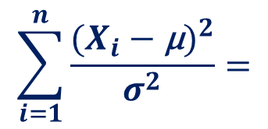

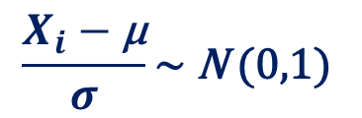
E$xample X_{1},X_{2},…{,X}_{n}$ is a sample of population X, and X ~ N ($μ$, $σ^{2}$), then the statistic
$$\sum_{i=1}^{n}{\frac{({X_{i}−\text{μ})}^{2}}{{ σ}^{2} }\text{\sim } χ^{2}(n) }$$
$$\frac{X_{i}−\text{μ}}{σ}\text{\sim } \text{N} \text{(0,1)}$$
proof :
X ~ N ($μ$, $σ^{2}$)
$X_{i}$ ~ N ($μ$, $σ^{2}$)
$$\sum_{i=1}^{n}{\frac{({X_{i}−\text{μ})}^{2}}{{ σ}^{2} }=}$$
$$\sum_{i=1}^{n}{{\left(\frac{X_{i}−\text{μ}}{σ}\right)}^{2} }$$
$$\text{\sim } χ^{2}(n)$$

Slide 31







Theorem 6.5.5 If
are independent random variables and
for
, then
Theorem 6.5.6 Suppose
and
are two independent random
variables. If
and
with
. Then
Theorem 6.5.7 Suppose
and
are the sample mean and the
sample variance of a random sample of size
from a population that
follows a normal distribution
. Then
(i)
and
$${\hat{S}}^{2}$$
are independent, and
(ii)
$$\frac{{n\hat{S}}^{2}}{σ^{2}}\sim χ^{2}(n−1)$$

Slide 32





6.6 Student’s Distributions (t-Distribution)
Consider the case that a random sample of size
from a normal
population with the mean
and the variance
. In Corollary 6.3.1,
we know that the random variable
is also a normal distribution
Furthermore,
(6.6.1)
Of course this is an important conclusion in statistics. However, in application, the population standard deviation
is usually unknown.
Therefore, people start to seek a replacement of
with an estimate.
Naturally, the sample standard deviation
seems to be a good choice.
Since in the later material, we will know that
, we replace
in (6.6.1) by
and it comes the problem:

Slide 33

What is the exact distribution of
for a random sample from a normal population?
This problem was originally studied by W.S. Gosset, who wrote under the pen name “student” because the company where he worked, Guiness’ Brewery in Dublin, did not allow publication by the employees. Gosset found that the quantities resulting from this substitution no longer follows normal distribution, instead, it satisfied a different type of distribution which has been called Student’s t-distribution since then. Let us first introduce a more general situation which leads to the formal definition of t-distribution.

Slide 34


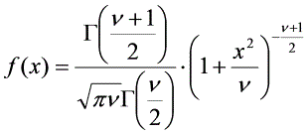

1．Student’s distribution
Theroem 6.6.1 Let
be a standard normal random variable and
be a
random variable with
degree of freedom such that
and
are independent, then the random variable
has density function
for
and it is called the t-distribution with
degrees of freedom.
We omit the detailed proof which is above the requirement of this book. If a random distribution has the t-distribution with degrees of freedom, we will write
for short.

Slide 35
Figure 6.6.1

Slide 36

Figure 6.6.1 includes the graphs of standard normal distribution, t-distributions with 1 and 5 degrees of freedom. We can see that the curves of t-distributions resemble in general shape the normal distribution. Also, as increases, the t-distribution will get closer to the normal distribution. In fact, the standard normal distribution can be considered to be the limiting case for the
distributions, that is,
.
With the help of Theorem 6.6.1, we are now able to obtain
the distribution of
which is the problem raised in the
beginning of this section. It is treated in the following theorem.

Slide 37
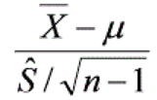




Theorem 6.6.2 Suppose that
and
are the mean and the variance
of a random sample of size
from a population which is a normal
distribution
. Then
has the t-distribution with
degrees of freedom. In short,
$$\sim t(n−1)$$
Let be a -distribution with degrees of freedom , find the value
such that
(a)
, when
;
(b)
, when
.

Slide 38
6.7 F-Distribution
In this section, we will study another important distribution in practical applications of statistics, the F-distribution. It helps us to deal with the comparison of the variability of two samples. In order to obtain the F-distribution, we consider the ratio of two independent chi-square random variables, each divided by its own degrees of freedom. The distribution of this radio is presented in the following theorem.

Slide 39



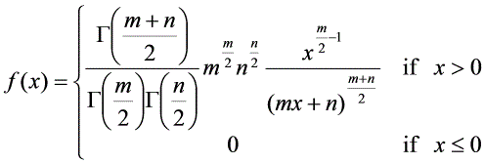
Theorem 6.7.1 Let
and
be two independent random variables such
that
and
. Then the random variable
has the density function
and it is called F-distribution with degrees of freedom
and
.

Slide 40

Theorem 6.7.1 is often applied in the cases when we are interested in comparing the variances of two normal populations or two samples from normal populations. For example, we may need to estimate the ratio
Or, in many cases we need to check whether

Slide 41








We already know, from Theorem 6.5.7, that if
is the variance of
a random sample of size
from a normal population with variance
, and
is the variance of a random sample of size
From a
normal population with variance
, then
Suppose that these two samples are independent random samples, which means that all the random variables in these two random samples are independent. Then these two chi-square random variables are also independent. Replacing and in Theorem 6.6.1 by
and
leads to the following important conclusion.

Slide 42
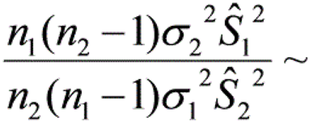

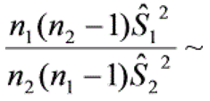
Theorem 6.7.2 Let and be the variance of two independent random samples of size and from two normal populations with the variance and . Then,
There is a special case when the two random samples are from a same normal population. Thus,
and we have the result below.
Corollary 6.7.1 Suppose that and are the variance of two independent random samples of size and from a normal population, then

Slide 43

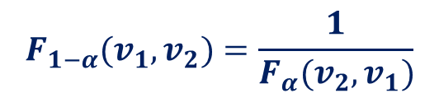
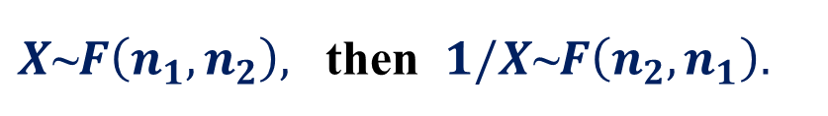
F-properties
$X\text{\sim }F\left(n_{1},n_{2}\right),$ then $1/X\text{\sim }F\left(n_{2},n_{1}\right).$
$$F_{1−α}{(v}_{1},v_{2})=\frac{1}{F_{α}{(v}_{2},v_{1})}$$
Find

