Slide 1
7. Estimation Problems

Slide 2

7.1 Point Estimate
1. concept
Estimation is one of the most important problems in statistics.
Why----the distribution depends on the parameter.
Normal distribution
Problems of estimation include
(1)determining parameters of a population from the random samples, estimating the mean or variance of a population by sampling,
(2)how to judge if such estimation is a “good” one.
Point Estimation-----use the value of a statistic to estimate a parameter

Slide 3

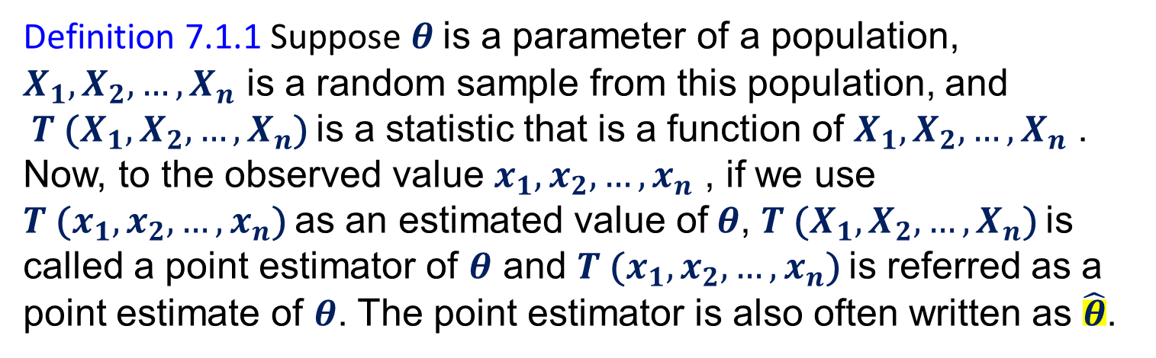
Definition 7.1.1 Suppose $θ$is a parameter of a population, $X_{1},X_{2},…{,X}_{n}$ is a random sample from this population, and $T$($X_{1},X_{2},…{,X}_{n}$) is a statistic that is a function of $X_{1},X_{2},…{,X}_{n}$ . Now, to the observed value $x_{1},x_{2},…{,x}_{n}$ , if we use $T$($x_{1},x_{2},…{,x}_{n}$) as an estimated value of$θ$, $T$($X_{1},X_{2},…{,X}_{n}$) is called a point estimator of $θ$ and $T$($x_{1},x_{2},…{,x}_{n}$) is referred as a point estimate of $θ$. The point estimator is also often written as $\hat{θ}$.
For example, if we use $\overline{X}$ to estimate the parameter $λ$ of a Poisson population, $\overline{X}$ is then the estimator of$λ$ and $\overline{x}$ is a point estimate of the parameter$λ$.
Point estimation is not unique.

Slide 4

2.Judge
(1) Unbiased
(2) asymptotically unbiased
(3) minimum variance unbiased estimator.
Definition 7.1.2. A statistic $\hat{Θ}$ is said to be an unbiased estimator of the parameter θ if E ($\hat{Θ}$) = θ.

Slide 5


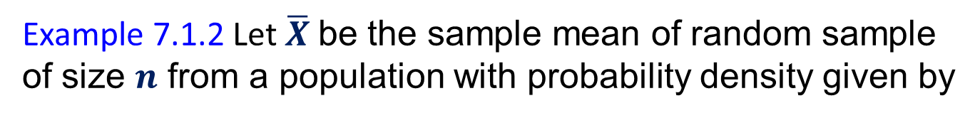
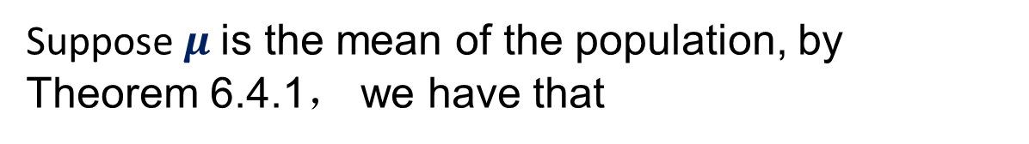

Example 7.1.2 Let $\overline{X}$ be the sample mean of random sample of size $n$ from a population with probability density given by
Show that $\overline{X}$ is a biased estimator of $ω$.
Proof.
Suppose$μ$is the mean of the population, by Theorem 6.4.1， we have that
Therefore,
$\overline{X}$ is a biased estimator of $ω$.

Slide 6
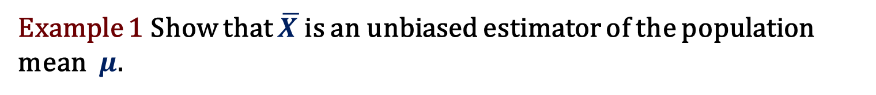
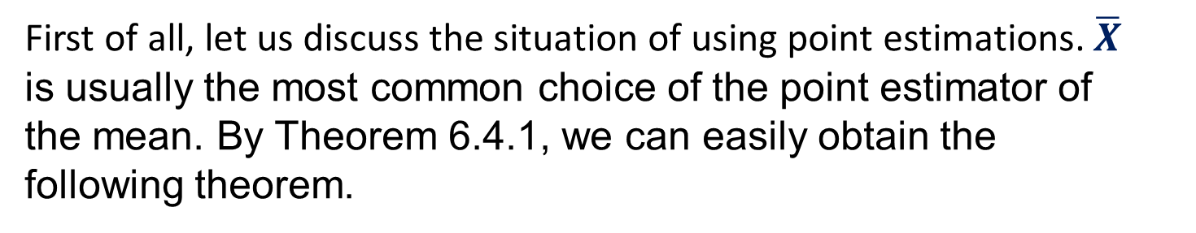
First of all, let us discuss the situation of using point estimations. $\overline{X}$ is usually the most common choice of the point estimator of the mean. By Theorem 6.4.1, we can easily obtain the following theorem.
Example 1 Show that $\overline{X }$is an unbiased estimator of the population
mean$μ$.

Slide 7

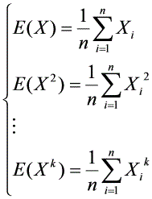

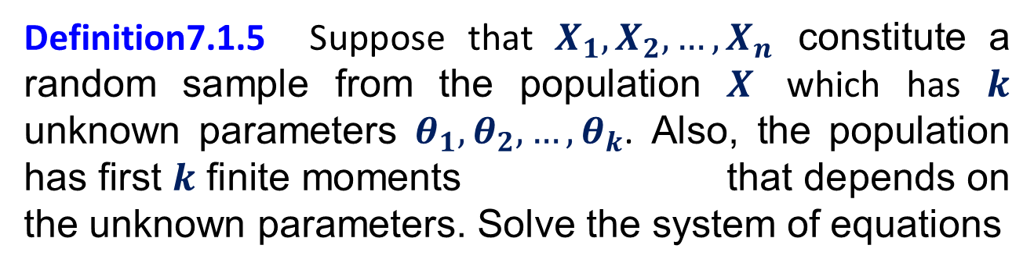
3. Method of Moments
Definition7.1.5 Suppose that $X_{1},X_{2},…{,X}_{n}$ constitute a random sample from the population $X$ which has $k$ unknown parameters $θ_{1},θ_{2},…{,θ}_{k}$. Also, the population has first $k$ finite moments that depends on the unknown parameters. Solve the system of equations
, (7.1.4)
for the unknown parameters expressed by the observations values, i.e.
for
Then
is an estimator of
By method of moments.

Slide 8
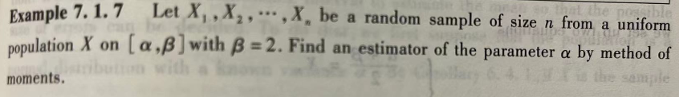



Slide 9





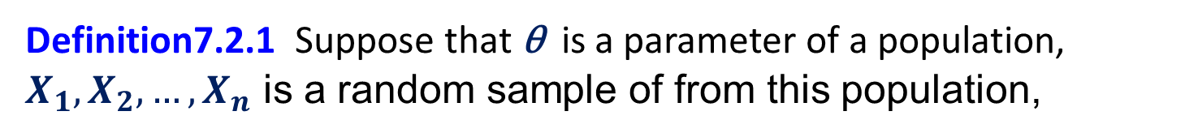
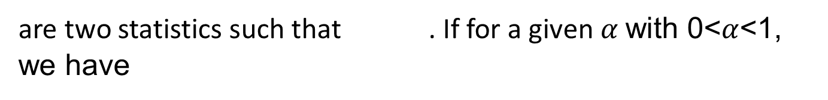
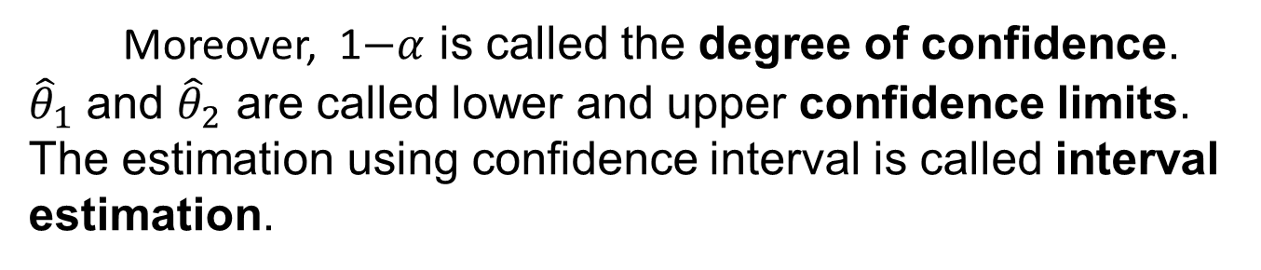
7.2 Interval Estimation
Definition7.2.1 Suppose that θ is a parameter of a population, $X_{1},X_{2},…{,X}_{n}$ is a random sample of from this population,
and
are two statistics such that . If for a given $α$ with 0<$α$<1, we have
Then we refer to as a confidence interval for θ.
Moreover, 1$−α$ is called the degree of confidence. ${\hat{θ}}_{1}$ and ${\hat{θ}}_{2}$ are called lower and upper confidence limits. The estimation using confidence interval is called interval estimation.

Slide 10
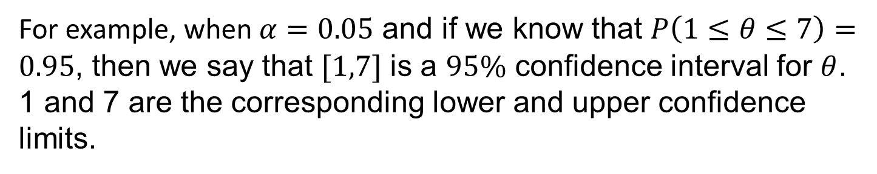
For example, when$α=0.05$ and if we know that $P\left(1≤θ≤7\right)=0.95$, then we say that $[1,7]$ is a $95\%$ confidence interval for $θ$. 1 and 7 are the corresponding lower and upper confidence limits.

Slide 11





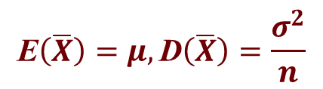







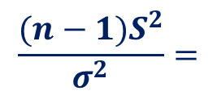


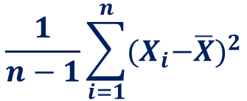

Summary for the Sampling Distributions of Normal Population
$$\frac{1}{n}\sum_{i=1}^{n}{X_{i}}$$
$$\text{E}\left(\overline{X}\right)=μ, \text{D}\left(\overline{X}\right)=\frac{σ^{2}}{n}$$
X ~ N ($μ$, $σ^{2}$),
Sample Mean:
$\overline{X}$ $=$
$$\frac{1}{n−1}\sum_{i=1}^{n}{{{(X}_{i}−\overline{X})}^{2}}$$
$$\text{Sample} \text{Variance}\text{:}$$
$S^{2}$ $=$
$$\text{E}\left(S^{2}\right)=σ^{2}$$
The Sampling Distribution of Sample Mean$\overline{X }$:
$$\frac{\overline{X}−μ}{σ/\sqrt{n}}$$
$$\frac{\overline{X}−μ}{S/\sqrt{n}}$$
~ $N\left(0\text{,} 1\right)$
~ $t(n−1)$
$σ^{2}$ is known
$σ^{2}$ is unknown, and replaced by it’s estimation $S^{2}$
$\text{T}\text{he} \text{Sampling} \text{Distribution} \text{of} {\text{Sample} \text{Variance} S}^{2}$:
$$\sum_{i=1}^{n}{\frac{({X_{i}−\text{μ})}^{2}}{{ σ}^{2} }\text{\sim } χ^{2}(n) }$$
$$\frac{(n−1)S^{2}}{{ σ}^{2} }=$$
$$\sum_{i=1}^{n}{\frac{({X_{i}−\overline{X})}^{2}}{{ σ}^{2} }}$$
~ $χ^{2}(n−1)$
μ is known
μ is unknown, and replaced by it’s estimation$\overline{X}$
We can use the sampling distribution of Sample Mean$\overline{X}$ and${ \text{Sample} \text{Variance} S}^{2}$ to make statistical inference about $\text{the} \text{mean} μ$and variance $σ^{2}$ of population $X$.

Slide 12

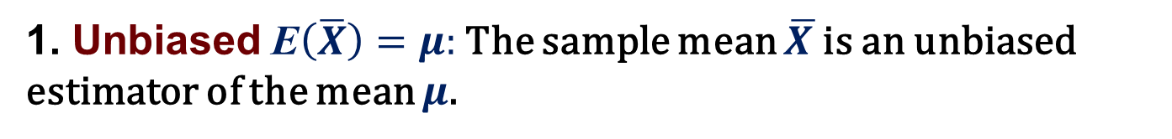
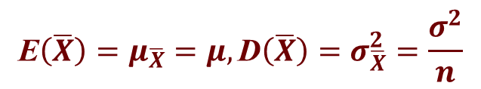


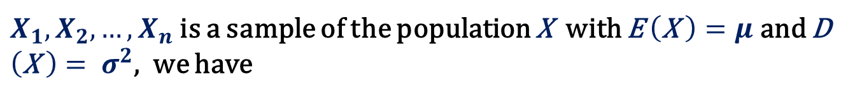


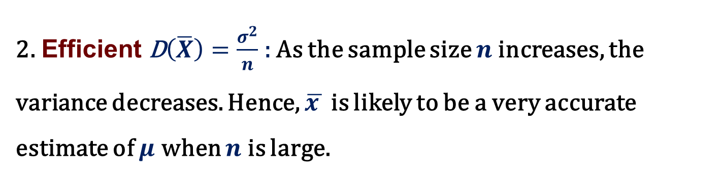

Point Estimation of the Mean$μ$
Point Estimator of the mean$μ$: The sample mean $\overline{X.}$
1. Unbiased$\text{E}\left(\overline{X}\right)=μ:$The sample mean $\overline{X }$is an unbiased estimator of the mean $μ$.
2. Efficient $\text{D}\left(\overline{X}\right)=\frac{σ^{2}}{n}$ : As the sample size $n$increases, the variance decreases. Hence, $\overline{x }$ is likely to be a very accurate estimate of $μ$ when $n$ is large.
$X_{1},X_{2},…{,X}_{n}$ is a sample of the population X with E $\left(\text{X} \right)=μ$ and D $\left(\text{X} \right)= σ^{2}$, we have
$${\text{E}\left(\overline{X}\right)=μ}_{\overline{X}}=μ, \text{D}\left(\overline{X}\right)=σ_{\overline{X}}^{2}=\frac{σ^{2}}{n}$$
and
$${\text{E}\left(S^{2}\right)=μ}_{S^{2}}=σ^{2}$$
$$\frac{1}{n}\sum_{i=1}^{n}{X_{i}}$$
$$\frac{1}{n−1}\sum_{i=1}^{n}{{{(X}_{i}−\overline{X})}^{2}}$$
where
$\overline{X}$=
$S^{2}$=

Slide 13
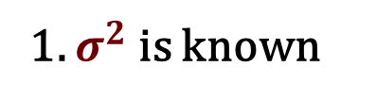
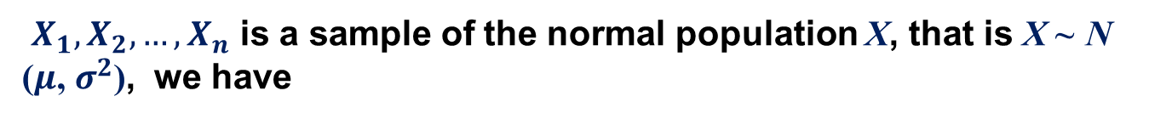



Interval Estimation of the Mean$μ$:${ σ}^{2}$ Known
The sampling distribution of $\overline{X }:$
1. $σ^{2}$ is known
$X_{1},X_{2},…{,X}_{n}$ is a sample of the normal population X, that is X ~ N ($μ$, $σ^{2}$), we have
$$μ_{\overline{X}}=μ, σ_{\overline{X}}^{2}=\frac{σ^{2}}{n}$$
$\overline{X}$ ~ $N\left(μ\text{,} \frac{σ^{2}}{n}\right)$
$Z=\frac{\overline{X}−μ}{σ/\sqrt{n}}$ ~ $N\left(0\text{,} 1\right)$
and

Slide 14
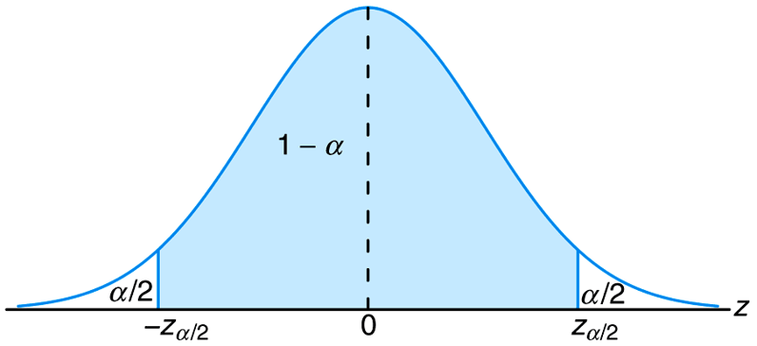


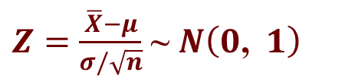

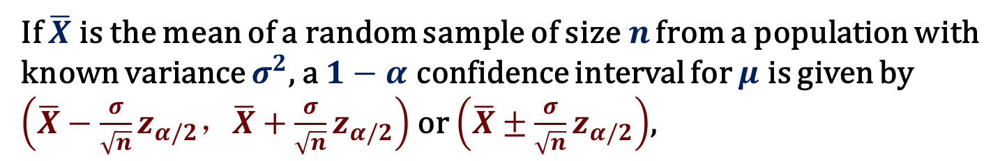


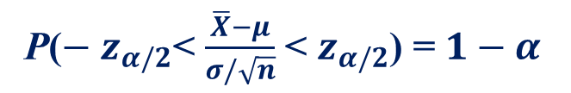
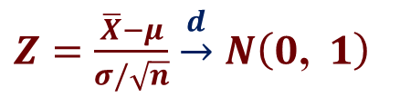


Confidence Interval on$μ$: $σ^{2}$ Known
$Z=\frac{\overline{X}−μ}{σ/\sqrt{n}}$ ~ $N\left(0\text{,} 1\right)$
$Z=\frac{\overline{X}−μ}{σ/\sqrt{n}}$ $\underset{→}{d}$ $N\left(0\text{,} 1\right)$
or
P($− z_{α/2}$< Z < $z_{α/2}$) = $1−α$
P($− z_{α/2}$< $\frac{\overline{X}−μ}{σ/\sqrt{n}}$ < $z_{α/2}$) = $1−α$
P($\overline{X}−z_{α/2}\frac{σ}{\sqrt{n}}$< $μ$<$\overline{X}+z_{α/2} \frac{σ}{\sqrt{n}}$) = $1−α$
Figure 1 P($− z_{α/2}$< Z< $z_{α/2}$) = $1−α$
$$P\left(\text{Z}<z_{α/2}\right)=1−α/2$$
If $\overline{X}$is the mean of a random sample of size$n$ from a population with known variance $σ^{2}$, a $1−α$ confidence interval for $μ$ is given by $\left(\overline{X}−{\frac{σ}{\sqrt{n}}z}_{α/2}，\overline{X}+\frac{σ}{\sqrt{n}}z_{α/2}\right)$ or $\left(\overline{X}±{\frac{σ}{\sqrt{n}}z}_{α/2}\right)$,
where $z_{α/2}$ is the $z$ -value leaving an area of $α/2$ to the right.

Slide 15




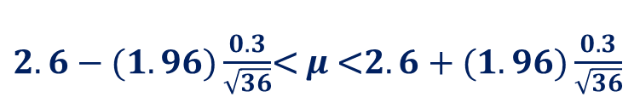














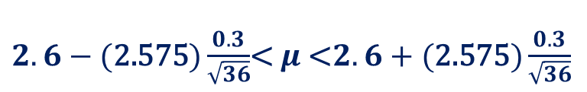






Example 1 The average zinc concentration recovered from a sample of measurements taken in 36 different locations in a river is found to be 2.6 grams per liter. Find the 95% and 99% confidence intervals for the mean zinc concentration in the river. Assume that the population standard deviation is 0.3 gram per liter.
$1−α$ confidence interval for $μ$： $\left(\overline{X}−{\frac{σ}{\sqrt{n}}z}_{α/2}，\overline{X}+\frac{σ}{\sqrt{n}}z_{α/2}\right)$
Solution :
The point estimate of$μ$ is $\overline{X}=2.6$,
$n=36, σ=0.3$.
(1)
1-$α$= 0.95
$α$= 0.05
$$z_{α/2}=z_{0.025},$$
$$P\left(\text{Z}<z_{0.025}\right)=0.975$$
$$z_{0.025}$$
$=\text{1.96}$.
Hence, the 95% confidence interval is
$2.6−(1.96)\frac{0.3}{\sqrt{36}}$< $μ$<$2.6+(1.96)\frac{0.3}{\sqrt{36}}$
$$2.50<μ<2.70.$$
(2)
1-$α$= 0.99
$α$= 0.01
$$z_{α/2}=z_{0.005},$$
$$P\left(\text{Z}<z_{0.005}\right)=0.995$$
$$z_{0.005}$$
$=\text{2.575}$.
Hence, the 99% confidence interval is
$2.6−(\text{2.575})\frac{0.3}{\sqrt{36}}$< $μ$<$2.6+(\text{2.575})\frac{0.3}{\sqrt{36}}$
$$2.47<μ<2.73.$$

Slide 16
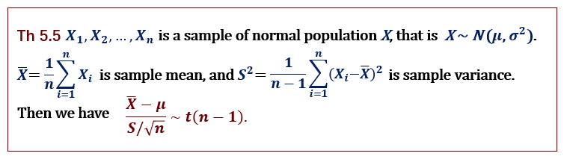

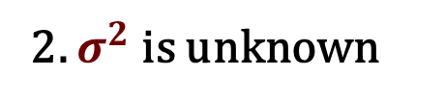
Interval Estimation of the Mean$μ$: $σ^{2}$ Unknown
the sampling distribution of $\overline{X }:$
2. $σ^{2}$ is unknown

Slide 17
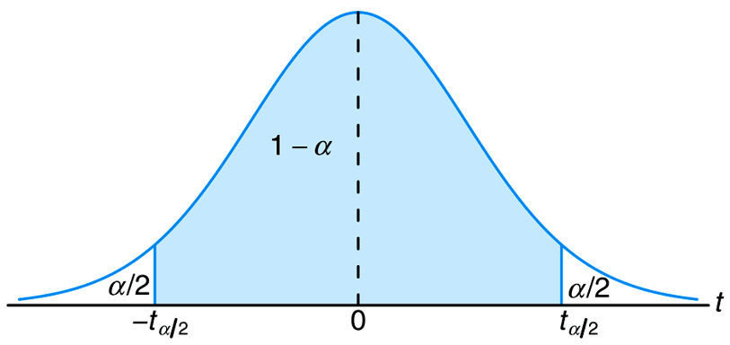
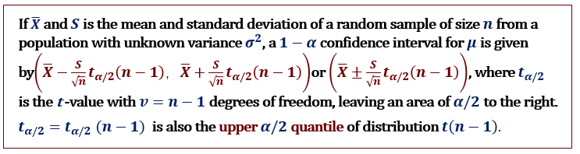

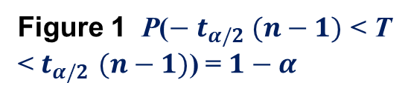

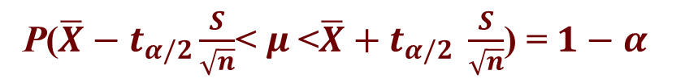

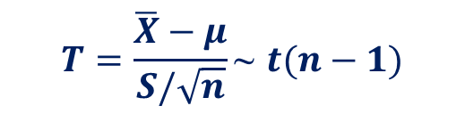


Confidence Interval on$μ$: $σ^{2}$ Unknown
$$T=\frac{\overline{X}−μ}{S/\sqrt{n}}\text{\sim } t(n−1)$$
P($− t_{α/2}$< T < $t_{α/2}$) = $1−α$
P($− t_{α/2}$< $\frac{\overline{X}−μ}{S/\sqrt{n}}$ < $t_{α/2}$) = $1−α$
P($\overline{X}−t_{α/2}\frac{S}{\sqrt{n}}$< $μ$<$\overline{X}+t_{α/2} \frac{S}{\sqrt{n}}$) = $1−α$
Figure 1 P($− t_{α/2}$ $(n−1)$< T < $t_{α/2}$ $(n−1)$) = $1−α$

Slide 18



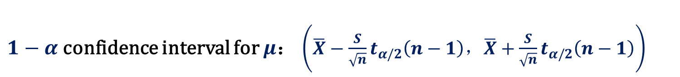



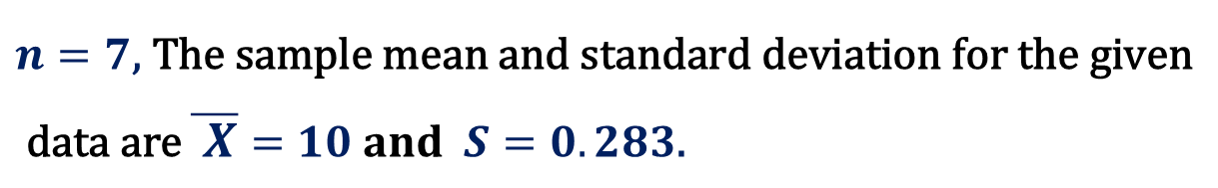

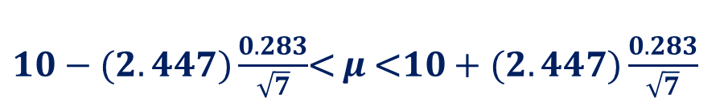

Example 3 The contents of seven similar containers of sulfuric acid are 9.8, 10.2, 10.4, 9.8, 10.0, 10.2, and 9.6 liters. Find a 95% confidence interval for the mean contents of all such containers, assuming an approximately normal distribution.
$1−α$ confidence interval for $μ$： $\left(\overline{X}−\frac{S}{\sqrt{n}}t_{α/2}\left(n−1\right)，\overline{X}+\frac{S}{\sqrt{n}}t_{α/2}\left(n−1\right)\right)$
Solution :
$$n=7\text{, }\text{The} \text{sample} \text{mean} \text{and} \text{standard} \text{deviation} \text{for} \text{the} \text{given}$$
$$\text{data} \text{are} \overline{ X}=10 and S=0.283\text{.}$$
1-$α$=0.95
$α$=0.05
$t_{α/2}{=t_{0.025} =t}_{0.025}(6)$
$$=2.447.$$
Hence, the 95% confidence interval is
$10−(2.447)\frac{0.283}{\sqrt{7}}$< $μ$<$10+(2.447)\frac{0.283}{\sqrt{7}}$
$$9.74<μ<10.26.$$

Slide 19
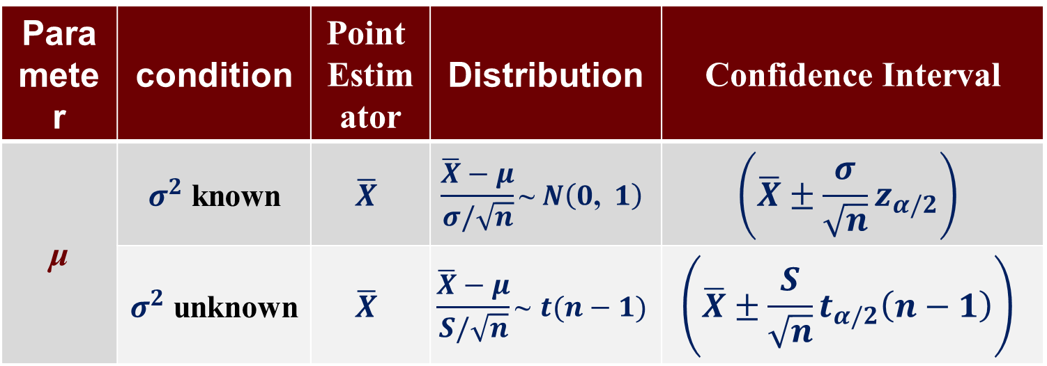
Summary for Estimating the Mean with Single Sample
Parameter | condition | Point Estimator | Distribution | Confidence Interval
μ | $σ^{2}$ known | $$\overline{X}$$ | $$\frac{\overline{X}−μ}{σ/\sqrt{n}}\text{\sim }N\left(0\text{,} 1\right)$$ | $$\left(\overline{X}±{\frac{σ}{\sqrt{n}}z}_{α/2}\right)$$
 | $σ^{2}$ unknown | $$\overline{X}$$ | $$\frac{\overline{X}−μ}{S/\sqrt{n}}\text{\sim } t(n−1)$$ | $$\left(\overline{X}±\frac{S}{\sqrt{n}}t_{α/2}\left(n−1\right)\right)$$

Slide 20
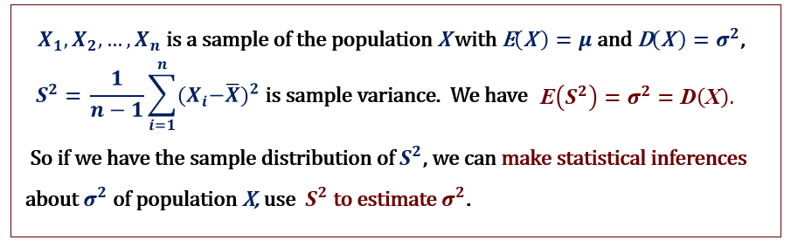

Point Estimation of the Variance${ σ}^{2}$
Point Estimator of the variance${ σ}^{2}$: The sample variance $S^{2}.$
Unbiased$\text{E}\left(S^{2}\right)={ σ}^{2}: S^{2}$ is an unbiased estimator of the variance ${ σ}^{2}$.

Slide 21



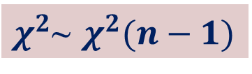

Interval Estimation of the Variance${ σ}^{2}$
the sampling distribution of${ S}^{2}:$
Th 5.4 If $S^{2}$ is the variance of a random sample of size n taken from a normal population having the variance ${ σ}^{2}$, then the statistic
$$χ^{2}=\frac{(n−1)S^{2}}{{ σ}^{2} }$$
$$=\sum_{i=1}^{n}{\frac{({X_{i}−\overline{X})}^{2}}{{ σ}^{2} }}$$
μ is unknown
has a chi-squared distribution with $v=n−1$ degrees of freedom.
$χ^{2}$~ $χ^{2}(n−1)$

Slide 22









Confidence Interval on$σ^{2}$
$\frac{(n−1)S^{2}}{{ σ}^{2} }$ ~ $χ^{2}(n−1)$
P (${ χ}_{1−a/2}^{2}\left(n−1\right)<\frac{(n−1)S^{2}}{{ σ}^{2} }<χ_{a/2}^{2}\left(n−1\right)$) = $1−α$
P ( $\frac{(n−1)S^{2}}{χ_{a/2}^{2}\left(n−1\right)}$<$σ^{2}$<$\frac{(n−1)S^{2}}{{ χ}_{1−a/2}^{2}\left(n−1\right)}$ ) = $1−α$
Figure 3 $P\left({χ_{1−\frac{α}{2}}^{2}(n−1)<χ}^{2}<χ_{\frac{α}{2}}^{2}(n−1) \right)=1−α$
If $s^{2}$ is the variance of a random sample of size$n$ from a normal population, a $1−α$ confidence interval for$σ^{2}$is given by, $\left(\frac{(n−1)S^{2}}{χ_{a/2}^{2}\left(n−1\right)}，\frac{(n−1)S^{2}}{{ χ}_{1−a/2}^{2}\left(n−1\right)}\right)$ .
where ${ χ}_{\frac{α}{2}}^{2}$ $(n−1)$ and${ χ}_{1−\frac{α}{2}}^{2}$ $(n−1)$ is the upper$α/2$and $1−α/2$quantile of distribution${ χ}^{2}(n−1).$

Slide 23
















Example 1 The following are the weights, in decagrams, of 10 packages of grass seed distributed by a certain company: 46.4, 46.1, 45.8, 47.0, 46.1, 45.9, 45.8, 46.9, 45.2, and 46.0. Find a 95% confidence interval for the variance of the weights of all such packages of grass seed distributed, assuming a normal population.
$1−α$ confidence interval for${ σ}^{2}$： $\left(\frac{(n−1)S^{2}}{χ_{a/2}^{2}\left(n−1\right)}，\frac{(n−1)S^{2}}{{ χ}_{1−a/2}^{2}\left(n−1\right)}\right)$
Solution :
$$n=10.$$
The point estimate of${ σ}^{2}$ is
$$\frac{1}{n(n−1)}\left[n\sum_{i=1}^{n}{X_{i }^{2}}−{\left(\sum_{i=1}^{n}{X_{i}}\right)}^{2}\right]$$
$$=\frac{10×21273.12−{461.2}^{2}}{10×9}=0.286.$$
$S^{2}$ $=$
$$χ_{\frac{α}{2}}^{2}\left(n−1\right)=χ_{0.025}^{2}\left(9\right)$$
$$=19.023,$$
1-$α$= 0.95
$α$= 0.05
$$χ_{1−\frac{α}{2}}^{2}\left(n−1\right)=χ_{0.975}^{2}\left(9\right)$$
$=2.7$.
Hence, the 95% confidence interval is
$\frac{(9)(0.286)}{19.023}$ $<σ^{2}< \frac{(9)(0.286)}{2.7 }$
$$0.135<σ^{2}<0.953.$$

Slide 24
7.4 Maximum Likelihood Estimation
The method of maximum likelihood in estimation which was introduced by R.A. Fisher is one of the most important methods of point estimation. This method is based on the idea that among all the possible estimations for a parameter the best choice is the one in which an observed result has the greatest probability.

Slide 25


A container has totally 5 beans inside it. These beans are green beans and red beans. Suppose that the number of green beans is either 2 or 4. If we pick up two beans randomly and find out that they are both green ones, which is the more reasonable number of the green beans, 2 or 4?
We can see that if the number of green beans is 2, then the probability of picking up two green beans is
If the number of green beans is 4, then the probability of picking up two green beans is
Since , we say that 4 is better choice than 2 for the estimation of number of green beans.

Slide 26




If, in this example, we don’t know any information about the number of green beans, what is the best choice for the number of green beans? We let $k$ represent the number of green beans. Then, for any given $k$， the probability of picking up two green beans is
and all the results of $p_{k}$ are listed in the following table.
Form the above table we can see that $k=5$ makes the largest probability of picking up two green beans so that we chose 5 as our estimation. Here, $k=5$ is called amaximum likelihood estimationof the number of green beans and such method is called themethod of maximum likelihood.

Slide 27



Thus, we find that when using the method of maximum likelihood we need to find a value for the unknown parameter under which the probability or probability density of getting the sample values is a maximum.
In the discrete case, suppose that an unknown parameter is $θ$ and the sample values are $x_{1},x_{2},…{,x}_{n}$. then the probability of getting these values is
(7.4.1)
which is the joint probability of the random variables $X_{1},X_{2},…{,X}_{n}$ at the values $x_{1},x_{2},…{,x}_{n}$ espectively. As the sample values are known, ${f(x}_{1},x_{2},…{,x}_{n};θ)$ is a function of$θ$.
In the continuous case, ${f(x}_{1},x_{2},…{,x}_{n};θ)$ in (7.5.1) represents the value of the joint probability density of the random variables $X_{1},X_{2},…{,X}_{n}$ at the values $x_{1},x_{2},…{,x}_{n}$ .

Slide 28


For a random sample of size $n$ , we can easily get the following theorem.

Slide 29






Theorem7.4.1 If the population has the probability function or density function $f(x;θ)$ and the sample is a random sample, then
(7.4.2)
The task of the maximum likelihood function is to find a value $θ$ to maximize the likelihood function. Such value is called a maximum likelihood estimate of$θ$.
Definition7.5.2 If there is a value $\hat{θ}$such that
for all$θ$, then $\hat{θ}$ is called a maximum likelihood estimate of$θ$.

Slide 30


We know that a necessary condition of $L\left(\hat{θ}\right)$ being amaximum valueis that $\frac{d}{dθ}L\left(\hat{θ}\right)$. A common technique in finding the maximum likelihood estimate of $θ$ is using $lnL\left(θ\right)$ rather than $L\left(θ\right)$ .
Since $lnx$ is a strictly increasing function in its domain, $L\left(θ\right)$ and $lnL\left(θ\right)$ reaches the maximum value at the same time. In many cases, it is much easier in finding the maximum value of $lnL\left(θ\right)$ than $L\left(θ\right)$. Thus, we often find the maximum likelihood estimate by setting $\frac{d}{dθ}L\left(θ\right)=0$ and then solve for $θ$.

Slide 31







Example7.4.1 Let $x_{1},x_{2},…{,x}_{n}$ be the values of a random sample from an exponential population with distribution defined in (4.5.1). Find the maximum likelihood estimator of its parameter $λ$.
Solution. The likelihood function in this example is
Thus,
and hence
Let $\frac{d}{dλ}L\left(λ\right)=0$ and solve for$λ$ to get the maximum likelihood estimate
which means the maximum likelihood estimator is

Slide 32




Example7.4.2 Let $x_{1},x_{2},…{,x}_{n}$ be the values of a random sample from a Poisson distribution
with
and
Find the maximum likelihood estimator of its parameter$λ$.
Solution. The likelihood function is
Therefore, let
which leads to
Therefore, the maximum likelihood estimator for a Poisson distribution is

Slide 33





Example7.4.3 Let $x_{1},x_{2},…{,x}_{n}$ be the values of a random sample of size $n$ from a normal population with the mean $μ$ and the variance $σ^{2}$. Find the maximum likelihood estimator of the two parameters $μ$ and$σ$.
Solution. The likelihood function for $μ$ and$σ$ is
so that
Let the partial differentiations of with respect to $μ$ and$σ$ equal to 0 and we have

Slide 34


The solution of the above system of equations is
which yields that the maximum likelihood estimators of $μ$ and$σ$ are
and

