Slide 1

Chapter 6：Binary tree

Slide 2
Main
6.1 Concept and property
6.2 Storage structure of BT
6.3 Binary Tree Traversals
6.4 Heap
6.5 Binary Search Tree
6.6 Balanced binary tree

Slide 3
6.1 Concept and property of BT
Binary tree T（二叉树 T ）defined:
  A limited set containing n (n ≥ 0) nodes (结点). When n = 0, called Null Binary Tree (空二叉树). Or Empty
  When n >0 ：
    （1）There is only a node called root；( 根 )
    （2）The other nodes of T form two disjoint binary tree T1 and T2
    T1 and T2 are called left sub-tree (左子树) and right sub-tree (右子树), respectively.
    The position of the left and right subtrees of each node in a binary tree cannot be reversed . If one or more of these positions are reversed , The tree will be another binary tree .

Slide 4
6.1 Concept and property of BT
As shown in figure
根结点
左子树
A
右子树
B
C
D
E
I
G
H
J

Slide 5


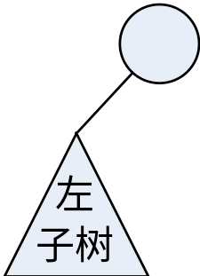
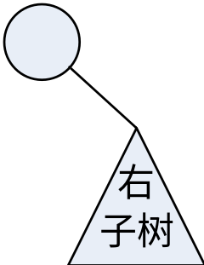
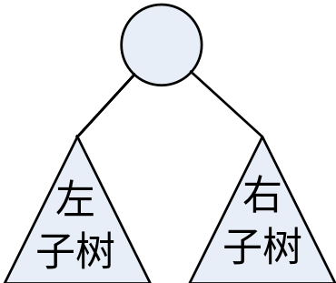
6.1 Concept and property of BT
Base Forms of BT
右子树为空
左子树为空
空二叉树
只有根结点
的二叉树
左、右子树
均非空

Slide 6
6.1 Concept and property of BT
Some Terms (术语) in BT
  Left branch 左分支、 Right branch右分支。
  Roots of the right and left trees of a node are called right child and left child (左、右孩子). The node is called parent (双亲) of children
双亲
A
左孩子
B
C
右孩子
D
E
F
G
H

Slide 7
6.1 Concept and property of BT
Five Properties , P127

Slide 8
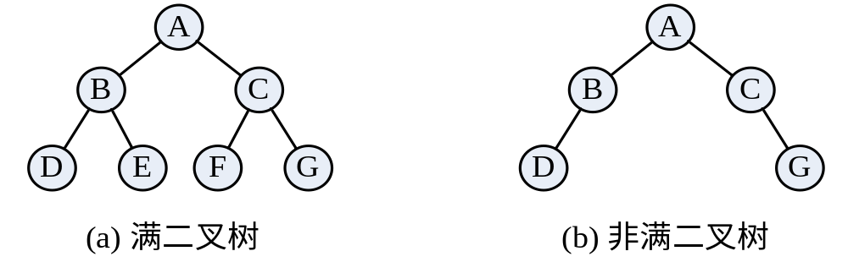
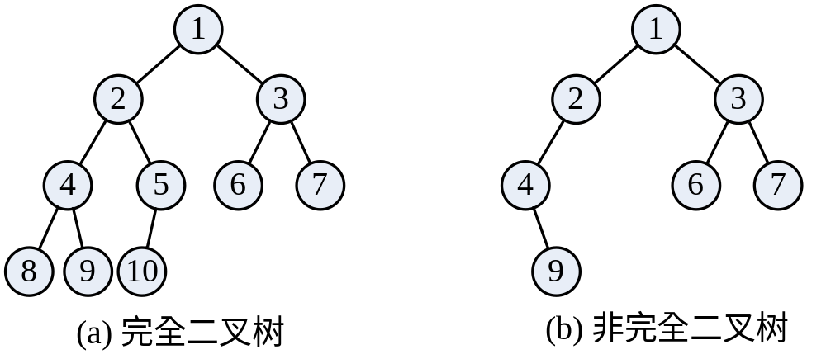
6.1 Concept and property of BT
Two special binary trees：
Full binary trees
满二叉树
Depth = k and
n = 2^{k}-1
Degrees = 0 or 2
Complete Binary Tree完全二叉树
二叉树中所含的 n 个结点和满二叉树中编号为 1 至 n 的结点一一对应

Slide 9
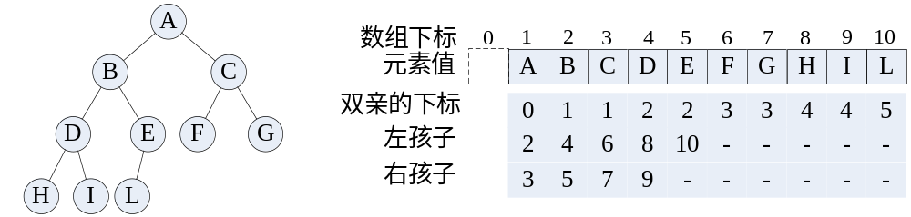
6.2 Storage structure of BT
6.2.1 Sequential storage structure 顺序存储结构
  Based on Property 5 :
  Complete Binary Tree can be stored in a one dimensional array (The unit 0 Unit 0 is not used).
  As shown in the figure. Stored and Found

Slide 10
6.2.1 Sequential storage structure
顺序存储结构
SqList of Complete Binary Tree
    typedef char TElemType;
    // 假设二叉树结点的元素类型为字符
    typedef struct {
    TElemType *elem; // unit 0 disuse
    int lastIndex; // 二叉树最后一个结点的编号
    } SqBiTree;

Slide 11
判别v结点是否为u结点的子孙
Status is_Desendant(SqBiTree T, int u, int v)
进行参数的检查
根据结点v的编号，利用性质5（1），可以依次找到结点v的祖先结点的编号。
Status is_Desendant(SqBiTree T, int u, int v) {
// 判断完全二叉树T的v结点是否是u结点的子孙
if(u<1 || u>T->lastIndex || v<1 || v>T->lastIndex || v<=u)
return FALSE; // u和v的范围不合理
while(v>u){ // 根据性质5找v的祖先
v = v/2;
if(v==u) return TRUE; // v是u的子孙
}
return FALSE; // v不是u的子孙
}
2
8
1
8/2=4
4/2=2
2
3
4
5
6
7
8
9

Slide 12
6.2 Storage structure of BT
6.2.2 Linked Storage Structure 链式存储结构
  1.Binary Linked List 二叉链表
  The nodes:
lchild data rchild
root
root
A
A
∧
B
B
D
E
D
∧
E
∧
F
G
∧
F
∧
∧
G
∧

Slide 13
6.2.2 Linked Storage Structure
Binary Linked List ( BLL / 二叉链表)
    typedef struct BiTNode {
    TElemType data; // 数据域
    struct BiTNode *lchild,*rchild; // 左、右孩子指针
    } BiTNode,*BiTree;

Slide 14
6.2.2 Linked Storage Structure
Operations based on BLL
  BiTree MakeBiTree(TElemType e, BiTree L, BiTree R);
  Status ReplaceLeft(BiTree &T, BiTree &LT);
  Status CutRight(BiTree &T, BiTree &RT);
  ......

Slide 15
Creating BiTree
BiTree MakeBiTree(TElemType e, BiTree L, BiTree R)
生成一个新结点t,其数据域的值为e
创建一棵二叉树T，其中根结点为t，L和R分别作为左子树和右子树
BiTree MakeBiTree(TElemType e, BiTree L, BiTree R) {
BiTree t;
t = (BiTree)malloc(sizeof(BiTNode));
if(NULL==t) return NULL;
t->data = e; // 根结点的值为e
t->lchild = L; // L作为t的左子树
t->rchild = R; // R作为t的右子树
return t;
}
t
e
L
R
D
∧
B
∧
F
∧
∧
G
∧
∧
E
∧

Slide 16
Replacing Left subtree
Status ReplaceLeft(BiTree &T, BiTree &LT)
判断树T是否为空树？
用LT替换T的左子树，并用LT返回T的原有左子树
Status ReplaceLeft(BiTree &T, BiTree &LT) {
BiTree temp;
if(NULL==T) return ERROR; // 树空
temp = T->lchild;
T->lchild = LT; // LT作为T的左子树
LT = temp; // LT返回T的先前左子树
return OK;
}
T
A
temp
LT
LT
∧
D
∧
B
∧
G
∧
∧
E
∧

Slide 17
Delete right subtree
Status CutRight(BiTree &T, BiTree &RT)
判断树T是否为空树？如果T为空，则RT为NULL，并返回ERROR。
若T非空，则剪除T的右子树，并赋给RT。
Status CutRight(BiTree &T, BiTree &RT) {
if(NULL==T) { RT = NULL; return ERROR; } // 树空
RT = T->rchild; // RT返回T的右子树
T->rchild = NULL; // 剪除右子树
return OK;
}
A
∧
RT
D
∧
B
∧
F
∧
∧
G
∧
∧
E
∧

Slide 18
6.2.2 Linked Storage Structure
2.Trifurcate Linked List (三叉链表)
  node:
lchild data parent rchild
root
root
A
A
∧
B
C
B
∧
C
∧
D
E
∧
D
∧
∧
E
∧

Slide 19
6.2.2 链式存储结构
2.Trifurcate Linked List
typedef struct TriTNode {
    TElemType data; // 数据域
    TriTNode *parent, *lchild, *rchild;
    // 双亲、左右孩子指针
    } TriTNode, *TriTree;

Slide 20
6.3 Traversal of binary tree
遍历二叉树（traversing binary tree）
  Traversal (遍历)：
    Starts from the root node，each node is accessed once and only once （(被访问一次且仅仅一次 ）
    The “accessed” could be any operation on the node:
    get、print、modify data and the others.
    Every node relative to its subtrees can be regarded as a root node 。

Slide 21
6.3 Traversal of binary tree
遍历二叉树（traversing binary tree）
  Three traversal paths：
    First left, then right 先左(子树)后右(子树)的遍历；
    First right, then left 先右(子树)后左(子树)的遍历；
    level traversals 先上后下的层次遍历。

Slide 22
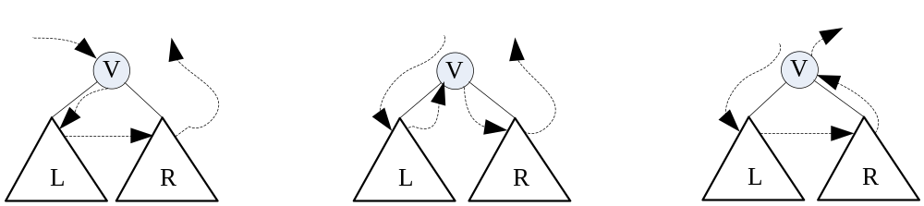
6.3.1 Traversal of binary tree
Root : Visit operation
Left and Right subtree:
recursion
Three traversing orders:
R
Tl
Tr
  VLR LVR LRV
  Pre-order In-order Post-order
  先序 中序 后序

Slide 23
Recursive implementation of In-order traversal
Status InOrderTraverse(BiTree T, Status (*visit)(TElemType e))
若二叉树不为空，则依次进行以下操作：
（1）遍历根结点的左子树；
（2）访问根结点；
（3）遍历根结点的右子树。
Status InOrderTraverse(BiTree T, Status (*visit)(TElemType e)) {
if(NULL==T) return OK;
if(ERROR==InOrderTraverse(T->lchild, visit))
return ERROR; // 递归遍历T的左子树
if(ERROR==visit(T->data)) return ERROR; // 访问结点的数据域
return InOrderTraverse(T->rchild, visit); // 递归遍历T的右子树
}

Slide 24
Recursive implementation of In-order traversal
In-order traversal
L V R
A
A
B
L V R
L V R
C
D
>
B
>
C
>
L V R
中序遍历序列：B D A C
>
>
D

Slide 25
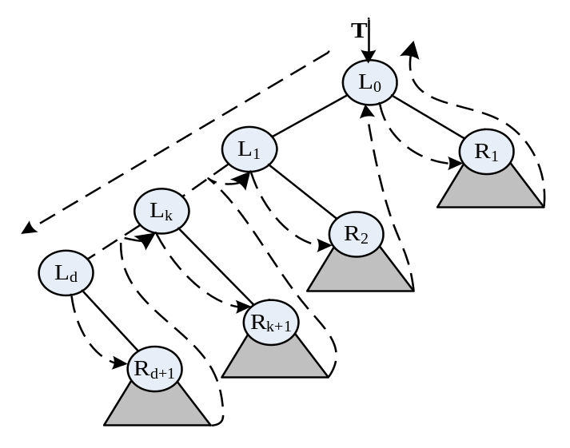
6.3.2 Non recursive traversal of binary tree
1. In-order Traversal , using stack
The first node ?
  左子树上处于“最左下”(左子树为空)的结点L_{d}
The next node L_{k}？
  若L_{d}右子树为空，或结点R_{d+1}对应的子树已遍历，则遍历的下一个结点为L_{d-1。}
  否则为对其右子树R_{d+1}进行中序遍历时访问的第一个结点；
how to find L_{k}？
  using stack

Slide 26
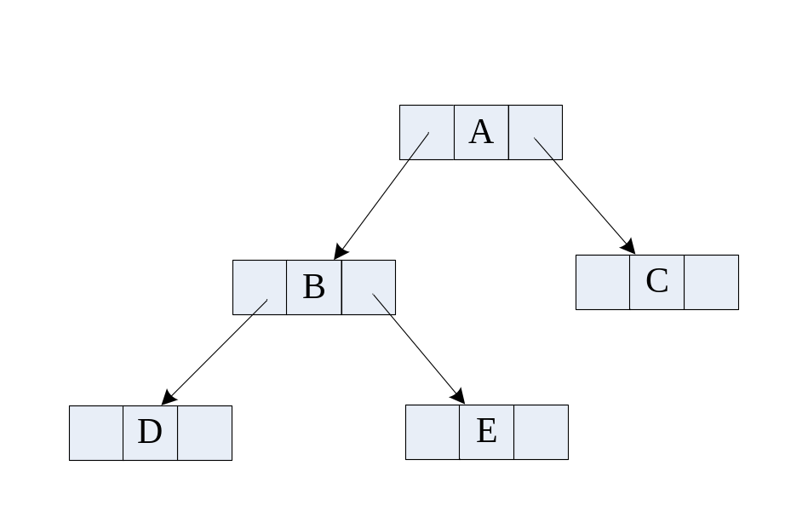
T
In-order Traversal , using stack
BiTNode *GoFarLeft(BiTree T, LStack &S)
B
∧
∧
A
∧
∧
∧
∧
栈S
BiTNode *GoFarLeft(BiTree T, LStack &S) {
// 栈S的元素类型是BiTree，从T结点出发，沿左分支不断
// 深入，直到左分支为空的结点，沿途结点入栈S，
if(NULL==T) return NULL;
while(T->lchild!=NULL) {
Push_LS(S, T);
T = T->lchild;
}
return T;
}

Slide 27
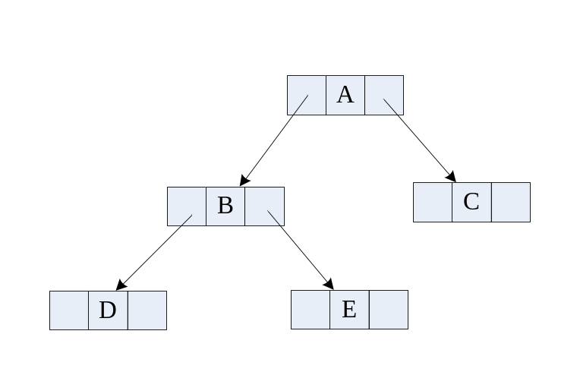
遍历序列：
In-order Traversal , using stack
D
B
E
A
C
T
void InorderTraverse_I(BiTree T, Status(*visit) (TElemType e))
    (1) 访问p结点；
    (2) 若p结点的右孩子存在，则令p指向右孩子，然后向左走到底，并依次将指向沿途结点的指针入栈。
    (3) 否则判断栈是否为空？若非空则将保留在栈顶的指针退栈并赋给p；
    (4) 若空，则强制p为空（遍历结束）。
B
A
∧
∧
p
栈S
∧
∧
∧
∧
void InorderTraverse_I(BiTree T, Status(*visit) (TElemType e)) {
LStack S; InitStack_LS(S);
BiTree p; p = GoFarLeft(T, S); // 找到最左下的结点
while(p!=NULL) {
visit(p->data); // 访问结点
if(p->rchild!=NULL) // 令p指向其右孩子为根的子树的最左下结点
p = GoFarLeft(p->rchild, S);
else if(StackEmpty_LS(S)!=TRUE) Pop_LS(S,p); // 栈不空时退栈
else p = NULL; // 栈空表明遍历结束
}
}

Slide 28
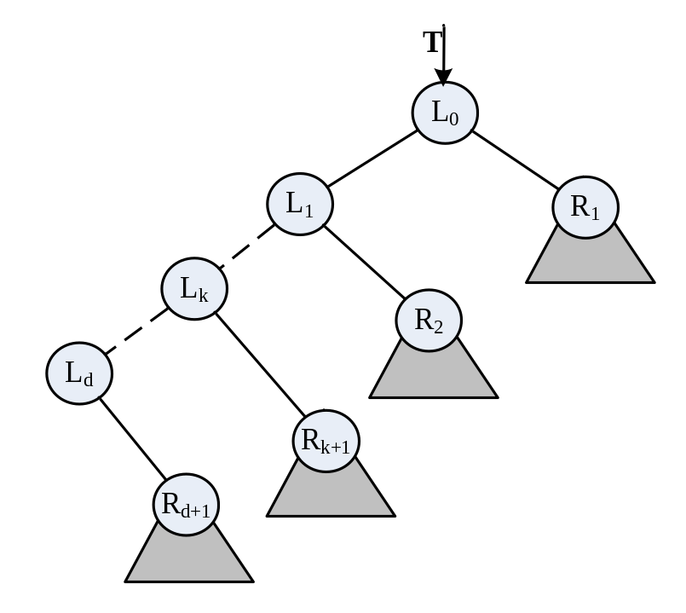
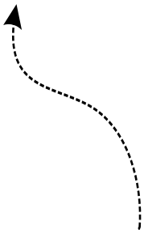

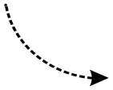
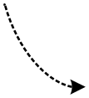
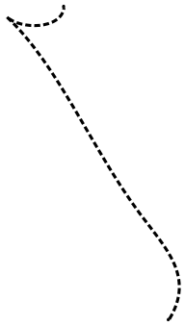
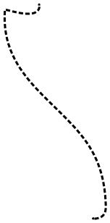
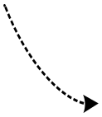
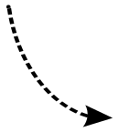
Pre-order Traversal, Do not use stack
先序遍历的顺序？
  沿左孩子方向，边走边访问， 直到左子树上处于“最左下”的结点L_{d} .
  然后访问其右子树，右子树访问完后.
  回到上一个有右子树的结点L_{k} ，访问L_{k}的右子树
  以此类推，直到所有结点访问完毕.

Slide 29
6.3.2 Non recursive traversal of binary tree
Pre-order Traversal, Do not use stack
    Trifurcate Linked List (三叉链表)
root
A
∧
B
∧
C
∧
∧
D
∧
∧
E
∧

Slide 30
6.3.2 Non recursive traversal of binary tree
Pre-order Traversal, Do not use stack
After the Left child of node p is visited，how to find the next node which will be visited？
Situation 1：p -> rchild != null
so move the p : p=p->rchild;
root
A
∧
p
B
∧
C
∧
∧
D
∧
∧
E
∧

Slide 31
6.3.2 Non recursive traversal of binary tree
Do not use stack
Situation 2：：p-> rchild == null
沿着p结点的祖先路线向上,查找一个有右子树未被访问的结点.
Moving : pr = p; p = p->parent;
successfull ：p!=NULL && p->rchild!=NULL && p->rchild!=pr
root
A
∧
B
∧
C
∧
p
pr
∧
D
∧
∧
E
∧

Slide 32
Pre-order Traversal, Do not use stack
Status PreOrderTraverse(TriTree T, Status (*visit)(TElemType e))
Status PreOrderTraverse(TriTree T, Status (*visit)(TElemType e)) {
TriTree p, pr;
if(T!=NULL) {
p = T;
while(p!=NULL) {
visit(p->data);
if(p->lchild) p = p->lchild;
else if(p->rchild) p = p->rchild;
else {
do { pr = p; p = p->parent;
} while(p!=NULL && (p->rchild==pr || NULL==p->rchild));
if(p!=NULL) p = p->rchild;
}
}
}
return OK;
}

Slide 33
6.3.2 Non recursive traversal of binary tree
3. level traversals , using queue
A
A
C
D
B
E
F
G
B
C
D
E
F
Sequence：
A
B
C
D
E
F
G
G

Slide 34
level traversals , using queue
void LevelOrderTraverse(BiTree T, Status (*visit)(TElemType e)) {
if(T!=NULL) {
LQueue Q; InitQueue_L(Q);
BiTree p = T; //初始化
visit(p->data); EnQueue_L(Q, p);
while(OK==DeQueue_L(Q, p)) {
if(p->lchild!= NULL){
visit(p->lchild->data);
EnQueue_L(Q, p->lchild);
}
if(p->rchild != NULL) {
visit(p->rchild->data);
EnQueue_L(Q, p->rchild);
}
}
}
}
  BiTree is not empty, then :
  Visit Root, and EnQueue；
  looping , when Queue is not empty :
  DeQueue,
  Deal with the left child
  Deal with the right child
    else , the end

Slide 35
6.3.3 Application of Traversal
例6-2 Destroy Bitree 销毁二叉树
  Visiting each root node : free them
    void DestroyBiTree(BiTree &T) {
    if(T!=NULL) {
    DestroyBiTree(T->lchild); // left
    DestroyBiTree(T->rchild); // right
    free(T); // Visit operation
    }
    }

Slide 36
6.3.3 Application of Traversal
例6-3 Counting leaf nodes of binary tree
(二叉树的叶子结点计数)
  Visiting each root node : if be leaf then count++
    void CountLeaf(BiTree T, int &count) {
    // count for counting leaf number
    if(T!=NULL) {
    if(NULL==T->lchild && NULL==T->rchild) count++; CountLeaf(T->lchild, count); // Left
    CountLeaf(T->rchild, count); // Right
    }
    }

Slide 37
6.3.3 Application of Traversal
例6-4 Caculating the depth of binary tree
(求二叉树深度)
  Find the relationship between the depth of a binary tree and its left-right subtrees ?
  Binary tree is composed of root and left and right subtrees.
    The root has an exclusive layer.
    BitreeDepth = Max { left depth, right depth} + 1
  The Algorithm:
  At first, calculate the Depths of left and right subtree, and then obtain the result.

Slide 38
6.3.3 Application of Traversal
例6-4 Caculating the depth of binary tree
  int BiTreeDepth(BiTree T) {
  int depthLeft,depthRight;
  if(NULL==T) return 0;
  else {
  depthLeft = BiTreeDepth(T->lchild);
  depthRight = BiTreeDepth(T->rchild);
  return 1+(depthLeft > depthRight ? depthLeft : depthRight);
  }
  }

Slide 39
6.3.3 Application of Traversal
例6-5 Creating Binary Tree (构造二叉树)
  以字符串的形式 根 左子树 右子树 定义一棵二叉树（即在其先序遍历序列中，添加表示空子树的符号）
  例如:
    空树 以字符“#”表示
    只含一个根结点的二叉树 以字符串“A # #”表示
A
A
以下列字符串表示：
A(B(D(#,#),E(#,#)),C(#,#))
简写为：
A B D # # E # # C # #
B
C
D
E

Slide 40
6.3.3 Application of Traversal
例6-5 Creating Binary Tree
  BiTree CreateBiTree(char *definition, int &i) {
  BiTree T;
  TElemType ch;
  ch = definition[i++];
  if(‘#’ == ch) InitBiTree(T);
  else {
  T = MakeBiTree(ch, NULL, NULL);
  T->lchild = CreateBiTree(definition, i);
  T->rchild = CreateBiTree(definition, i);
  }
  return T;
  }

Slide 41
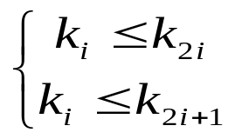
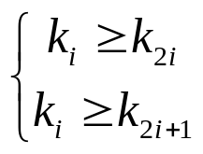
6.4 Heap 堆
Heap is a complete binary tree.
According to number nodes of CBTree, sequence of n nodes (k₁, k₂, …， k_{n}) is called heap .
Less Top Heap / Less Root Heap (小顶堆 / 小根堆)
The parent element is less than its left-right childs.
Larger top heap / Larger root (大顶堆 / 大根堆)
The parent element is larger than its left-right childs.
In the Sequence: the root called Heap top (堆顶); The last node called Heap tail (堆尾); number of nodes is called Heap length
less top heap
Larger top heap
(i = 1, 2, …, ⎣n/2⎦ )

Slide 42
Structure of heap
typedef struct {
RcdType *rcd; // Unit 0 is not used
int n; // length
int size;
int tag; // Less or Larger flag：tag = 0 , 1
int (*prior)(KeyType, KeyType);
} Heap;
int greatPrior(int x, int y) { return x>=y; }
int lessPrior(int x, int y) { return x<=y; }

Slide 43
Operations
Status InitHeap(Heap &H, int size, int tag,
int (*prior)(KeyType, KeyType));
void MakeHeap(Heap &H, RcdType *E, int n, int size, int tag,
int (*prior)( KeyType, KeyType));
Status DestroyHeap(Heap &H);
void siftDown(Heap &H, int pos); // siftDown（筛选）
Status InsertHeap(Heap &H, RcdType e);
Status RemoveFirstHeap(Heap &H, RcdType &e);
Status RemoveHeap(Heap &H, int pos, RcdType &e);

Slide 44
Operations
1. siftdown (筛选)
Supose that the left/right subtrees of a complete binary tree are both heaps but the root node. Adjust (调整) the tree to being heaps.
筛选
Heap
Heap

Slide 45
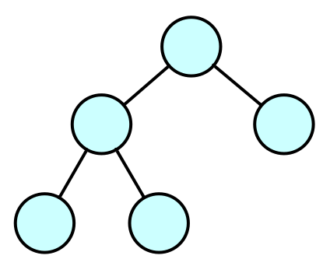
pos
Siftdown (筛选)
42
c
rc
void siftDown(Heap &H, int pos)
86
68
pos node is compare to Left/right childs
if pos node win then over，else swap
pos move down
c
rc
58
42
void siftDown(Heap &H, int pos) {
int c, rc;
while (pos<=H.n/2) {
c = pos*2;
rc = pos*2+1;
if(rc<=H.n && H.prior(H.rcd[rc].key, H.rcd[c].key)) c = rc;
if(H.prior(H.rcd[pos].key, H.rcd[c].key)) return;
swapHeapElem(H, pos, c);
pos = c;
}
}
O(logn)

Slide 46
Operations
4. Create a Heap
Save all data elements into a SqList. Two ways:
  The one: Use the insert operation . n elements are inserted into an initially empty heap one by one. (Time complexity O(nlogn) )
  The other:
    Input datas into SqList to create a Complete binary tree
    Adjust (调整) the tree in SqList to being heaps.

Slide 47
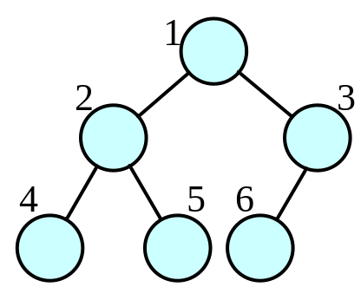
Create a Heap
1
42
void MakeHeap(Heap &H, RcdType *E, int n, int size,
int tag, int (*prior)( KeyType, KeyType))
2
3
58
68
98
86
42
void MakeHeap(Heap &H, RcdType *E, int n, int size, int tag,
int (*prior)( KeyType, KeyType)) {
int i;
H.rcd = E;
H.n = n; H.size = size; H.tag=tag; H. prior = prior;
for(i=n/2; i>0; i--) shiftDown(H, i);
}

Slide 48
Heapsort
{ 40, 55, 49, 73, 12, 27, 98, 81, 64, 36 }
Create Max heap
{ 98, 81, 49, 73, 36, 27, 40, 55, 64, 12 }
swap 98、12
{ 12, 81, 49, 73, 36, 27, 40, 55, 64, 98 }
siftdown
Adjust again
{ 81, 73, 49, 64, 36, 27, 40, 55, 12, 98 }

Slide 49
6.5 Binary search tree (二叉查找树)
Binary Search(Sort) Tree (二叉查找(排序)树)
BST can be a null tree. if it isn’t null, then:
（1）if the left subtree isn’t null, then the values of all nodes on the left subtree are less than the value of the root node
（2）if the right subtree isn’t null, then the values of all nodes on the right subtree are larger than the value of the root node
（3）left and right subtrees are binary search trees too.

Slide 50
6.5 Binary search tree
88
47
98
19
55
50
89
It’s not
a Binary Search(Sort) Tree

Slide 51
6.5 Binary search tree
The structure:
typedef struct BSTNode {
RcdType data;
struct BSTNode *lchild, *rchild;
} BSTNode, *BSTree;

Slide 52
6.5 Binary search tree
Operations：
  Status InitBST(BSTree &T);
  Status DestroyBST(BSTree &T);
  BSTree SearchBST(BSTree T, KeyType key);
  Status InsertBST(BSTree &T, RcdType e);
  Status DeleteBST(BSTree &T, KeyType key);

Slide 53
6.5 Search Operation of BST
Suppose search Key on a BST . Point T to the root node. The process :
(1) Search from the root.
(2) If T == null , searching is unsuccessful. Return null.
else:
A) if the key == value of root , then success
B) if the key < value of root , then point T to Left subtree and repeat the (2)
C) if the key > value of root , then point T to right subtree and repeat the (2)

Slide 54
6.5 Search Operation of BST
Recursive implementation
BSTree SearchBST(BSTree T, KeyType key) {
if(NULL==T) return NULL;
if(T->data.key == key) return T;
if(T->data.key > key)
return SearchBST(T->lchild, key);
return SearchBST(T->rchild, key);
}

Slide 55
6.5 Search Operation of BST
88
47
98
19
55
50
key
== 55 ,
98 ,
99 ,

Slide 56
6.5 Search Operation of BST
Non recursive implementation
BSTree SearchBST(BSTree T, KeyType key) {
// non-recursive
while(T!=NULL) {
if(T->data.key == key) return T;
else if(T->data.key > key) T = T->lchild;
else if(T->data.key < key) T = T->rchild;
}
return NULL;
}

Slide 57
6.5 Insertion of BST
Suppose to insert X. If X is not found, the location where the search ends is where X should be inserted, then insert it. Steps：
(1) If BST is null, then create a new node for X to insert and the algorithm be over.
(2) if X < value of root , then execute recursion on the left subtree
(3) if X > value of root , then execute recursion on the right subtree
(4) if X == value of root , then donot anything and return.

Slide 58
6.5 Insertion of BST
Status InsertBST(BSTree &T, RcdType e) {
if(NULL==T) {
BSTNode *s = (BSTNode*)malloc(sizeof(BSTNode));
if(NULL==s) return OVERFLOW;
s->data = e; s->lchild = NULL; s->rchild = NULL;
T = s;
return TRUE;
}
if(e.key < T->data.key) return InsertBST(T->lchild,e);
if(e.key > T->data.key) return InsertBST(T->rchild,e);
return FALSE; // e.key==T->data.key
}

Slide 59
6.5 ASL of BST
Use (1，2，3，4，5) to create a BST
1
2
ASL =（1+2+3+4+5）/ 5
= 3
3
4
5
Use ( 3，1，2，5，4 ) to create a BST
3
1
5
ASL =（1+2+3+2+3）/ 5
= 2.2
2
4

Slide 60
6.6 Balanced Binary Tree ( BBT )
Balanced Binary Tree (平衡二叉树)
Balance Factor（平衡因子）defined :
  Height of left subtree minus height of right subtree
  So the balance factor can only be - 1,0,1.
  Therefore, the BT is unbalanced as long as absolute value of BF of a node larger then 1.

Slide 61
6.6 Balanced Binary Tree ( BBT )
5
5
4
8
4
8
2
2
1
is BBT
is not BBT

Slide 62
6.6 Balanced Binary Tree ( BBT )
Based on BST：
typedef struct BBSTNode {
RcdType data;
int bf; // Balance factor of a node
struct BBSTNode *lchild, *rchild;
}*BBSTree;

