Slide 1

Chapter 7：Tree

Slide 2
Main
7.1 definition of Tree
7.2 Storage structure
7.3 Traversal
7.4 B-tree

Slide 3
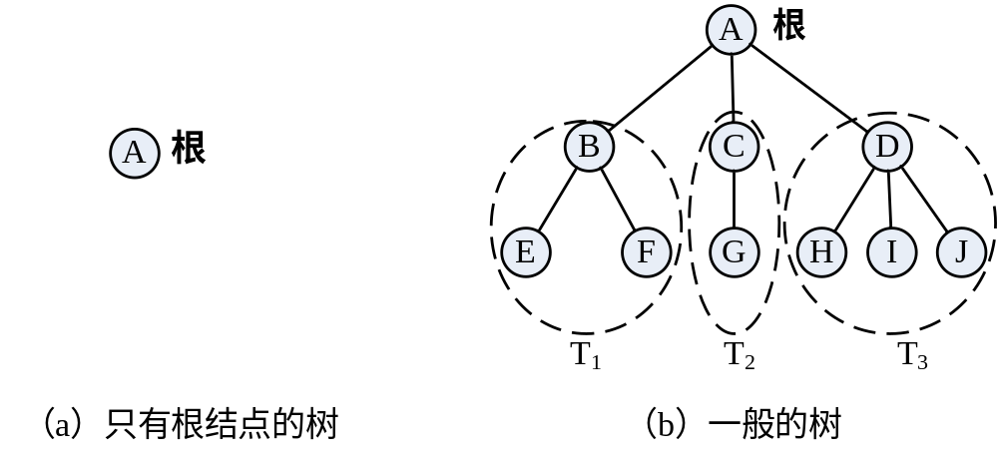
7.1 definition of Tree
Tree（树）is a limited set containing n (n ≥ 0) nodes. If a tree isnot empty, then：
  （1）There is only one node called root;
  （2）if n>1, the other nodes belonging to m（m>0）limited disjoint set (T1, T2, … , Tm). Each set of them itself is a tree These set (T1, T2, … , Tm) are called SubTree of root。

Slide 4
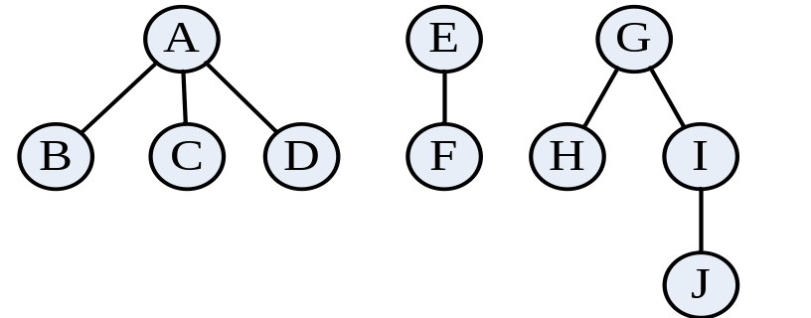
7.1 definition of Tree
Forest(森林) is disjoint set of m(m≥0) trees，marked F = (T1, T2, T3,..., Tm)。

Slide 5
7.2 Storage structure of tree
Key points of storage structure：
Storage information of every node and their relationship.
  Parent representation 双亲表示法
  Parent-child representation双亲孩子表示法
  Child-sibling representation (孩子兄弟表示法)

Slide 6
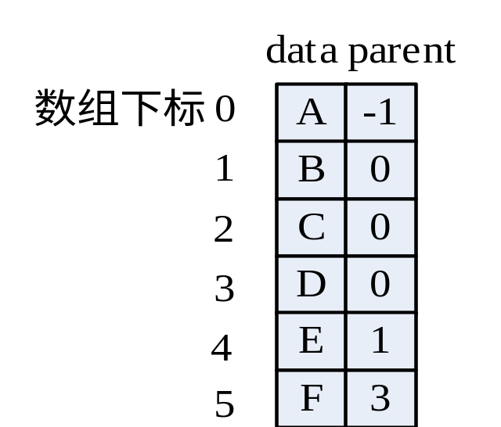
7.2.1 Parent representation双亲表示法
Use array to storage the nodes and their relationship
Elements of the array are Struct composed of data field and parent pointer field.
A
B
C
D
E
F

Slide 7
7.2.1 Parent representation
  typedef struct PTNode {
  TElemType data;
  int parent; // parent of root == -1
  } PTNode; // elem stuct of array
  typedef struct {
  PTNode *nodes;
  int r, nodeNum;
  } PTree;

Slide 8
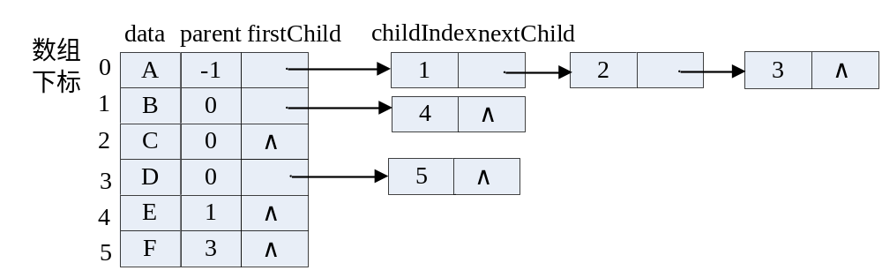
7.2.2 Parent-child representation双亲孩子表示法
Add a first Child pointer
A
B
C
D
E
F

Slide 9
7.2.2 Parent-child representation
typedef struct ChildNode {
int childIndex;
struct ChildNode *nextChild;
} ChildNode;
typedef struct {
TElemtype data;
int parent;
struct ChildNode *firstChild;
} PCTreeNode;
typedef struct {
PCTreeNode *nodes;
int nodeNum, r;
} PCTree;

Slide 10
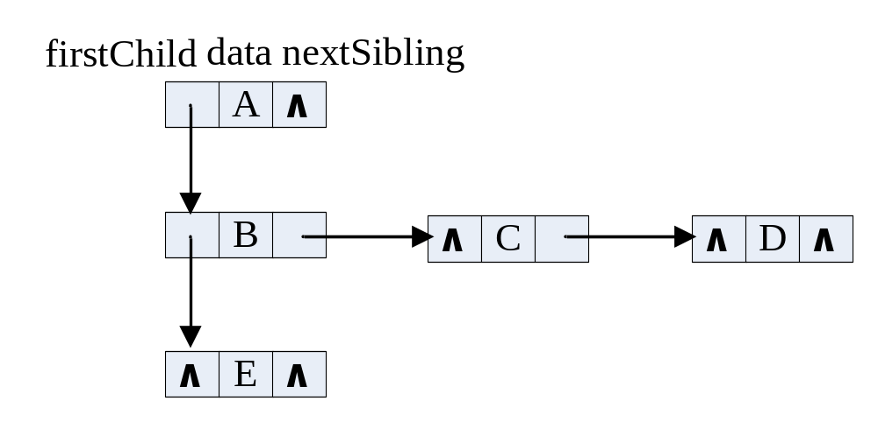
7.2.3 Child-Sibling representation(孩子兄弟表示法)
Use Binary Linked List.
Three fields:
  data , child pointer , sibling pointer
A
B
C
D
E

Slide 11
7.2.3 Child-Sibling representation
  typedef struct CSTreeNode {
  TElemType data;
  struct CSTreeNode *firstChild,*nextSibling;
  } CSTreeNode,*CSTree;

Slide 12
7.2.3 Child-Sibling representation
Operations:
  CSTree MakeTree(TElemType e, int n, ...);
  int TreeDepth(CSTree T);
  Status InsertChild(CSTree T, int i, CSTree c);
  ...

Slide 13
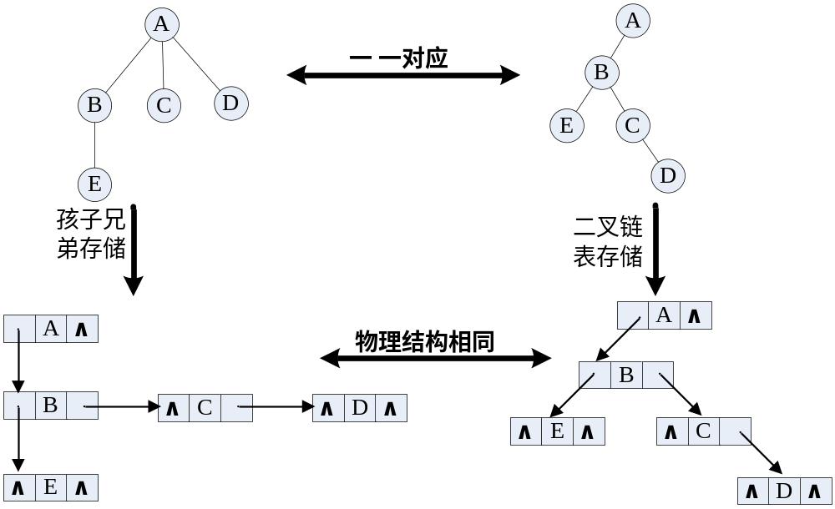
7.2.3 Child-Sibling representation
The equivalence of tree and binary tree

Slide 14
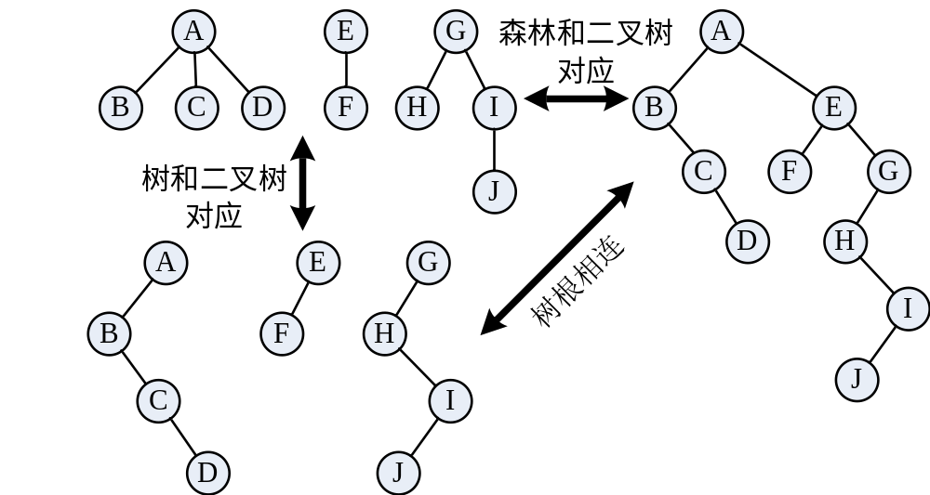
7.2.3 Child-Sibling representation
The equivalence of forest and binary tree

Slide 15
7.3 Tree Traversal
Three traversal algorithms for tree traversal
  Pre-order traversal:
    if tree is not null, visit the root. And then traverse the subtrees in order
  Post-order traversal 后序(次序)遍历:
    if tree is not null, traverse the subtrees in order , visit the root at last.
  level traversals 层次遍历

Slide 16
7.3 Tree Traversal
Pre-order
Sq ：ABCDE
Post-order
Sq：BDCEA
Level
Sq：ABCED
A
B
C
E
D

Slide 17
7.3 Tree Traversal
corresponding relationship
  Tree binary tree
  Pre-order Pre-order
  Post-order In-order

Slide 18
Pre-order of Tree
Status PreOrderTraverseTree(CSTree T, Status(*visit)(TElemType))
if T != null：
（1）Visit the root；
（2）Visit the sub tree forest of root node T；
（3）The other subtree
Status PreOrderTraverseTree(CSTree T, Status(*visit)(TElemType)) {
if(NULL==T) return OK;
if(ERROR==visit(T->data)) return ERROR;
if(ERROR==PreOrderTraverseTree(T->firstChild, visit))
return ERROR;
return PreOrderTraverseTree(T->nextSibling, visit);
}

Slide 19
7.3 Tree Traversal
Find the depth of the tree
  int TreeDepth(CSTree T) {
  int dep1, dep2, dep;
  if(NULL==T) dep = 0;
  else {
  dep1 = TreeDepth(T->firstChild);
  dep2 = TreeDepth(T->nextSibling);
  dep = dep1+1>dep2 ? dep1+1 : dep2;
  }
  return dep;
  }

Slide 20
7.3 Tree Traversal
Searching
  CSTreeNode* Search(CSTree T, TElemType e) {
  CSTreeNode* result = NULL;
  if(NULL==T) return NULL;
  if(T->data==e) return T;
  if((result = Search(T->firstChild, e))!=NULL)
  return result;
  return Search(T->nextSibling, e);
  }

Slide 21
7.4 B-tree
B-tree is a kind of balance tree for Improving searching efficiency
Balanced Tree of order m (m阶B树)，B-tree.
Maybe an empty tree. Maybe a m multi-tree (m叉树)：
(1) Each node in the tree has m subtrees at most.
(2) if the root isnot leaf ，then has 2 subtrees at lease.
(3) All non terminal nodes but root have ⎡m/2⎤ subtrees.
(4) In each non terminal node：
(n，A₀，K₁，A₁，K₂，A₂，......，K_{n}，A_{n})

Slide 22
7.4.1 Definition of B-tree
In ：
1）K_{i} (1≤i≤n)is Keywords，sorted in ascending order；
2）pointer A_{i}(0≤i≤n)pointed to the root of a subtree，
and K_{i-1} < A_{i-1} < K_{i}
3）The n which the total keywords in a node must to satisfy:
⎡m/2⎤-1≤n≤m-1
（5）All leaves are at the same layer. And there is not anything information in these leaves.

Slide 23
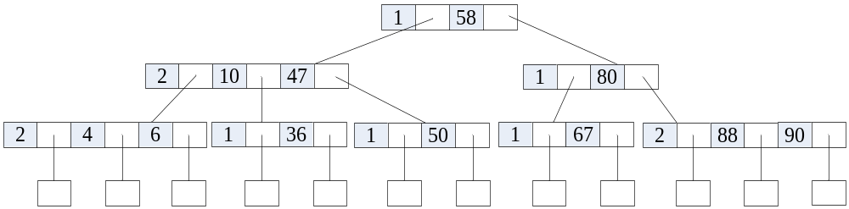
7.4.1 Definition of B-tree
  Typical 3-order B-Tree

Slide 24
7.4.1 Definition of B-tree
#define m 3 // Order
typedef struct BTNode {
int keynum;
KeyType key[m+1]; // key[0] unuse
struct BTNode *parent;
struct BTNode *ptr[m+1];
Record *recptr[m+1];
} BTNode, *BTree;

Slide 25
7.4.1 Definition of B-tree
typedef struct {
BTree pt;
int i; // 1≤i≤m，
int tag; // search flag : 1: success，0: fail
} result;

Slide 26
7.4.2 Search of B-Tree
1
100
search 36
search 108
2
9
48
1
112
2
4
6
1
36
36
2
68
90
2
101
110
1
121

Slide 27
7.4.3 Insertion of B-tree
Insertion operation:
  Find the insertion location of the keyword k by search of B-tree
  if the k exist, then do nothing and return.
  Else, current location must be the bottom non-terminal node. And then insert the k here.
  if the total keywords n <= m-1, the end. Else the node has to be split (分裂)。
Steps of splitting :
  { The next page to be continue }

Slide 28
7.4.3 Insertion of B-tree
Steps of splitting (分裂):
  Split a node into three parts. The keyword in the middle is separated alone.
  The front half part is left in the old node.
  Make a new node in which to store the last half part.
  The middle key and the pointer of the new node are inserted into their parent node.
  After finish the first splitting, if the total keywords of parent are not satisfy n < m, then split the parent node.
  Repeat the above steps until n < m . At last a new root maybe be created.

Slide 29
7.5.3 B树的插入
50
50 80
30 50 80
30
80
50
∧ 20 ∧ 40 ∧
∧ 20 ∧
∧ 40 ∧
∧ 80 ∧
∧ 60 ∧ 80 ∧
∧60∧80∧90∧
∧60∧
∧90∧
插入关键字 = 60,
90,
30

Slide 30
7.4.4 Deleting of B-tree
Think about deleting K
  1．If the node deleted is in the bottom layer, then delete the K from the node at first. And then there are three possible situations

Slide 31
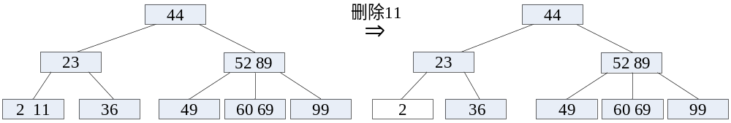
7.4.4 Deleting of B-tree
（1）if n>=⎡m/2⎤ in the node，delete it。

Slide 32
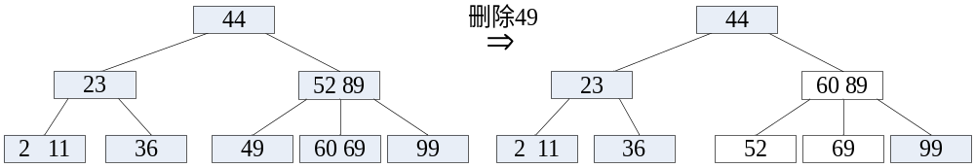
7.4.4 Deleting of B-tree
（2）if n = ⎡m/2⎤-1 in the node of the keyword deleted, then we have to be adjusted :
If there are rich keywords in its left-right siblings node, then move a keyword from sibling in order to n >⎡m/2⎤-1.

Slide 33
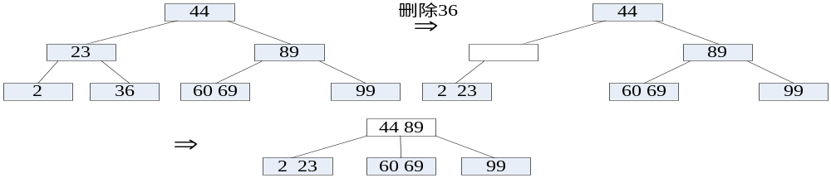
7.4.4 Deleting of B-tree
（3）if there are not rich keywords in its left-right siblings node, That means the keywords in its sibling n = ⎡m/2⎤-That is more complicated.

Slide 34
7.4.4 Deleting of B-tree
2．若该结点不是最下层非终端结点，且被删关键字为该结点中第i个关键字key[i]，则可从指针ptr[i]所指的子树中找出位于最下层非终端结点的最小关键字Y，替代key[i]，然后在最底层非终端结点中移除Y。因此，把在非终端结点删除关键字k的问题就变成了删除最下层非终端结点中的关键字的问题了。

Slide 35
7.4.4 Deleting of B-tree
void DeleteBTree(BTree p, int i) {
if(p->ptr[i-1]!=NULL) {
Successor(p, i);
DeleteBTree(p, 1);
} else {
Remove(p, i);
if(p->keynum < (m-1)/2)
Restore(p, i);
}
}

Slide 36
7.4.5 B⁺ tree
B⁺tree 是应文件系统所需而提出的一种B树的变型。一棵m阶B⁺树和m阶B树的差异在于：
（1）有n棵子树的结点中含有n个关键字。
（2）所有的叶子结点中包含了全部关键字的信息， 及指向含这些关键字记录的指针，且叶子结点本身依关键字的大小自小而大顺序链接。
（3）所有的非终端结点可以看成是索引部分，结
点中仅含其子树（根结点）中的最大（或最小）关键字。

Slide 37
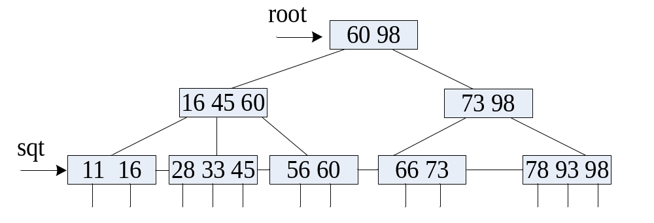
7.4.5 B⁺ tree
two head pointers in B⁺ tree : a pointed to the root node, the other one pointed to the leaf node in which the smallest keyword is.

