Slide 1
DESIGN AND ANALYSIS OF ALGORITHMS [ˈælgərɪðəm]
Instructor: Zhihua Jiang （蒋志华）
Dep. Of Computer Science and Technology
Email: tjiangzhh@jnu.edu.cn

Slide 2
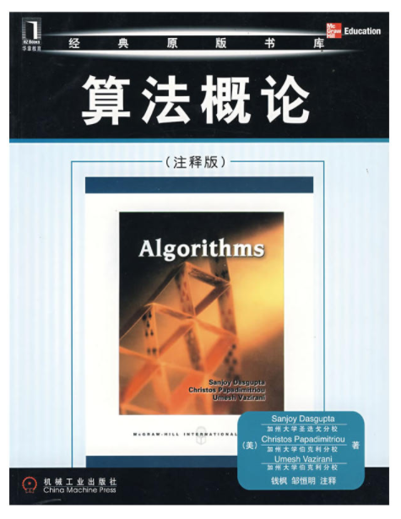
The textbook
《Algorithms》(with annotations)
Sanjoy Dasgupta et al.,
China Machine Press, ￥55.0
ISBN:978－7－111－25361－7

Slide 3
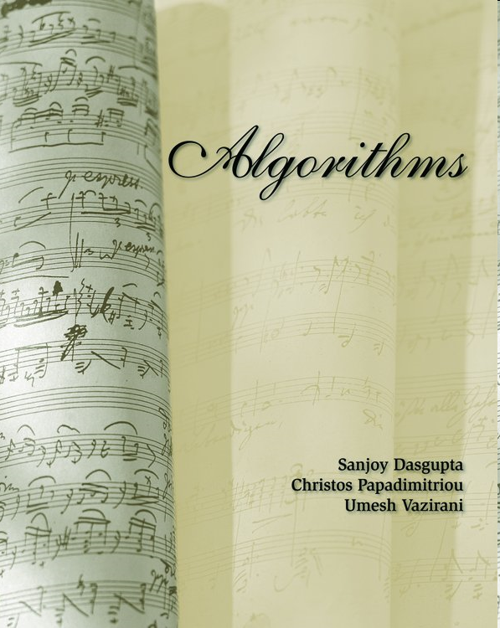
Original English book
Algorithms S. Dasgupta, C.H. Papadimitriou, U.V. Vazirani, McGraw-Hill Higher Education, 2007.
Draft available at http://www.cs.berkeley.edu/~vazirani/algorithms.html

Slide 4
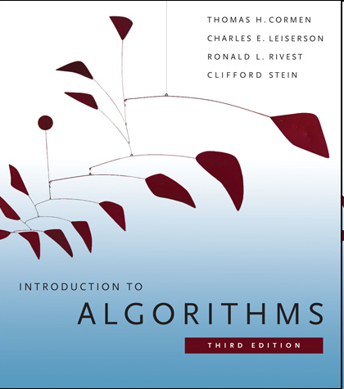
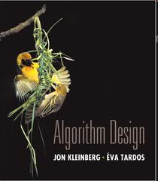
References
The following two books are very good references, containing many materials that we don’t have time to cover.
Introduction to Algorithms, 3rd ed, T. H. Cormen, C. E. Leiserson, R. L. Rivest, C. Stein, MIT Press, 2009.
Algorithm Design, J. Kleinberg and E. Tardos, Addison Wesley, 2005.

Slide 5
Content
I. Introduction
0. Prologue
II. General algorithms
2. Divide-and-conquer algorithms
5. Greedy algorithms
6. Dynamic programming
III. Algorithms in graph
3. Decompositions of graphs
4. Paths in graphs
IV. Complexity theory
8. NP-complete problems
9. Coping with NP-Completeness
V. Numeric algorithm (optional)
1. Algorithms with numbers
7. Linear programming and reductions

Slide 6
Requirements
Officially:
DISCRETE MATHEMATICS
DATA STRUCTURES
Effectively:
Basic mathematical maturity
functions, polynomial, exponential;
proof by induction;
basic data structure operations (stack, queue, …);
basic math manipulations…

Slide 7
Evaluations
Closed-book examination: 60%
Assignment: 25%
Participation : 15%
Suggestions/expectations:
In class:
Try to come on time.
Try your best to get more involved in the class.
After class:
Treat homework seriously
The exam will be related to homework.

Slide 8
Chapter 0 Prologue
0.1 Books and algorithms
0.2 Enter Fibonacci
0.3 Big-O notation (asymptotic analysis)

Slide 9
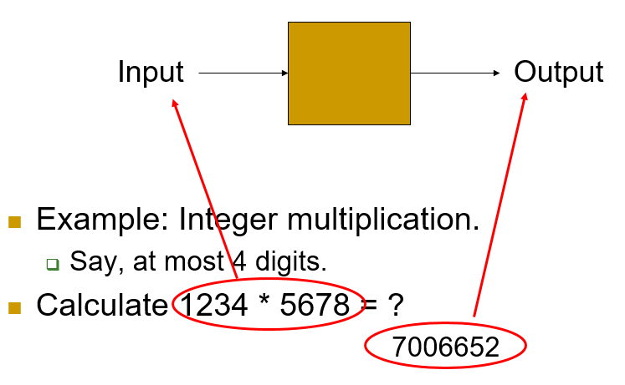
0.1 Books and algorithms
Computation vs. Algorithm
An algorithm is a computational procedure that has step-by-step instructions.

Slide 10
Features of algorithm
Definition: an algorithm is a sequence of steps which is used to solve a category of problems.
Features:
Unambiguous: every step is deterministic
Mechanical: machine can “understand”
Finite: can be implemented in limited steps
Input / output: to state the problem size and the result
This is a course about performance!

Slide 11
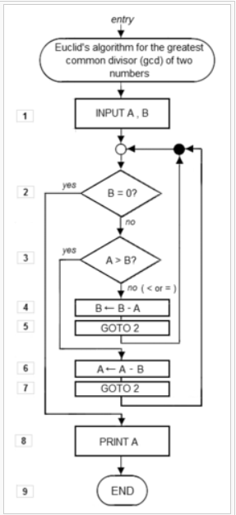
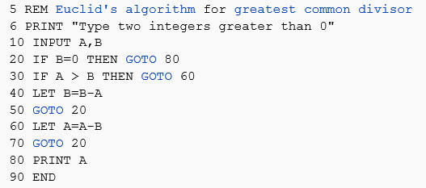
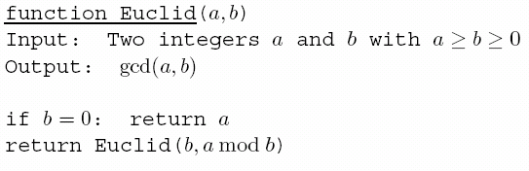
Expressing algorithms
Program
√
Pseudocode
Flow chart

Slide 12
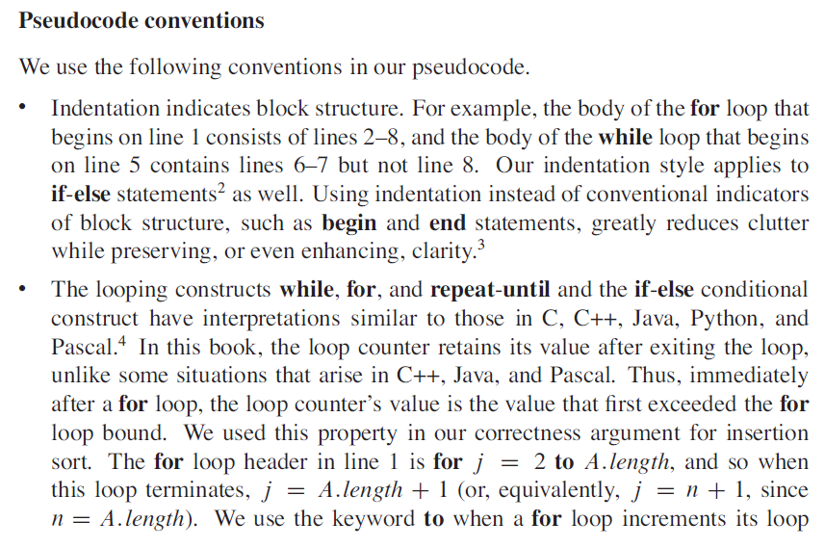

Slide 13
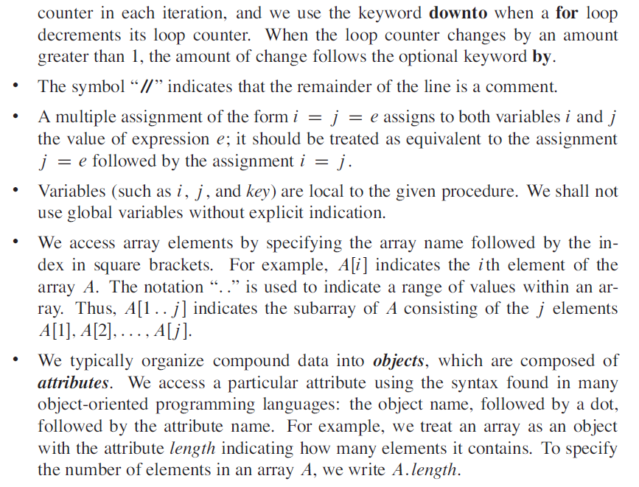

Slide 14
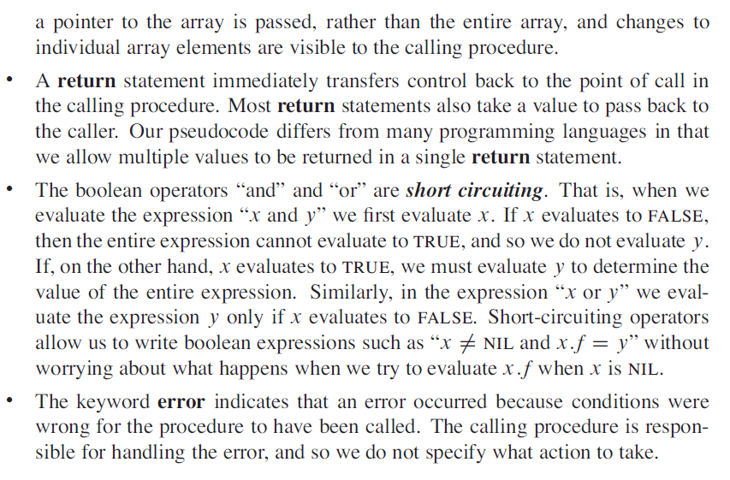

Slide 15
Role of algorithm
In programming, what is more important than performance? The answer is correctness, simplicity, maintainability, reliability and safety.
What kind of role do algorithms play in computer science? They are footstones. Without algorithms, we cannot talk about these important things.

Slide 16
Algorithm vs. program
Some people maybe think that algorithms are just programs. We need to clarity that programs are a way to express algorithms, and they are not exactly same.
The big difference between algorithms and programs is that algorithms are for people to communicate while programs are for machines to run.
Generally, algorithms cannot be directly executed in computers. In additions, it is too precise when we use programs to express algorithms.

Slide 17
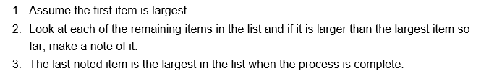
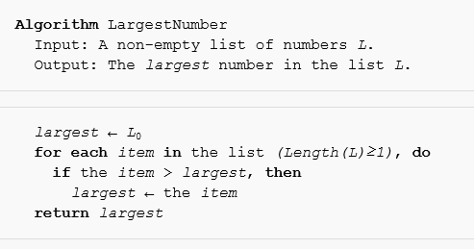
Expressing algorithms (cont.)
Informal description
Formal description

Slide 18
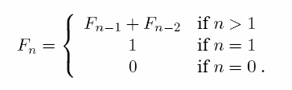
0.2 enter fibonacci
Fibonacci sequence:
0,1,1,2,3,5,8,13,21,34,…,
Each is the sum of its two immediate predecessors
Generated by the simple rule:
Question: What is the precise value of F₁₀₀, or of F₂₀₀?
F_{n} ≈ 2^{0.694n} = 1.6^{n}

Slide 19
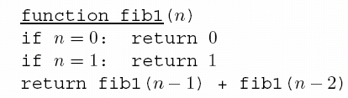


0.2 Fibonacci - An exponential algorithm
Is it correct?
How much time does it take, as a function of n?
T(n) is exponential in n. Can we do better?
T(n): the number of computer steps

Slide 20
0.2 Fibonacci - An exponential algorithm
how bad is exponential time?
T(200)≥F₂₀₀≥2¹³⁸
Suppose fastest computer:
40 trillion steps per second
fib1(200) take 2⁹² seconds
until the sun turns into a red star

Slide 21
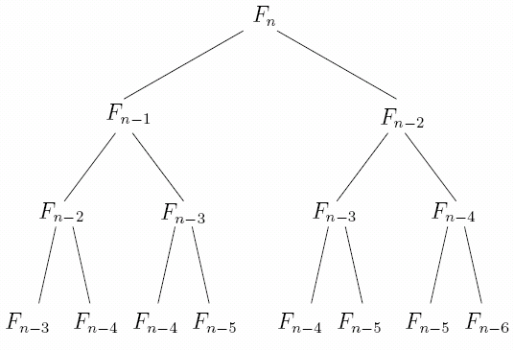
0.2 Fibonacci - An exponential algorithm
Problem: many computations are repeated!
Solution: store the intermediate results.

Slide 22
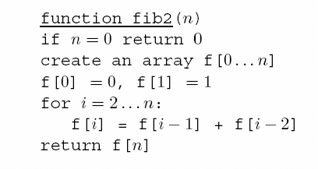
0.2 Fibonacci – a polynomial algorithm
The number of computer steps used by fib2 is linear in n.
Running time: from exponential to polynomial.
Can we do even better than fib2?
(logarithm with some factor of matrix multiplications. see Exercise 0.4)

Slide 23
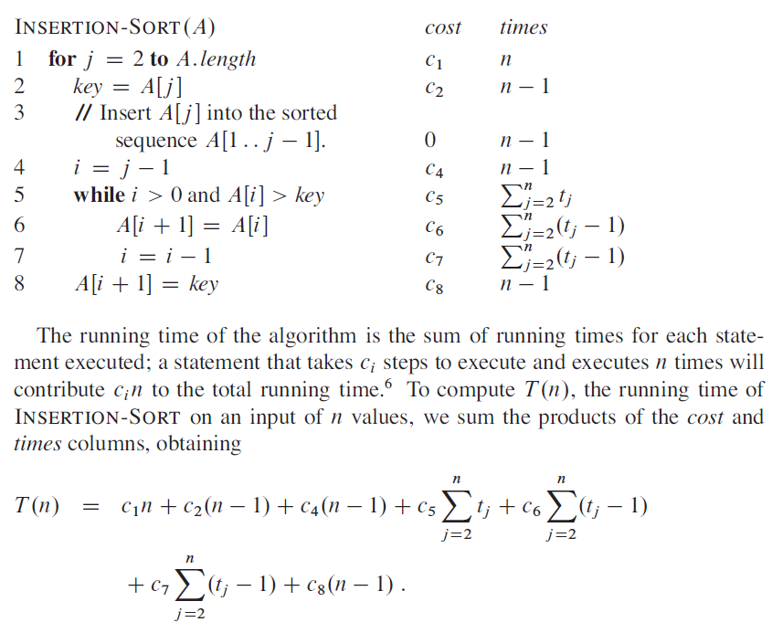
Example of T(n)

Slide 24
0.3 big-o notation
Why not express running time in terms of basic computer steps?
Too precise
Depend on particular machines
Simplification: 5n³+4n+3 → 5n³ → n³
Leave out lower-order terms (insignificant as n grows)
Leave out the coefficient in the leading term (computers will be faster)
Finally, 5n³+4n+3 = O(n³)

Slide 25


0.3 big-o notation
Definition:
n: size of problem
f =O(g) is a loose analog of “f ≤ g”. It differs from the usual notion ≤ because of the constant c.
E.g., 2n+20 =O(n²), n² ≠O(2n+20), 2n+20 =O(n+1)

Slide 26
0.3 BIG-O NOTATION
For n ≤ 5, n² is smaller.
But, f₂=2n+20 scales much better than f₁=n² as n grows.

Slide 27
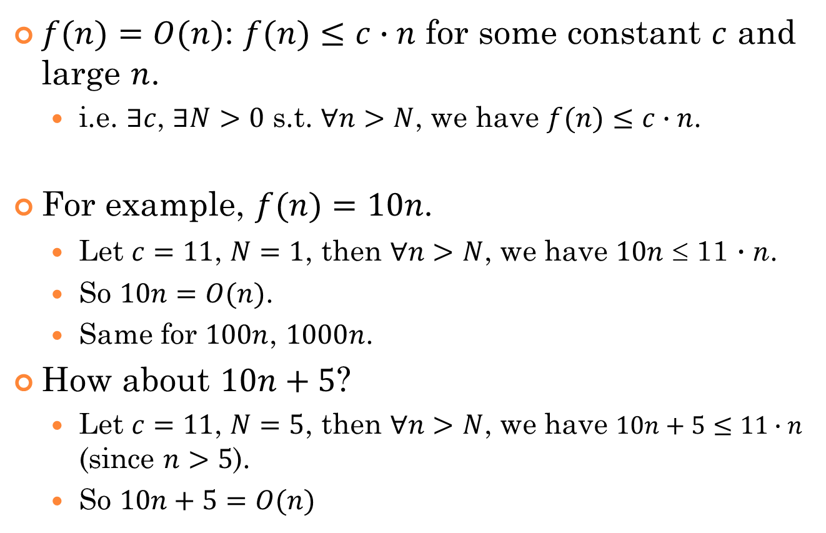
Extended definition: O, Ω, Θ
$f(n)=O(n)$: $f(n)≤c∙n$ for some constant $c$ and large $n$.
i.e. $∃c$, $∃N>0$ s.t. $∀n>N$, we have $f(n)≤c∙n$.
For example, $f(n)=10n$.
Let $c=11$, $N=1$, then $∀n>N$, we have $10n$ ≤ 11 $∙$n.
So $10n=O(n)$.
Same for $100n$, $1000n$.
How about $10n+5$?
Let $c=11$, $N=5$, then $∀n>N$, we have $10n+5≤11∙n$ (since $n>5$).
So $10n+5=O(n)$

Slide 28
Example: n^{1/2} vs. cn
10n
9n
7n
n^{1/2}
0.1n
No matter how small c is, as long as
it’s some positive constant, then finally
cn will catch up n^{1/2}.

Slide 29
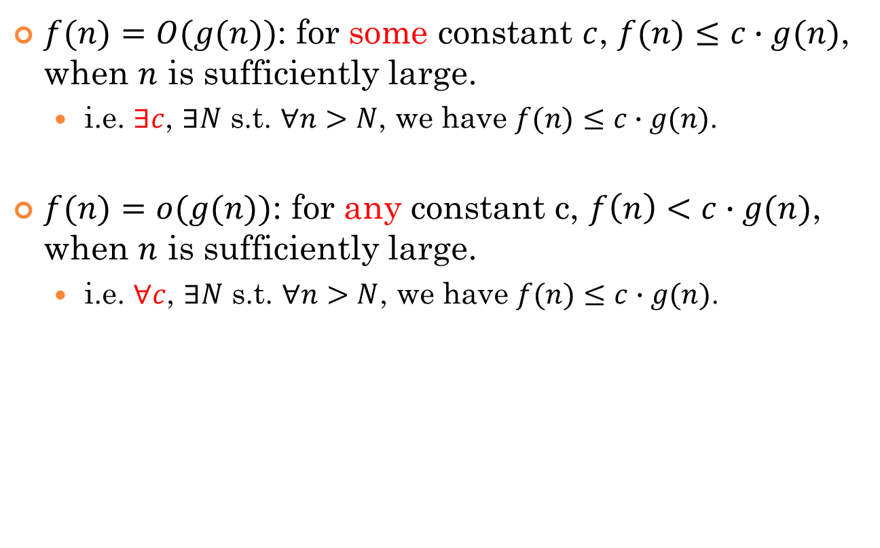
General definition
$f(n)=O(g(n))$: for some constant $c$, $f(n)≤c∙g(n)$, when $n$ is sufficiently large.
i.e. $∃c$, $∃N$ s.t. $∀n>N$, we have $f(n)≤c∙g(n)$.
$f(n)=o(g(n))$: for any constant c, $f\left(n\right)<c∙g(n)$, when $n$ is sufficiently large.
i.e. $∀c$, $∃N$ s.t. $∀n>N$, we have $f(n)≤c∙g(n)$.

Slide 30
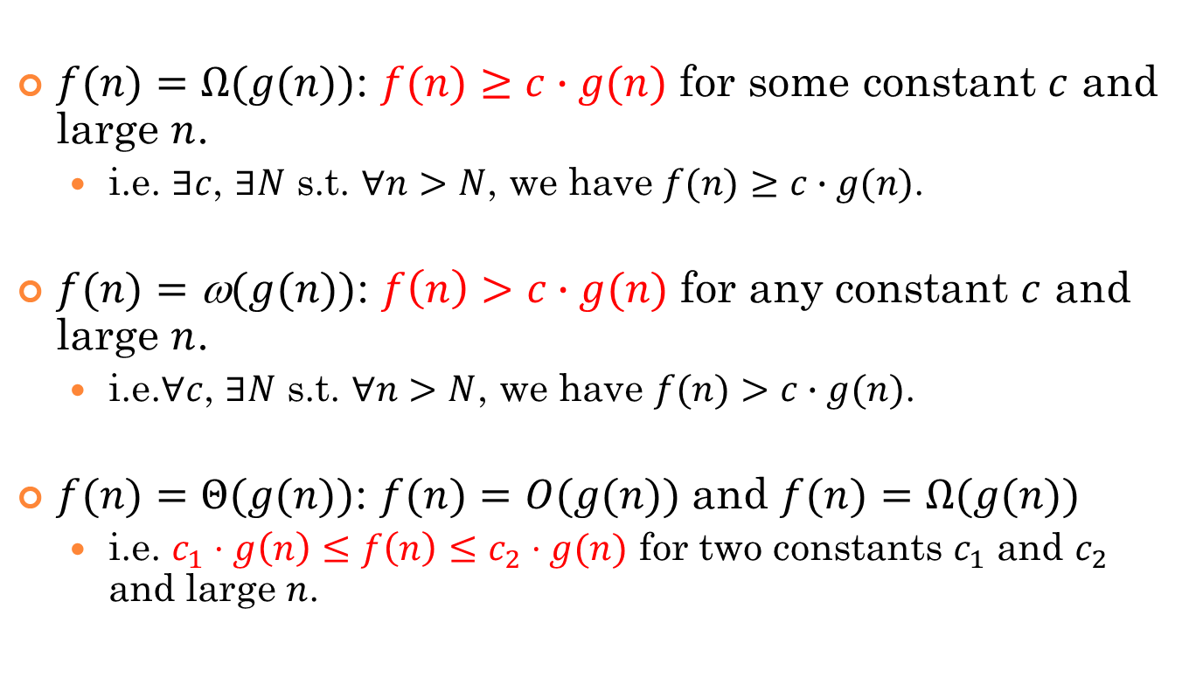
General definition (cont.)
$f(n)=Ω(g(n))$: $f(n)≥c∙g(n)$ for some constant $c$ and large $n$.
i.e. $∃c$, $∃N$ s.t. $∀n>N$, we have $f(n)≥c∙g(n)$.
$f(n)=\text{ω}(g(n))$: $f\left(n\right)>c∙g(n)$ for any constant $c$ and large $n$.
i.e.∀$c$, $∃N$ s.t. $∀n>N$, we have $f(n)>c∙g(n)$.
$f(n)=Θ(g(n))$: $f(n)=O(g(n))$ and $f(n)=Ω(g(n))$
i.e. $c_{1}⋅g\left(n\right)≤f\left(n\right)≤c_{2}⋅g(n)$ for two constants $c_{1}$ and $c_{2}$ and large $n$.

Slide 31
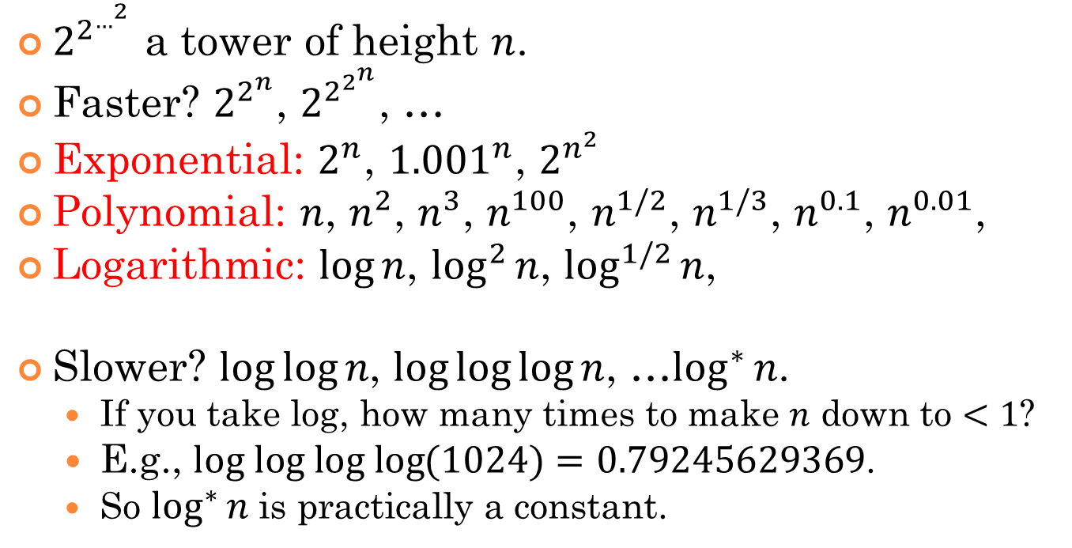

Spectrum of functions…
|←exponential→|
tower
… n^{1/3}, n^{1/2}, n, n², n³, … … 2^{n}, $2^{n^{2}}$, … $2^{2^{n}}$, … $2^{2^{…^{2}}}$
O(1) , …, log* n, … loglog n, … log n, log² n, …
…
|← constant →|
|← logarithmic →|
|← polynomial →|
double exp
$2^{2^{…^{2}}}$ a tower of height $n$.
Faster? $2^{2^{n}}$, $2^{2^{2^{n}}}$, …
Exponential: $2^{n}$, ${1.001}^{n}$, $2^{n^{2}}$
Polynomial: $n$, $n^{2}$, $n^{3}$, $n^{100}$, $n^{1/2}$, $n^{1/3}$, $n^{0.1}$, $n^{0.01}$,
Logarithmic: $\log{n}$, $\log^{2}{n}$, $\log^{1/2}{n}$,
Slower? $\log{\log{n}}$, $\log{\log{\log{n}}}$, …$\log^{∗}{n}$.
If you take log, how many times to make $n$ down to $<1$?
E.g., $log log log log{(1024)}=0.79245629369$.
So $\log^{∗}{n}$ is practically a constant.

Slide 32
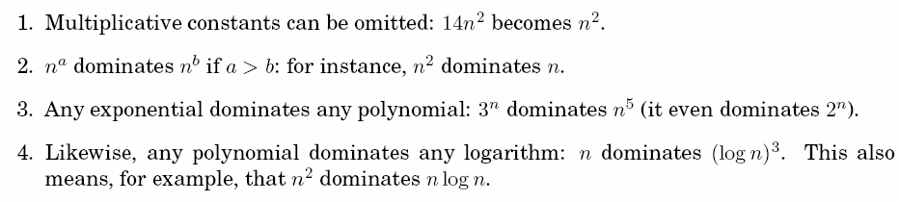
0.3 big-o notation
Commonsense rules:

Slide 33
Properties of asymptotic notations
(1) Transitivity:
f(n)= Θ(g(n))， g(n)= Θ(h(n)) ⇒ f(n)= Θ(h(n))；
f(n)= O(g(n))， g(n)= O (h(n)) ⇒ f(n)= O(h(n))；
f(n)= Ω(g(n))， g(n)= Ω(h(n)) ⇒ f(n)= Ω(h(n))；
f(n)= o(g(n))， g(n)= o(h(n)) ⇒ f(n)= o(h(n))；
f(n)= ω(g(n))， g(n)= ω(h(n)) ⇒ f(n)= ω(h(n))；

Slide 34
(2) Reflexivity
f(n)= Θ(f(n))
f(n)= O(f(n))
f(n)= Ω(f(n))
(3) Symmetry
f(n)= Θ(g(n)) ⇔ g(n)= Θ (f(n))
(4) Mutual symmetry
f(n)= O(g(n)) ⇔ g(n)= Ω (f(n))
f(n)= o(g(n)) ⇔ g(n)= ω (f(n))

Slide 35
(5) Arithmetic operations：
O(f(n))+O(g(n)) = O(max{f(n),g(n)})
O(f(n))+O(g(n)) = O(f(n)+g(n))
O(f(n))*O(g(n)) = O(f(n)*g(n))
O(cf(n)) = O(f(n))
g(n)= O(f(n)) ⇒
O(f(n))+O(g(n)) = O(f(n))+O(O(f(n))) = O(f(n))

Slide 36
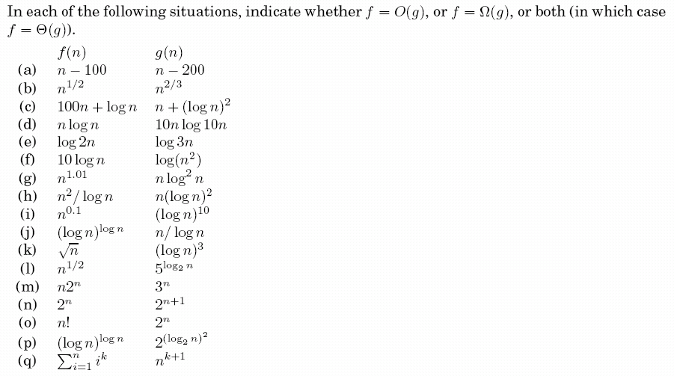
Exercise 0.1

Slide 38
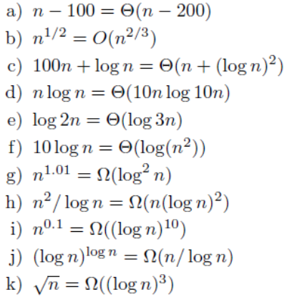

Slide 39
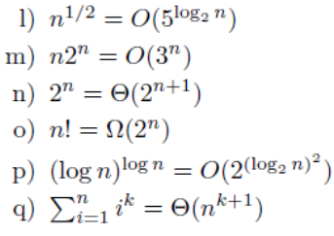

Slide 42
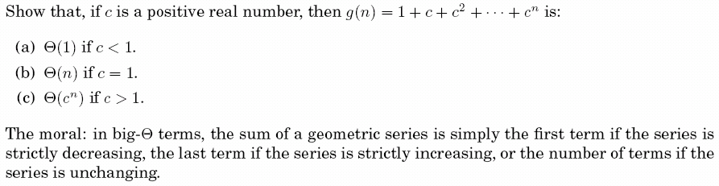
Exercise 0.2
Notes:
分子numerator
分母denominator

Slide 43
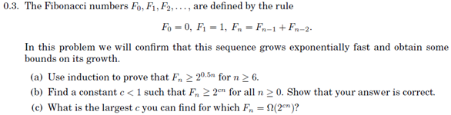
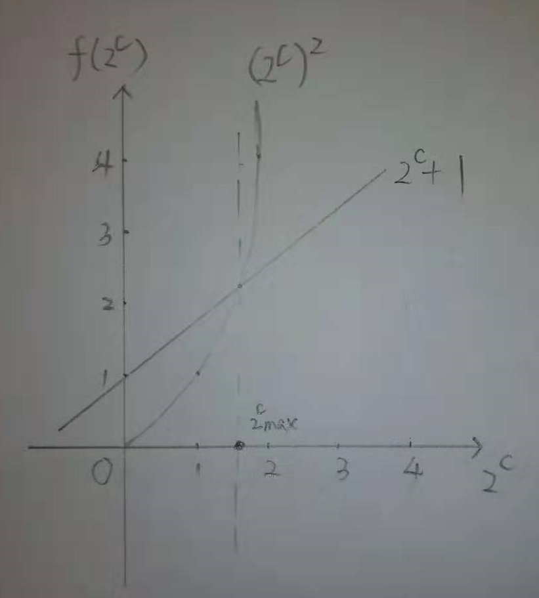

Slide 44
Exercise 0.4

Slide 45
Exercise 0.4
8

